Slide 1
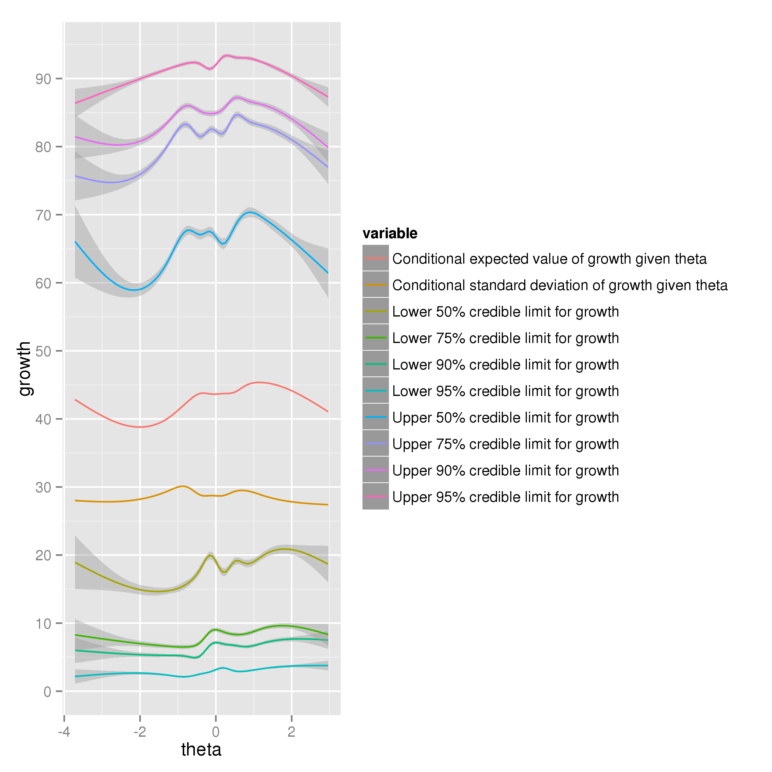
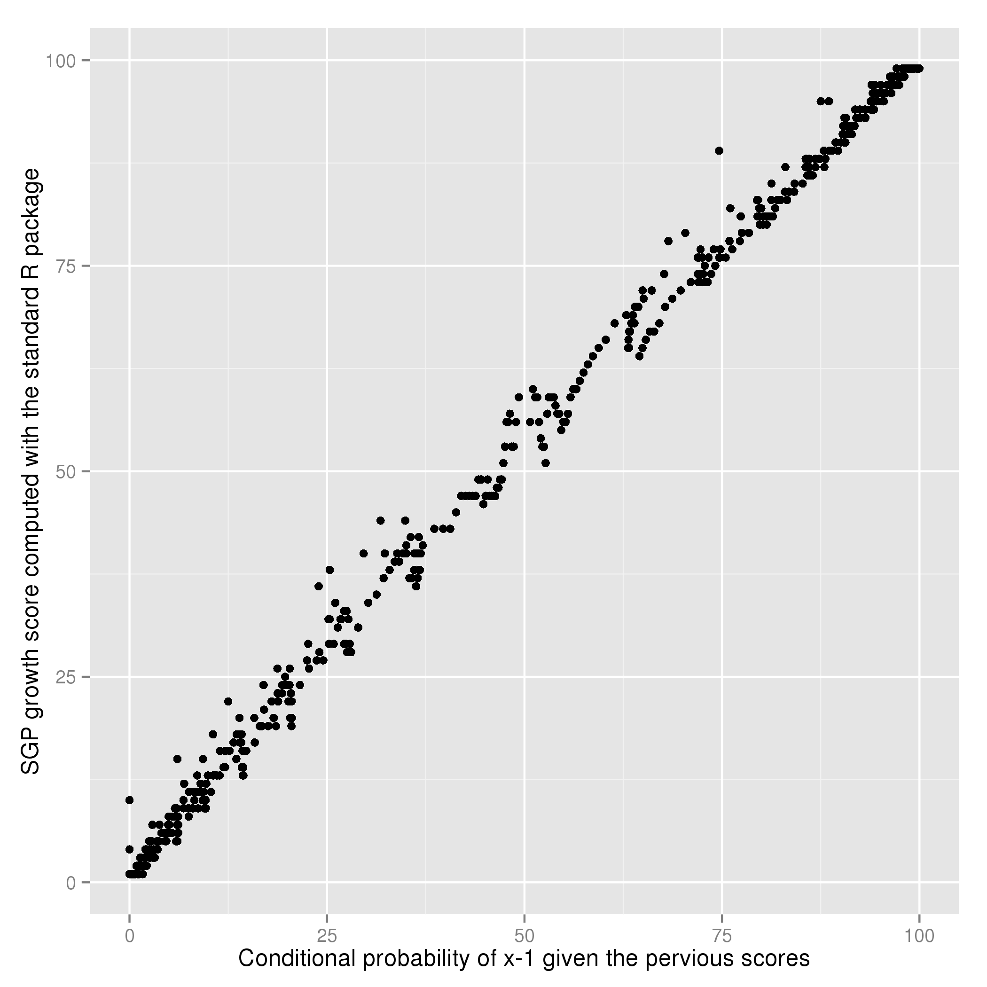
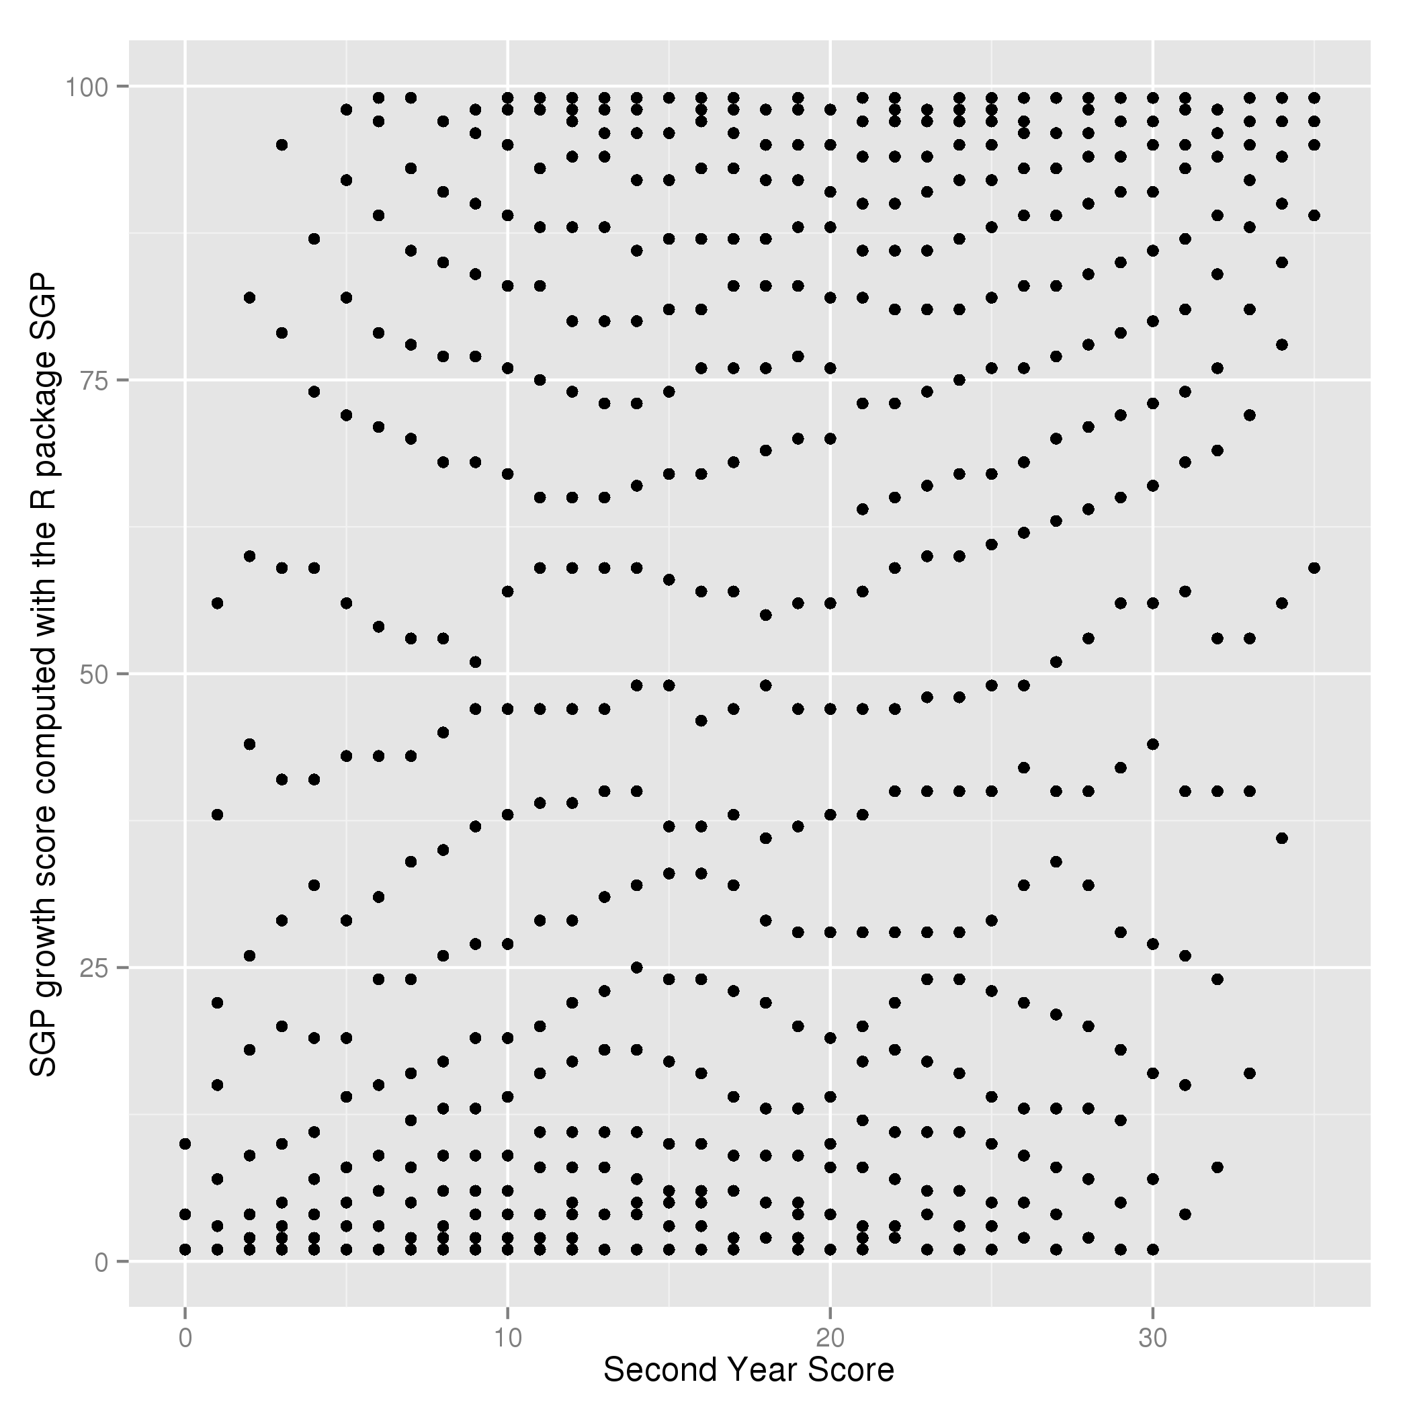
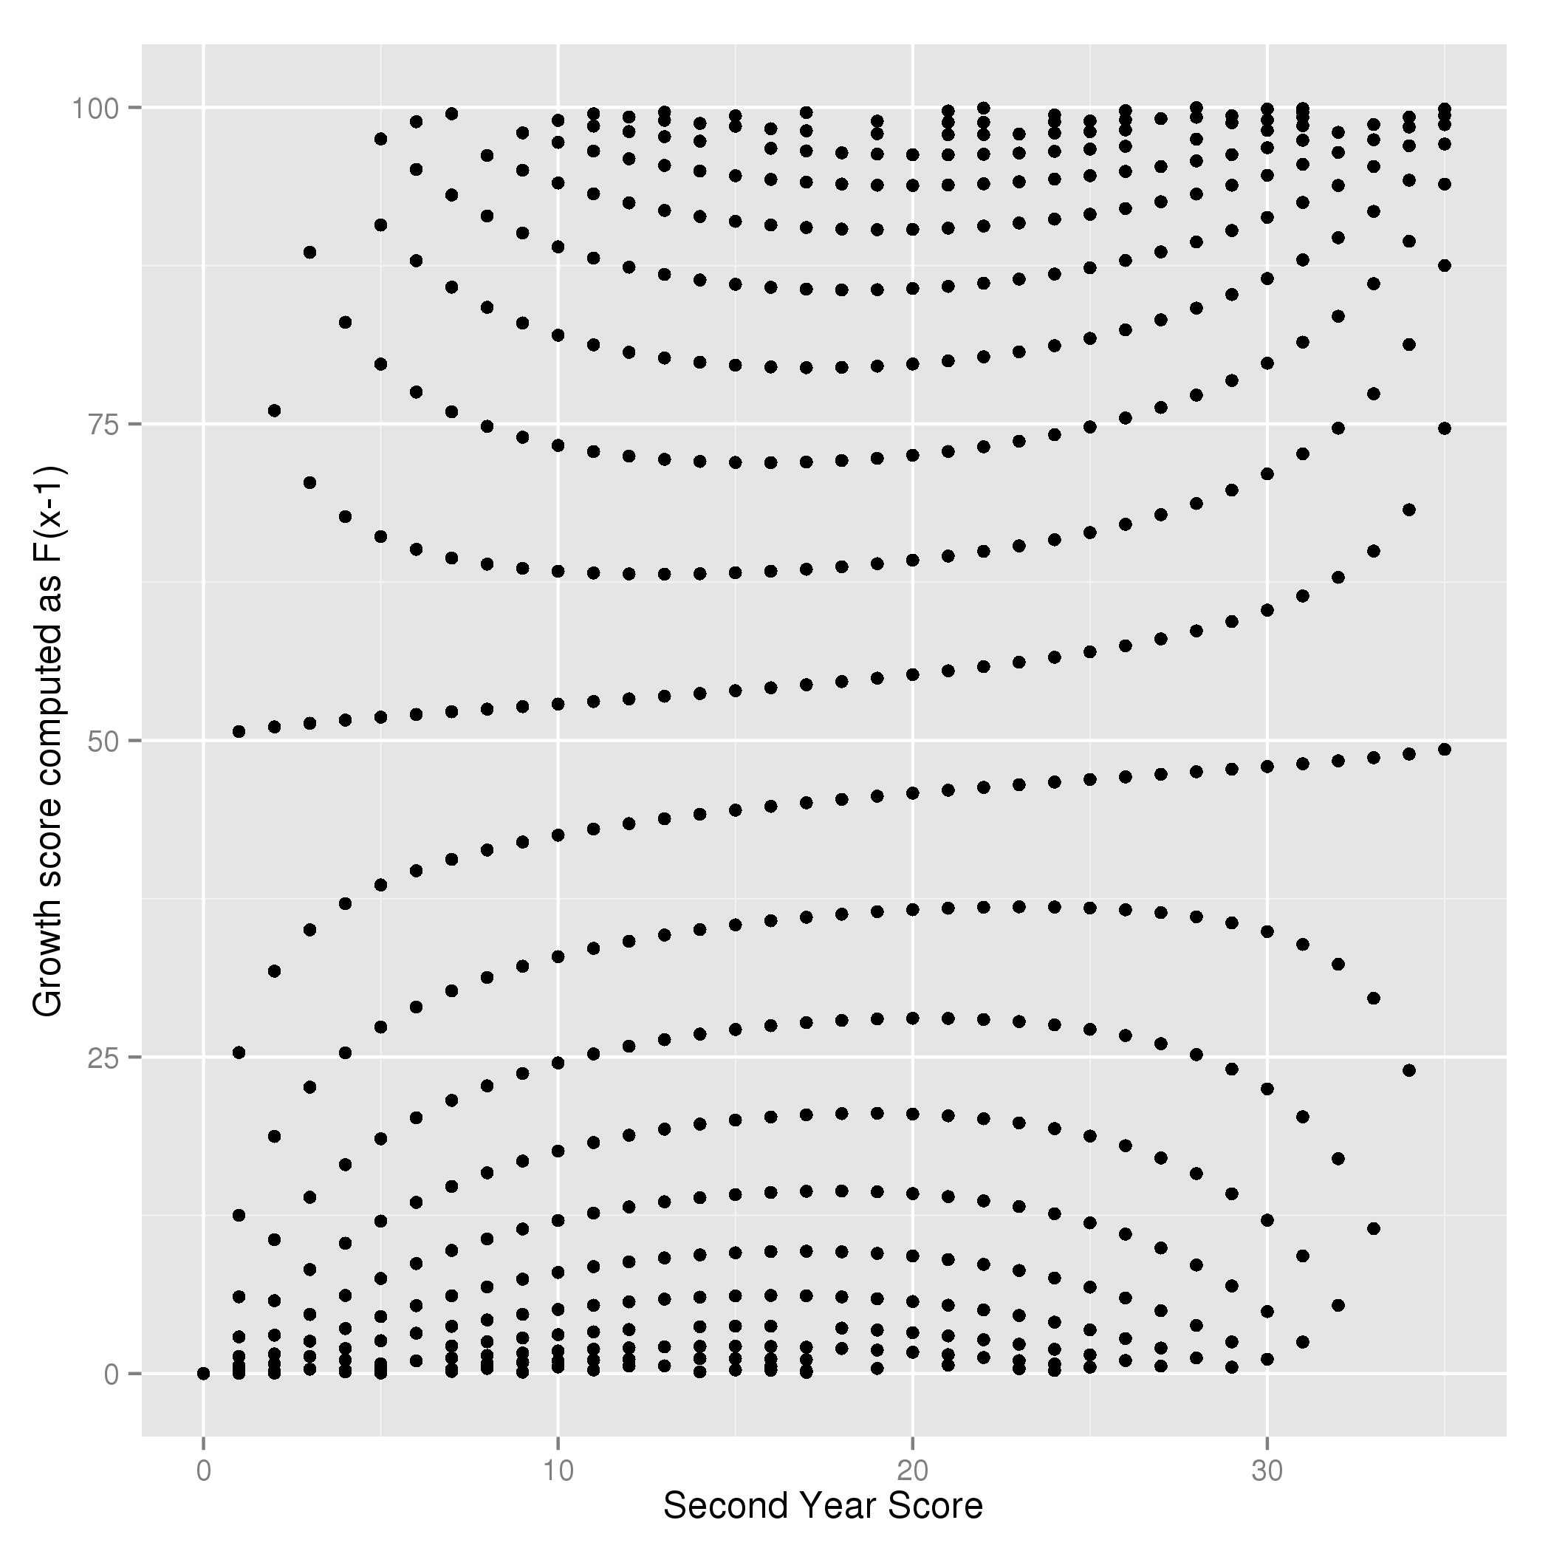
Modeling Variability in Student Growth Measures
Noyce Undergraduate Research Experience Summer 2015
Jason Dimmick 2018, Abby Soraci 2016, Megan Yarmalowicz 2017 and Professor Eugene Quinn
Stonehill College
Abstract
Beta-binomial simulation results
IRT-based Bayesian simulation
The operational definition and complicated nature of the Student Growth Percentile (SGP) model makes it difficult to study. We propose an equivalent but mathematically concise definition using a conditional probability model and use it to explore the statistical characteristics of the growth measure.
The graph below indicates that there is good agreement between the growth measures generated by the standard SGP software and our probability-based method.
The Colorado Growth Model
The growth model uses 99 separate quantile regression models to predict each of the 99 quantiles of the Massachusetts Common Assessment System (MCAS) score conditioning on between one and four prior scores for each student. “Growth” is defined as the percentile associated with the largest predicted score no greater than the actual current score.
By considering the collection of quantiles as estimates of the cumulative (conditional) probability distribution of current scores, we can define the growth percentile as the conditional probability that the student would obtain a score lower than the one they actually got.
Despite their being universally described as comparing each student to an academic “peer group”, it would be more accurate to say that they measure whether the student over or underperformed according to some model.
Using the published Item Response Theory (IRT) characteristics of the MCAS as informative priors, we used a Bayesian model to construct 95% credible intervals for the growth measure. With this model, the upper and lower limits differ by about 80 percentage points. This indicates that growth is a noisy measure.
“Growth measures ... focus attention on student learning and show progress. While these measures are better than what existed before, educators will continue to improve them, and sharp, critical attention from the research community can help.” ~ Arne Duncan, U.S. Secretary of Education
The graph below on the left shows the SGP growth measure as a function of the simulated second year score, and the graph on the right shows the probability-based growth measure .
The SGP measure assumes a continuous score distribution, and is at best an approximation to the actual score distribution, which is discrete.
Conditional Probability Formulation
All growth measures require an underlying probability model for the test scores (whether explicitly stated or not). We define growth as the cumulative (conditional) probability assigned by the probability model to the value one less than the current score.
To test the equivalence of our measure with the SGP, we generated a sample of 70,000 simulated test scores using a beta-binomial probability model, for which the conditional score distribution is tractable.
We computed a growth score for each student with the standard SGP software, and a second growth score using our conditional probability formulation.
References
Study Funded By: Robert Noyce Teacher Grant at Stonehill College
Betebenner, D. W. (2011). A technical overview of the student growth percentile methodology: Student growth percentiles and percentile growth projections/trajectories.
Massachusetts Department of Education 2011 MCAS and MCAS-Alt Technical Report.
STAN probabilistic programming language (mc-stan.org)
Notes:
<number>
Elementary school students (merror score=9.26) were significantly less accurate at estimating age than high school (6.66) and college students (5.68) indicating that age estimation accuracy nears adult levels by early high school. However, both elementary school (md’=0.93) and high school students (0.88) had significantly lower d’ scores than college students (1.39), indicating that face recognition accuracy may not reach adult levels until late high school, around ages 16 to 18.

