Slide 1


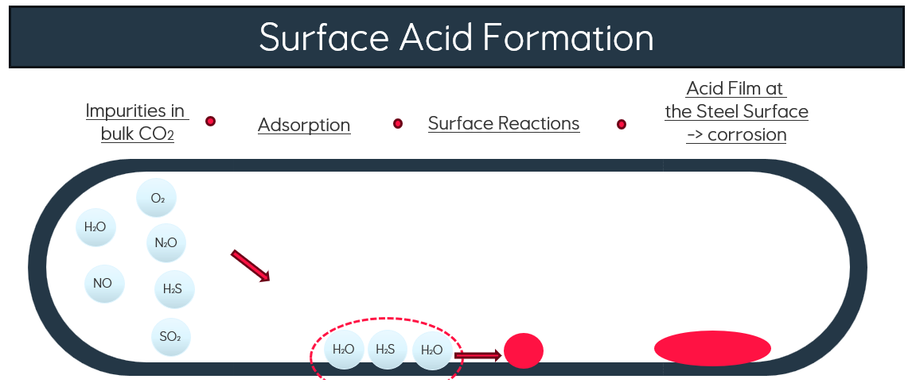
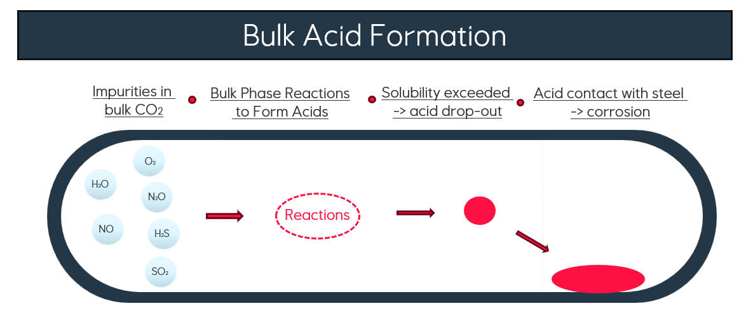
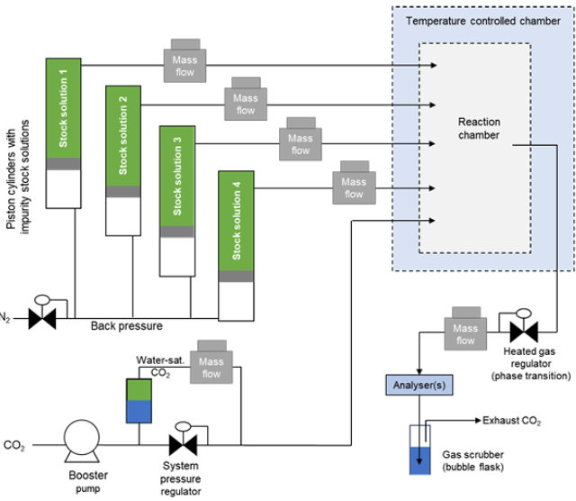
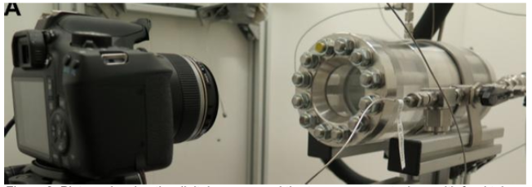
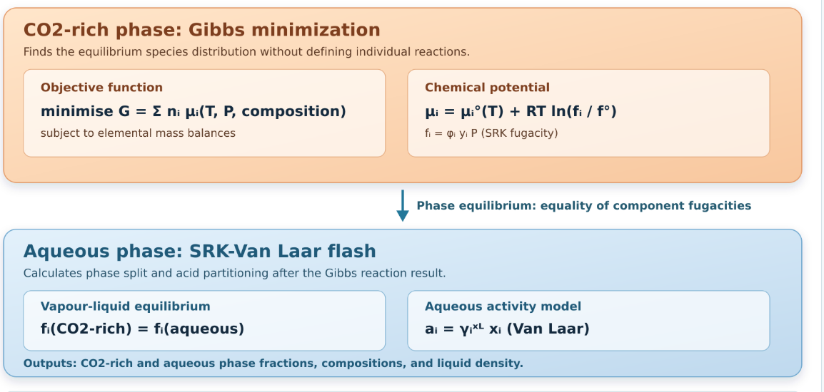
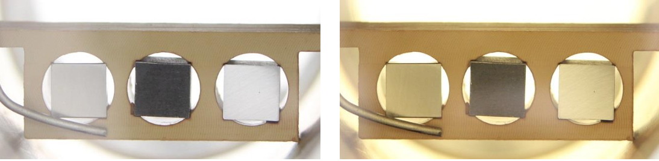
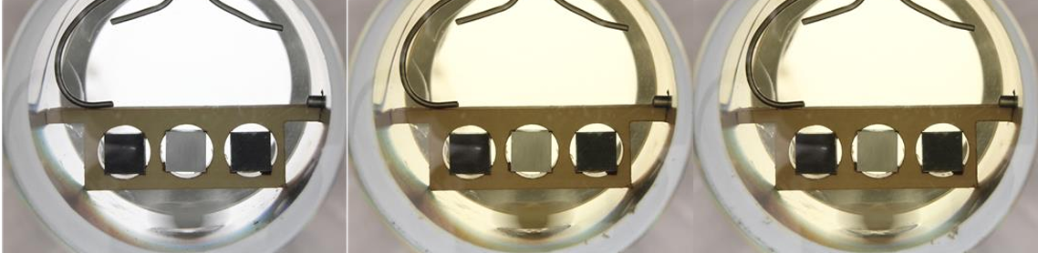
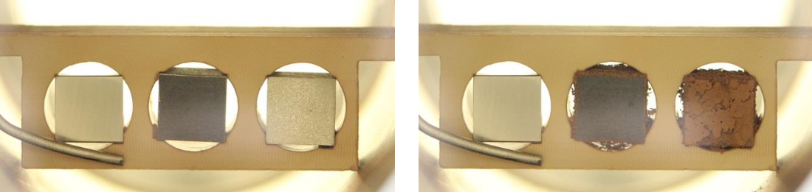
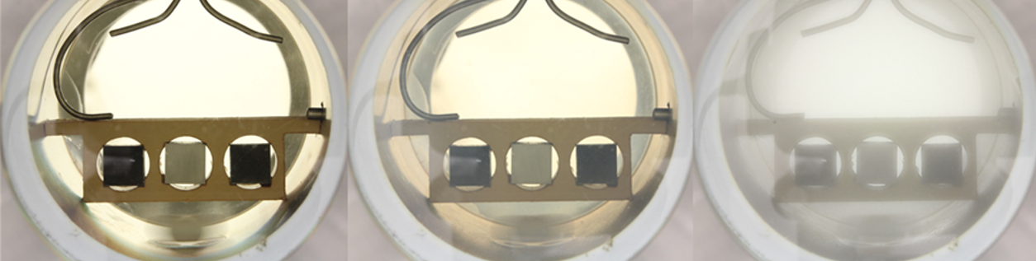
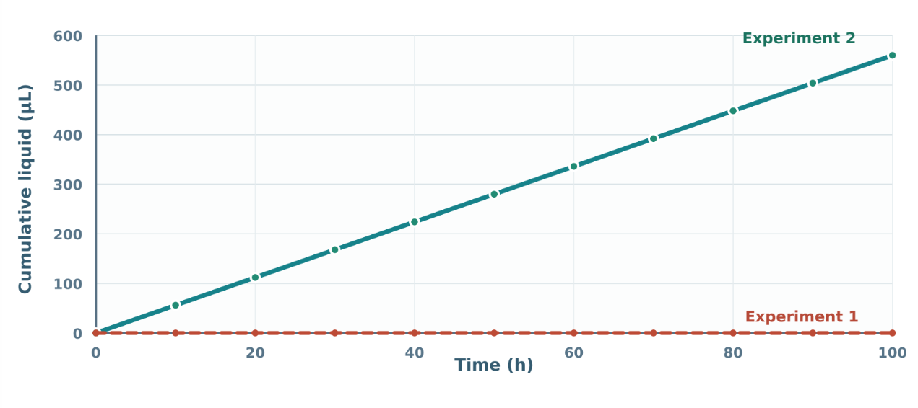
Applying Gibbs Minimization to Reactions Between Impurities in CO2
Introduction and Objectives
More…
Methods
Experiment
Results
Discussion
Experiments 1
Experiment 2
Observed from experiments
Experiment 1: no fog observed, no visible acid formation,
visible coupon surface changes.
Experiment 2: fog clearly observed, stronger chemical reactions than Experiment 1
Model Results
Experiment 1: low acid formation; no liquid phase predicted.
Experiment 2: concentrated H2SO4 acid formation; acid-liquid phase predicted.
Conditions
Conditions
Modelled Acid Formation
P: 100 bar
T: 25 C
P: 99 bar
T: 25 C
Model
Experimental
Model
Experimental
Component
Input
Output
Output
Component
Input
Output
Output
H2S
-
0
0
H2S
36
0
0
SO2
-
0
0
SO2
32
25
0
O2
-
0
0
O2
90
15
2
H2O
675
675
673
H2O
20
28
0
NO2
72
70
67
NO2
31
4
31
NO
-
4
2
NO
-
1
0
H2SO4
-
-*
0
H2SO4
-
-*
56
HNO3
-
-*
3.5
HNO3
-
-*
12
Conclusion
References

