Slide 1
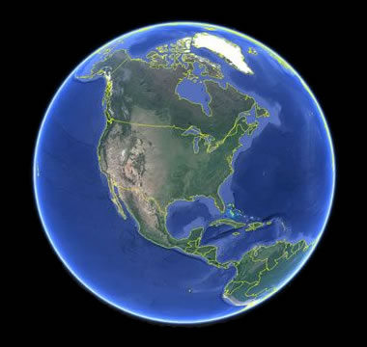
MapHub is Equinor’s portal for finding, sharing, creating, and analyzing geospatial content. In this workshop, you will learn skills needed for working with maps and geospatial data in MapHub. We will use ArcGIS API for Python and learn fundamentals of working with maps, geocoding, vectors, raster, lines, routing and directions.
Plan for the workshop:
GIS: CRS and Projections
Maphub
ArcGIS Python API Install
Get started using the API

Slide 2

Flat? Round? Whatever?

Slide 3
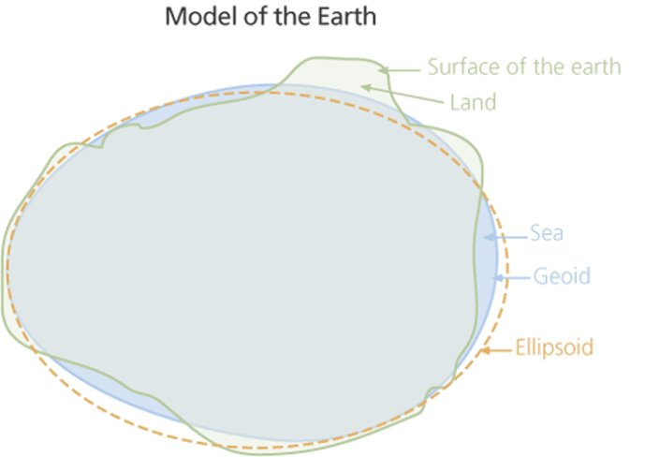

Slide 4
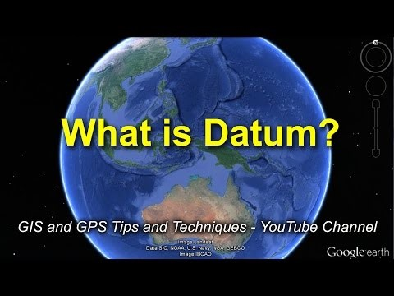
https://www.youtube.com/watch?v=xKGlMp__jog

Slide 5

And how to make it flat?​

Slide 6
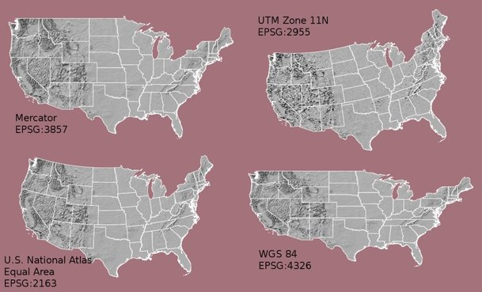
Reference link/​
Video
Web Mercator
EPSG:3857
https://no.wikipedia.org/wiki/Web_mercator

Slide 7
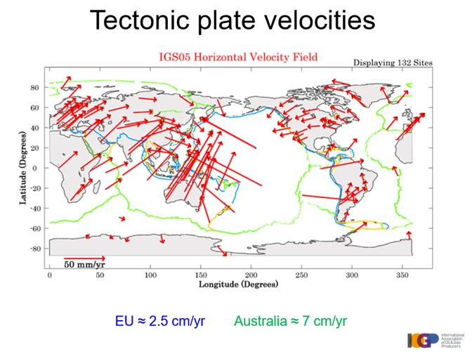

Slide 8
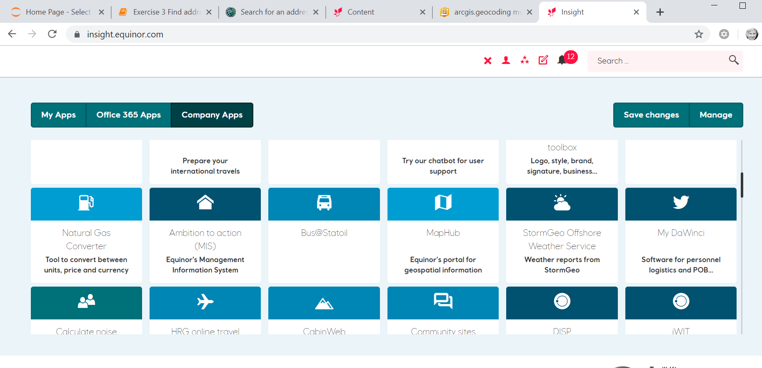

Slide 9
MapHub is available at https://maphub/
Portal for ArcGIS acts as both a content management system and a platform for spatial analysis, helping you organize and share information throughout your organization via maps and map-related apps/tools/etc as well as providing geoprocessing tools and apps to analyze spatial data.
ArcGIS Data Store acts as a repository for both user uploaded data (non-managed) and temporary by-products from analysis tools (MapHub map viewer and Insights for ArcGIS).

Slide 10
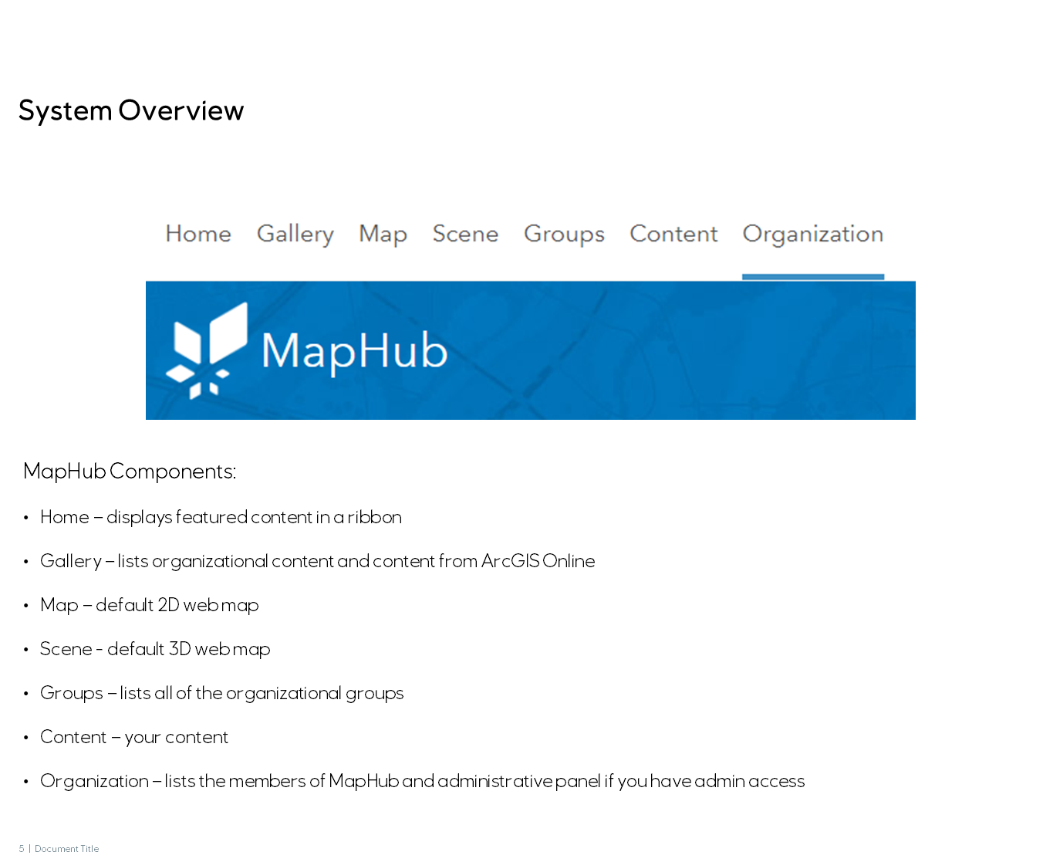

Slide 11
MapHub roles:
Anonymous – can only view items that are shared to "Everyone". Cannot create content. This is the default "role" users have before they apply to one of the AccessIT roles mentioned below.
User – can create and share content, but cannot publish/upload data to MapHub (Data Store). Available on AccessIT
Publisher – same as User, but can publish/upload data to MapHub (Data Store). Available on AccessIT.
Publisher with Insights – same as Publisher, but with access to Insights for ArcGIS, a geospatial analytics tool inside MapHub. Available on AccessIT.
Advanced Publisher – same as Publisher, but can administer Portal groups. Available on AccessIT.
Admin – GISP only; administrates platform

Slide 12

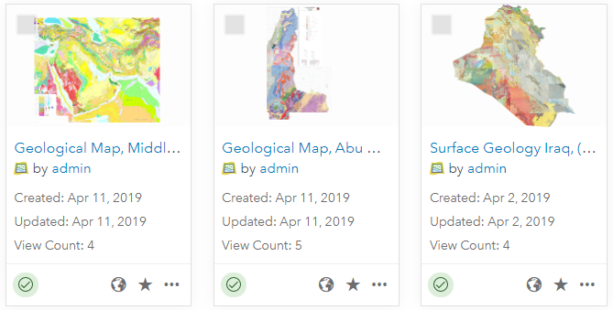
Authoritative content vs user content
Important
What is user content? MapHub items such as data, web maps, or applications that are created, published, or uploaded by common users are regarded as user content by default.
What is authoritative content? Items curated by GISP (admin) and some content maintained by local data managers have status authoritative. This badge guarantees that these items are trustworthy and regularly updated.
How can content become authoritative? Content created by users is not regarded as authoritative by default. Items can be suggested to GISP or local domain experts to become authoritative.

Slide 13
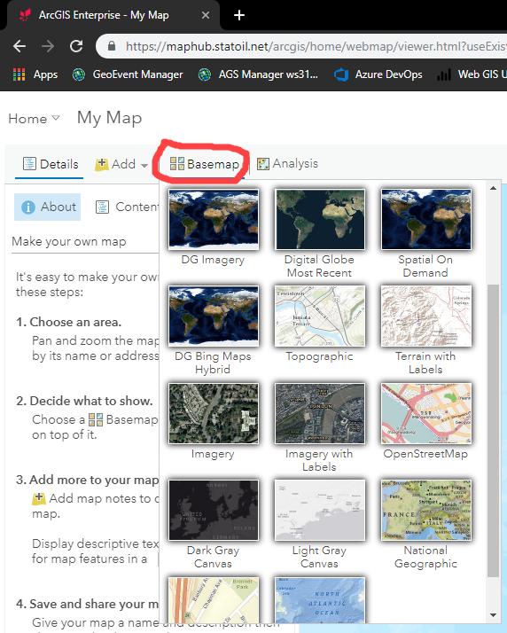
Coordinate systems when making maps
Important
The basemap establishes the coordinate system of the map in Map Viewer.
The default coordinate reference system (CRS) of the Esri basemaps from the Basemap Gallery is the Web Mercator projection (EPSG:3857).
De facto standard for web mapping applications.
Advantages: allows continuous panning and zooming at all locations and not too computationally demanding
Disadvantage: distortion at high latitudes
If you want to use a different CRS than Web Mercator, you need to add a layer to Map Viewer in the desired CRS and use this as a basemap. See Choose basemap (Esri).
Note: If a layer is added that is based on a different datum than the basemap, MapHub chooses the appropriate default transformation. Sometimes the default choice is not as precise as you need!
For geodetic advice, please contact Geodesy and position quality control on Services@Equinor.

Slide 14
Setup API and get samples
Setup Python API and samples for workshop
https://github.com/equinor/edc2019-gis
Documentation of api and samples:
https://esri.github.io/arcgis-python-api/apidoc
Collection of geographic information from around the globe. It includes maps, apps, and data layers:
https://livingatlas.arcgis.com/en/
Download Python API and samples:
https://github.com/Esri/arcgis-python-api/releases/tag/v1.6.2

