Slide 1
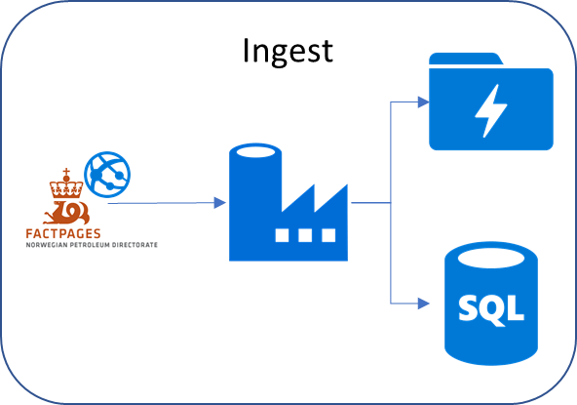
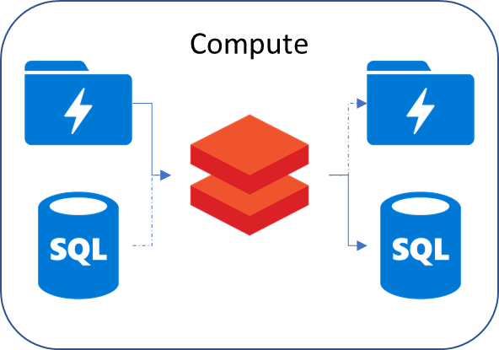
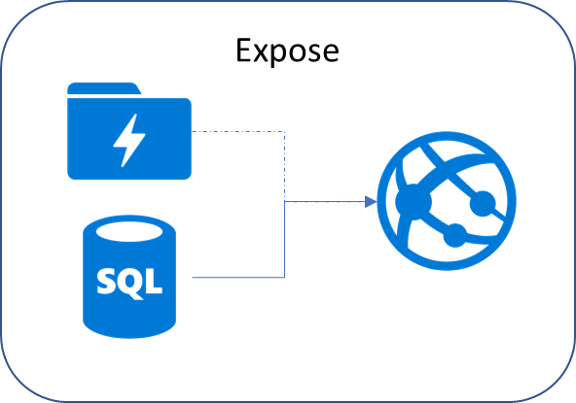
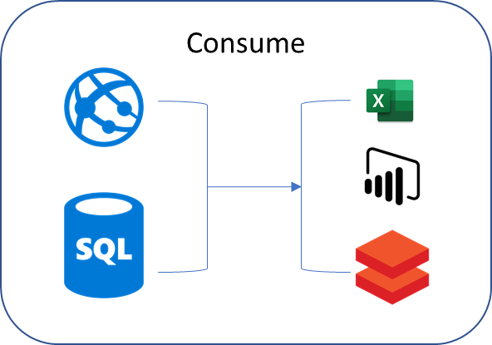









Workshop modules 1-4
Ingest
Compute
Expose
Consume

Slide 2
Module #1
Ingest

Slide 3
Module #2
Compute

Slide 4
Module #3
Expose

Slide 5
Module #4
Consume

Slide 6


Ingest
Compute
Expose
Consume
Deploy

