Slide 3
Managing Subsurface Uncertainty Across the Asset Lifecycle with OSDU RDDMS
Marcus Apel (Equinor), Camille Msika, Dani Al Saab, Markus Vevle (Emerson)

Slide 4

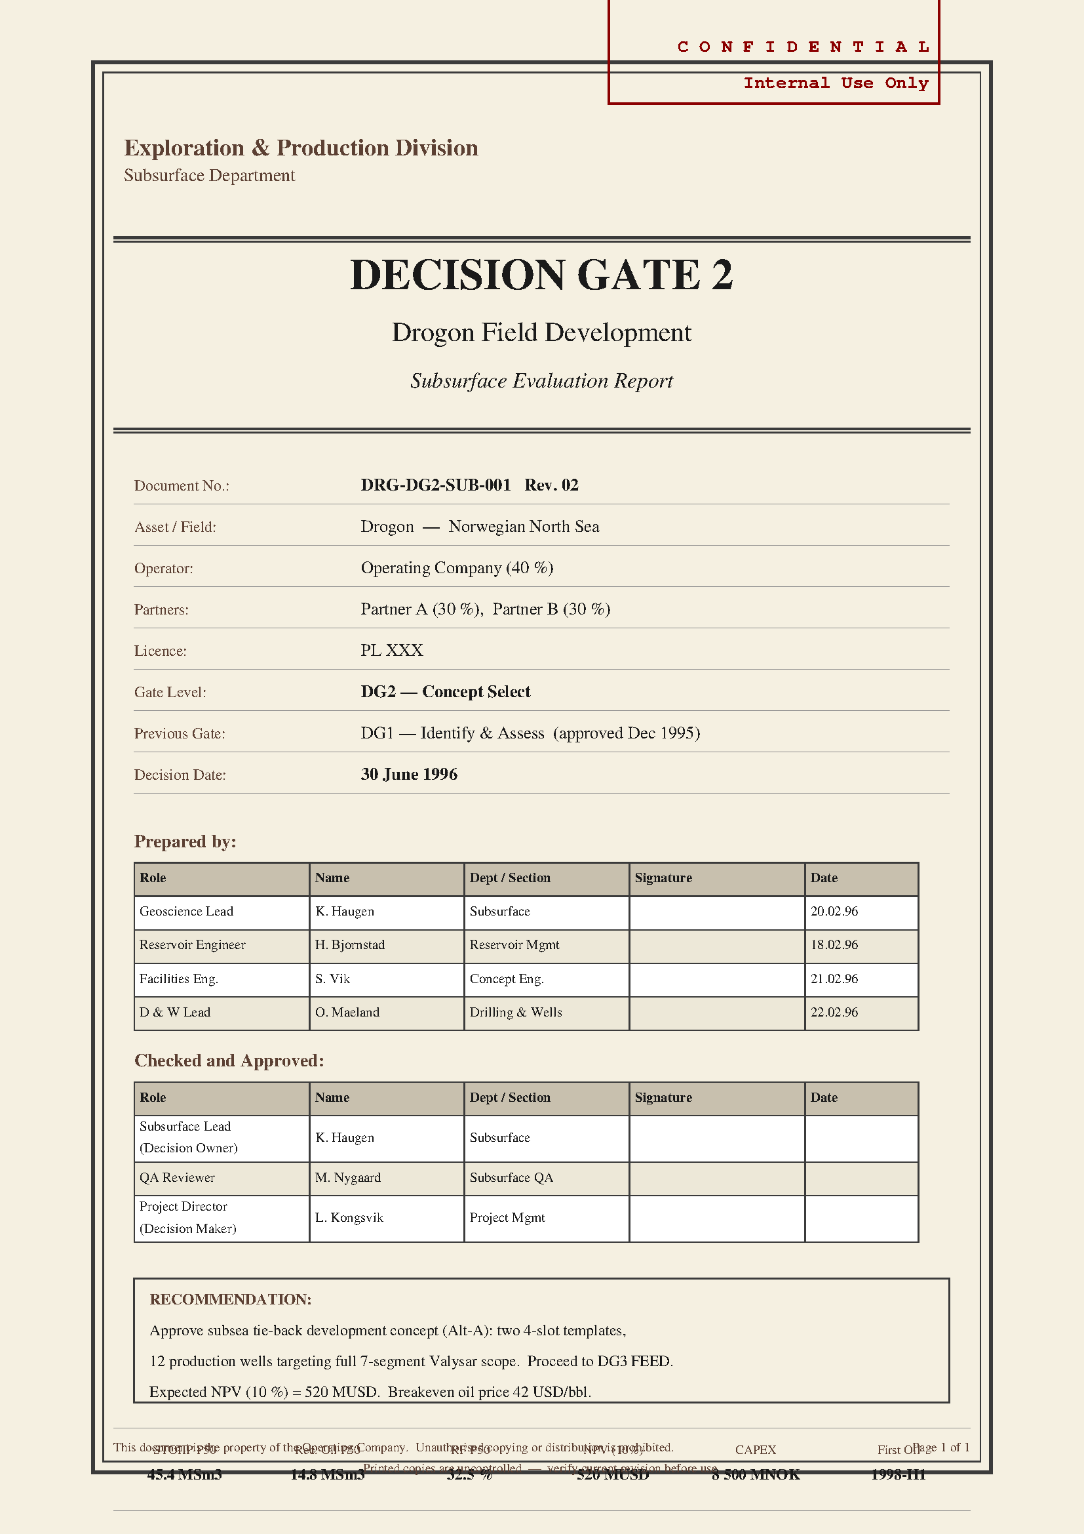
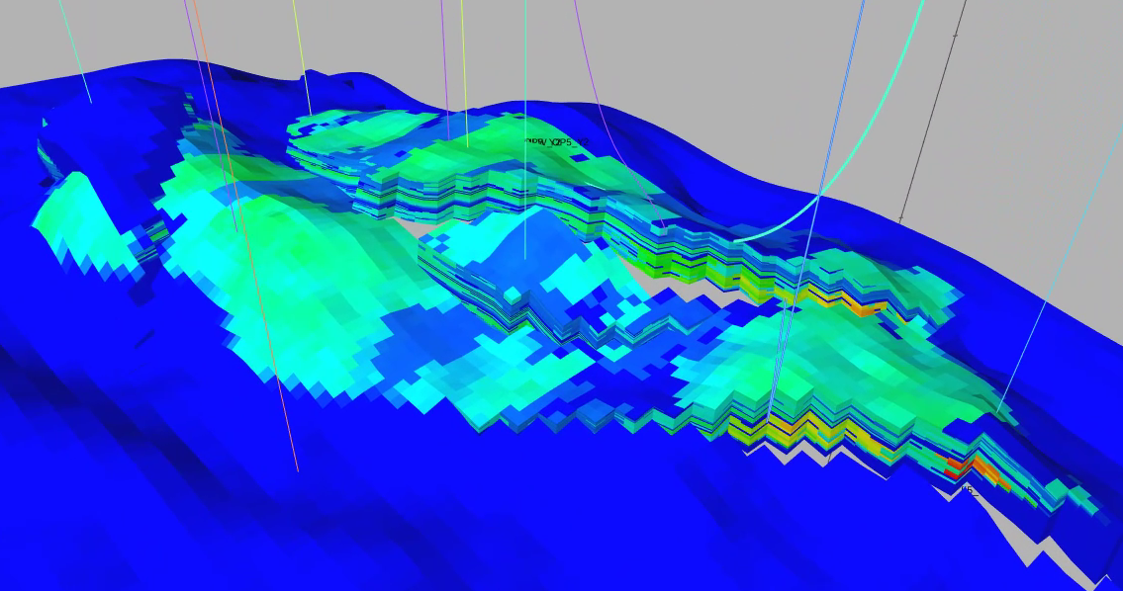
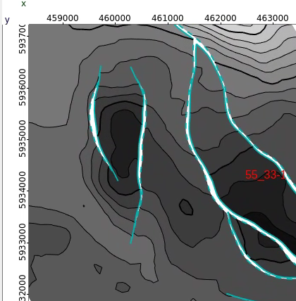
Subsurface Decision Gates
The past: fragmented Data Management
Pre-DG1
Exploration phase
Decision Gate 1
Develop concept
Decision Gate 2
Select concept
Decision Gate
Mature concept
Decision Gate 4
Sanction project
No standardized, complete, searchable archive at DG’s
Notes:
Backdrop: O&G field development passes set of stages, DG, where the project continuation path is decided on DG based on a set of data, models, outcomes, predications at a that stage Uncertainty, associated Risks in subsurface directly influences critical business decisions at different stages of an asset’s lifecycle.
In order to to improve future decision making and uncertainty and risk attribution, and production attainment, it is desirable to learn from the history.

Slide 5
Impact
Current Challenges in Decision Gate Data Management
Challenge ​ | Current state​ | Impact​
Data Storage​ Revise the historical decision with added data! | Single system pre-DG1 but fragmented beyond​ | Loss of continuity across DGs​: cannot reproduce decisions if activities not recorded
Traceability What drove a volume drop between gates? | No formal linkage of inputs/outputs.​ | No coherency in attribute/volumetric changes; Manual comparison error-prone, not auditable​
Searchability​ Query all evidence used for DG2! | No standardized archive​; poor relationships | Limited ability to query and analyze historical decisions​
Uncertainty and Performance Tracking How can we avoid poor production attainment? ​ | Partial ensemble-based lifecycle record​; no consolidated risk evolution record​ | Limited uncertainty evaluation reduction over time​; prevents performance analysis​

Slide 6
The Strategy
OSDU as Decision-Gate Backbone
Performance Tracking
Compare volumetric estimates across DG1–DGx and attribute changes to input parameters.
Uncertainty Calibration
Discover data relationships; refine input distributions for improved decisions
Risk Governance
Link risks and mitigations to decisions for audit readiness.
Evidence Consolidation
Package subsurface modelling input & output, concepts, and documents under BusinessDecision

Slide 7

“Drogon” demo objective
Collaborate
System of Record
Prove OSDU can serve as the canonical backbone for decision-gate data
Demonstrate relevant data types, schemas, and reference data and entity relationship support.
Reference to complete persisted decision data: OSDU Reservoir DDMS DataSpace with geomodel and interpretation data and parameters, Catalog with tables, documents, etc.
Enable rich query; use relationships, and granularity across gates
Generate Report from BusinessDecision metadata and data such as volumes, profiles, maps
Risk Governance
Link risks and mitigations to decisions and uncertainty parameters, audit ready.
Track risk and uncertainty evolution from DG0 onwards.
Uncertainty Calibration
Use outputs to discover data relationships, refine input distributions for improved future field development decisions.
Monitor changes across decision gates
Storage of uncertainty distributions/parameters Activity with Business Decisions.

Slide 8
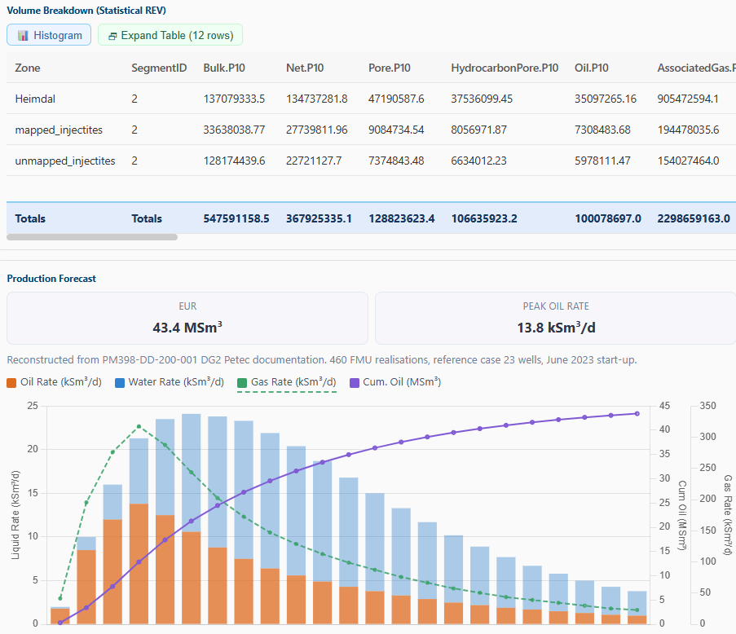

Demo workflow
Reservoir Data in Business Decisions … simplified
Reservoir DDMS
OSDU Catalog
Business
Decision
Volumes Statistics
Reservoir Model
Volume statistics, maps, sim deck, profiles, …
Risks
Parameters
Uncertainty Distributions

Slide 9
Building blocks
Commonly used kinds of records
Master‑data, unique valid keys for all DG
Reservoir: reservoir entity of interest.
ReservoirSegment — segments under the reservoir (compartments like fault block, zone, fluid region)
BusinessDecision – one per gate
Risk
Reference‑data, examples for canonical types:
UnitsOfMeasure
Statistics facets: P10,P50,P90,ArithmeticMean,Minimum,Maximum,StandardDeviation, …
Canonical volume property types: ReservoirEstimatedVolumePropertyType: Bulk,Net,Pore,Oil,AssociatedGas, …
Work Product Components (WPC), derived objects per DG – linked to Master Data
Design Matrix, Time series etc.: ColumnBasedTable.
Spatial data: grids, properties, as WPCs (e.g., GenericRepresentation: STOIIP 2d grid map), GeoLabelSet
Output volumes: ReservoirEstimatedVolumes, raw per‑realization and aggregated statistics
Activity: Use Parameters[] with ParameterRole {input, output, context} to record run inputs/outputs and workflow context
Collections for DG input/output/scenarios/cases
WorkProduct: covering versioned package: yearly revisions, PUD, DG … (design/input, Activities, outputs).
CollaborationProjectCollection: curated working set while iterating.

Slide 10
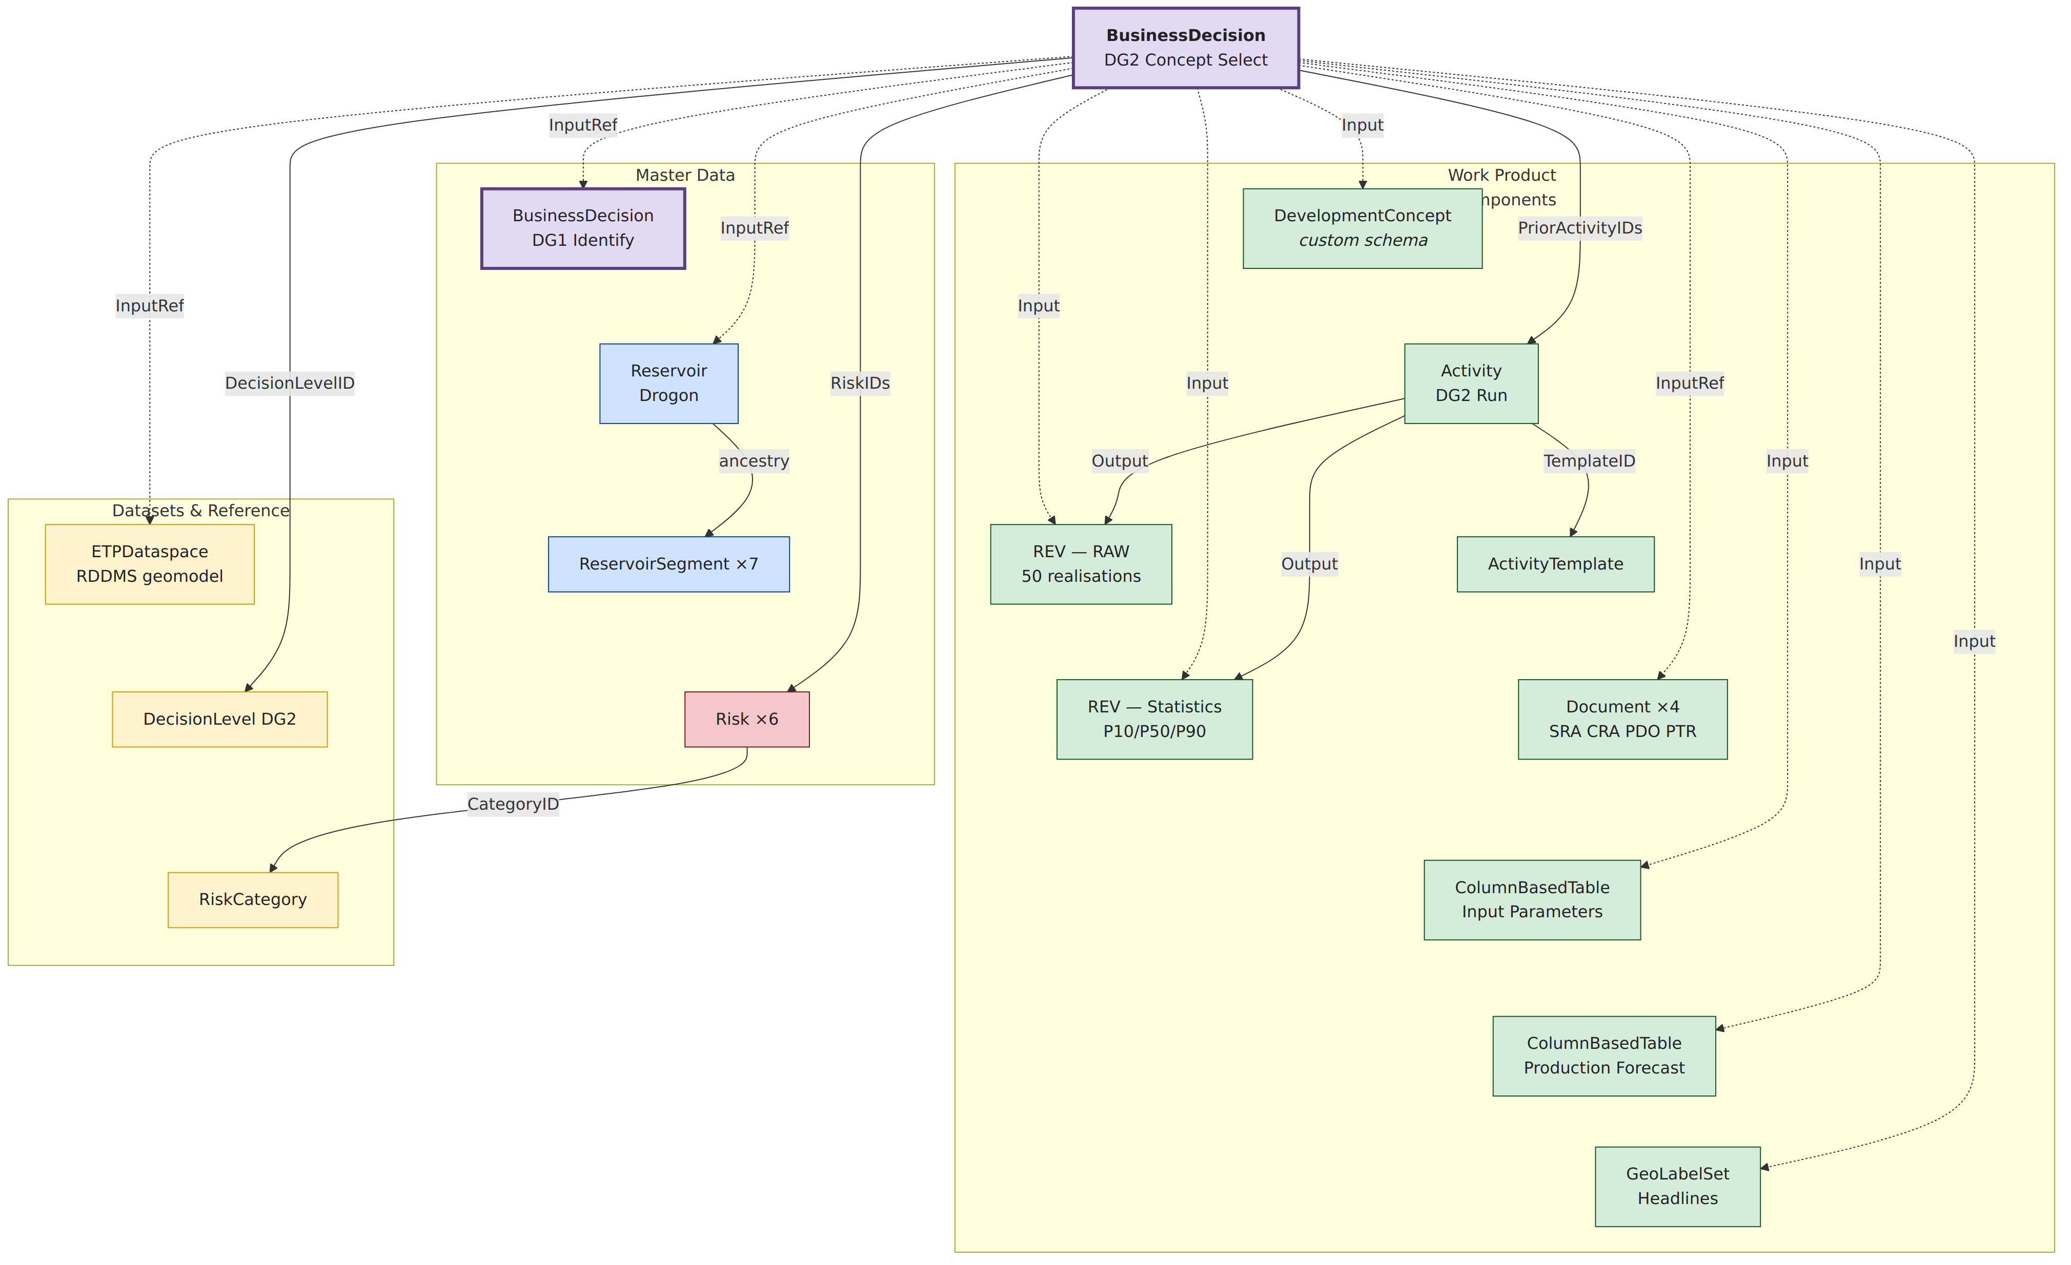
What OSDU provides
Drogon DG2 canonical schemas (~25 linked records)
Category | OSDU Kind | Purpose
Master | BusinessDecision:1.0.0 | DG2 decision — central hub
Master | Reservoir:2.0.0 | Drogon (shared with DG1)
Master | ReservoirSegment:2.0.0 | 7 segments
Master | Risk:1.2.0 | 6 DG2 risks
WPC | ReservoirEstimatedVolumes:1.1.0 | Raw realisations + P10/P50/P90
WPC | ColumnBasedTable:1.3.0 | Input params + production forecast
WPC | Activity + ActivityTemplate | Workflow run + template, captures methods input&output
WPC | Document:1.2.0 | SRA, CRA, PDO, PTR
WPC | GeoLabelSet:1.0.0 | Headline volumes per segment
Custom | DevelopmentConcept:1.0.0 | Custom LOCAL schema
Dataset | ETPDataspace:1.0.0 | Reservoir DDMS DataSpace pointer: here spatial reservoir model is stored
Ref | DecisionLevel / RiskCategory / … UoM, FacetRoles, PropertyTypes | Reference catalogs
Masterdata (Reservoir, Segments) are shared across gates. WPCs (volumes, risks, concepts) are versioned per gate. BusinessDecision links them all.
Relationships are handled via Parameters[], RiskIDs, PriorActivityIDs, ancestry. OSDU separates data management (searchable metadata in Storage) from the reservoir data (gridded/array data via ETP/RDDMS). BusinessDecision ties both worlds via Parameters[].

Slide 11
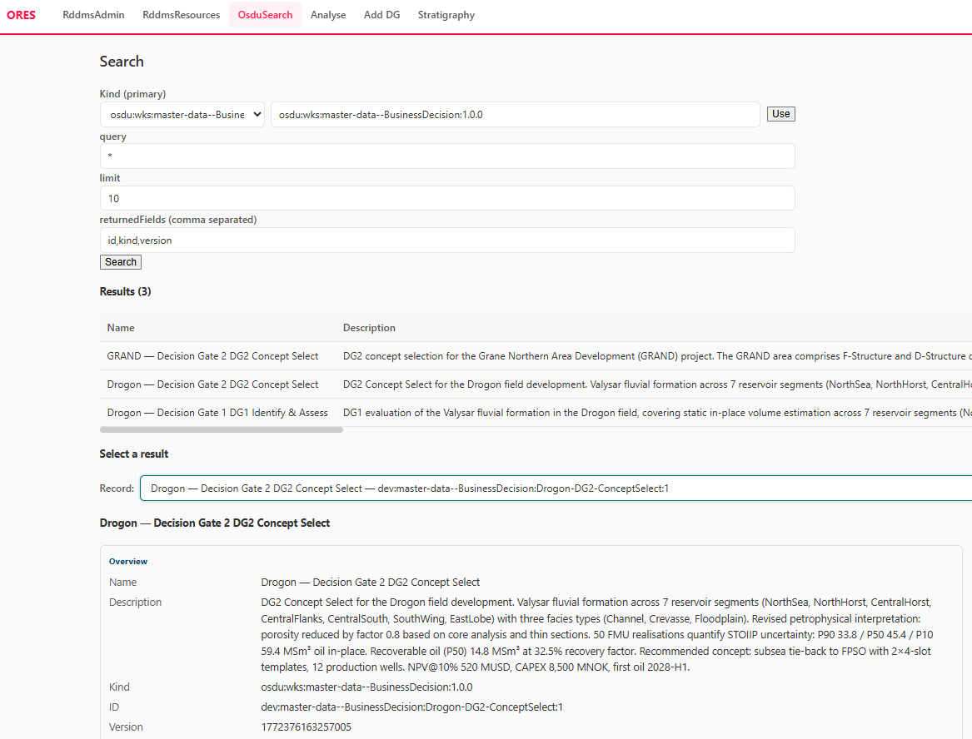
Drogon DG2 BusinessDecision WPC 1
https://github.com/equinor/eageosdudrogon
Search and analyse BusinessDecision related data in OSDU data platform
Public github PoC demo incl. pipeline, data and client

Slide 12
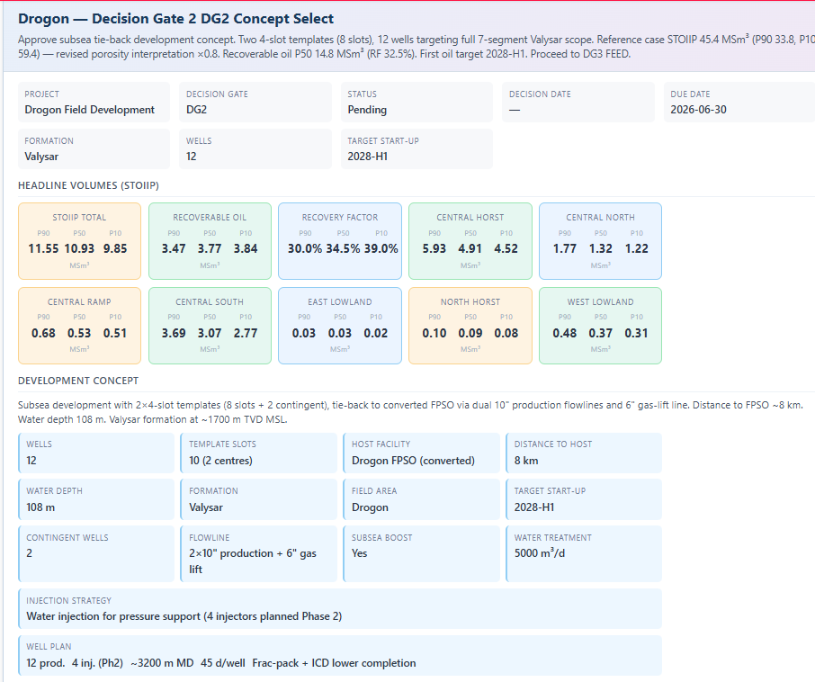
Drogon DG2 BusinessDecision
WPC 2
All key metadata and headline numbers are accessible
All relying on OSDU well known schema
Except local schema DevelopmentConcept

Slide 13
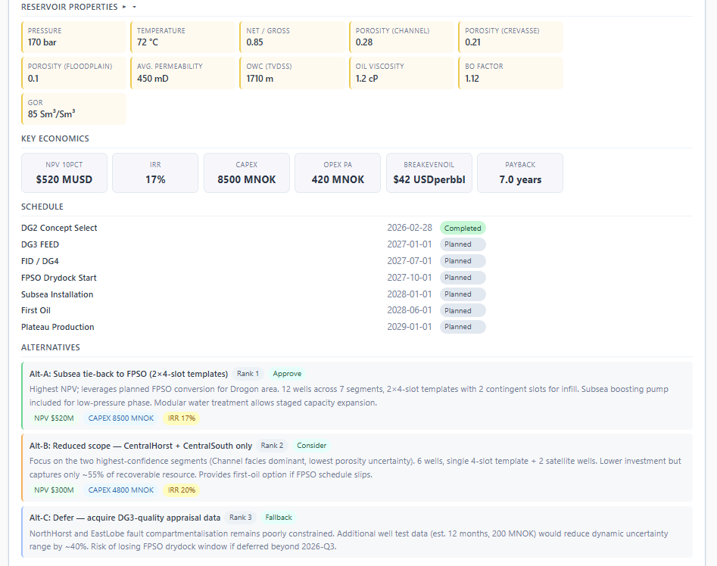
Drogon DG2 BusinessDecision WPC 3
All key metadata and headline numbers are accessible
All relying on OSDU well known schema
Except local schema DevelopmentConcept

Slide 14
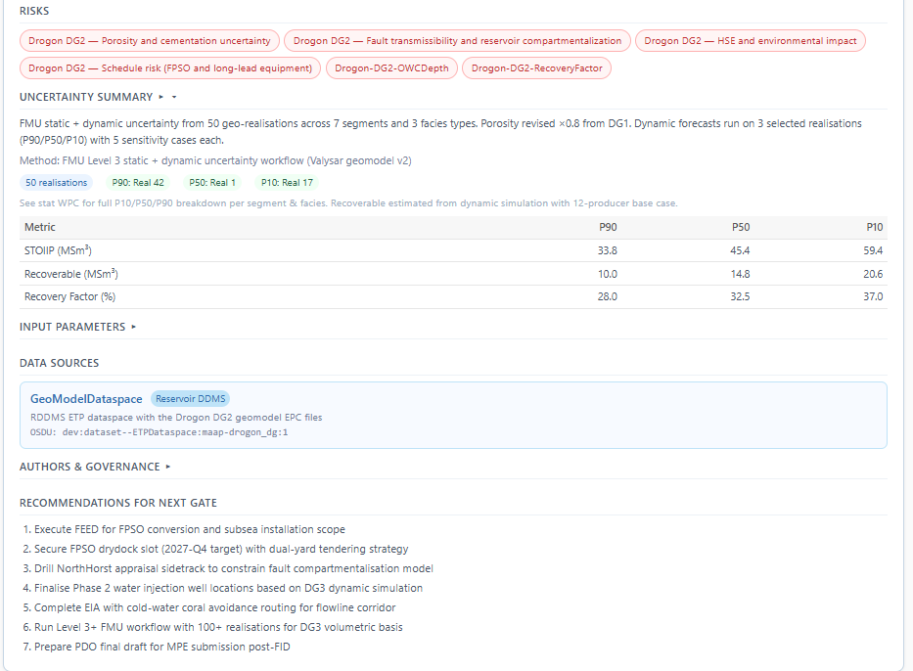
Drogon DG2 BusinessDecision WPC 4
Link Risk master data
Link to the DataSpace in Reservoir DDMS where the Geomodel input and output is archived, incl. parameters/Activity to be reproducible

Slide 15
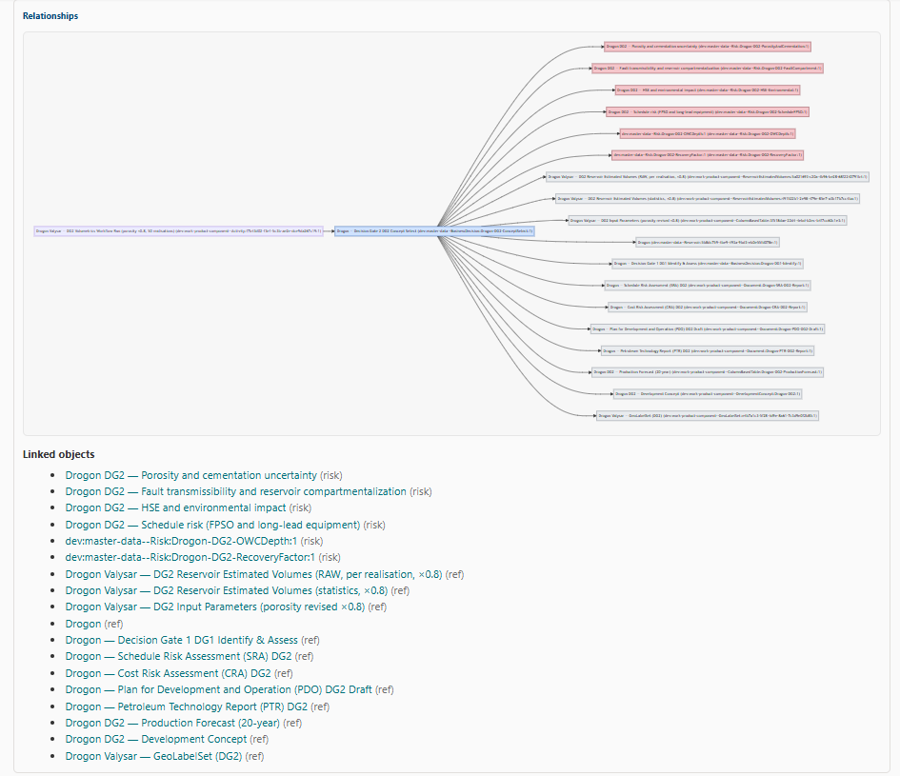
Drogon DG2 BusinessDecision
WPC 5
BusinessDecision is a rich repository, with link to all required documents and data

Slide 16
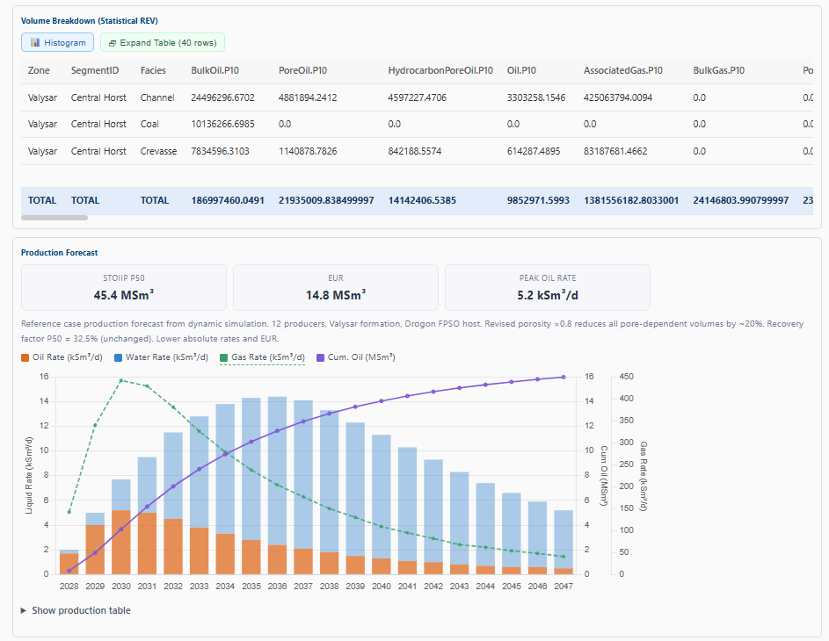
Drogon DG2 BusinessDecision WPC 6
Via references, key data like volume statistics and profiles are available in a canonical way …
Let’s use it for query and analysis!

Slide 17
Analysis: DG comparison dashboard
Sensitivity Analysis (Tornado)
Vary one input at a time (OWC, porosity, NTG), hold others at P50. Rank by STOIIP delta → tornado chart shows dominant drivers.
Drogon Demo in OSDU:
Reservoir DDMS Dataspace
Activity → Parameter DesignMatrix
Activity → Variables, Methods
ColumnBasedTable → input parameters
REV RAW → Segment volumes
REV STAT → P10/P50/P90 … per segment
Risk records → Severity/Probability before & after
All queryable, all linked via BusinessDecision.
→ Enough structure for automated sensitivity & AI-generated insight reports.
Design Matrix Correlation
Realisations × Input variables. Compute correlation between each input column and output STOIIP → identify key levers.
Gate-to-Gate Delta Attribution
Compare DG1 vs DG2 Activity records. Diff input ranges and exp. design (properties, scenarios), attribute volume change.
What-If / Scenario Comparison
Use BD.Parameters[] to swap input WPCs. Re-run with alternative porosity model → compare recoverable volumes and economic impact.

Slide 18
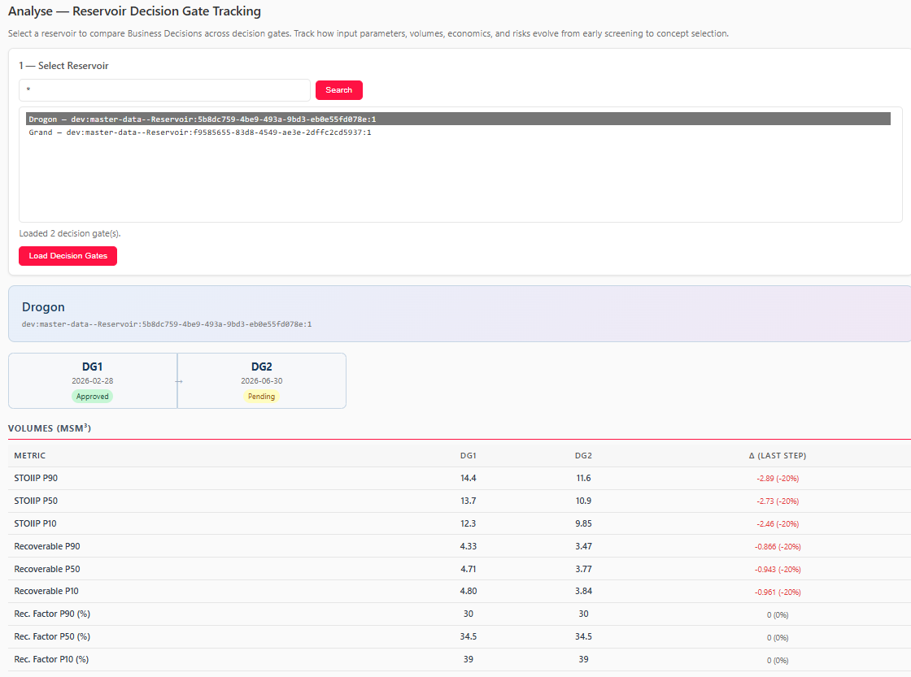
Analysis: DG comparison dashboard 1
Current Capabilities
• Reservoir selection
• Discovery of BDs referencing reservoir
• Gate-by-gate comparison (DG1 → DG2)
• Metric deltas: STOIIP, Recoverable, RF
• Economics: NPV, CAPEX, OPEX, IRR, breakeven
• GeoLabelSet enrichment per segment
• Risk tracking: severity/probability evolution
• Property delta computation (porosity, NTG …)

Slide 19
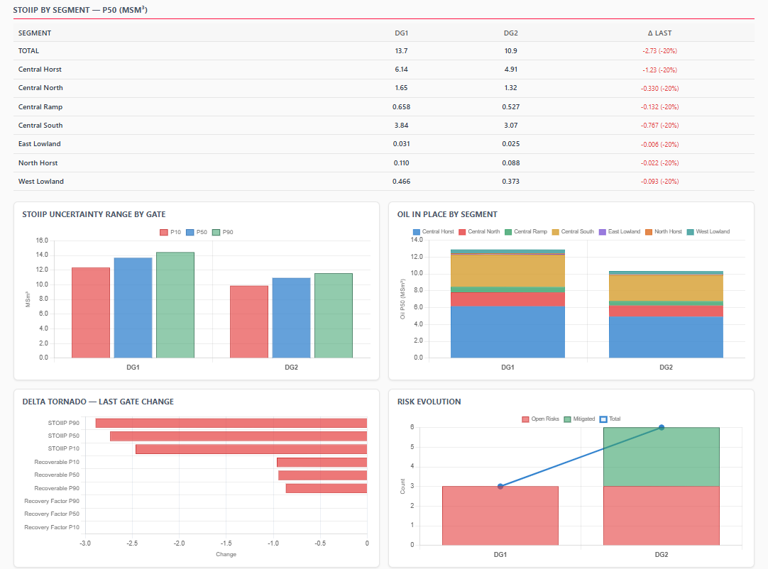
Analysis:
DG comparison
dashboard 2

Slide 20
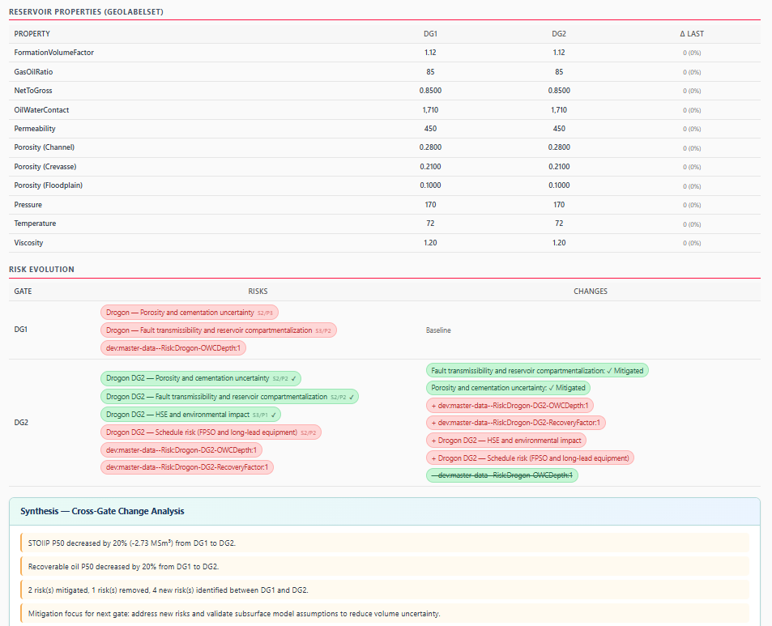
Analysis:
DG comparison
dashboard 3

Slide 21
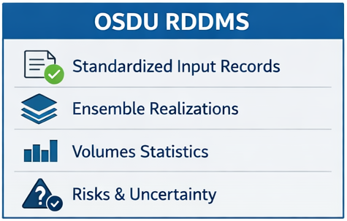
OSDU enabled traceablity
Reservoir DDMS supports Business Decisions
OSDU RDDMS transforms fragmented, non-auditable workflows into a transparent, traceable decision pipeline supporting continuous performance improvement.
Compare volumetric estimates across DG
Attribute changes to underlying inputs
Track uncertainty reduction and decision quality
Enable repeatable, data‑driven governance
Maintain a long-term, searchable archive
Full traceability and auditability
Improved uncertainty tracking
Enable comparisons and analytics
Supports lifecycle analysis
Enhanced performance and maturation tracking
Lossless Input/Output Records
Ensemble-Based Data Support
Standardized Data Models
Searchable Archive
Lifecycle Feedback Loop

Slide 22



We want to thank Equinor and Emerson-AspenTech for allowing us to present this work
Thank You

