Slide 1

EquiPro Walk and Trot
Data + Phase Model
Background for the Python lesson notebook
Key ingredients
EquiPro stride data
LH–RH–LF–RF limb convention
Walk and trot phase targets
Observed vs modeled timing
Notes:
[Sources] - User-provided notebook: EquiPro_Gait_Lesson_1_Walk_Trot_Phase_Model (4).ipynb - Title image generated with OpenAI image generation for this deck

Slide 2
Why this notebook exists
This is an introductory lesson to gait.
What students learn from the data
What students learn from the model
What the comparison shows
How footfall timing, stride duration, and normalized phase encode the gait pattern.
How phase locking can reproduce walk and trot as stable relative phase relationships.
Real horses cluster around ideal timing patterns, but they are not perfectly periodic.
Load
Select
Normalize
Model
Compare
EquiPro CSV
stride summaries
one walk +
one trot block
hoof-on events to
phase on [0,1)
reduced 4-limb
phase CPG
observed vs
modeled timing
The notebook is organized as a sequence: load → normalize → visualize → model → compare.
Notes:
[Sources] - User-provided notebook: EquiPro_Gait_Lesson_1_Walk_Trot_Phase_Model (4).ipynb

Slide 3
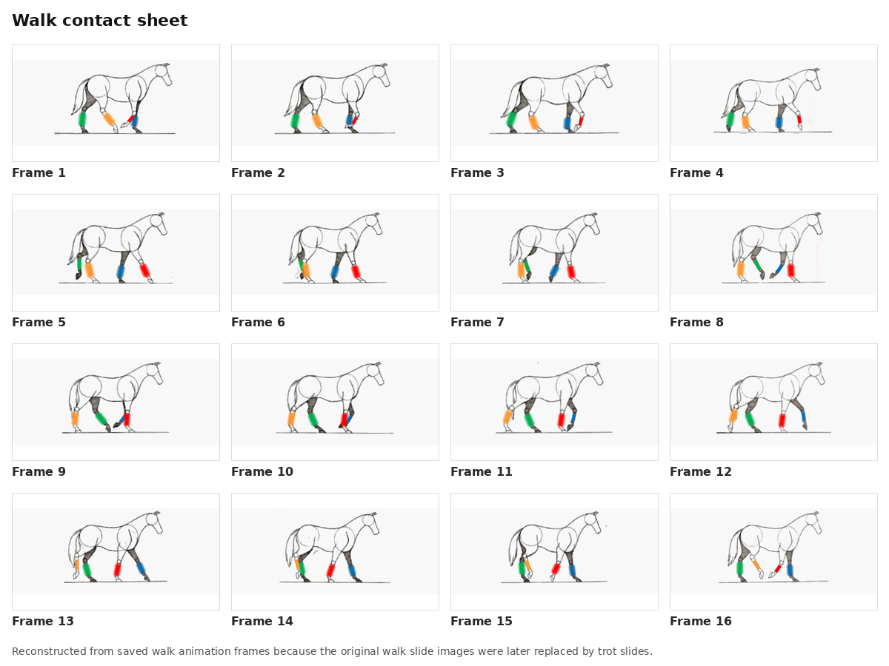
The walk
The walk is a symmetric 4-beat gait
The footfall sequence is: Left Hind – Left Front – Right Hind – Right Front
Notes:
[Sources] - User-provided notebook: EquiPro_Gait_Lesson_1_Walk_Trot_Phase_Model (4).ipynb

Slide 4
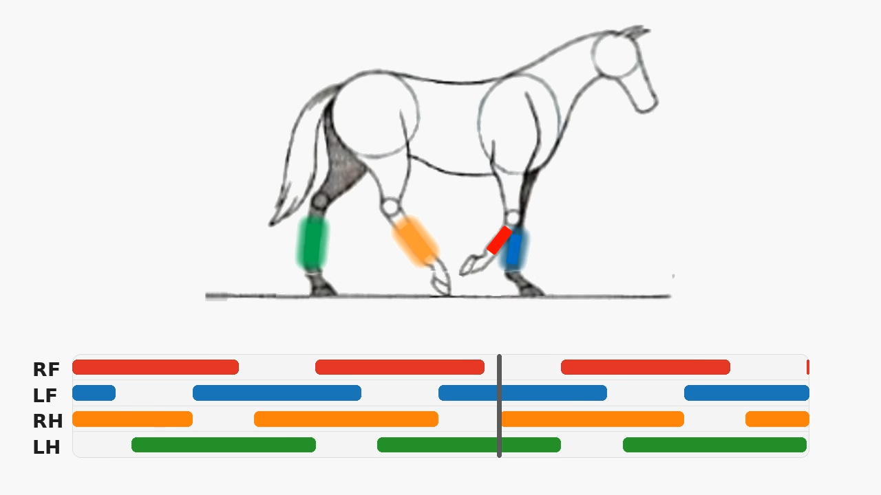
The walk
The walk is a symmetric 4-beat gait
The footfall sequence is: Left Hind – Left Front – Right Hind – Right Front
Notes:
[Sources] - User-provided notebook: EquiPro_Gait_Lesson_1_Walk_Trot_Phase_Model (4).ipynb

Slide 5
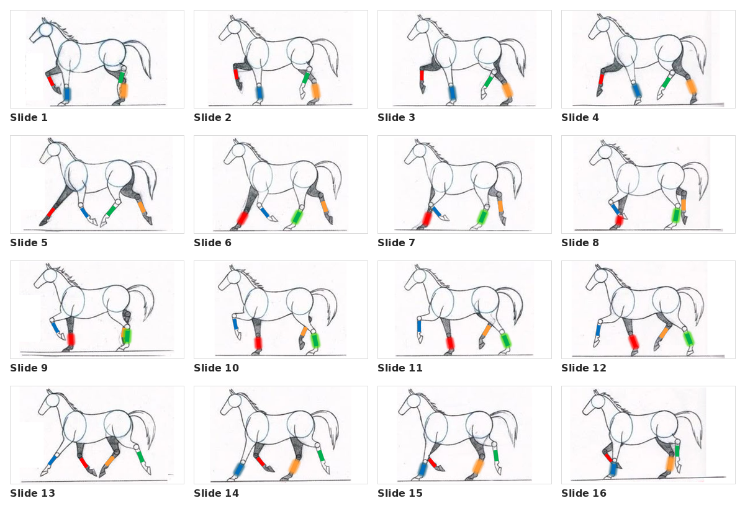
The trot
The trot is a symmetrical, two-beat diagonal gait.
The footfall sequence is: Left Hind + Right Front – Suspension – Right Hind + Left Front – Suspension
Notes:
[Sources] - User-provided notebook: EquiPro_Gait_Lesson_1_Walk_Trot_Phase_Model (4).ipynb

Slide 6
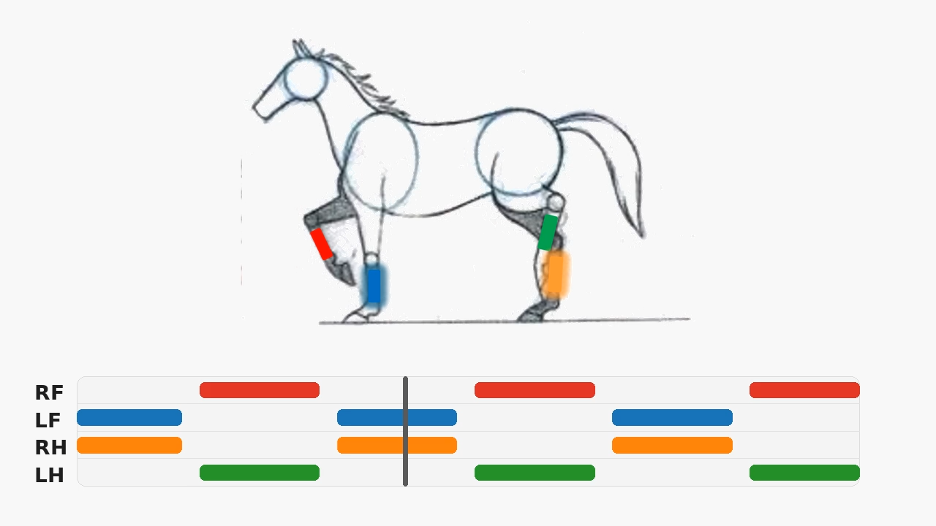
The trot
The trot is a symmetrical, two-beat diagonal gait.
The footfall sequence is: Left Hind + Right Front – Suspension – Right Hind + Left Front – Suspension
Notes:
[Sources] - User-provided notebook: EquiPro_Gait_Lesson_1_Walk_Trot_Phase_Model (4).ipynb

Slide 7
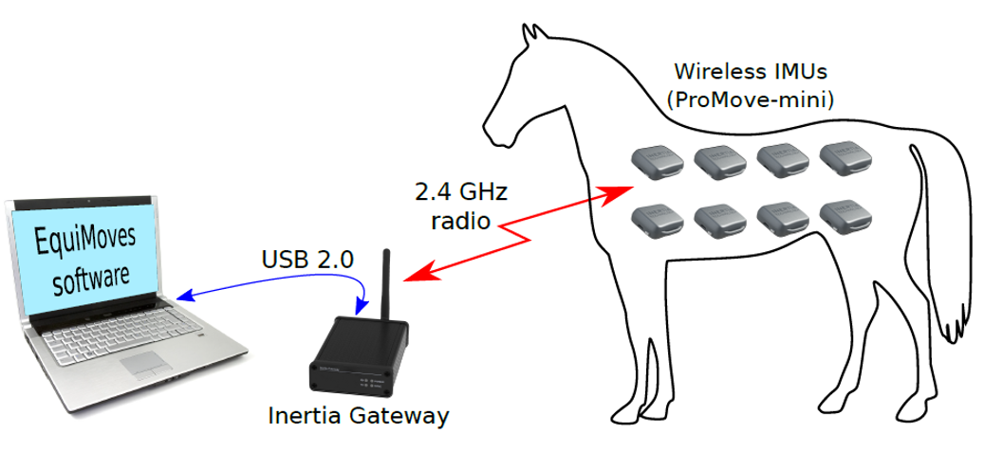
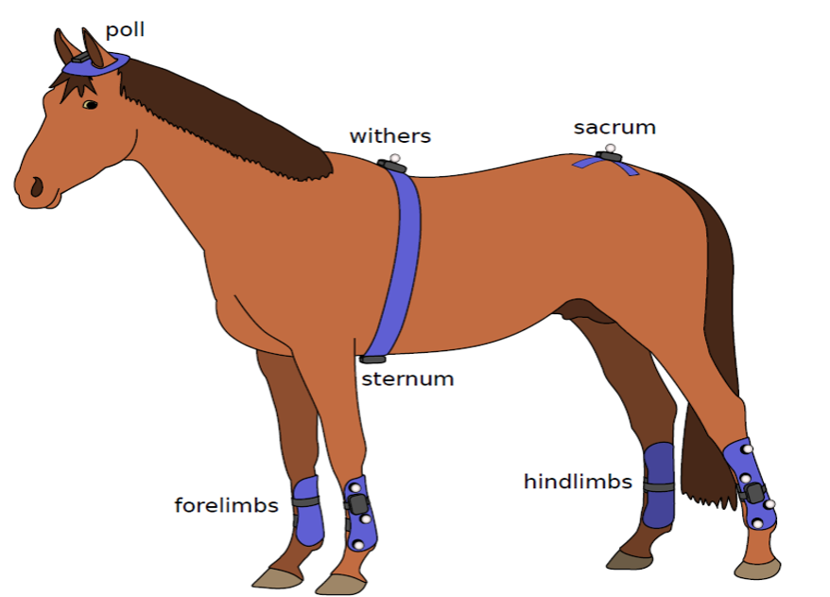
EquiPro Inertia Technology
System components, synchronization, and gait-processing outputs
Components and features
• Eight synchronized wireless inertial measurement units (IMUs).
• Data transmit wirelessly to an inertia gateway receiver.
• IMUs are time-synchronized, enabling limb-by-limb timing comparisons.
System overview: software, gateway, and body-mounted wireless IMUs
Data processing
• Step detection from hoof-on and hoof-off movements.
• 3D orientation from accelerometers and gyroscopes.
• Derived gait metrics such as protraction, retraction, abduction, and adduction angles.
Example sensor placement: poll, withers, sternum, sacrum, and limb sensors
Bosch et al., 2018

Slide 8
What the EquiPro lesson uses from the data
The first notebook relies on stride-level timing rather than continuous raw signals.
CSV structure
Core variables in CSV
The lesson notebook treats the EquiPro CSV as stride-by-stride data: each row is a detected stride with hoof-on timestamps and stride metrics.
Example stride fields
Hoof-on timestamps
ts_hoof_on_LH
observed event timing by limb
ts_hoof_on_RH
Stride duration
stride_dur
Timing variables
elapsed time from one reference stride to the next
duty_factor
Hoof-on times define the observed gait events. Stride duration and duty factor summarize timing from stride to stride.
Duty factor
how much of the stride a limb spends in contact
Mean limb-angle tracks
Lesson choice
stride-normalized waveform summaries from EquiPro
One walk block and one trot block are selected under similar conditions for a clean comparison.
Lesson 1 focuses on event timing and phase; later notebooks can extend to richer waveform and raw-signal analysis.
Notes:
[Sources] - User-provided notebook: EquiPro_Gait_Lesson_1_Walk_Trot_Phase_Model (4).ipynb

Slide 9
From real time to normalized phase
The notebook turns hoof-on times into stride-relative phase values.
Walk target phases
Normalized hoof-on phase
Quarter-cycle spacing
LH
LF
RH
RF
0
1
Using LH as the reference limb means the LH phase is always 0. Every other hoof-on event is written as a location on the interval [0,1).
Trot target phases
Diagonal pairs synchronize
LH
RH
Why normalize?
RF
LF
0
Compare strides with different durations
0
1
See phase clusters instead of raw clock times
Match the form used in the phase model
Interpretation
The raster plot shows raw event structure. The phase plot shows where each event falls inside a reference stride.
Notes:
[Sources] - User-provided notebook: EquiPro_Gait_Lesson_1_Walk_Trot_Phase_Model (4).ipynb

Slide 10
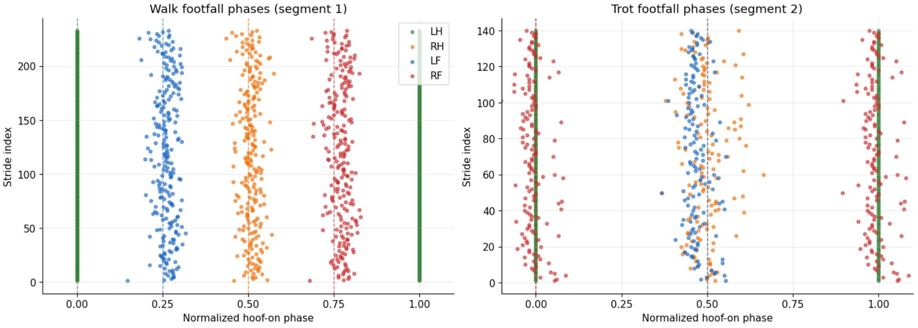
Footfall phases
Experimental data showing when each hoof hits the ground for many strides
Notes:
[Sources] - User-provided notebook: EquiPro_Gait_Lesson_1_Walk_Trot_Phase_Model (4).ipynb

Slide 11
Stride length and duty factor
Two simple summaries used to interpret how a horse moves through space and time
Stride length
Duty factor
Distance traveled from one hoof-on of a limb to the
next hoof-on of the same limb.
Fraction of the stride spent in stance (hoof in contact with the ground).
Stride length
stance
swing
hoof-on
hoof-off
hoof-on
one stride
Interpretation
How to read it
• Longer stride length means more ground covered per
stride.
• It usually depends on gait, speed, body size, and
collection/extension.
• Stride length is a spatial summary, complementing
timing measures such as phase and duty factor.
Higher duty factor means the limb spends more of the stride on the ground.
Lower duty factor means relatively more time in swing.
Walk typically has higher duty factor than trot because there is no aerial phase.

Slide 12
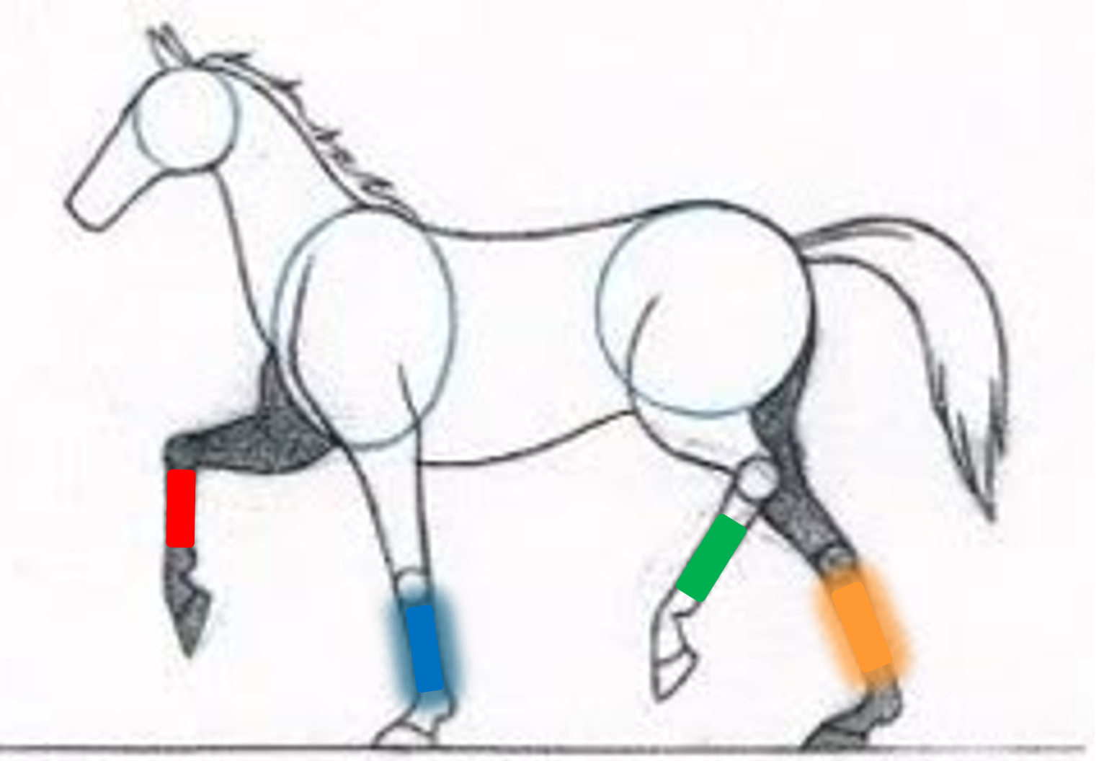
The reduced quadruped CPG phase model
One oscillator per limb; coupling drives the system toward a target gait pattern.
Reduced phase equations
Each limb has a phase variable. The coupling term depends on the difference between current relative phase and the desired target lag for the chosen gait.
θ_i: phase of limb i
ω: natural stepping frequency
K: coupling strength
φ*: target phase vector for walk or trot
Notebook limb order: LH, RH, LF, RF
N: number of oscillators (e.g. legs)
This is a simple model whose job is to explain the relative timing of the four limbs.
Notes:
[Sources] - User-provided notebook: EquiPro_Gait_Lesson_1_Walk_Trot_Phase_Model (4).ipynb

Slide 13
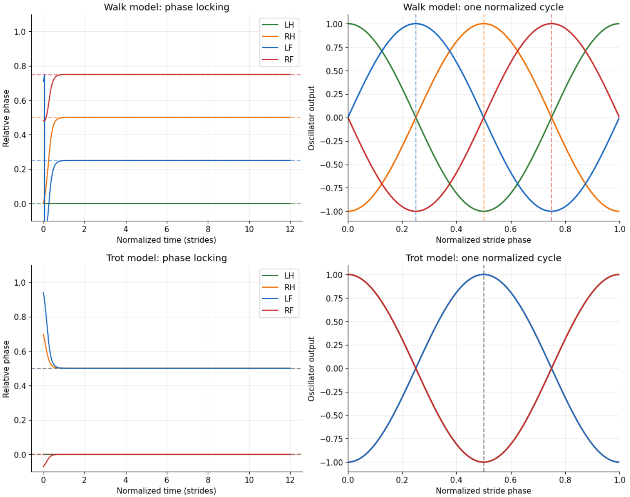
Oscillator model results
This would represent a perfectly symmetrical horse
Notes:
[Sources] - User-provided notebook: EquiPro_Gait_Lesson_1_Walk_Trot_Phase_Model (4).ipynb

Slide 14
How the notebook is organized
A guided sequence from observed data to model-based interpretation.
Load data
Import the EquiPro file and inspect the available segments.
1
Helper functions
Compute normalized phases and prepare plotting/model utilities.
2
Choose segments
Pick one walk block and one trot block for the lesson.
3
Plot real data
Footfall timing, phase rasters, summary table, limb-angle means.
4
Simulate model
Run the reduced 4-limb coupled phase-oscillator system.
5
Compare + summarize
Check phase locking, compare observed/model timing, discuss limitations.
6–7
Notes:
[Sources] - User-provided notebook: EquiPro_Gait_Lesson_1_Walk_Trot_Phase_Model (4).ipynb

Slide 15
What students should leave with
The lesson is about timing structure, not a complete physiology model.
Key takeaway 1
Important limitations
A gait can be described as a stable pattern of relative phases among limbs.
The CSV used here is a stride summary file, not a full continuous time-series export.
The comparison is mainly about event timing and relative phase, not continuous limb motion.
Key takeaway 2
Normalizing hoof-on times to phase makes walk and trot easy to compare across strides.
Real data show stride-to-stride variability that the reduced model does not try to explain.
Key takeaway 3
A simple four-oscillator model already captures the main timing relationships.
Notes:
[Sources] - User-provided notebook: EquiPro_Gait_Lesson_1_Walk_Trot_Phase_Model (4).ipynb

