Slide 1

EQUIPHYSICS OUTREACH · 2026
Horse Heart Lab
How a horse's heart beats, from standing still to a gallop, and how to build one from a clock and five bumps.
Laura Miller · EquiPhysics, Sonoita, Arizona · equiphysics.github.io/web-apps/heart

Slide 2
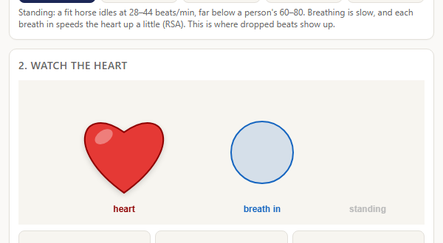
A HEART THE SIZE OF A BASKETBALL
Why a horse's heart?
• About 4 to 5 kg, one percent of the horse. Yours is about 300 g.
• Rests at 28–44 beats a minute. Climbs past 220 at a gallop. That is a six-fold range.
• Pushes close to a liter of blood with every beat.
• Fit horses skip a beat now and then while standing quietly, on purpose.
• Question for the room: what is your resting heart rate? How high does it go?
EquiPhysics · Horse Heart Lab · equiphysics.org
Notes:
Hook. Ask students to find their own pulse. Then show the app's Standing preset at 36 beats per minute and let them feel how slow that is.

Slide 3
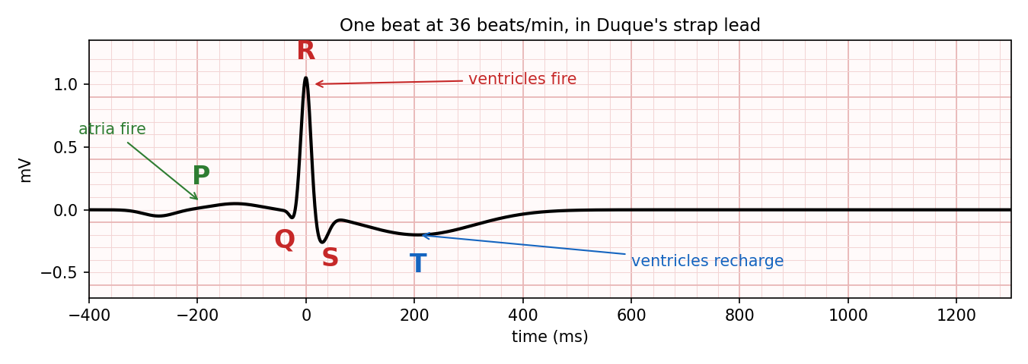
P, QRS, T
Reading the ECG
• The ECG is the electrical echo of the heart muscle firing.
• P: the atria fire (top chambers).
• QRS: the ventricles fire. The big spike.
• T: the ventricles recharge.
• Where the electrodes sit decides which way each wave points. In Duque's strap the T points down.
EquiPhysics · Horse Heart Lab · equiphysics.org

Slide 4
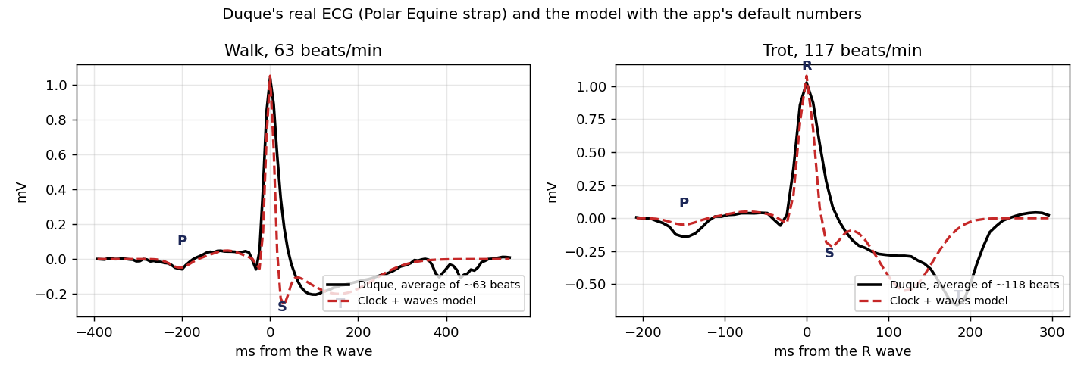
A REAL HORSE, A REAL STRAP
Duque's own beats
• Duque wears a Polar Equine strap: one ECG lead, 125 samples a second.
• Left: about 60 beats averaged while walking, 63 beats/min.
• Right: about 120 beats averaged while trotting, 117 beats/min.
• The T wave grows and moves closer to the R as the rate goes up.
• The red dashed line is the model with the app's default numbers.
EquiPhysics · Horse Heart Lab · equiphysics.org

Slide 5
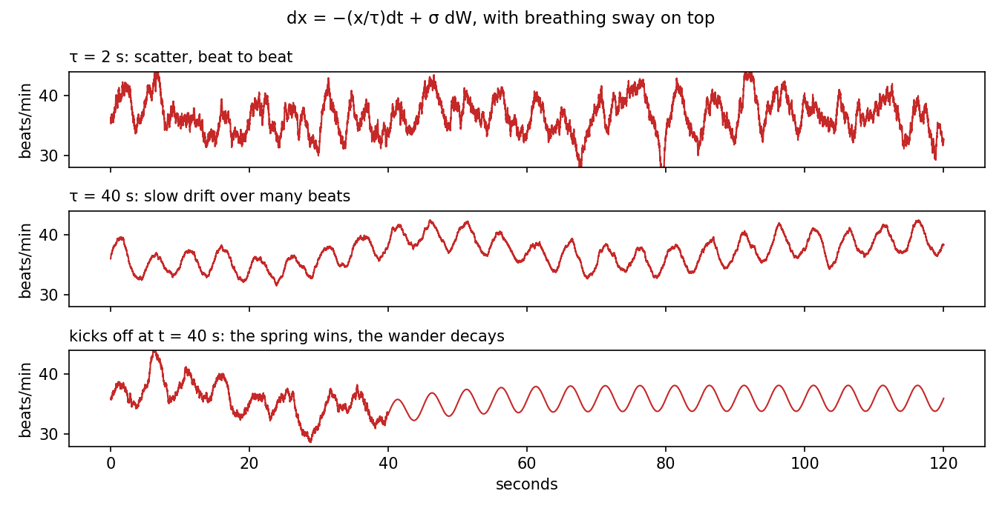
NOT A METRONOME
The rhythm wanders, and that is healthy
• RR interval: the time from one beat to the next.
• SDNN: how spread out the intervals are overall.
• RMSSD: how much they change from one beat to the next.
• Breathing in speeds the heart up a little (RSA). Slow, smooth sway.
• Standing quietly, Duque's RR is about 1.8 s with SDNN near 150 ms and RMSSD near 50 ms.
EquiPhysics · Horse Heart Lab · equiphysics.org
Notes:
The figure is the app's wander model: a short memory time gives scatter, a long one gives drift, and with the random kicks off the wander dies away.

Slide 6
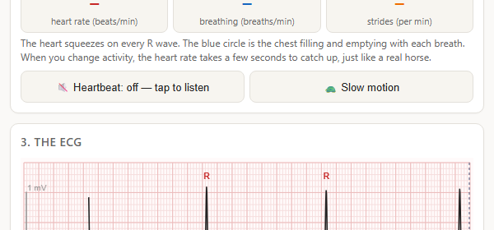
THE MATH BEHIND IT
A clock and five bumps
• One hand θ sweeps around once per beat at speed ω = 2π·HR/60.
• Each wave is a bump of height aᵢ and width bᵢ parked at its own angle θᵢ.
• The ECG is the sum of the bumps as the hand passes them.
• McSharry, Clifford, Tarassenko & Smith (2003).
dθ/dt = ω(t) = 2π · HR(t) / 60
ECG(θ) = Σᵢ aᵢ · exp( −(θ − θᵢ)² / 2bᵢ² )
EquiPhysics · Horse Heart Lab · equiphysics.org

Slide 7
A STOCHASTIC DIFFERENTIAL EQUATION
Where the wander comes from
• The rate is a set point, swayed by breathing, times a wandering factor x.
• Spring: −(x/τ) dt pulls x back toward zero. τ is the memory time.
• Kicks: σ dW, random nudges from the nervous system (a Wiener process).
• Turn the kicks off and only the spring is left: the wander decays.
• This is the Ornstein–Uhlenbeck process, the simplest SDE.
HR(t) = HR₀·(1 + RSA·sin 2πφ_breath)·(1 + x)
dx = −(x / τ) dt + σ dW
Short τ → beat-to-beat scatter (RMSSD up).
Long τ → slow drift over many beats (SDNN up).
Kicks off → an ordinary differential equation, x → 0.
EquiPhysics · Horse Heart Lab · equiphysics.org

Slide 8
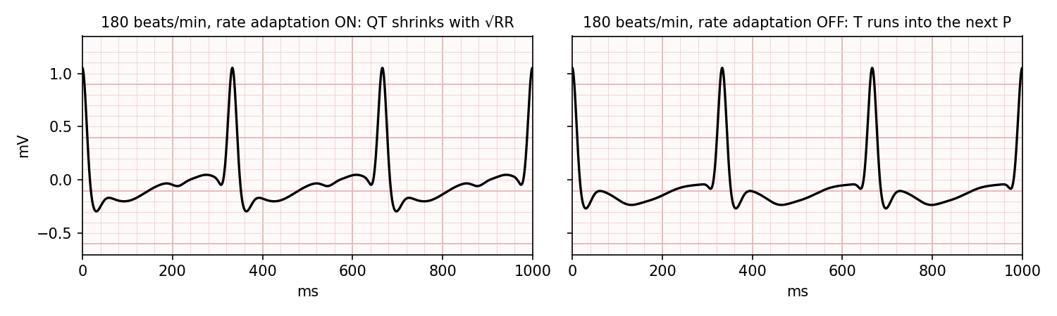
WHAT HAD TO SHRINK?
Rate adaptation
• At a gallop the heart beats almost four times a second.
• The QRS keeps its width: the ventricles fire just as fast.
• The P and T waves move closer to the R: the ventricles recharge faster.
• QT scales with the square root of the RR interval. Bazett's rule, 1920.
• Switch it off in the app: the T wave of one beat runs into the P wave of the next.
EquiPhysics · Horse Heart Lab · equiphysics.org

Slide 9
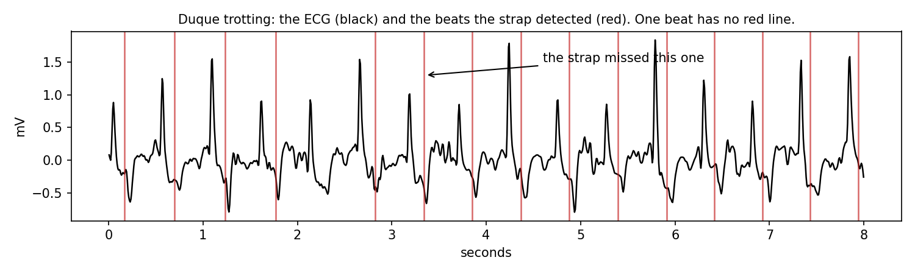
THE SENSOR IS PART OF THE SYSTEM
Did the heart skip, or did the strap?
• The strap has its own beat detector (the red lines).
• Sometimes it misses a beat and reports one interval twice as long.
• The ECG shows a full QRS inside the gap. The heart beat; the strap blinked.
• A real skipped beat would show a P wave with nothing after it.
• Always ask which part of the system made the feature: the horse, the model, or the sensor.
EquiPhysics · Horse Heart Lab · equiphysics.org

Slide 10
OPEN IT ON YOUR PHONE
Your missions today
• A · Read the ECG: five activities, label the waves.
• B · The rhythm: breathing sway, memory time, kicks on and off, dropped beats.
• C · Build the beat: ω, rate adaptation, match Duque's trot, the SDE in words.
• D · Reality check: standing, trot, the whole ride, and the strap-miss detective question.
Scan with your camera
equiphysics.github.io/web-apps/heart
EquiPhysics · Horse Heart Lab · equiphysics.org

Slide 11
EQUIPHYSICS · A 501(C)(3) NONPROFIT FOR HORSE SCIENCE
Stay in touch
• Math and movement science, put to work for the horses that inspire it.
• All of today's materials are free: equiphysics.github.io
• Data, lessons, and code: github.com/equiphysics/education
• equiphysics.org · laura_miller@equiphysics.org
EquiPhysics · Horse Heart Lab · equiphysics.org

