Slide 1
Horse Heart Rate (HR)
& Heart Rate Variability (HRV)
A guide for Duque’s weekly lunge test + 90‑day routine
What you’ll learn:
What HR vs HRV actually measure
How to collect clean data during work + recovery
How to interpret weekly trends
Notes:
[Sources]
- HRV definition & common time-domain metrics: Task Force standards (Circulation, 1996). https://pubmed.ncbi.nlm.nih.gov/8598068/
[/Sources]

Slide 2
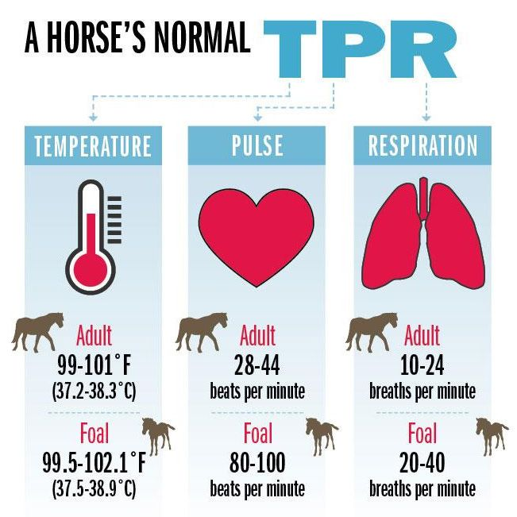
What is normal for a horse?
EquiPhysics – equiphysics.org
Pella Vet
Horse Heartbeats Lab
Notes:
[Sources]
- Definition of HRV and interpretation framework (time-domain, frequency-domain): Task Force standards (Circulation, 1996). https://pubmed.ncbi.nlm.nih.gov/8598068/
- Factors influencing equine HRV during rest/exercise/recovery: Younes et al., Frontiers in Physiology (2016). https://www.frontiersin.org/articles/10.3389/fphys.2016.00155/full
[/Sources]

Slide 3
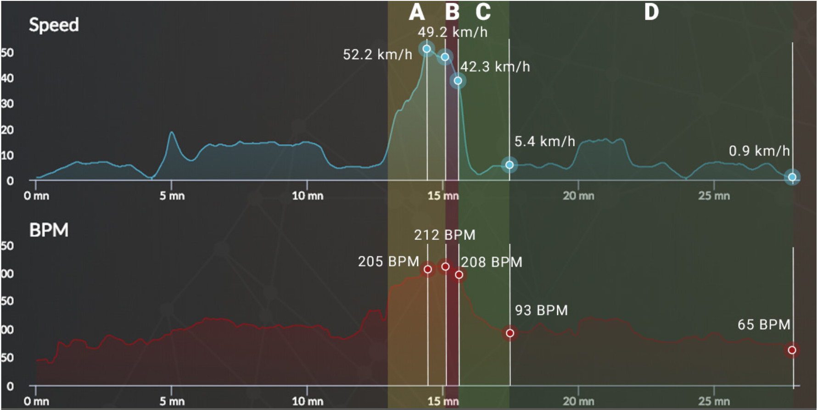
What is extreme?
EquiPhysics – equiphysics.org
https://training.arioneo.com/en/heart-rate/
Horse Heartbeats Lab
Notes:
[Sources]
- Definition of HRV and interpretation framework (time-domain, frequency-domain): Task Force standards (Circulation, 1996). https://pubmed.ncbi.nlm.nih.gov/8598068/
- Factors influencing equine HRV during rest/exercise/recovery: Younes et al., Frontiers in Physiology (2016). https://www.frontiersin.org/articles/10.3389/fphys.2016.00155/full
[/Sources]

Slide 4
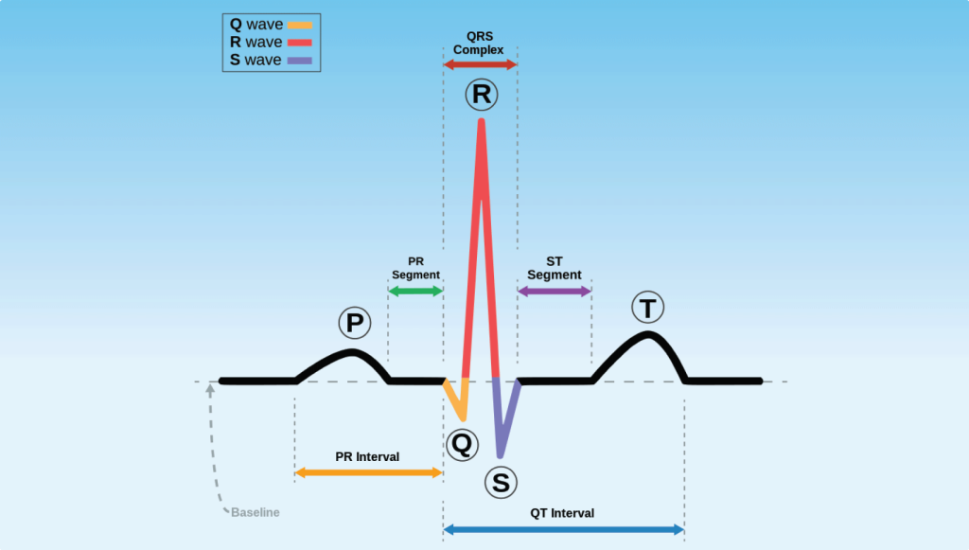
Electrocardiogram (ECG)
EquiPhysics – equiphysics.org
https://medtigo.com/blog/how-do-you-interpret-ecg-values/
Electrocardiography (ECG) is a diagnostic tool used to measure the electrical activity of the heart. An ECG machine records the electrical signals from the heart and produces an ECG waveform, which is a graphical representation of the heart’s electrical activity.
Horse Heartbeats Lab
Notes:
[Sources]
- Definition of HRV and interpretation framework (time-domain, frequency-domain): Task Force standards (Circulation, 1996). https://pubmed.ncbi.nlm.nih.gov/8598068/
- Factors influencing equine HRV during rest/exercise/recovery: Younes et al., Frontiers in Physiology (2016). https://www.frontiersin.org/articles/10.3389/fphys.2016.00155/full
[/Sources]

Slide 5
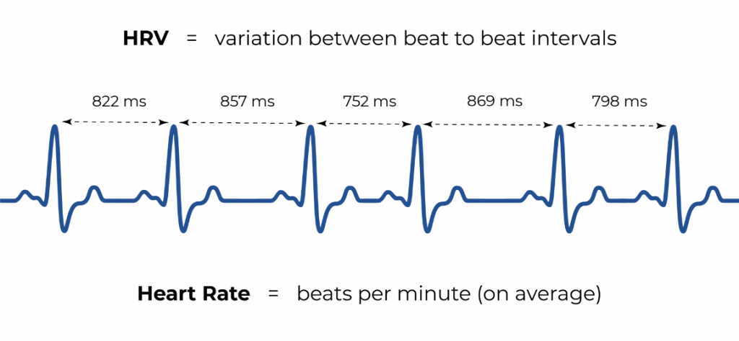
What is Heart Rate Variability (HRV)?
EquiPhysics – equiphysics.org
What Does HRV Tell Us?
Higher HRV is associated with lower stress levels in humans and other animals.
Heartbeat coupling and synchronized HRV between humans and horses.
HRV synchronization flows both ways—from human to horse and from horse to human.
https://www.tres.in/health-insight/heart-rate-variability-does-it-matter/
Horse Heartbeats Lab
Notes:
[Sources]
- Definition of HRV and interpretation framework (time-domain, frequency-domain): Task Force standards (Circulation, 1996). https://pubmed.ncbi.nlm.nih.gov/8598068/
- Factors influencing equine HRV during rest/exercise/recovery: Younes et al., Frontiers in Physiology (2016). https://www.frontiersin.org/articles/10.3389/fphys.2016.00155/full
[/Sources]

Slide 6
Why measure HR + HRV?
EquiPhysics – equiphysics.org
HR tells us fast or hard the heart is working. HRV helps interpret how the body is responding.
Heart Rate (HR)
Heart Rate Variability (HRV)
Beat‑to‑beat timing variation (R‑R intervals)
Higher HRV is associated with lower stress levels
Most useful when measured in rest and recovery
Increases with workload: speed + effort + terrain
Fitness shows up as lower HR for same work
Recovery HR: how quickly a horse returns toward baseline
EquiPhysics • Weekly Duque Routine
Notes:
[Sources]
- Definition of HRV and interpretation framework (time-domain, frequency-domain): Task Force standards (Circulation, 1996). https://pubmed.ncbi.nlm.nih.gov/8598068/
- Factors influencing equine HRV during rest/exercise/recovery: Younes et al., Frontiers in Physiology (2016). https://www.frontiersin.org/articles/10.3389/fphys.2016.00155/full
[/Sources]

Slide 7
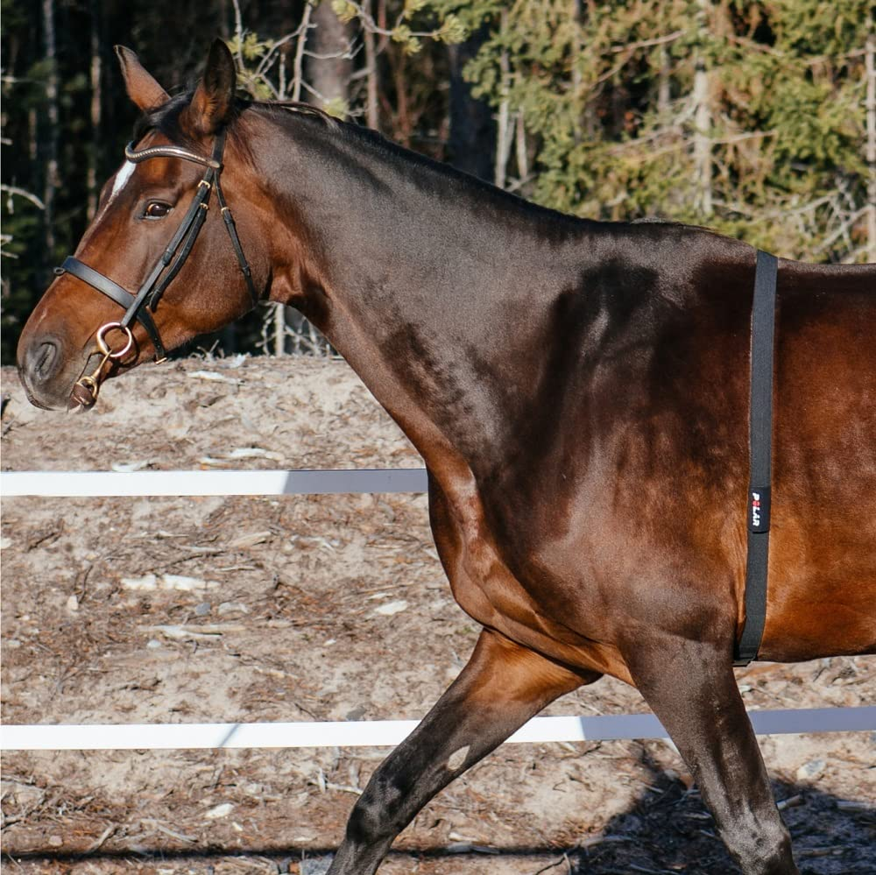
How do we measure HR and HRV?
EquiPhysics – equiphysics.org
The Polar V800 heart rate monitor is a system validated for collecting accurate Inter-Beat Interval (IBI) data in horses.
How it Works:
An electrode belt is placed around the horse's girth, near the elbow, to capture the heart's electrical signals.
It records beat-to-beat (R-R interval) data, which is essential for both heart rate and HRV analysis.
EquiPhysics • Weekly Duque Routine
Notes:
[Sources]
- Definition of HRV and interpretation framework (time-domain, frequency-domain): Task Force standards (Circulation, 1996). https://pubmed.ncbi.nlm.nih.gov/8598068/
- Factors influencing equine HRV during rest/exercise/recovery: Younes et al., Frontiers in Physiology (2016). https://www.frontiersin.org/articles/10.3389/fphys.2016.00155/full
[/Sources]

Slide 8
Duque: What we hope to see during his fitness program
EquiPhysics – equiphysics.org
Ideal changes week to week
Lower HR at the same workload
Faster HR recovery after trot sets
More stable baseline
HRV trends consistent with improved recovery / lower stress
Goal: Build fitness safely over 90 days while measuring objective change.
Why Duque?
~19 years old PRE gelding
Light recent work
Early muscle atrophy
Ideal case for careful progression + data
?
EquiPhysics • Weekly Duque Routine
Notes:
[Sources]
- Definition of HRV and interpretation framework (time-domain, frequency-domain): Task Force standards (Circulation, 1996). https://pubmed.ncbi.nlm.nih.gov/8598068/
- Factors influencing equine HRV during rest/exercise/recovery: Younes et al., Frontiers in Physiology (2016). https://www.frontiersin.org/articles/10.3389/fphys.2016.00155/full
[/Sources]

Slide 9
Weekly lunge exercise test (standardized)
EquiPhysics – equiphysics.org
Standardize: 18 m circle • indoor arena • same tack • same order (Left → Right)
Pre‑test (standing)
Switch direction 30–60 sec
Quiet standing 5 min (HR/HRV)
Block B — Right
Block A — Left
Walk warm‑up 5 min
Trot 2 min
Walk recovery 2 min
Trot 2 min
Walk cool‑down 2 min
Walk warm‑up 5 min
Trot 2 min
Walk recovery 2 min
Trot 2 min
Walk cool‑down 2 min
Post‑test (standing)
Standing recovery 10 min
Total time: ~40–45 min door‑to‑door (work blocks 26 min + standing before/after)
EquiPhysics • Weekly Duque Routine
Slide 6

Slide 10
HRV metrics we’ll report (and what they mean)
EquiPhysics – equiphysics.org
Metric
Layman description
Best use
RMSSD
Root Mean Square of Successive Differences: How much one beat interval changes compared with the next.
It’s relatively robust for short recordings and is commonly used in daily readiness/recovery tracking.
SDNN
Standard Deviation of NN intervals: Overall variability across the whole segment you’re analyzing
Longer resting windows; not ideal in noisy exercise data.
Mean HR
Average heart rate for a segment.
Workload + recovery speed.
Recovery slope
How quickly HR drops after trot sets.
Fitness/recovery trends across the 90 days.
Important: HRV metrics are sensitive to artifacts (missed/extra beats) — clean data matters.
EquiPhysics • Weekly Duque Routine
Notes:
[Sources]
- HRV metric definitions (RMSSD, SDNN) and interpretation: Task Force standards (Circulation, 1996). https://pubmed.ncbi.nlm.nih.gov/8598068/
- Equine HRV collection/analysis considerations (including artifacts/arrhythmias): Mitchell et al. (2021) review. https://www.sciencedirect.com/science/article/pii/S1090023320301672
[/Sources]

Slide 11
Collecting clean HR/HRV data (horses)
EquiPhysics – equiphysics.org
HRV is powerful — but only if the signal is clean.
Common confounders
Heat, hydration, pain/discomfort, excitement
Environment (new horses, wind, noise)
Different warm-up intensity
Device errors during movement
Best practices
Use the same device, placement, and settings every week
Get a calm baseline (quiet standing) before work
Minimize motion artifacts: snug strap, good electrode contact
Remove segments with noise before interpreting HRV
Rule of thumb
Interpret HRV mostly in
(1) quiet standing
(2) standing recovery
Exercise HRV is often noisier
EquiPhysics • Weekly Duque Routine
Notes:
[Sources]
- Accuracy concerns for HR monitors assessing HRV during exercise in horses: Kapteijn et al., Frontiers in Veterinary Science (2022). https://www.frontiersin.org/articles/10.3389/fvets.2022.939534/full
- Factors affecting equine HRV across rest/exercise/recovery and sites: Younes et al., Frontiers in Physiology (2016). https://www.frontiersin.org/articles/10.3389/fphys.2016.00155/full
[/Sources]

Slide 12
What we’ll publish each week (example format)
EquiPhysics – equiphysics.org
*These plots are illustrative. We’ll replace the values with Duque’s actual data each week.
HR during the lunge session (example)
Key questions we’ll answer
For the same work, is HR lower?
Is recovery faster?
Is standing recovery RMSSD trending up/down?
Do left vs right directions differ?
EquiPhysics • Weekly Duque Routine
Notes:
[Sources]
- General HRV standards and definitions: Task Force (Circulation, 1996). https://pubmed.ncbi.nlm.nih.gov/8598068/
- Exercise and recovery conditions influence equine HRV: Younes et al. (2016). https://www.frontiersin.org/articles/10.3389/fphys.2016.00155/full
[/Sources]

Slide 13
Interpreting trends: do’s & don’ts
EquiPhysics – equiphysics.org
Do
Don’t
Compare the same segments week-to-week
Track direction effects (left vs right) separately
Use notes: weather, footing, behavior, tack changes
Treat changes as hypotheses (“why might this shift?”)
Over-interpret a single day
Assume “higher HRV = always better”
Compare exercise HRV numbers without checking for artifacts
Use HRV as a diagnostic tool — it’s one piece of the puzzle
When to pause
If HR rises at the same workload and/or recovery slows for multiple weeks, or if behavior changes, talk with your vet/trainer team.
EquiPhysics • Weekly Duque Routine
Notes:
[Sources]
- HRV interpretation and limitations (artifact sensitivity, context): Task Force (Circulation, 1996). https://pubmed.ncbi.nlm.nih.gov/8598068/
- Equine HRV depends on conditions (site, duration, age) and can be affected during exercise/recovery: Younes et al. (2016). https://www.frontiersin.org/articles/10.3389/fphys.2016.00155/full
[/Sources]

Slide 14
Questions?
EquiPhysics – equiphysics.org
We’ll post Duque’s weekly lunge-test results throughout the 90‑day routine, including:
• HR workload + recovery
• HRV in quiet standing + standing recovery
• Notes on conditions and training changes
Disclaimer: This content is educational and not a veterinary diagnosis.
Github link for Python notebook:
https://github.com/equiphysics/education/blob/main/labs/Duque-Exercise/Duque_Lunge_Test.ipynb
Google Drive link for data: https://drive.google.com/drive/folders/1PTUOogGCghmoGYvzgzTaX4nUULSeq23b?usp=sharing
Video presentation: https://drive.google.com/file/d/1jaiEV2PssI8UMKxvMHOj7RkMWqcBlYT6/view?usp=sharing
How to use Python Notebook: https://drive.google.com/file/d/15mAcd1Ac8XIEhCuOcphAe0HiPSdV_O2P/view?usp=drive_link
EquiPhysics • equiphysics.org
Notes:
[Sources]
- HRV standards and definitions: Task Force (Circulation, 1996). https://pubmed.ncbi.nlm.nih.gov/8598068/
- Equine HRV measurement considerations (artifacts, arrhythmias): Mitchell et al. (2021) review. https://www.sciencedirect.com/science/article/pii/S1090023320301672
[/Sources]

