Slide 1
Destination/Source Routing
draft-ietf-rtgwg-dst-src-routing-revive-02
Jen Linkova^{G}, Anton Smirnov^{C}, Mingwei Xu^{T}, Shu Yang^{S},
David ‘equinox' Lamparter^{N}
IETF 121 · Dublin, IE · rtgwg · 2024-11-05
^{C} Cisco — ^{G} Google — ^{N} NetDEF — ^{S} Shenzen U. — ^{T} Tsinghua U.

Slide 2
Changelog
… is empty
Shu Yang agreed to act as editor

Slide 3
60-second history
draft just had 10th birthday 🎉
originally homenet related
but keeps popping up in random places

Slide 4
refresher/summary (1)
start at most specific destination prefix match
look for best source prefix match w/ that dst
match found? ⇒ stop
no source prefix match?
⇒ repeat with next less specific destination

Slide 5
refresher/summary (2)
IPv6 only
‘classic’ dst-only route
≡ dst-src route with src prefix ::/0

Slide 6
refresher/summary (3)
intended for single consistent routing domain
⇒ destination before source
⇒ opposite of typical policy routing
(this is not intended to represent zones/VRFs!)
can (should) be implemented without loop (use artificial/dummy routes if needed)

Slide 7
Protocol cross-refs
specified for BABEL in RFC9079 (Aug’ 2021)
  originally referenced this doc, dropped to publish
OSPFv3 & IS-IS drafts expired
  may revive (after this) depending on interest
doc’ing common bits is main goal of this draft

Slide 8
Implementations (forwarding)
Linux:
commit 4e96c2b4180aff4f080b77314712073c6ca430e7
Author: YOSHIFUJI Hideaki <yoshfuji@linux-ipv6.org>
Date: Wed Aug 23 17:23:39 2006 -0700
[IPV6] KCONFIG: Add subtrees support.

Slide 9
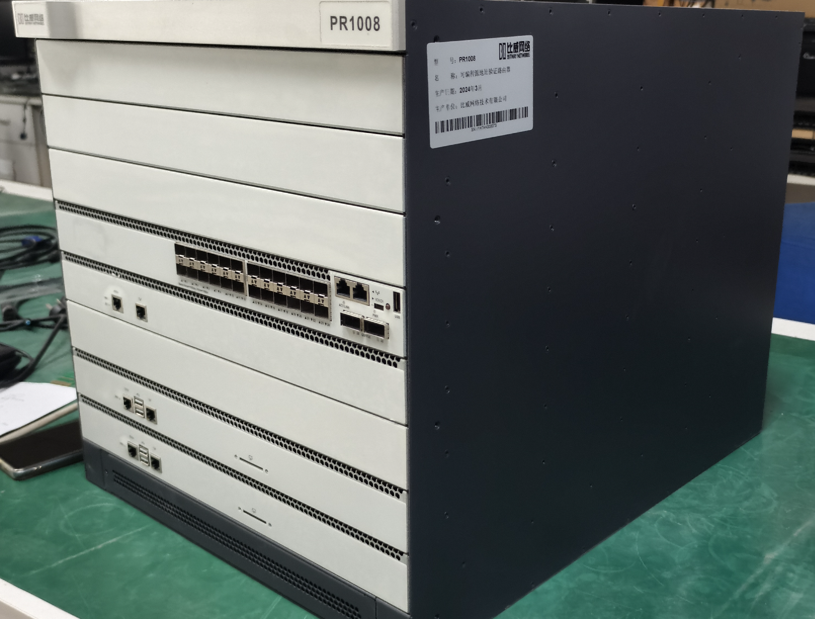
Implementations (forwarding)
FITI implementation
Control Plane:
Updated OSPFv3 protocol
Forwarding Plane:
Hardware TCAM-based,
implemented on Barefoot Tofino

Slide 10
Implementations (control plane)
BIRD (static, BABEL)
FRRouting (static)
babeld

Slide 11
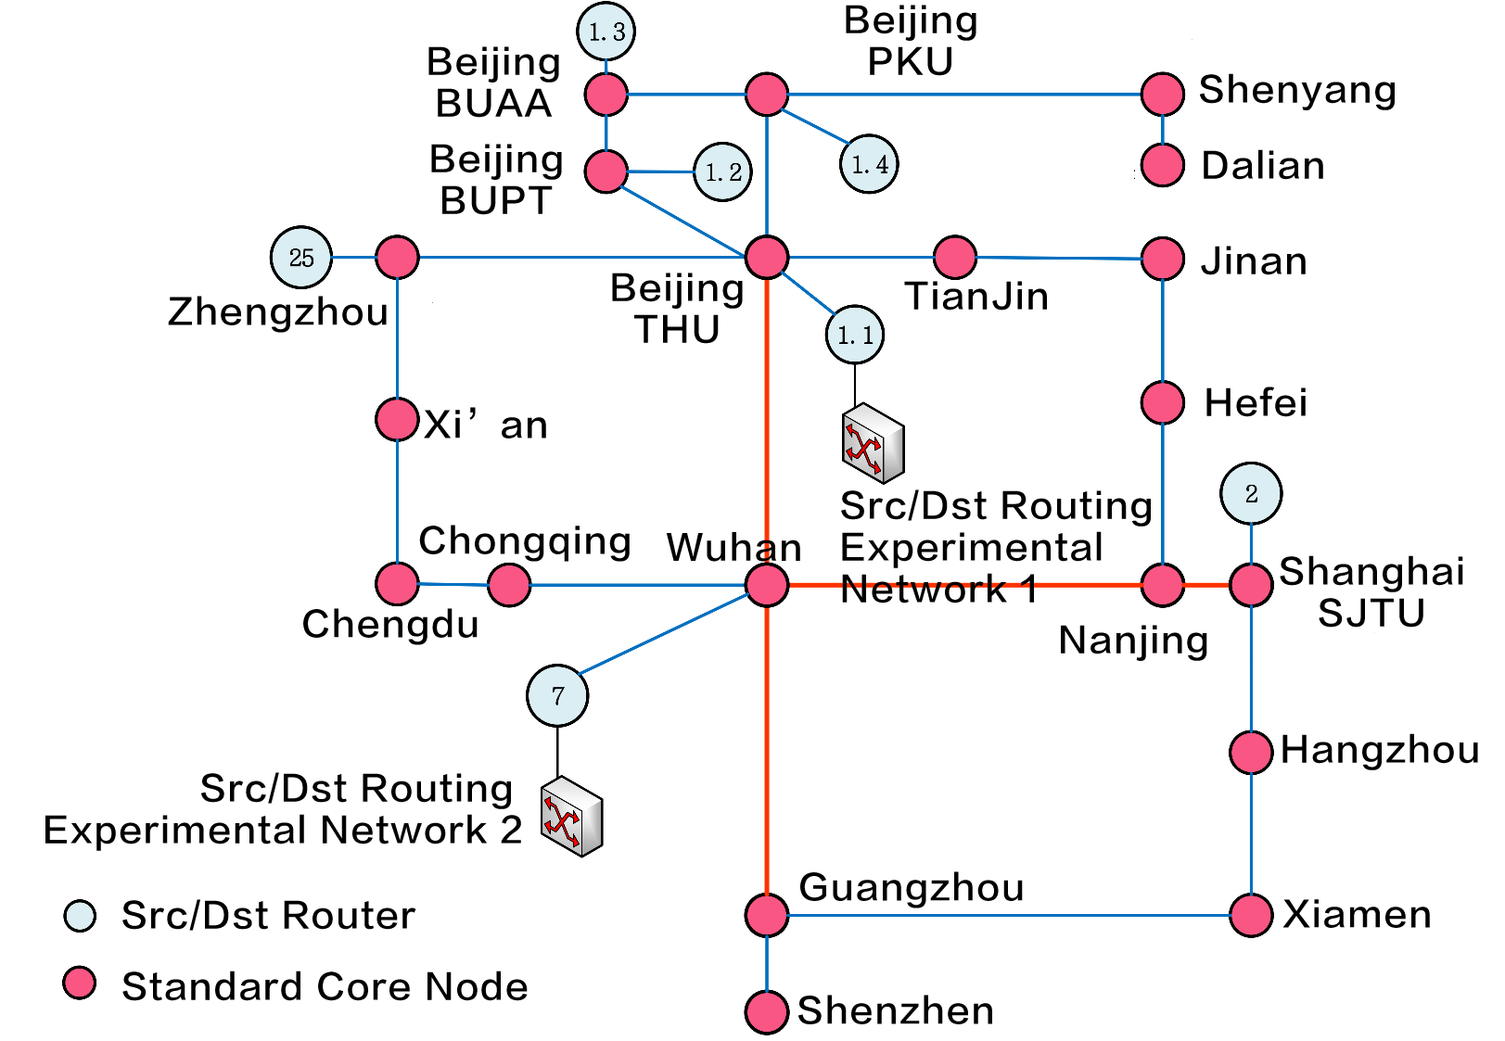
Deployment (1)
Future Internet Infrastructure
(CN research network project)
7 dst-src routers deployed &
tested; doing load balancing,
access control, multi-homing
and FRR

Slide 12
Deployment (2)
any OpenWRT router/CPE
  includes a whole bunch of OEMs shipping OpenWRT derivatives
  kernel/forwarding on by default,
  control plane support (=included packages) varies

Slide 13
Source address sel. interactions (1)
RFC6724 rule 5.5 keeps coming up
Rule 5.5: Prefer addresses in a prefix advertised by the next-hop.
If SA or SA's prefix is assigned by the selected next-hop that will
be used to send to D and SB or SB's prefix is assigned by a different
next-hop, then prefer SA. […]

Slide 14
Source address sel. interactions (2)
selected source address is persistent, happens at connection establishment
routing choice may or may not be sticky
  even if it is sticky, routing info can change
  if done extra poorly, chosen source address might flip which gateway
  is selected from equal options (e.g. part of LB hash) ⇒ self-break
    have not actually seen this, thankfully (hosts don’t ECMP on default routers)

Slide 15
Source address sel. interactions (3)
a dst/src routing table on the end host actually makes this work correctly
  when processing RA/PIO, install additional default routes with source prefix = PIO range
not described in draft…
  …yet (should it?)

Slide 16
Questions?

