Slide 1

MINI PROJECT 2026
LOCAL • VERIFIED • BOOK
LOCAL SERVICE
HUB
Local Service Booking Platform
A trusted platform to discover, compare and book verified local professionals.
TEAM MEMBERS
Aman Kumar
Prakash Kumar
Roll No. 2500970109004
Roll No. 2500970109017
Ayush Rathour
Akash Rai
Roll No. 2500970109005
Roll No. 2500970109003
B.Tech – Computer Science & Engineering (CSE-A)
Galgotias College of Engineering and Technology

Slide 2
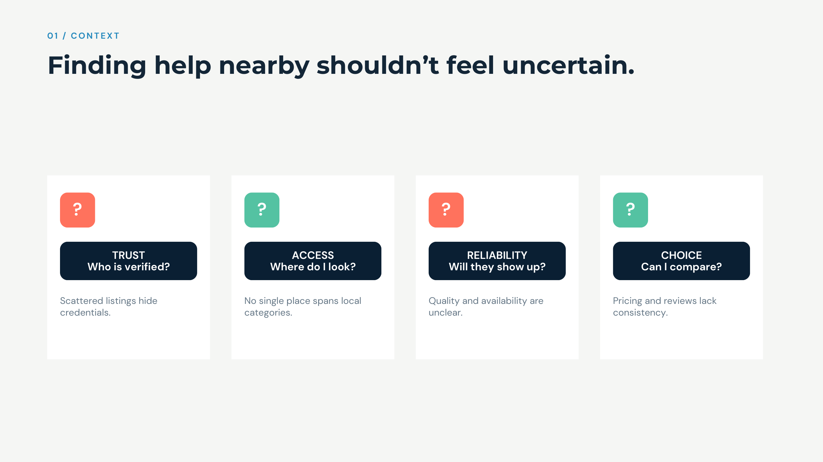

Slide 3
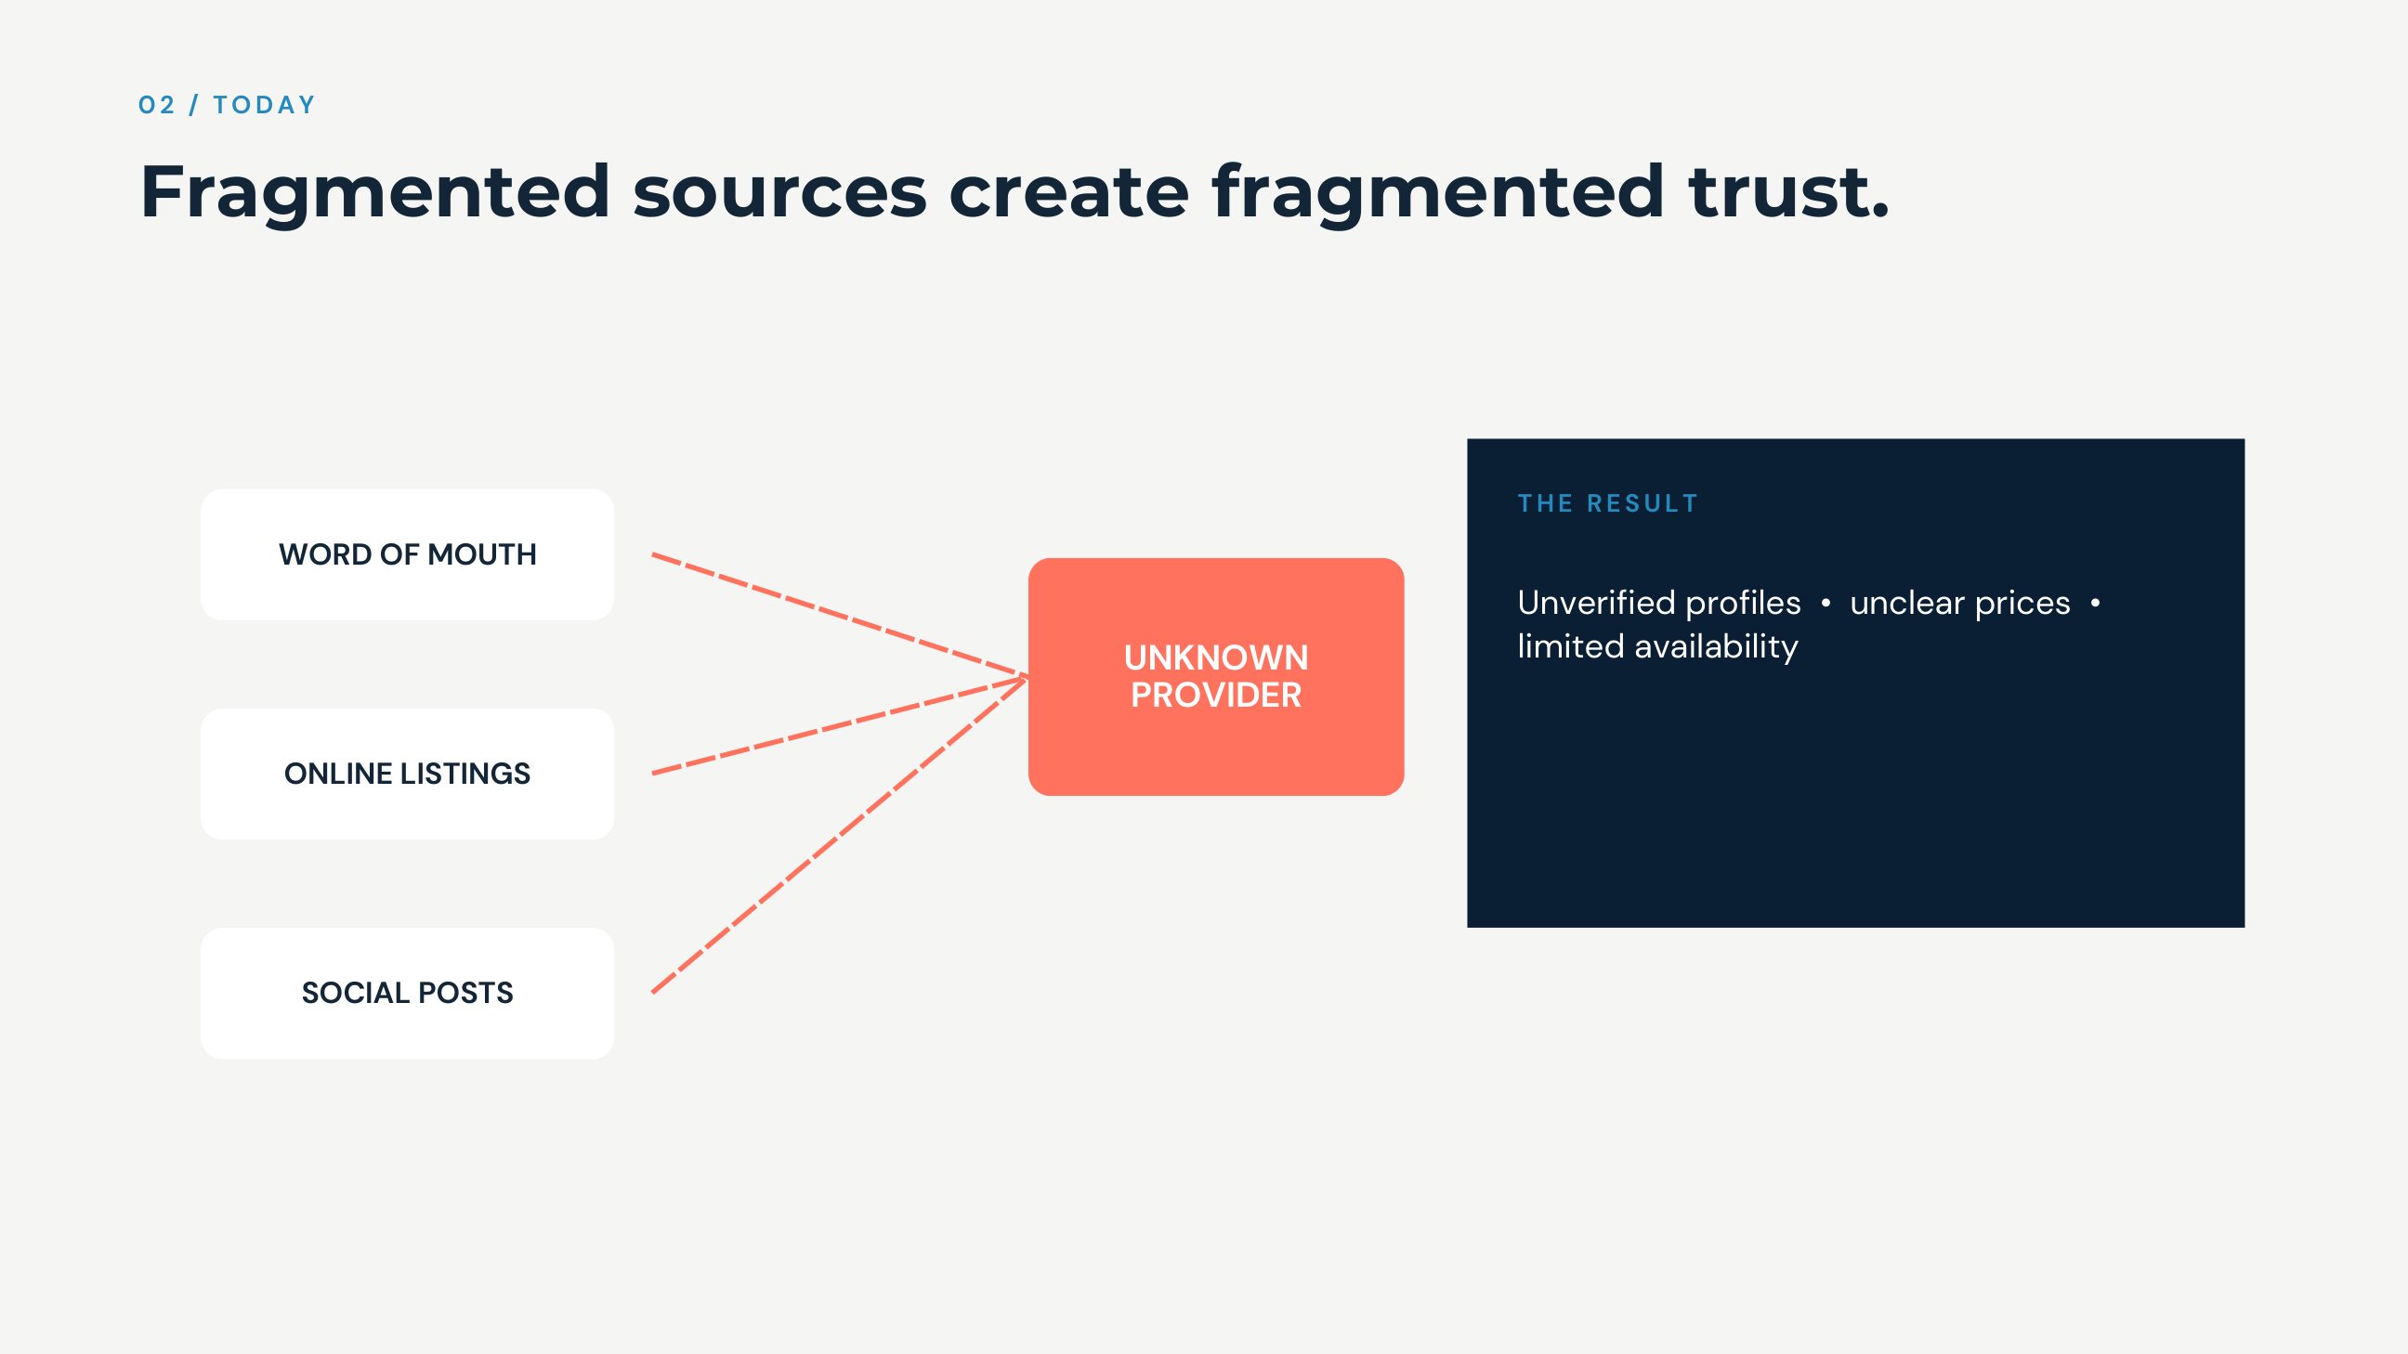

Slide 4
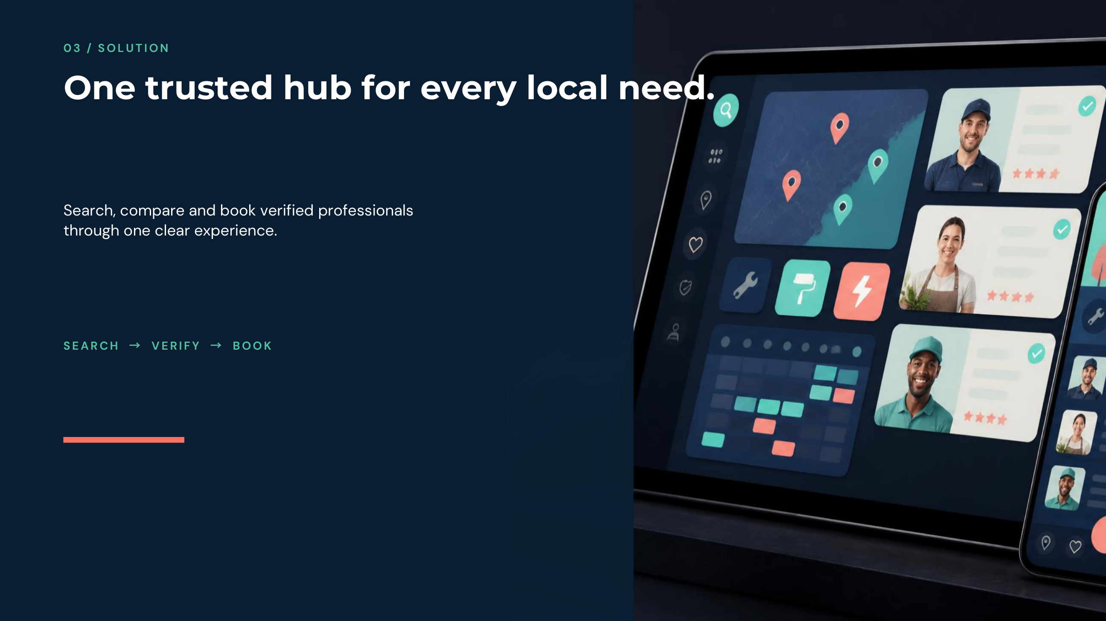

Slide 5
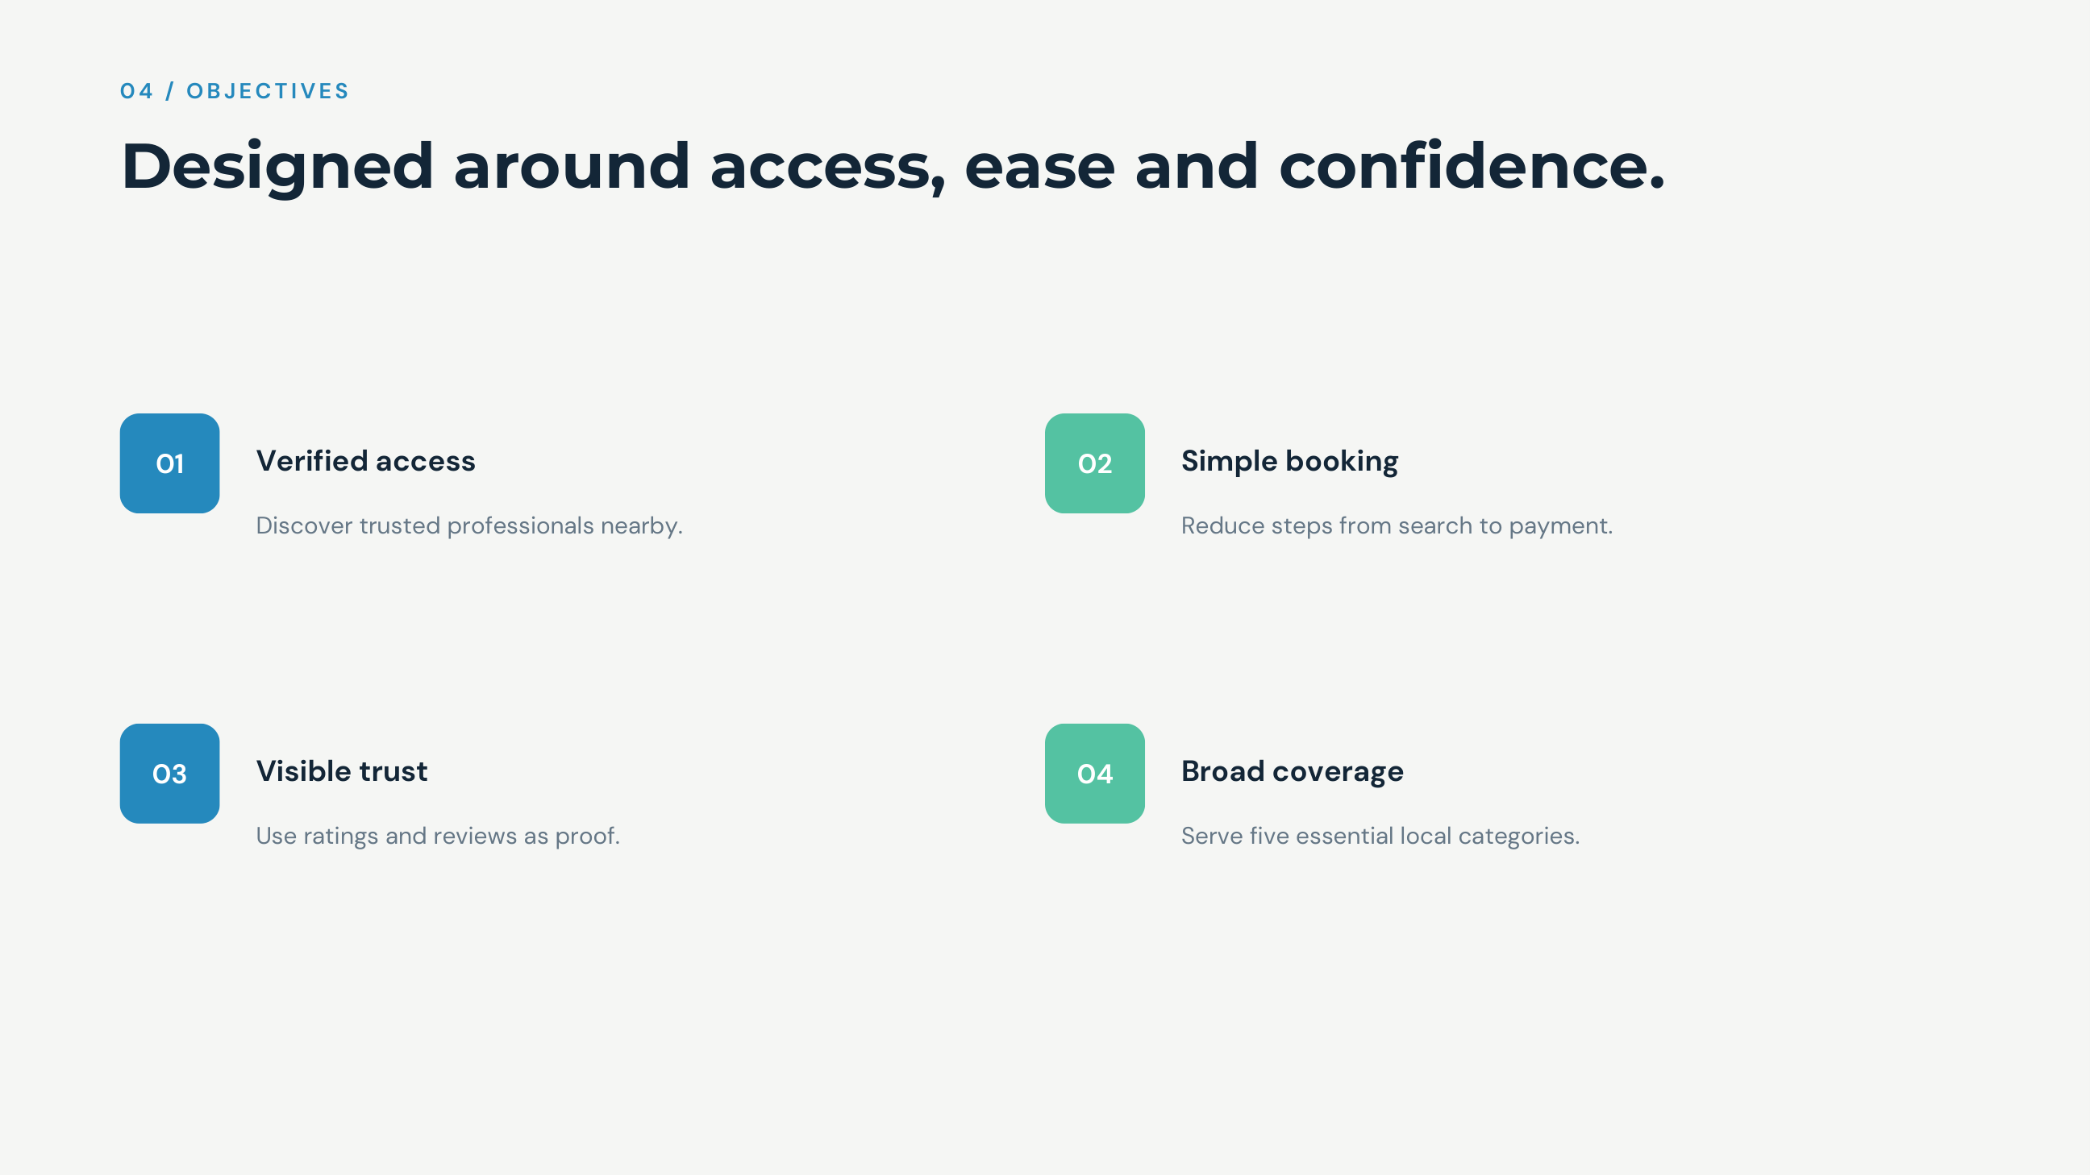

Slide 6
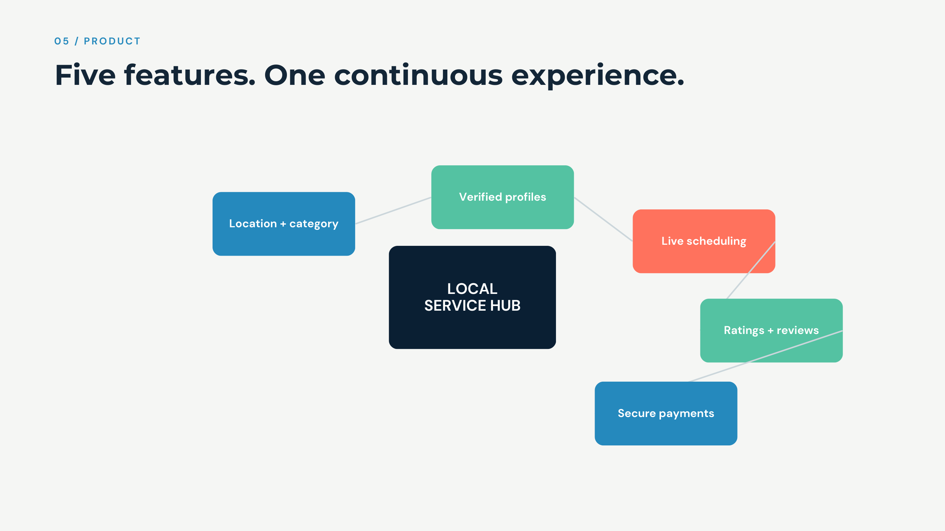

Slide 7
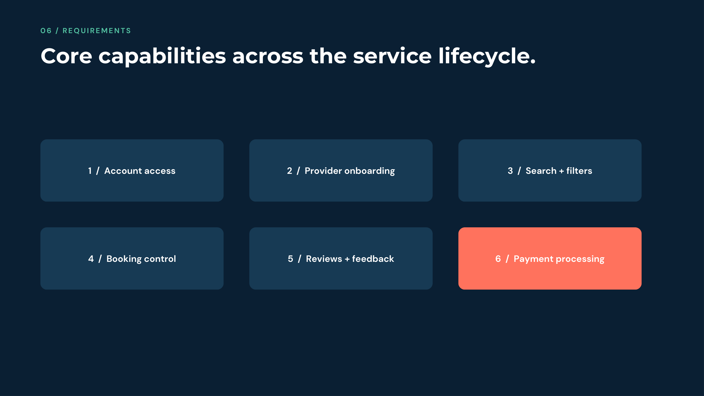

Slide 8
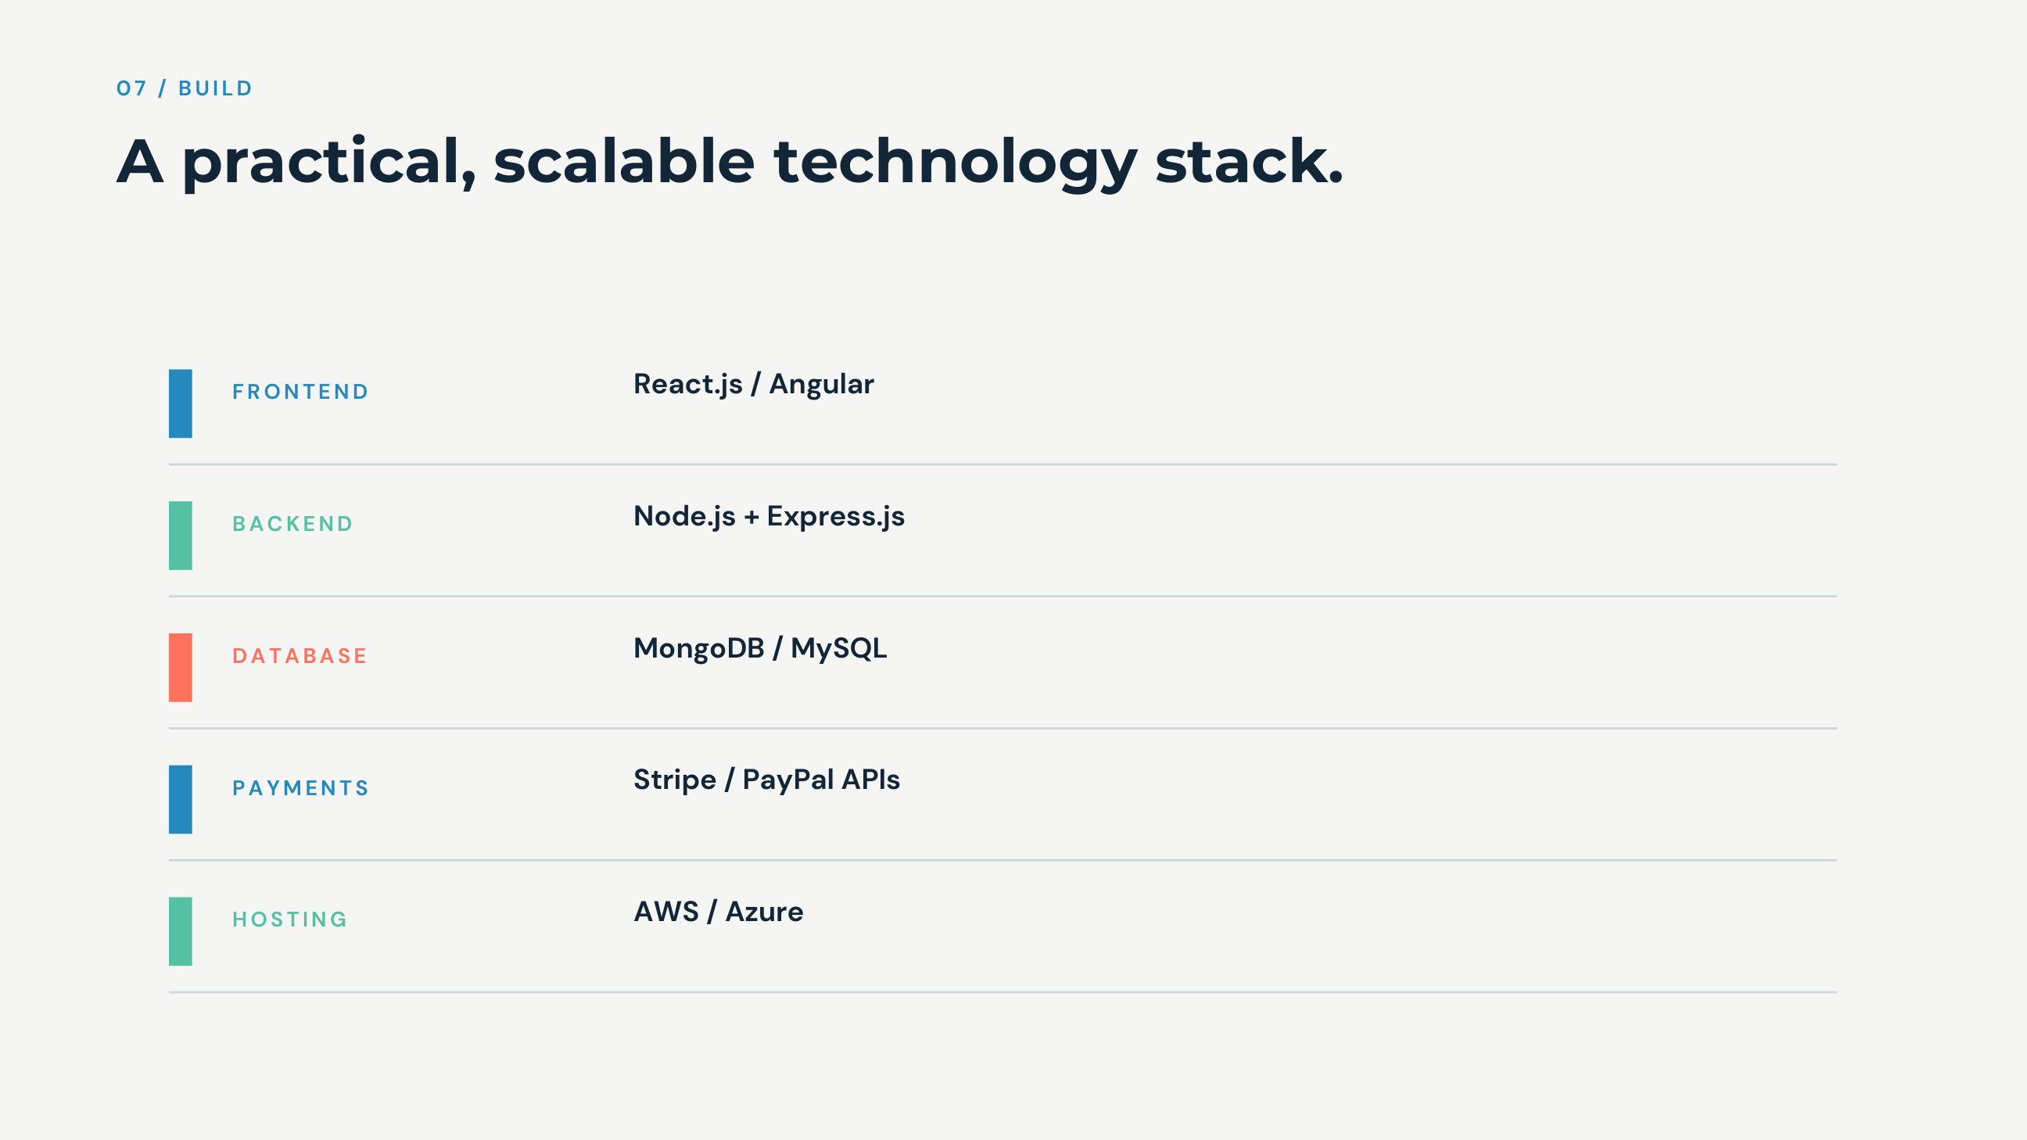

Slide 9
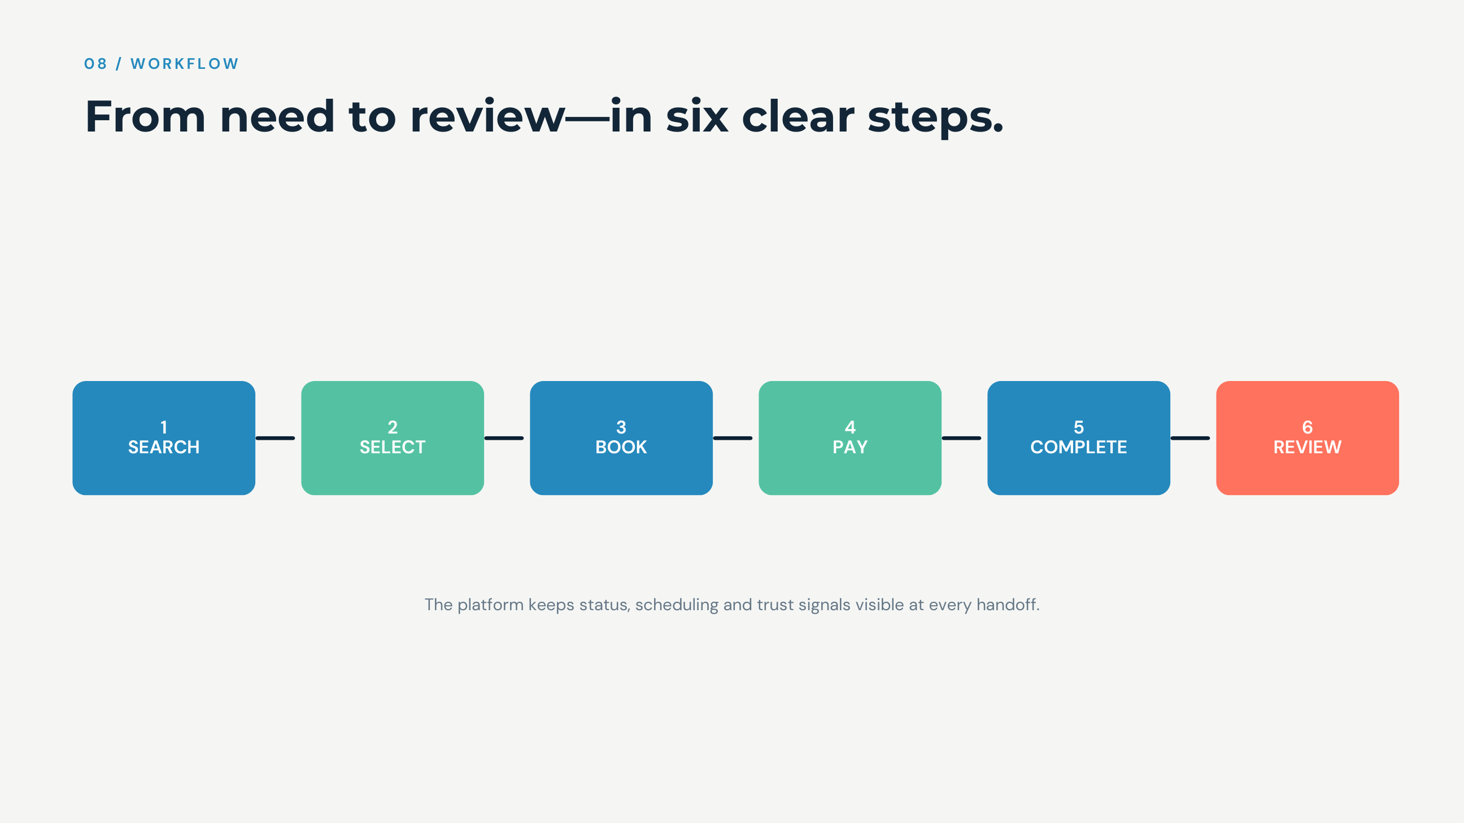

Slide 10
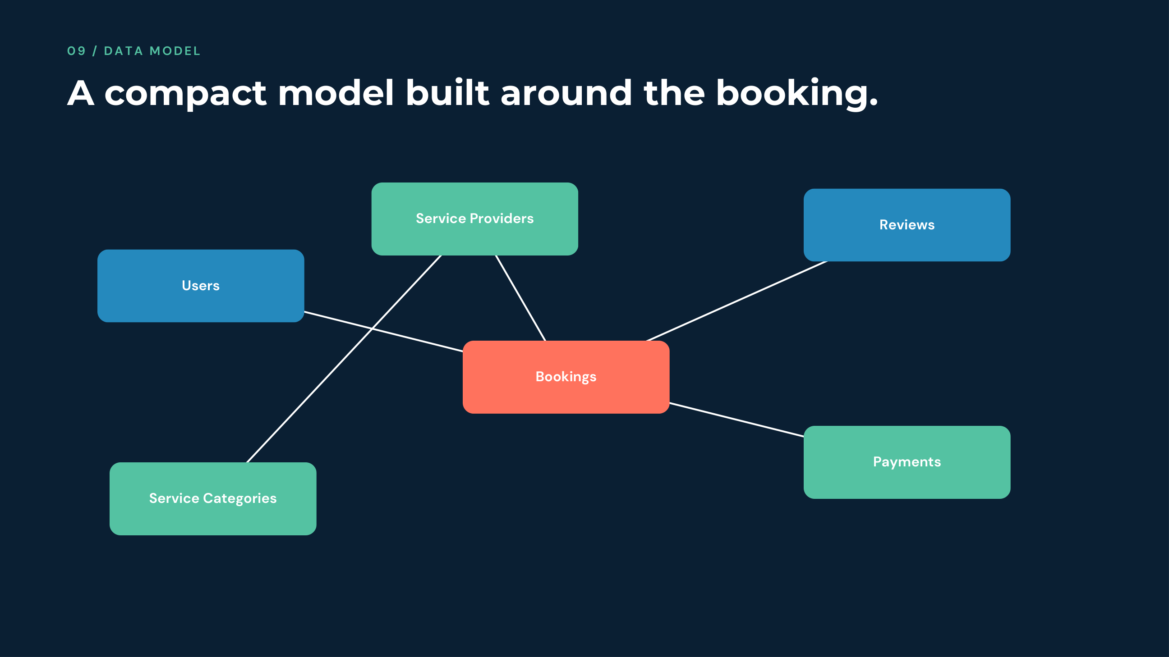

Slide 11
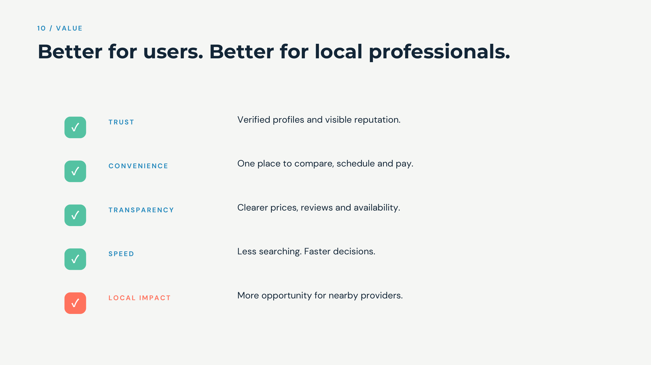

Slide 12


