Slide 1

SMART INDIA HACKATHON 2026
VERCEL
Problem Statement ID – 26179
Problem Statement Title – AI Powered Retail Intelligence Platform
Theme – Miscellaneous
PS Category – Hardware
Team ID – 166870
Team Name (Registered on portal) – VERCEL

Slide 2
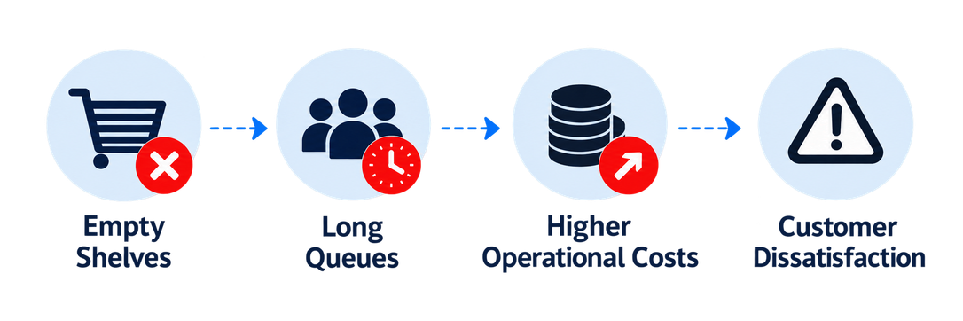
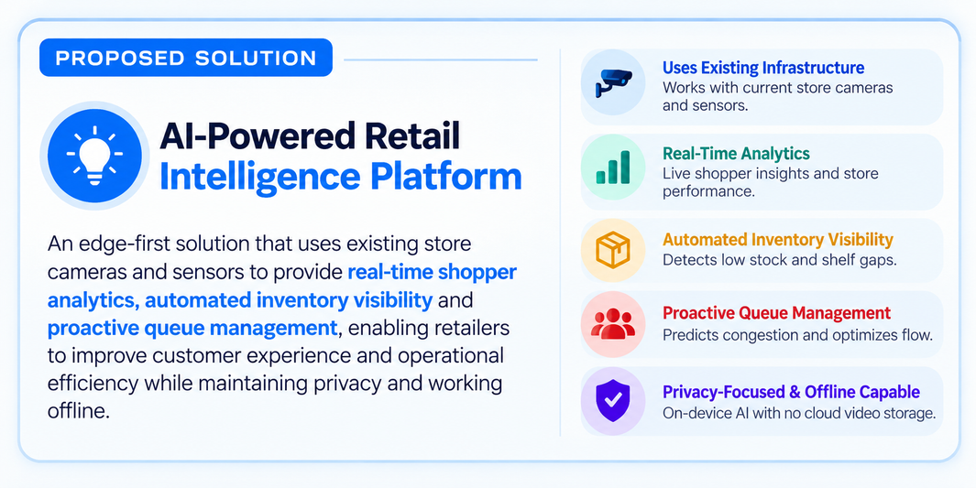
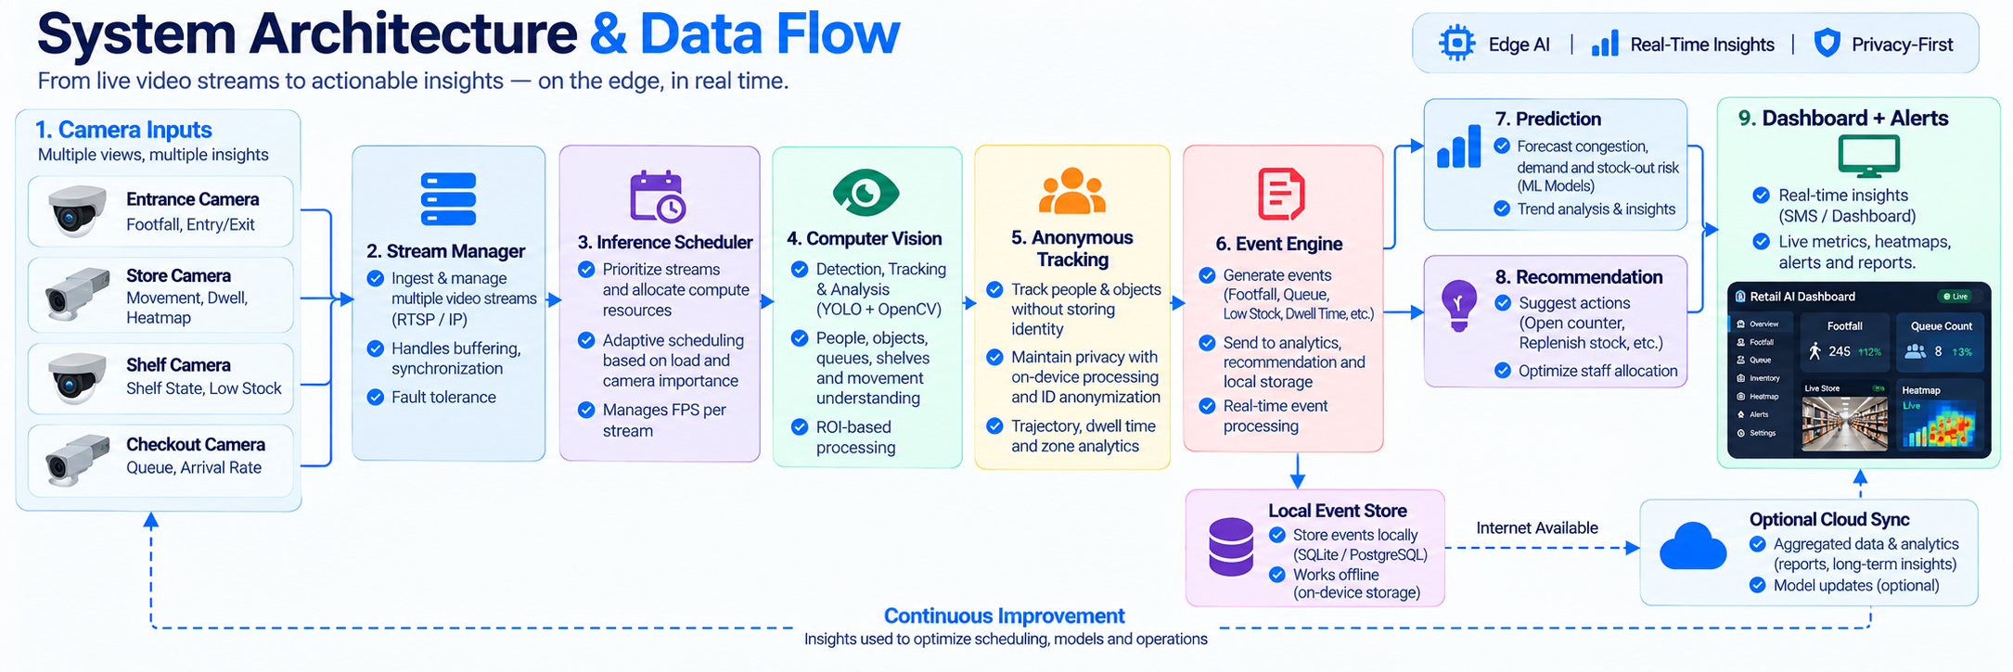
IDEA TITLE
Vercel
*Prototype
Detailed Report*
Stores currently lack the ability to track empty shelves,
customer movement, and long queues in real time.
Video
Report
Website
GitHub
Uses existing store cameras and processes data locally.
Detects empty shelves and long queues in real time.
Gives quick, privacy-safe alerts to staff.
Helps improve daily store operations.
Works with existing POS/ERP systems.
Poor staffing decisions increase operating costs.
Stores have limited visibility into shopper behavior.
Manual monitoring wastes staff time.
Weak connectivity makes cloud systems unreliable.
Privacy concerns limit customer tracking.

Slide 3
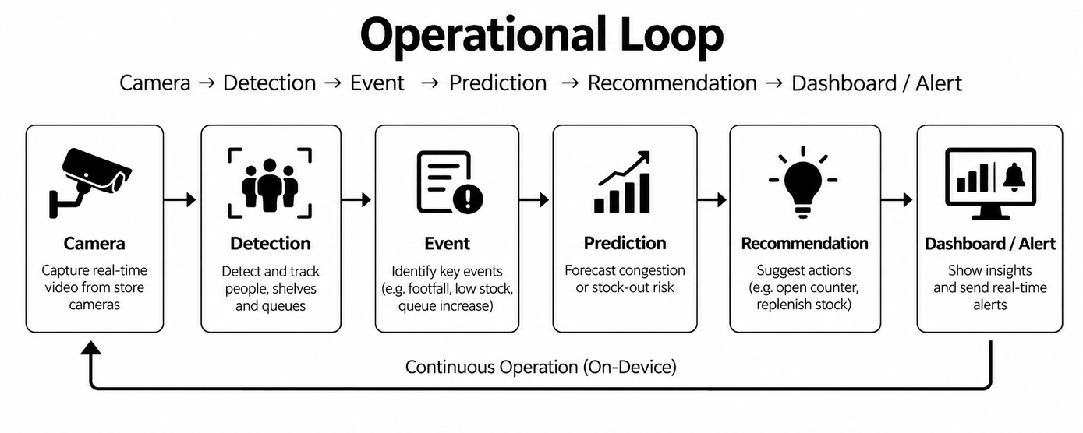

TECHNICAL APPROACH
Vercel

Slide 4
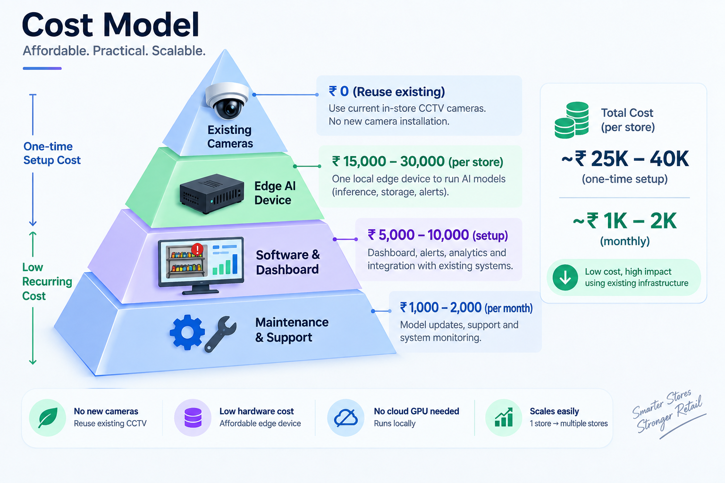
FEASIBILITY AND VIABILITY
Vercel

Slide 5
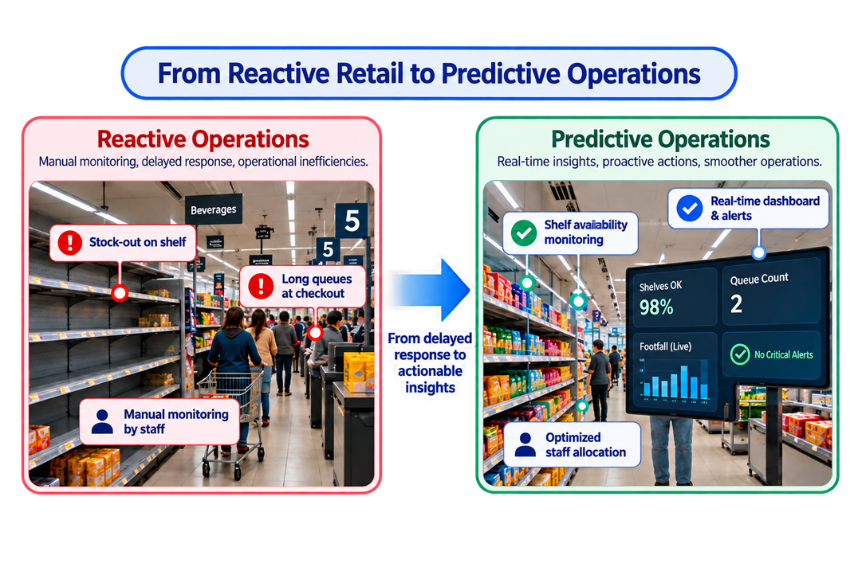
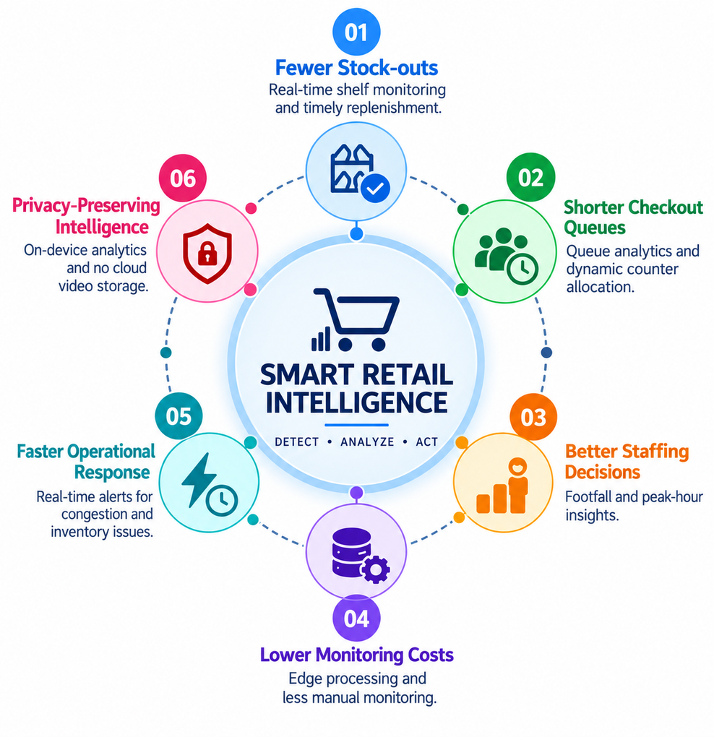
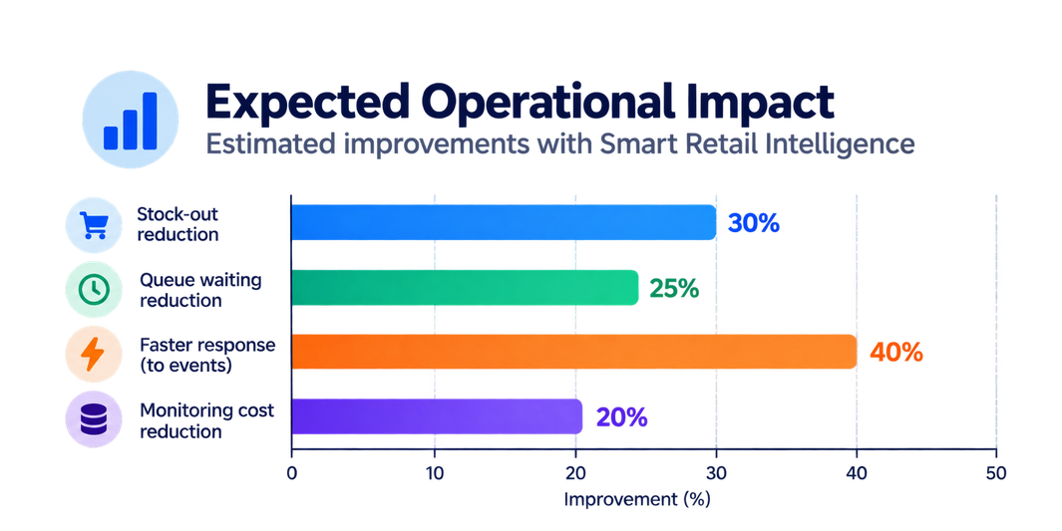
IMPACT AND BENEFITS
Vercel

Slide 6
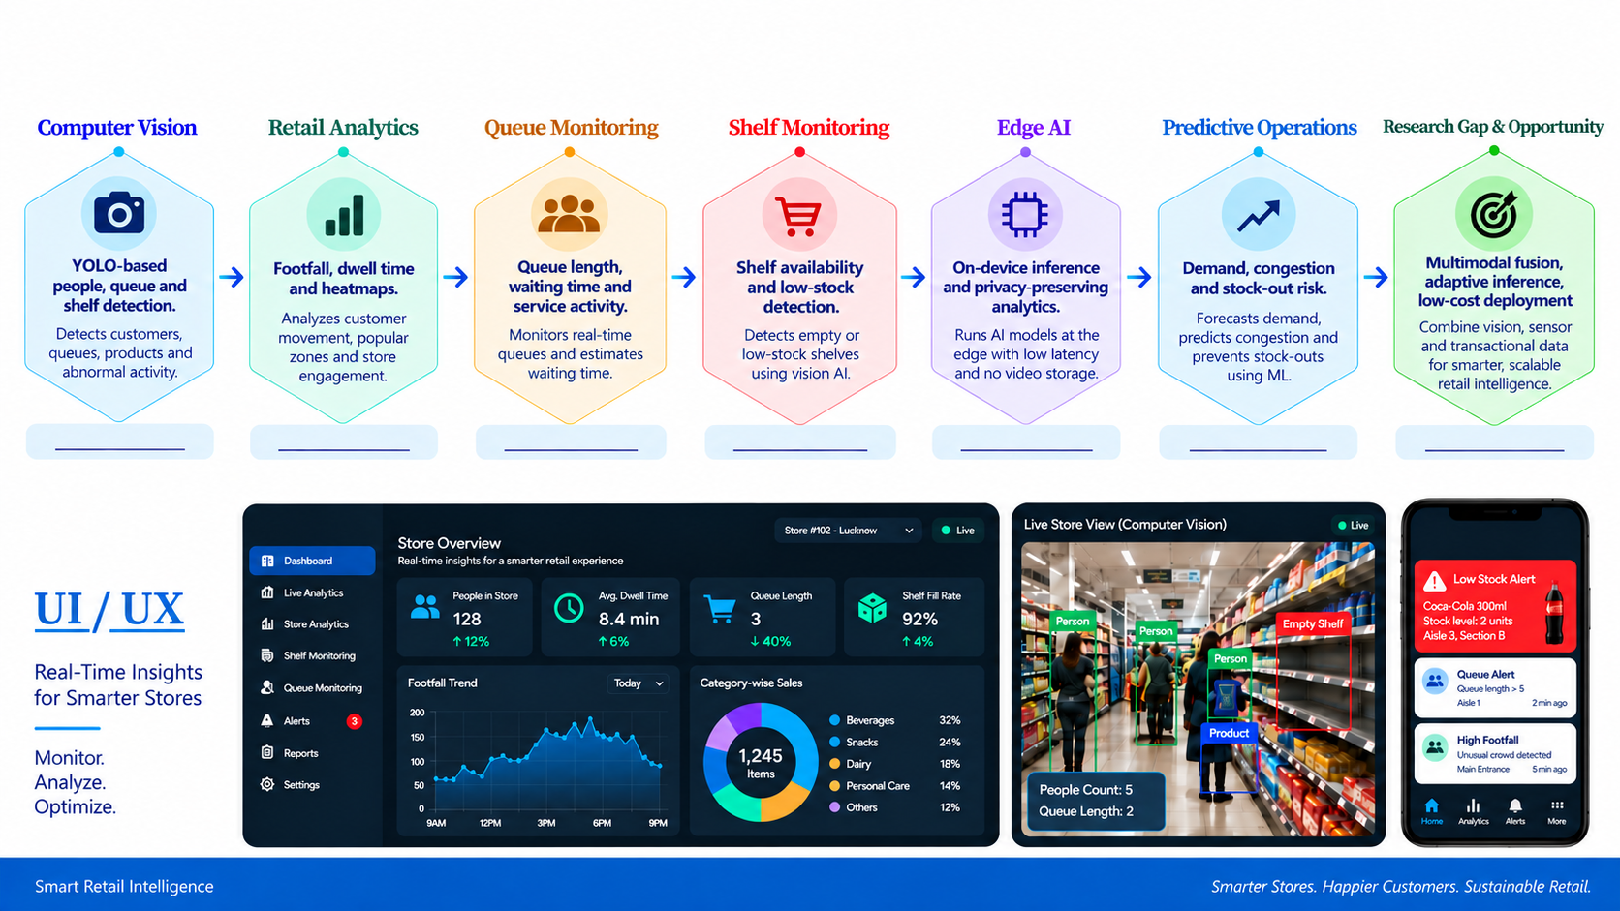
RESEARCH AND REFERENCES
Vercel
Docs Link
Inspiration
Docs Link
Dataset Link
Qualcomm
Paper Link
Paper Link

