Slide 1
Spring Data Repositories
Understanding Spring Data repositories
Using a Spring Data repository
Annex:
Accessing MongoDB
Demo project: demo-spring-data-repositories

Slide 2
1. Understanding Spring Data Repositories
Overview of Spring Data repositories
Spring Data repository capabilities
Paging and sorting
Technology-specific repositories
Domain-specific repositories

Slide 3
Overview of Spring Data Repositories
Spring Data is a data-access abstraction mechanism
Makes it very easy to access a wide range of data stores
Using a familiar "repository" pattern
Create / Read / Update / Delete (CRUD)
It provides template repositories for…
JPA
MongoDB, Cassandra, CouchBase
Etc.

Slide 4
Spring Data Repository Capabilities
Spring Data defines a general-purpose repository interface:
public interface CrudRepository<T,ID> extends Repository<T,ID> {
long count();
void delete(T entity);
void deleteAll();
void deleteAll(Iterable<T> entities);
void deleteById(ID id);
boolean existsById(ID id);
Iterable<T> findAll();
Iterable<T> findAllById(Iterable<ID> ids);
Optional<T> findById(ID id);
T save(T entity);
Iterable<T> saveAll(Iterable<T> entities);
}

Slide 5
Paging and Sorting
Support for paging and sorting is provided via this interface:
public interface PagingAndSortingRepository<T,ID> extends Repository<T,ID> {
Page<T> findAll(Pageable pageable);
Iterable<T> findAll(Sort sort);
}

Slide 6
Technology-Specific Repositories
Spring Data also provides technology-specific repositories
Provide technology-specific extensions
<<interface>>
CrudRepository
<<interface>>
PagingAndSortingRepository
<<interface>>
JpaRepository
<<interface>>
MongoRepository
<<interface>>
CouchBaseRepository
etc.

Slide 7
Domain-Specific Repositories
You can define your own domain-specific interfaces
Extend CrudRepository (or sub-interface)
Specify the entity type and the PK type
You can define specific query methods for your entities
Spring Data reflects on method names to create queries
You can provide an explicit query string for complex queries
See next section for an example…

Slide 8
2. Using a Spring Data Repository
Overview
Defining a repository
Locating Spring Data repositories
Using a Spring Data repository
Demo package: demo.springdatarepositories

Slide 9
Overview
In this section we'll see how to access a relational database by using a Spring Data repository
Note the following key points in the demo first:
pom.xml
application.properties
Employee.java
SeedDb.java

Slide 10
Defining a Repository
Here's an example of a domain-specific repository:
Note:
Entity type is Employee, PK type is Long
Also, we've defined some custom queries
public interface EmployeeRepository extends CrudRepository<Employee, Long> {
List<Employee> findByRegion(String region);
@Query("select e from Employee e where e.dosh >= ?1 and e.dosh <= ?2")
List<Employee> findInSalaryRange(double from, double to);
Page<Employee> findByDoshGreaterThan(double salary, Pageable pageable);
}
EmployeeRepository.java

Slide 11
Locating Spring Data Repositories
A Spring Boot application scans for Spring Data JPA repository interfaces when it starts
It looks in the main application class package, plus sub-packages
You can tell it to look elsewhere, if you like
Via @EnableJpaRepositories
import org.springframework.data.jpa.repository.config.EnableJpaRepositories;
…
@SpringBootApplication
@EnableJpaRepositories({"repopackage1", "repopackage2"})
public class Application {
…
}

Slide 12
Using a Spring Data Repository (1 of 2)
Let's see how to use some standard repository methods:
@Component
public class EmployeeService {
@Autowired
private EmployeeRepository repository;
public void useStandardRepoMethods() {
// Insert an employee.
Employee newEmp = new Employee(-1, "Simon Peter", 10000, "Israel");
newEmp = repository.save(newEmp);
System.out.printf("Inserted employee, id %d\n", newEmp.getEmployeeId());
// Get count of all employees.
System.out.printf("There are now %d employees\n", repository.count());
// Get all employees.
displayEmployees("All employees: ", repository.findAll());
}
…
}
EmployeeService.java

Slide 13
Using a Spring Data Repository (2 of 2)
Let's see how to use our custom queries in the repository:
@Component
public class EmployeeService {
@Autowired
private EmployeeRepository repository;
public void useCustomQueryMethods() {
// Get all employees by region.
displayEmployees("All employees in London: ", repository.findByRegion("London"));
// Get employees by salary range.
List<Employee> emps = repository.findInSalaryRange(20000, 50000);
displayEmployees("Employees earning 20k to 50k: ", emps);
// Get a page of employees.
Pageable pageable = PageRequest.of(1, 3, Direction.DESC, "dosh");
Page<Employee> page = repository.findByDoshGreaterThan(50000, pageable);
displayEmployees("Page 1 of employees more than 50k: ", page.getContent());
}
}
EmployeeService.java

Slide 14
Summary
Understanding Spring Data repositories
Using a Spring Data repository

Slide 15
Annex: Accessing MongoDB
What is MongoDB?
Getting MongoDB
Using MongoDB in Spring Boot
Spring Boot APIs for MongoDB
Defining a MongoDB entity class
Defining a repository
Seeding the MongoDB database
Other useful info about the demo app
Demo project: demo-spring-data-mongodb

Slide 16
Overview of MongoDB (1 of 2)
MongoDB is an open-source document database
In MongoDB, a document is a BSON object ("binary JSON")
A document contains fieldname/value pairs
Values can be simple types, arrays, or nested documents
Here's an example of a MongoDB document:
{
name: "Kari Nordmann",
age: 25,
skills: [ "Java", "Spring Boot", "Cobol" ],
additionalInfo: {
nationality: "Norsk",
companyCar: {
make: 'Bugatti',
model: 'Divo'
}
}
}

Slide 17
Overview of MongoDB (2 of 2)
High performance
Via indexes
Rich query language for CRUD operations
Data aggregation
Text search and queries
High availability
Via automatic failover and data redundancy
Horizontal scalability across a cluster
Via sharding

Slide 18
Getting MongoDB for Mac (1 of 2)
Open a Terminal window and type the following:
After downloading Mongo, create the "db" directory
This is where the Mongo data files will live
You can create the directory in the default location as follows:
Make sure the /data/db directory has correct permissions
brew update
brew install mongodb
mkdir -p /data/db
> sudo chown -R `id -un` /data/db
> # Enter your password

Slide 19
Getting MongoDB for Mac (2 of 2)
Run the Mongo daemon as follows:
Then open another Terminal window and run the Mongo shell as follows:
You can then enter commands in the Mongo shell to create data, query data, etc.
When you're ready to stop:
To exit the mongo shell, type quit()
To stop the Mongo daemon, hit ctrl+c
mongod6
mongo

Slide 20
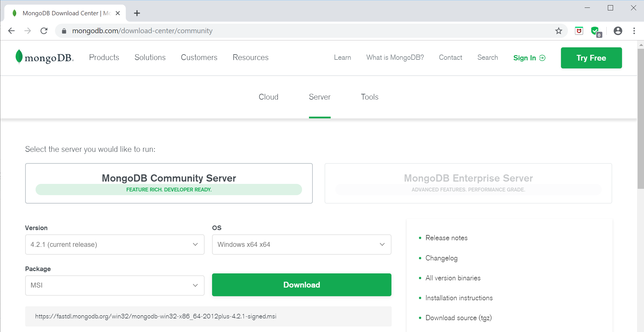
Getting MongoDB for Windows (1 of 5)
This section shows how to install MongoDB Community Edition on Windows…
Requires Windows Server 2008 R2, Windows Vista, or later
Go to the download page for MongoDB Community Edition
https://www.mongodb.com/download-center#community

Slide 21
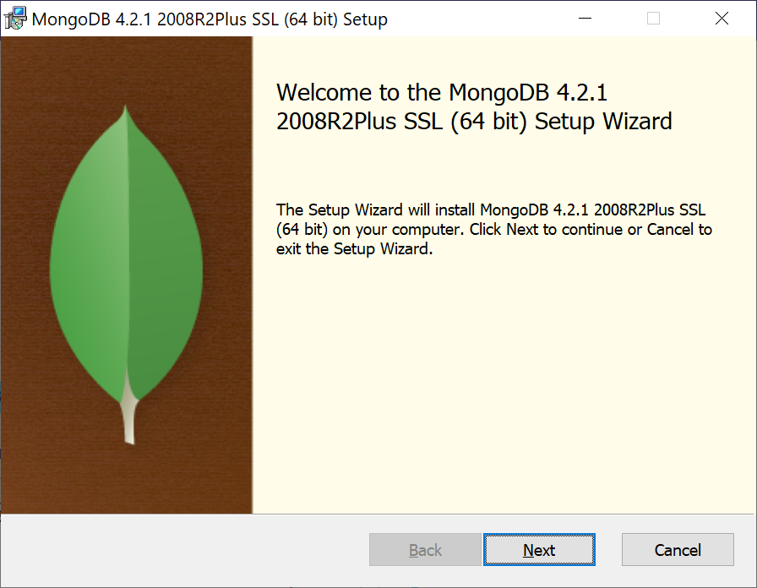
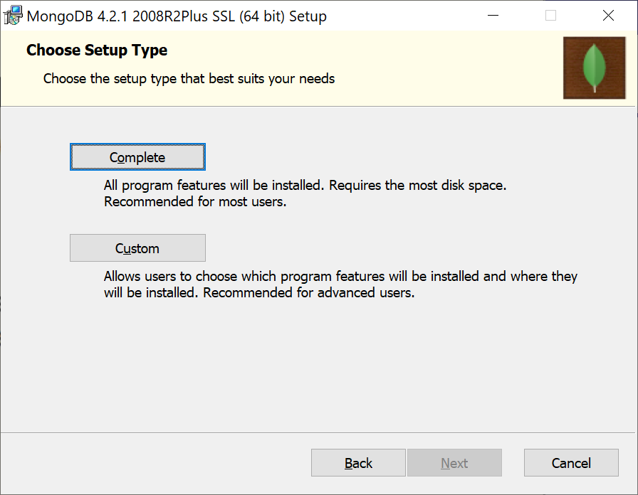
Getting MongoDB for Windows (2 of 5)
When the MongoDB msi has downloaded, run it

Slide 22
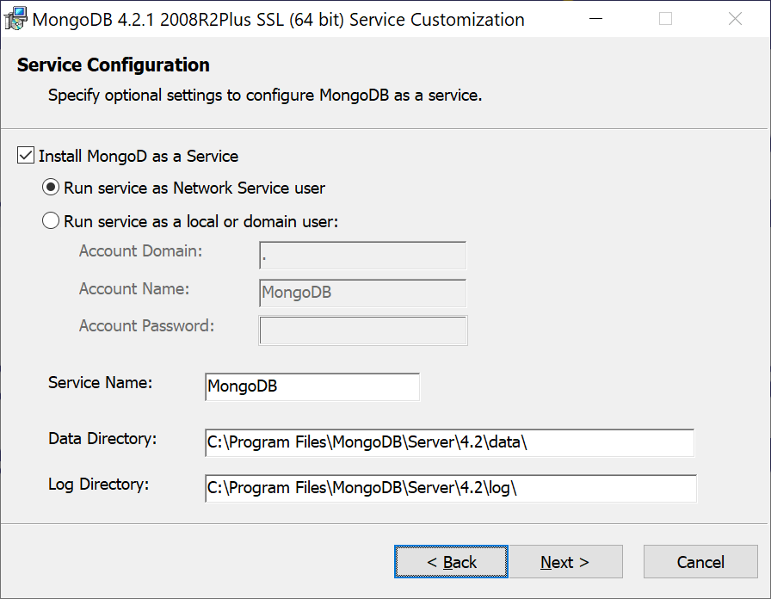
Getting MongoDB for Windows (3 of 5)
It's possible to install MongoDB as a Windows Service
MongoDB starts automatically when the machine boots up
MongoDB requires a data directory to store all data
You can accept the default location, or specify a different location

Slide 23
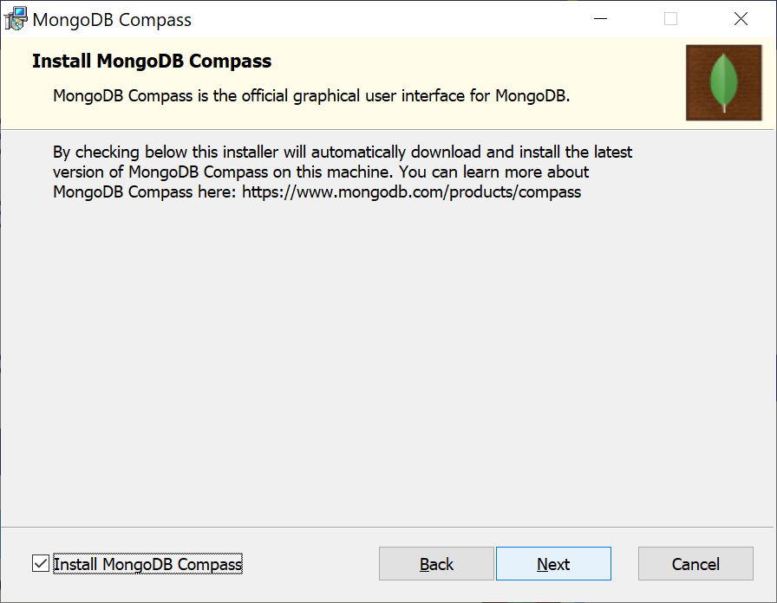
Getting MongoDB for Windows (4 of 5)
You can choose to install MongoDB Compass
The official IDE for managing MongoDB
Deselect this option if Compass is already installed, or if you want to install it later

Slide 24
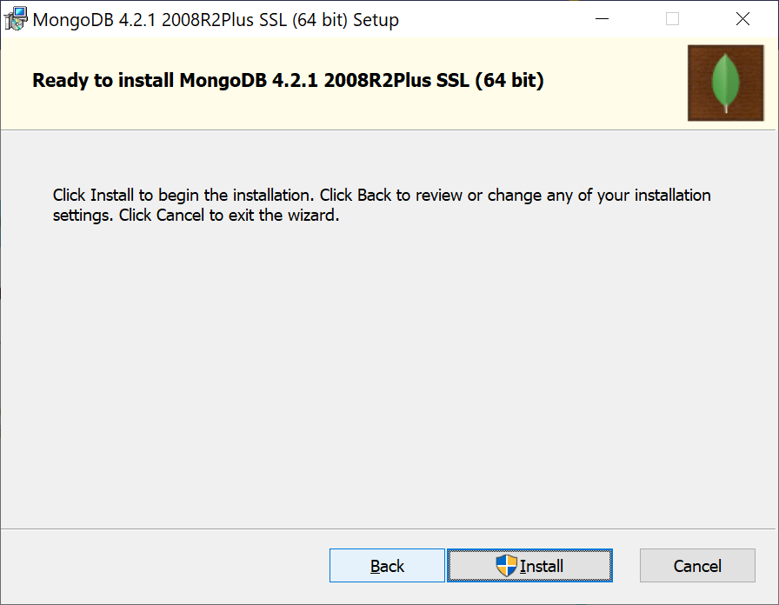
Getting MongoDB for Windows (5 of 5)
Proceed to begin the installation

Slide 25
Using MongoDB in Spring Boot
Now let's see how to access MongoDB databases in a Spring Boot application
You need the following Maven dependency:
By default, Spring Boot assumes the following URI to connect to MongoDB (you can customize if necessary)
<dependency>
<groupId>org.springframework.boot</groupId>
<artifactId>spring-boot-starter-data-mongodb</artifactId>
</dependency>
pom.xml in demo project
spring.data.mongodb.uri=mongodb://localhost:27017/test
application.properties

Slide 26
Spring Boot APIs for MongoDB
Spring Boot has a MongoTemplate class
Allows you to perform low-level MongoDB operations
Similar purpose to JdbcTemplate (for low-level JDBC operations)
Alternatively you can use Spring Data Repositories, similar to the JPA Data Repository earlier
Define an interface that extends CrudRepository
Declare method signatures, representing the queries you need
Spring Data implements the methods automatically, using MongoTemplate under the covers
We'll take this approach…

Slide 27
Defining a MongoDB Entity Class
If you're using Spring Data Repositories to access MongoDB, you must define MongoDB entity classes
Similar to JPA entity classes, but note the differences highlighted:
import org.springframework.data.annotation.Id;
import org.springframework.data.mongodb.core.mapping.Field;
public class Employee {
@Id
private long employeeId = -1;
private String name;
private String region;
@Field("salary")
private double dosh;
…
}
Employee.java

Slide 28
Defining a Repository
A Spring Data repository for MongoDB is very similar to any other Spring Data repository
But note, the @Query annotation uses MongoDB query syntax!
Note:
We extended MongoRepository, for reasons explained here: https://docs.spring.io/spring-data/jpa/docs/current/reference/html/ #repositories.multiple-modules
import org.springframework.data.mongodb.repository.MongoRepository;
import org.springframework.data.mongodb.repository.Query;
public interface EmployeeRepository extends MongoRepository<Employee,Long> {
List<Employee> findEmployeesByRegion(String region);
@Query("{'dosh' : {$gte : ?0, $lte : ?1}}")
List<Employee> findEmployeesInSalaryRange(double from, double to);
Page<Employee> findEmployeesByDoshGreaterThan(double salary, Pageable pageable);
}
EmployeeRepository.java

Slide 29
Seeding the Database
We've defined a SeedDb component to create MongoDB documents at startup, and to delete them at the end
@Component
public class SeedDb {
@Autowired
private EmployeeRepository repository;
@PostConstruct
public void init() {
repository.save(new Employee(1, "James", 21000, "London"));
repository.save(new Employee(2, "Marie", 22000, "Edinburgh"));
repository.save(new Employee(3, "Peter", 23000, "Belfast"));
…
}
@PreDestroy
public void cleanup() {
repository.deleteAll();
}
}
SeedDb.java

Slide 30
Other Useful Info About the Demo App
The MongoDB demo app is semantically equivalent to the JPA repository example earlier in the course
In fact, EmployeeService.java is identical to the JPA example
About the demo app:
The demo creates Employee documents in the MongoDB database, manipulates them, and then deletes them at the end
All these tasks are achieved using the high-level Spring Data repository for MongoDB - nice ☺
Note:
MongoDB must be running when you run the demo (!)

Slide 31

Exercise
We've seen how to define a custom "select" method
Annotate a method with @Query
Specify a "select" JPQL string
It's also possible to define a custom "modifying" method
Annotate with @Query, @Modifying, @Transactional
Specify an "insert", "update", or "delete" JPQL string
public interface EmployeeRepository extends CrudRepository<Employee, Long> {
@Query("delete from Employee e where e.dosh >= ?1 and e.dosh <= ?2")
@Modifying(clearAutomatically=true)
@Transactional
int deleteInSalaryRange(double from, double to);
…
}

