Slide 1
Additional REST Service Techniques
Consuming REST services
Microservice architecture
Circuit breakers

Slide 2
1. Consuming REST Services
Overview
Key methods in RestTemplate
Example
Key classes in the REST client application
Aside: Consuming a REST service via WebClient
Aside: Consuming a REST service from HTML

Slide 3
Overview
Spring enables you to implement client code to consume REST services
Via the RestTemplate class
Include the following POM dependency:
<dependency>
<groupId>org.springframework.boot</groupId>
<artifactId>spring-boot-starter-web</artifactId>
</dependency>
pom.xml

Slide 4
Key Methods in RestTemplate
Here are some of the key methods in RestTemplate:
ResponseEntity<T> getForEntity(String, Class<T>, Object...)
ResponseEntity<T> postForEntity(String, Object, Class<T>, Object...)
void put(String, Object, Object...)
void delete(String, Object...)
ResponseEntity<T> exchange(String, HttpMethod, object, Class<T>)

Slide 5
Example
Let's see an example of how to consume REST endpoints:
REST request
REST client
MyRestClient
REST service
/full/products
REST response
demo-consumingrest-client
http://localhost:8181
demo-consumingrest-service
http://localhost:8080

Slide 6
Key Classes in the REST Client Application
MyRestClient
Calls REST service endpoints, by using RestTemplate
Product
Product objects passed to/from REST service
Serialized/deserialized by RestTemplate

Slide 7
Aside: Consuming a REST Service via WebClient
We've seen how to use RestTemplate
This is synchronous (the client blocks until the response is in)
An alternative approach is to use WebClient
Can be synchronous or asynchronous
Well suited to calling reactive REST services (WebFlux)
Requires this dependency:
See MyRestClientViaWebClient.java
<dependency>
<groupId>org.springframework.boot</groupId>
<artifactId>spring-boot-starter-webflux</artifactId>
</dependency>
pom.xml

Slide 8
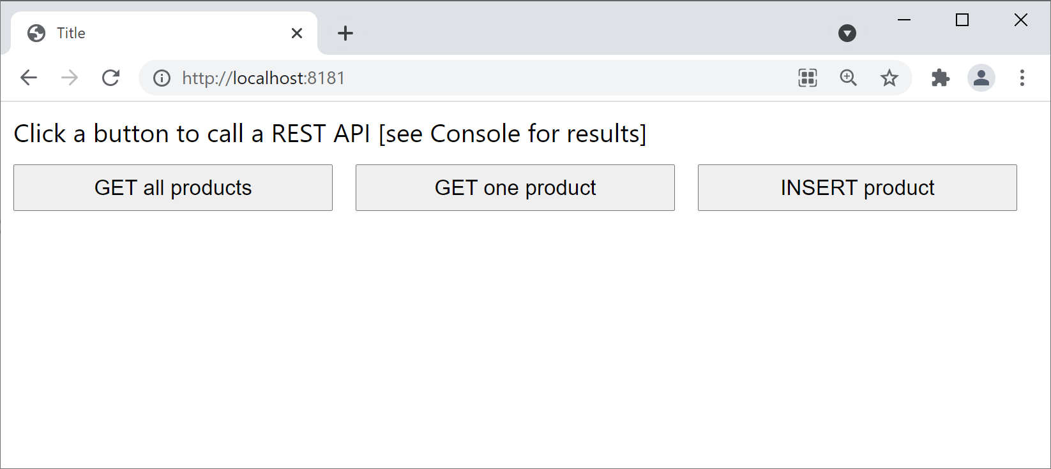
Aside: Consuming a REST service from HTML
We've also implemented a simple HTML page to show how to consume a REST service from a web UI
project: demo-consumingrest-client
Folder: src/main/resources/static
Open a browser and browse to http://localhost:8181

Slide 9
2. Microservice Architecture
What are microservices
Microservice application example
Implementing the catalog service
Implementing the client service

Slide 10
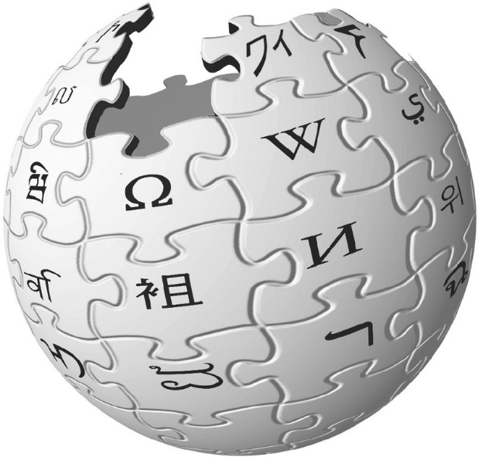
What are Microservices?
According to Wiki:
Microservices is a specialisation of an implementation approach for service-oriented architectures (SOA) used to build flexible, independently deployable software systems.
Services in a microservice architecture (MSA) are processes that communicate with each other over a network in order to fulfil a goal. These services use technology-agnostic protocols.
The microservices approach is a first realisation of SOA that followed the introduction of DevOps and is becoming more popular for building continuously deployed systems.

Slide 11
Microservice Application Example
Let's see a complete (simple) example of how to create a microservice application
There are two Spring Boot applications in the demo:
demo-msa-clientservice
demo-msa-catalogservice
client service
catalog service

Slide 12
Implementing the Catalog Service (1 of 2)
The "catalog" service is a Spring Boot application with a REST service that returns catalog info
See demo-msa-catalogservice
The server.port property is 8081
Take a look at the endpoints in CatalogController:
/catalog
/catalog/{index}

Slide 13
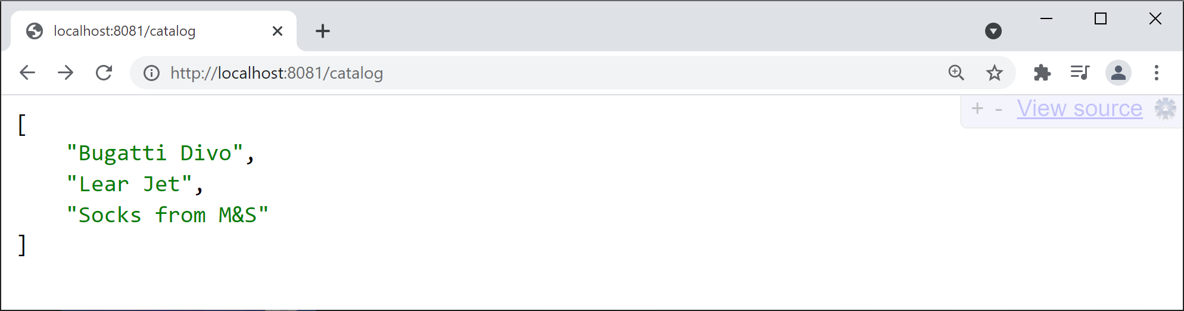
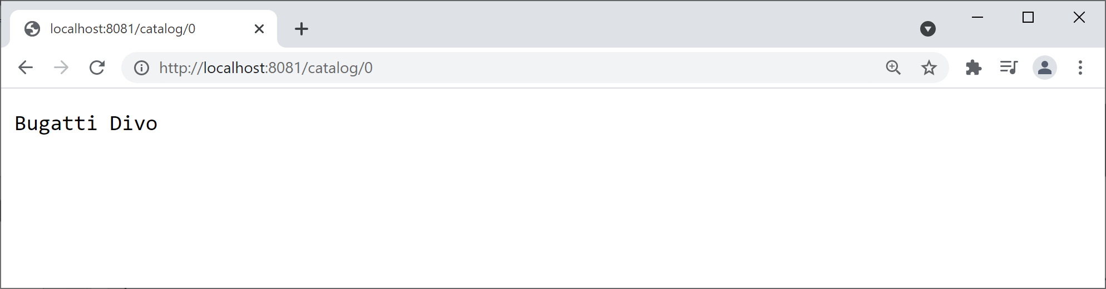
Implementing the Catalog Service (2 of 2)
Run the catalog app and ping the following URLs…
http://localhost:8081/catalog
http://localhost:8081/catalog/0

Slide 14
Implementing the Client Service (1 of 3)
The "client" service is another Spring Boot application with a REST service
See demo-msa-clientservice
The server.port property is 8080
Take a look at the endpoint in ClientController:
/client/{index}

Slide 15
Implementing the Client Service (2 of 3)
The "client" service invokes the "catalog" service
Using a Spring RestTemplate
@RestController
public class ClientController {
@GetMapping("/client/{index}")
public String getItem(@PathVariable int index){
URI catalogUrl = URI.create("http://localhost:8081/catalog/" + index);
RestTemplate restTemplate = new RestTemplate();
String result = restTemplate.getForObject(catalogUrl, String.class);
return String.format("[%s] Item %d %s", LocalTime.now(), index, result);
}
}
HTTP request
Catalog service

Slide 16
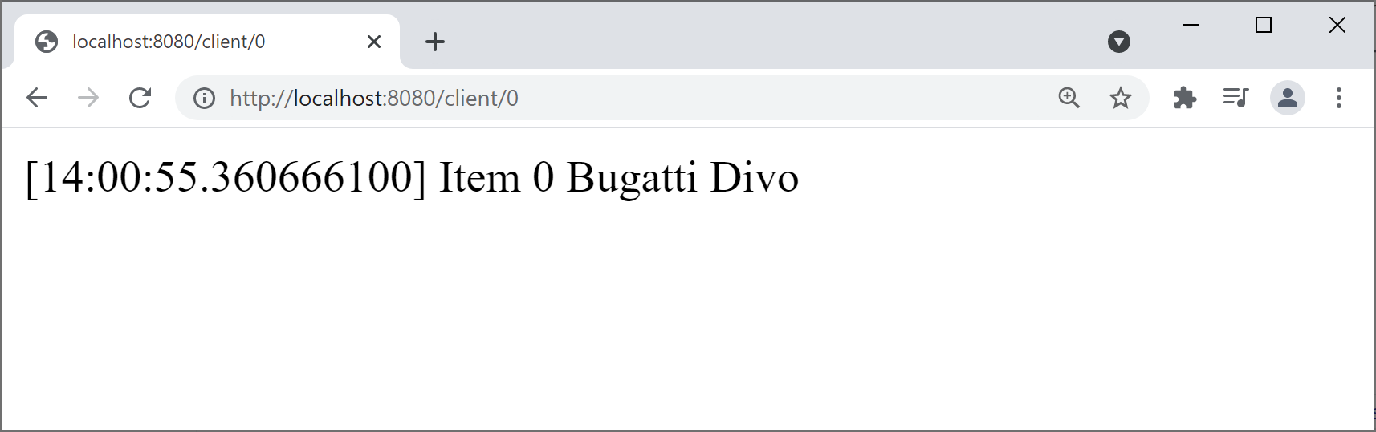
Implementing the Client Service (3 of 3)
Run the client app and ping the following URL…
http://localhost:8080/client/0

Slide 17
3. Circuit Breakers
Overview
Circuit breakers in Spring Cloud
Spring Cloud circuit breaker dependency
Spring Cloud circuit breaker example
Seeing a circuit breaker in action

Slide 18
Overview
In a microservice application, services call other services
E.g. ServiceA calls ServiceB, ServiceB calls ServiceC, etc.
If any service is down, you get a ripple effect of failures
E.g. if ServiceC is down…
Then ServiceB will fail (because it depends on ServiceC)
Then ServiceA will fail (because it depends on ServiceB), etc.
To avoid the ripple effect of failures, use a circuit breaker
Specify a fallback method that can be called, if a service fails

Slide 19
Circuit Breakers in Spring Cloud
Spring Cloud provides a circuit breaker API
Via the CircuitBreakerFactory class
CircuitBreakerFactory is an abstraction over various circuit breaker implementations, including:
Resilience4J (we'll use this)
Netflix Hystrix
Sentinel
Spring Retry

Slide 20
Spring Cloud Circuit Breaker Dependency
To use the Resilience4J circuit breaker implementation, add the following dependency to the pom file in your (client) project :
Once you've added this dependency, Spring Boot autoconfig will automatically create a Resilience4J bean
This bean is exposed via CircuitBreakerFactory
See next slide for an example of how to use a circuit breaker…
<dependency>
<groupId>org.springframework.cloud</groupId>
<artifactId>spring-cloud-starter-circuitbreaker-resilience4j</artifactId>
<version>3.0.0</version>
</dependency>
pom.xml (client project)

Slide 21
Spring Cloud Circuit Breaker Example
@RestController
public class ClientWithFallbackController {
@Autowired
private CircuitBreakerFactory factory;
@GetMapping("/clientWithFallback/{index}")
public String getItem(@PathVariable int index){
URI catalogUrl = URI.create("http://localhost:8081/catalog/" + index);
RestTemplate restTemplate = new RestTemplate();
CircuitBreaker circuitBreaker = factory.create("circuitbreaker");
String result = circuitBreaker.run(
() -> restTemplate.getForObject(catalogUrl, String.class),
err -> getFallback(index));
return String.format("[%s] Item %d %s", LocalTime.now(), index, result);
}
public String getFallback(int i) { return "FALLBACK-ITEM-" + i;}
}
HTTP request
Catalog service

Slide 22
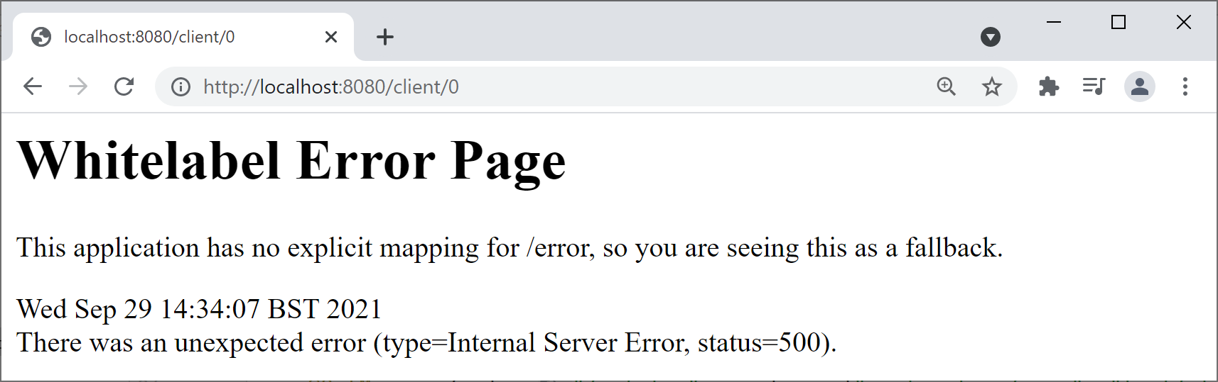
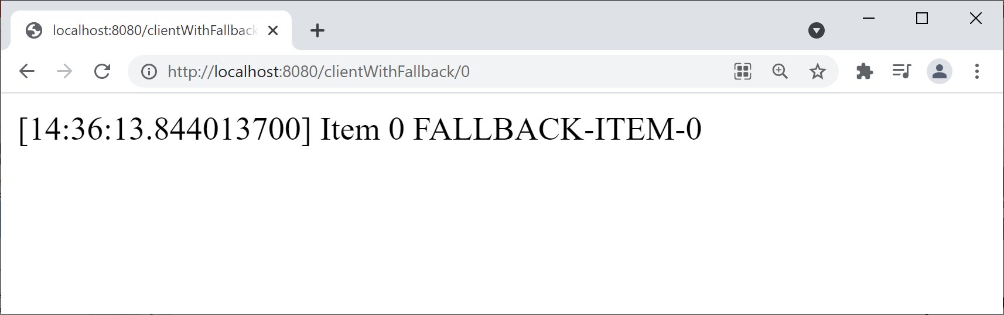
Seeing a Circuit Breaker in Action
To see the effect of the circuit breaker, follow these steps:
Stop the catalog service
Then ping the following client endpoints…
http://localhost:8080/client/0
http://localhost:8080/clientWithFallback/0

Slide 23
Summary
Consuming REST services
Microservice architecture
Circuit breakers

