Slide 1
Reactive Programming
The need for reactive programming
The promise of reactive programming
The usage of reactive programming
Demo project: demo-reactive

Slide 2
[Foreword] Project Lombok (1 of 2)
The examples in this chapter make use of Project Lombok
Via the following pom dependency
Project Lombok defines annotations to simplify your code
It can generate getters/setters, constructors, toString() etc.
For full details, see https://projectlombok.org/features/all
<dependencies>
<dependency>
<groupId>org.projectlombok</groupId>
<artifactId>lombok</artifactId>
<optional>true</optional>
</dependency>
…
</dependencies>
pom.xml in demo project

Slide 3
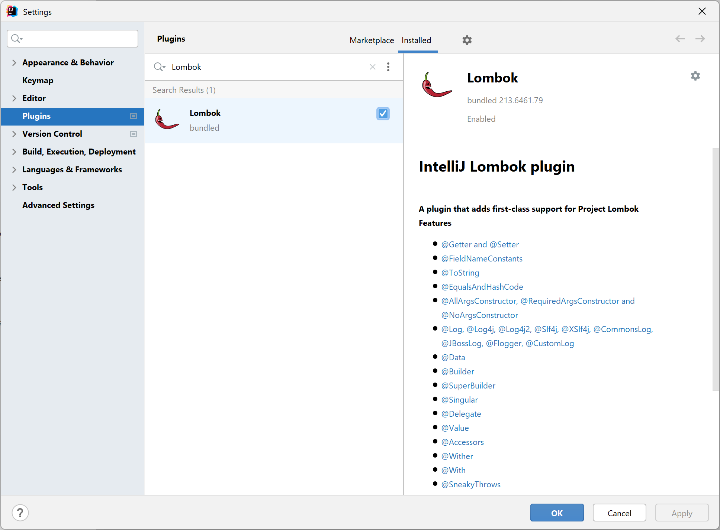
[Foreword] Project Lombok (2 of 2)
You must also install the Project Lombok plugin in IntelliJ
Via File | Settings | Plugins

Slide 4
1. The Need for Reactive Programming
What is reactive programming
Doing synchronous I/O
Characteristics of synchronous I/O
Asynchronous I/O to the rescue
Aside: Java NIO
Doing asynchronous I/O
Characteristics of asynchronous I/O

Slide 5
What is Reactive Programming?
Reactive programming is a way to process asynchronous data streams
Asynchronous I/O can offer big improvements in performance
Avoid wasting CPU cycles that are idly waiting for I/O to complete
Reactive programming inverts the way we do I/O
Rather than the client asking for data from the server, the client is notified when data arrives
This enables the client to do other work in the meantime
Reactive programming is a pub/sub pattern
Publisher publishes a stream of data
Subscriber subscribes to stream and receives data asynchronously

Slide 6
Doing Synchronous I/O (1 of 4)
To appreciate the need for asynchronous I/O, it's useful to first see the problems with synchronous I/O
We'll see how to read a file synchronously
The file could be large, so we'll return it in chunks
We'll put each chunk into a Payload object
@Log4j2
@Data
class Payload {
private final byte[] bytes;
private final int length;
public static Payload from(byte[] bytes, int len) {
return new Payload(bytes, len);
}
@Override
public String toString() {
return String.format("[*****THREAD %d PROCESSING PAYLOAD*****] %s",
Thread.currentThread().getId(),
new String(bytes));
}
}
demo.syncasync.Payload.java

Slide 7
Doing Synchronous I/O (2 of 4)
Here's an interface that specifies a read operation
The read() function reads data from the specified file, …
… puts data into Payload objects, …
… and passes Payload objects to a consumer to process
The interface doesn't specify how read() works
We'll implement the method synchronously first
Then we'll implement it asynchronously, to avoid wasted waiting
import java.util.function.Consumer;
public interface Reader {
void read(String filename, Consumer<Payload> consumer);
}
demo.syncasync.Reader.java

Slide 8
Doing Synchronous I/O (3 of 4)
Synchronous implementation of the Reader interface
Makes use of InputStream read() method
This is blocking I/O
@Log4j2
@Component
@Lazy
class SynchronousReader implements Reader {
@Override
public void read(String filename, Consumer<Payload> consumer) {
try (InputStream in = new FileInputStream(filename)) {
byte[] data = new byte[1024];
int res;
while ((res = in.read(data, 0, data.length)) != -1) {
consumer.accept(Payload.from(data, res));
}
}
catch (IOException ex) {
log.error(ex.getMessage());
}
}
}
demo.syncasync.SynchronousReader.java

Slide 9
Doing Synchronous I/O (4 of 4)
Client code can use the synchronous reader as follows
Run this code and see what happens
When will it display "main thread doing useful work" messages?
@Log4j2
@SpringBootApplication
public class Application {
public static void main(String[] args) {
ApplicationContext context = SpringApplication.run(Application.class, args);
Reader reader = context.getBean(SynchronousReader.class);
doRead("Data/Macbeth.xml", reader);
}
private static void doRead(String filename, Reader reader) {
reader.read(filename, bb -> System.out.println(bb));
for (int i = 0; i < 10; i++) {
System.out.println("[*****MAIN THREAD DOING USEFUL WORK*****]");
try { Thread.sleep(1000); } catch (InterruptedException ex) {}
}
}
}
demo.syncasync.Application.java

Slide 10
Characteristics of Synchronous I/O
Synchronous I/O is pull-model processing
We're pulling bytes out of a data source (e.g. an InputStream)
This is fine if the data source is fast
E.g. the local file system
It's not fine if the data source is slow
E.g. a network file, or a remote service
When we call in.read(), it could take a very long time
Running the code on a separate thread doesn't help
We're limited to the number of threads on our core
Eventually we'll run out of threads - not infinitely scalability!

Slide 11
Asynchronous I/O to the Rescue
Synchronous I/O is problematic if the data stream is slow
The only way to handle more I/O is to add more threads
But our ability to add more threads is finite
If the bulk of your work is I/O:
Then asynchronous I/O can help alleviate the wastage of threads
The next few slides we show how to do asynchronous I/O using Java NIO, in the package java.nio
Provides support for low-level I/O operations
Based on the concept of channels and buffers

Slide 12
Aside: Java NIO (1 of 2)
Channels are bidirectional sources or sinks of data
E.g. FileChannel reads/writes a file
Data manipulated in blocks
Buffers are the unit of data moved through channels
Basic type of buffer is ByteBuffer, also IntBuffer etc.
Array of data
Operations and attributes to simplify data movement
FileChannel
ByteBuffer

Slide 13
Aside: Java NIO (2 of 2)
To place data into a buffer
Invoke channel read() method to read data from channel
Or invoke buffer put() method to put in data manually
To take data from a buffer
Invoke channel write() method to write data into channel
Or invoke buffer get() method to get out data manually
channel
channel
read()
write()
put()
get()

Slide 14
Doing Asynchronous I/O (1 of 3)
Asynchronous implementation of the Reader interface
Makes use of AsynchronousFileChannel read() method
Non-blocking, calls back CompletionHandler when data ready
@Log4j2
@Component
@Lazy
class AsynchronousReader implements Reader, CompletionHandler<Integer, ByteBuffer> {
private long position;
private AsynchronousFileChannel fileChannel;
private Consumer<Payload> consumer;
public void read(String filename, Consumer<Payload> c) {
this.consumer = c;
try {
this.fileChannel = AsynchronousFileChannel.open(
Paths.get(filename),
StandardOpenOption.READ);
ByteBuffer buffer = ByteBuffer.allocate(1024);
this.fileChannel.read(buffer, 0, buffer, this);
}
catch (IOException ex) { … }
}
…
demo.syncasync.AsynchronousReader.java

Slide 15
Doing Asynchronous I/O (2 of 3)
We implement the CompletionHandler interface to handle data as soon as it is available
@Log4j2
@Component
@Lazy
class AsynchronousReader implements Reader, CompletionHandler<Integer, ByteBuffer> {
…
@Override
public void completed(Integer bytesRead, ByteBuffer buffer) {
if (bytesRead < 0)
return;
// Flip FileChannel buffer from write- to read-mode, then read bytes from it.
buffer.flip();
byte[] data = new byte[buffer.limit()];
buffer.get(data);
// Put the data into our Payload object, and consume (process) it.
consumer.accept(Payload.from(data, data.length));
// Clear the FileChannel buffer, and fire off the next read.
buffer.clear();
this.position = this.position + bytesRead;
this.fileChannel.read(buffer, this.position, buffer, this);
}
}
demo.syncasync.AsynchronousReader.java

Slide 16
Doing Asynchronous I/O (3 of 3)
Client code can use the asynchronous reader as follows
Run this code and see what happens
When will it display "main thread doing useful work" messages?
@Log4j2
@SpringBootApplication
public class Application {
public static void main(String[] args) {
ApplicationContext context = SpringApplication.run(Application.class, args);
Reader reader = context.getBean(AsynchronousReader.class);
doRead("Data/Macbeth.xml", reader);
}
private static void doRead(String filename, Reader reader) {
reader.read(filename, bb -> System.out.println(bb));
for (int i = 0; i < 10; i++) {
System.out.println("[*****MAIN THREAD DOING USEFUL WORK*****]");
try { Thread.sleep(1000); } catch (InterruptedException ex) {}
}
}
}
demo.syncasync.Application.java

Slide 17
Characteristics of Asynchronous I/O
Asynchronous I/O is push-model processing
The read() operation returns on the main thread immediately
The main thread can do useful work in the meantime
When data is ready, it's pushed to our CompletionHandler on a separate thread
Asynchronous I/O helps for I/O-bound operations
We can get better juice out of our available hardware
Asynchronous I/O doesn't help for CPU-bound operations
E.g. number-crunching, etc.

Slide 18
2. The Promise of Reactive Programming
From I/O to collections
Future<T> and CompletableFuture<T>
Iterator<T> and Stream<T>
The essence of the problem
Reactive programming to the rescue

Slide 19
From I/O to Collections
Most coding tasks don't use InputStream or Channel, but instead tend to work with collections
The concepts are similar though…
We expect to be able to get all of the data, quite quickly
Collections can become problematic if:
You're dealing with large or unbounded amounts of data
You're dealing with data with a lot of latency between records
These cases require asynchrony, i.e. the ability to deal with data that will eventually arrive
Can Future<T> or CompletableFuture<T> help?
Can Iterator<T> or Stream<T> help?

Slide 20
Future<T> and CompletableFuture<T>
Future<T> and CompletableFuture<T> describe a task that will eventually complete
But they only describe one completion
They don't describe multiple ongoing completions
So they aren't a good way to represent a whole bunch of (potentially unlimited) data arrivals

Slide 21
Iterator<T> and Stream<T>
Iterator<T> and Stream<T> both work fine with very large (or potentially unlimited) data streams
But they use a pull model
They don't push data at you when it becomes available
If Iterator<T> and Stream<T> did have push model capabilities, that would raise another issue…
Who knows how much data the data source might push at you?
You'd need a way to push-back, i.e. to say "whoa tiger!"

Slide 22
The Essence of the Problem
We need asynchrony
The ability to process data on a separate thread
We'd like a push model
The data source pushes data at us, when it's available
We need a way to push-back
To tell the data source, we're ready for the next xxx bytes when they're available

Slide 23
Reactive Programming to the Rescue
The issues on the previous slide pertain to flow-control
The ability of the client to signal how much work it can handle
This is called back pressure
Reactive programming resolves these issues
Several libraries available
E.g. RxJava, Akka Streams, Project Reactor
Reactive Streams is an initiative that defines a standard for async stream processing with non-blocking back pressure
See http://www.reactive-streams.org/

Slide 24
3. The Usage of Reactive Programming
Support for Reactive Streams in Java 9+
Understanding the Java Flow API
Flow API interfaces
Implementing a subscriber class
Main code - publishing and subscribing
Implementing a processor class
Subscribing to the processor class
Main code - publishing and subscribing

Slide 25
Support for Reactive Streams in Java 9+
Java 9+ supports Reactive Streams via the Flow API
A combination of the Iterator and Observer patterns…
The Iterator is a pull model
The app pulls items from the source
The Observer is a push model
Items from the source are pushed to the application

Slide 26
Understanding the Java Flow API
The Java Flow API is a mixture of pull and push:
The subscriber initially requests N items
The publisher publishes at most N items to the subscriber
Addresses the common problem of back pressure
Whereby buffer fills up because subscriber is too slow
Subscriber
Request N items
Publisher
Push stream of N items

Slide 27
Flow API Interfaces
The Flow API defines several key interfaces inside the java.util.concurrent.Flow class
@FunctionalInterface
public static interface Flow.Publisher<T> {
public void subscribe(Flow.Subscriber<? super T> subscriber);
}
public static interface Flow.Subscriber<T> {
public void onSubscribe(Flow.Subscription subscription);
public void onNext(T item) ;
public void onError(Throwable throwable) ;
public void onComplete();
}
public static interface Flow.Subscription {
public void request(long n);
public void cancel();
}
public static interface Flow.Processor<T,R>
extends Flow.Subscriber<T>, Flow.Publisher<R> {
}

Slide 28
Implementing a Subscriber Class
import java.util.concurrent.Flow.*;
…
public class MySubscriber<T> implements Subscriber<T> {
private Subscription subscription;
public ArrayList<T> consumedItems = new ArrayList<>();
@Override
public void onSubscribe(Subscription subscription) {
this.subscription = subscription;
subscription.request(1); // The subscription facilitates back pressure.
}
@Override
public void onNext(T item) {
System.out.println("MySubscriber onNext(): " + item);
consumedItems.add(item);
subscription.request(1);
}
@Override
public void onError(Throwable t) {
t.printStackTrace();
}
@Override
public void onComplete() {
System.out.println("MySubscriber onComplete()");
}
}
demo.reactive1.MySubscriber.java

Slide 29
Main Code - Publishing and Subscribing
Here's the main code
We use SubmissionPublisher to publish strings
We define a subscriber to subscribe to the flow
import java.util.concurrent.SubmissionPublisher;
…
// Create a publisher - we've used the SubmissionPublisher implementation class.
SubmissionPublisher<String> publisher = new SubmissionPublisher<>();
// Register a subscriber.
MySubscriber<String> subscriber = new MySubscriber<>();
publisher.subscribe(subscriber);
// Publish some items.
System.out.println("Publishing Items...");
String[] items = {"matthew", "mark", "luke", "john"};
Arrays.asList(items).stream().forEach(item -> publisher.submit(item));
// Tell subscribers we're done.
publisher.close();
System.out.printf("Subscriber consumed %d items\n", subscriber.consumedItems.size());
demo.reactive1.Main.java

Slide 30
Implementing a Processor Class (1 of 2)
Now let's see how to implement a processor class
i.e. a class that implements Flow.Processor
A processor class is like a transformer:
Subscribes to an upstream publisher, to receive items
Processes the items
Publishes results to a downstream subscriber
public static interface Flow.Processor<T,R>
extends Flow.Subscriber<T>, Flow.Publisher<R> {
}

Slide 31
Implementing a Processor Class (2 of 2)
public class MyTransformProcessor<T,R>
extends SubmissionPublisher<R>
implements Flow.Processor<T,R> {
private Flow.Subscription subscription;
private Function<T,R> function;
public MyTransformProcessor(Function<T,R> function) {
this.function = function;
}
@Override
public void onSubscribe(Flow.Subscription subscription) {
this.subscription = subscription;
subscription.request(1);
}
@Override
public void onNext(T item) {
R transformResult = function.apply(item);
this.submit(transformResult);
subscription.request(1);
}
@Override
public void onError(Throwable t) { … }
@Override
public void onComplete() { … }
}
demo.reactive2.MyTransformProcessor.java

Slide 32
Subscribing to the Processor Class
The processor class is part-publisher, part-subscriber
So we need to subscribe to its outputs
See MySubscriber class in demo.reactive2 package
Same code as before
i.e. it subscribes and accumulates results locally

Slide 33
Main Code - Publishing and Subscribing
Here's the main code
We use SubmissionPublisher to publish strings
We use our processor to process these strings
We use our subscriber to subscribe to the transformed results
SubmissionPublisher<String> publisher = new SubmissionPublisher<>();
MyTransformProcessor<String, Integer> transformProcessor =
new MyTransformProcessor<>(s -> s.length());
publisher.subscribe(transformProcessor);
MySubscriber<Integer> subscriber = new MySubscriber<>();
transformProcessor.subscribe(subscriber);
System.out.println("Publishing Items...");
String[] items = {"matthew", "mark", "luke", "john"};
Arrays.asList(items).stream().forEach(item -> publisher.submit(item));
publisher.close();
System.out.printf("Subscriber consumed %d items\n", subscriber.consumedItems.size());
demo.reactive2.Main.java

Slide 34
Summary
The need for reactive programming
The promise of reactive programming
The usage of reactive programming

