Slide 1
Thymeleaf
Introduction to Thymeleaf
Thymeleaf syntax
Demo project: demo-thymeleaf

Slide 2
1. Introduction to Thymeleaf
What is Thymeleaf?
Thymeleaf sample application
Configuring Maven dependencies
Setting Thymeleaf as the view resolver
Defining template pages

Slide 3
What is Thymeleaf?
Thymeleaf is an open-source view template framework for HTML5, XHTML, or XML resources
A popular alternative to JSP, especially when you have a Spring Boot app with an embedded servlet container
Benefits:
Clean and powerful templating syntax
Allows for faster and offline prototyping of pages, because you can view pages outside a Web server
Note:
You can use Thymeleaf in Spring and non-Spring apps

Slide 4
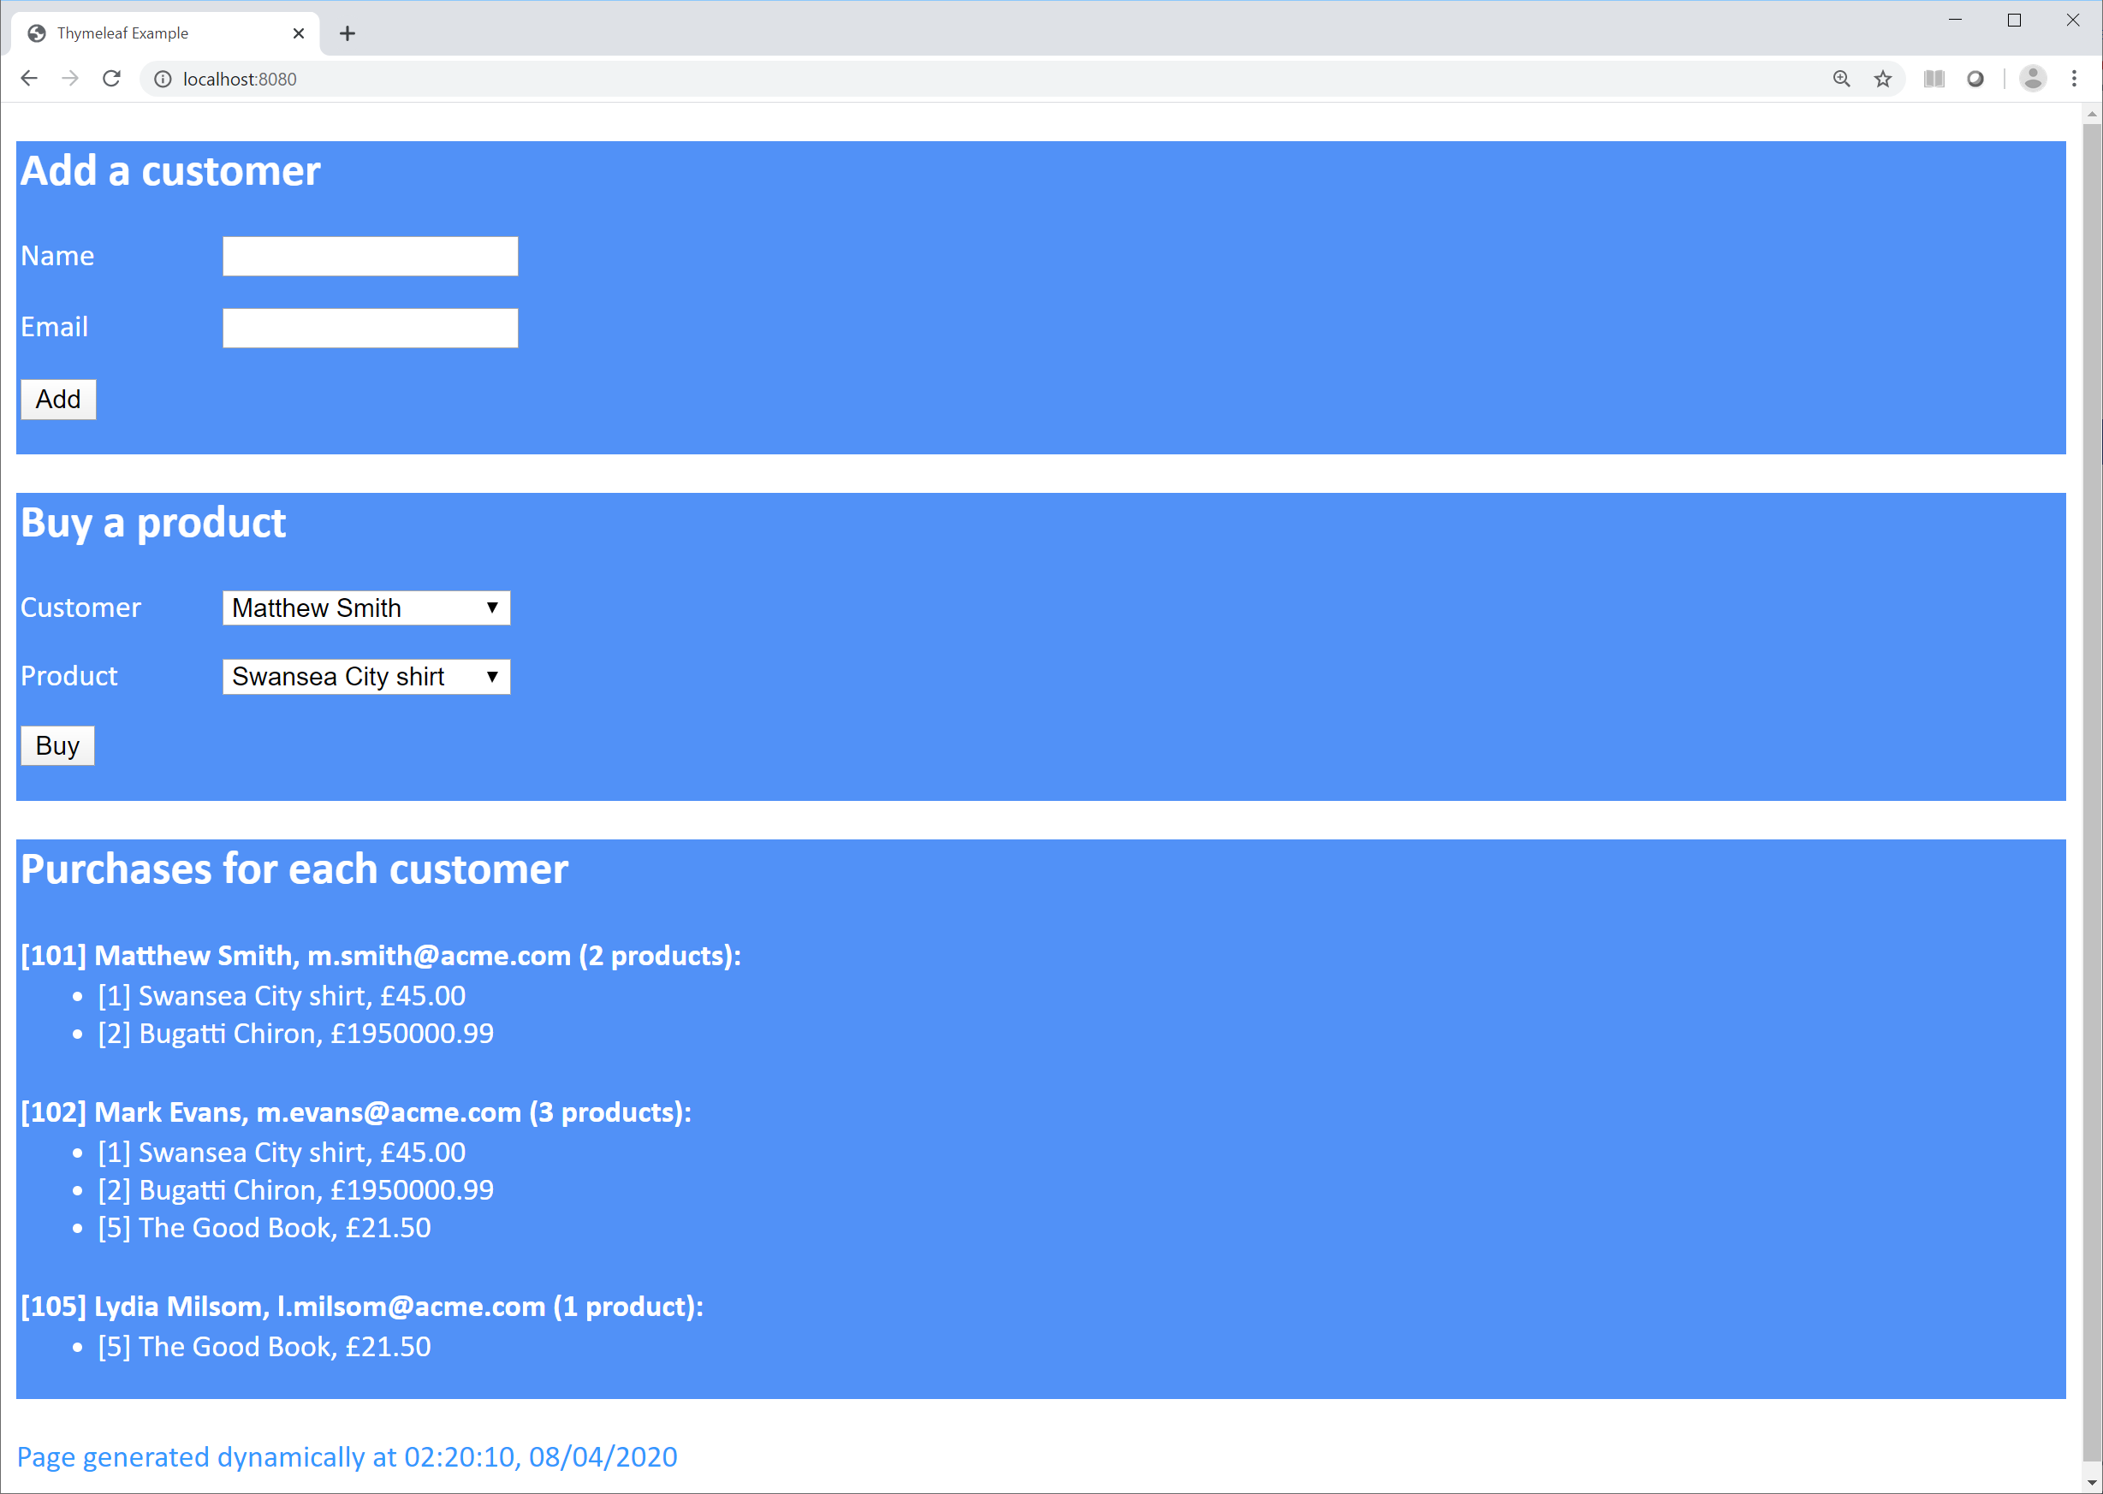
Thymeleaf Sample Application
We'll explore demo-thymeleaf in this chapter
This application stores customers and products in a simple in-memory repository
For details, see the following classes in the demo application:
Customer
Product
Repository

Slide 5
Configuring Maven Dependencies
In Spring Boot, you just need to add the Spring Boot Starter for Thymeleaf
Auto-configures all the beans needed by Thymeleaf
<dependencies>
<dependency>
<groupId>org.springframework.boot</groupId>
<artifactId>spring-boot-starter-web</artifactId>
</dependency>
<dependency>
<groupId>org.springframework.boot</groupId>
<artifactId>spring-boot-starter-thymeleaf</artifactId>
</dependency>
<dependency>
<groupId>org.springframework.boot</groupId>
<artifactId>spring-boot-starter-test</artifactId>
<scope>test</scope>
</dependency>
</dependencies>
pom.xml in demo project

Slide 6
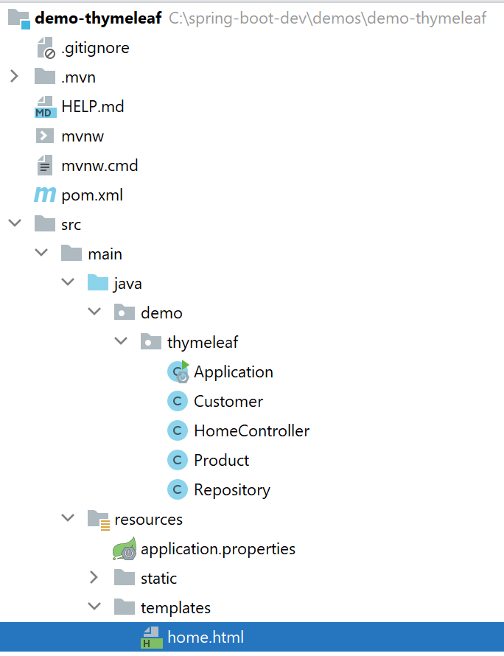
Defining Template Pages (1 of 2)
You put your template pages in the folder specified by the view resolver
By default, this is the templates folder

Slide 7
Defining Template Pages (2 of 2)
You define template pages as follows
The <!DOCTYPE> declaration is necessary, to prevent errors
The xmlns:th namespace declaration allows you to use Thymeleaf attributes in your HTML element, e.g. th:field
<!DOCTYPE html SYSTEM "http://www.thymeleaf.org/dtd/xhtml1-strict-thymeleaf-spring4-4.dtd">
<html xmlns="http://www.w3.org/1999/xhtml" xmlns:th="http://www.thymeleaf.org">
<head>
…
</head>
<body>
…
</body>
</html>
/templates/home.html

Slide 8
2. Thymeleaf Syntax
Online vs. offline operation
Accessing model objects
Accessing properties on an object
Creating mixed content
Binding fields to form values
Creating URLs
Creating repeated items
Conditional rendering
Accessing bean values
Linking to resources

Slide 9
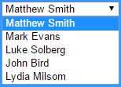
Online vs. Offline Operation
Thymeleaf can replace text in an HTML page
If the page is loaded offline (without a Web server), the "normal" text is displayed
In this example: Customer name [offline]
If the page is accessed via a Web server, the text will be replaced with whatever's in customer.name
<select name="customerID">
<option th:text="${customer.name}" … > Customer name [offline] </option>
</select>
/templates/home.html

Slide 10
Accessing Model Objects (1 of 2)
Controllers can populate the model with useful values
@Controller
public class HomeController {
@RequestMapping(value = "/")
public String home(Model model) {
model.addAttribute("newCustomer", new Customer());
model.addAttribute("Customers", Repository.getAllCustomers());
model.addAttribute("Products", Repository.getAllProducts());
return "home";
}
…
}
HomeController.java

Slide 11
Accessing Model Objects (2 of 2)
You can access model values in a template page
Use the syntax ${nameOfModelAttribute}
Example in our template page home.html:
<form action="#" th:object="${newCustomer}" method="post" … >
<select name="customerID">
<option th:each="c : ${Customers}"
th:value="${c.customerID}"
th:text="${c.name}">Customer name [offline]</option>
</select>
<select name="productID">
<option th:each="p: ${Products}"
th:value="${p.productID}"
th:text="${p.description}">Product description [offline]</option>
</select>
/templates/home.html

Slide 12
Accessing Properties on an Object
The ${…} syntax also allows you to access a specific property on an object
Thymeleaf uses OGNL syntax
E.g. ${c.customerID} calls getCustomerID()
Example:
<select name="customerID">
<option th:each="c : ${Customers}"
th:value="${c.customerID}"
th:text="${c.name}">Customer name [offline]</option>
</select>
<select name="productID">
<option th:each="p: ${Products}"
th:value="${p.productID}"
th:text="${p.description}">Product description [offline]</option>
</select>
/templates/home.html

Slide 13
Creating Mixed Content
If you want to mix static and dynamic text, you can use simple string concatenation
If you want to mix static and dynamic HTML elements, the easiest way is to define nested elements
<div th:text="${'Hi' + newCustomer.name + ', how are you?'}"></p>
<div>Your name is <b><span th:text="${newCustomer.name}"></span></b></div>

Slide 14
Binding Fields to Form Values
The *{…} syntax allows you to bind a field to a form value
Example:
The input fields here are bound to the name and emailAddress properties in the newCustomer object
<form th:action="@{/addCustomer}" th:object="${newCustomer}" … >
<p>
<label>Name</label>
<input type="text" th:field="*{name}" />
</p>
<p>
<label>Email</label>
<input type="email" th:field="*{emailAddress}" />
</p>
<p>
<button type="submit">Add</button>
</p>
</form>
/templates/home.html

Slide 15
Creating URLs
The @{…} syntax allows you to create a URL
Example:
The following form posts to the URL /addCustomer
This is mapped to handleAddCustomer() in the controller class
<form th:action="@{/addCustomer}" th:object="${newCustomer}" … >
<p>
<label>Name</label>
<input type="text" th:field="*{name}" />
</p>
<p>
<label>Email</label>
<input type="email" th:field="*{emailAddress}" />
</p>
<p>
<button type="submit">Add</button>
</p>
</form>
/templates/home.html

Slide 16
Creating Repeating Items
Use th:each to create repeated items
Useful for iterating through collections, in a similar way to using the JSTL tag library
Example:
The following <option> uses th:each to iterate over customers
Thymeleaf will create a separate <option> for each customer
<select name="customerID">
<option th:each="c : ${Customers}"
th:value="${c.customerID}"
th:text="${c.name}">Customer name [offline]</option>
</select>
/templates/home.html

Slide 17
Conditional Rendering
Use th:if for conditional rendering
Useful for hiding/displaying items based on current data
Example:
The following <div> displays customer details, but only if the customer has purchased some products
<div th:if="${!customer.products.isEmpty()}">
<h4 th:text="${customer} + ':' ">Customer details [offline]</h4>
<ul>
<li th:each="product : ${customer.products}" th:text="${product}"> … </li>
</ul>
</div>
/templates/home.html

Slide 18
Accessing Bean Values
You can access bean values directly
Here's a bean value:
Here's how to access it in the template page:
@SpringBootApplication
public class Application {
…
@Bean
@Scope("request")
public String timestamp() {
// Return a string containing the current date and time…
}
}
Application.java
<footer>
<p th:text="${@timestamp}">Timestamp</p>
</footer>
/templates/home.html

Slide 19
Linking to Resources
You can define stylesheets and other static resources
Put these files in the normal place for static content in a Spring Boot app, e.g. in the /static folder
<head>
<title>Thymeleaf Example</title>
<link th:href="@{/styles.css}" type="text/css" rel="stylesheet" />
</head>
/static/styles.css

Slide 20
Summary
Introduction to Thymeleaf
Thymeleaf syntax

