Slide 1
Kafka Topics, Partitions, Consumers
Topics and partitions
Partitions and replication
Consumers
Kafka commands

Slide 2
1. Topics and Partitions
Recap of topics
Topics are partitioned
How partitioning works
Defining a custom partitioner
Partitioning strategies

Slide 3
Recap of Topics
A topic is a logical sequential collection of messages
A producer process publishes messages to a topic
Consumer processes pull messages from a topic
Note:
The docs refers to messages as records, so we will too ☺
Consumer
Producer
Topic T1
Consumer

Slide 4
Topics are Partitioned
In Kafka, each topic is partitioned
You specify the number of partitions when you create the topic
Records are ordered within each partition
Writes to each partition are sequential
Each record in a partition is assigned a sequential id
This is called the offset, identifies each record in a partition
Partition 0
0
1
2
3
4
5
6
7
8
9
10
11
Partition 1
0
1
2
3
4
5
Partition 2
0
1
2
3
4
5
6
7
8
9
Partition 3
0
1
2
3
4
5
6
7

Slide 5
How Partitioning Works
When a producer sends a record, the record is a key/value pair
The key (optional) is a partition specifier
The value is the actual record data
If Kafka receives a record that doesn't have a key:
Kafka use a round-robin partition strategy
If Kafka receives a record that does have a key:
Kafka uses a default partitioner to choose the partition…
The default partitioner hashes the key…
Kafka uses the hash to determine the partition

Slide 6
Defining a Custom Partitioner
You can also define a custom partitioner
A custom partitioner performs semantic processing on a key
E.g. if a key is a country, we can map it to a partition per continent
You can implement a custom partitioner as a Java class
Kafka will pass records to the custom partitioner
The custom partitioner has access to a record's key/value
The custom partitioner decides the partition for the record
We'll show how to do all this later

Slide 7
Partitioning Strategies
Each partition is consumed by a designated consumer
We'll describe how this works shortly
Random partitioning is recommended
When the producer sends a record, specify a random key
So records will be evenly distributed across partitions
So consumers will have an even distribution of work to do
Aggregated partitioning is another possibility
Scenario: In an online retailer app, each customer has an ID
The producer can use the customer ID as a record key
All records for the same customer will go in the same partition, and will therefore be processed by the same consumer
This enables the consumer to aggregate data per customer

Slide 8
2. Partitions and Replication
Overview
Leader vs. follower brokers
Additional technical info

Slide 9
Overview
Replication is a critical ingredient in production systems
Data must be replicated, to avoid a single point of failure
In Kafka, replication works at the partition level
The default replication factor is 3
i.e. each partition is stored on 3 separate brokers

Slide 10
Leader vs. Follower Brokers
For each partition:
1 broker is designated as the leader broker
The other brokers (e.g. 2 others) are designated as followers
All reads/writes go to the leader broker
The follower brokers just fulfil a backup role
E.g. when a producer publishes a record, it goes to the leader
The leader appends the record to its log and increments the offset
The leader propagates the record to the follower brokers
Acknowledgments are issued, to indicate successful delivery

Slide 11
Additional Technical Info
How does a producer know which broker is the leader for a particular partition?
The producer contacts the cluster to determine partition leaders
How does Kafka distribute leadership?
Fairly, i.e. each broker is a leader for a fair share of partitions
What happens when a leader broker goes down?
Kafka promotes one of the followers to become the leader
Where is data actually stored?
Each partition is stored as a separate directory on the file system
There are 2 files - the data (*.log file) and an index (*.index file)

Slide 12
3. Consumers
Recap of consumers
Consumer groups
Consumers and partitions
Best practices

Slide 13
Recap of Consumers
A consumer is a process that subscribes to a topic and reads records from that topic
Consumer
Producer
Topic T1
Consumer

Slide 14
Consumer Groups
Kafka consumers are all part of a consumer group
A consumer group can have multiple consumers
Consider the scenario above:
Topic T1 has 4 partitions
Consumer group G1 has one consumer C1
If C1 subscribes to T1, it gets all records from all 4 partitions in T1
Topic T1
Consumer Group G1
Partition 0
0
1
2
3
4
5
6
7
8
9
10
11
Consumer C1
Partition 1
0
1
2
3
4
5
Partition 2
0
1
2
3
Partition 3
0
1
2
3
4
5
6
7

Slide 15
Consumers and Partitions (1 of 3)
If there are multiple consumers in a group…
Each consumer in the group will handle specific partition(s)
All records in a particular partition go to the same consumer
Consider the scenario above:
Consumer group G1 has fewer consumers than there are partitions
Kafka will share the partitions evenly amongst the consumers
Topic T1
Consumer Group G1
Partition 0
0
1
2
3
4
5
6
7
8
9
10
11
Consumer C1
Partition 1
0
1
2
3
4
5
Consumer C2
Partition 2
0
1
2
3
Partition 3
0
1
2
3
4
5
6
7

Slide 16
Consumers and Partitions (2 of 3)
If there are the same number of consumers in a group as there are partitions in the topic…
Each consumer in the group will handle a specific partition
Topic T1
Consumer Group G1
Partition 0
0
1
2
3
4
5
6
7
8
9
10
11
Consumer C1
Partition 1
0
1
2
3
4
5
Consumer C2
Partition 2
0
1
2
3
Consumer C3
Partition 3
0
1
2
3
4
5
6
7
Consumer C4

Slide 17
Consumers and Partitions (3 of 3)
If there are more consumers in a group than there are partitions in the topic…
Surplus consumers are idle - they never receive any records
Topic T1
Consumer Group G1
Partition 0
0
1
2
3
4
5
6
7
8
9
10
11
Consumer C1
Partition 1
0
1
2
3
4
5
Consumer C2
Partition 2
0
1
2
3
Consumer C3
Partition 3
0
1
2
3
4
5
6
7
Consumer C4
Consumer C5
Consumer C6
Consumer C7

Slide 18
Best Practices
The primary way to improve data consumption is to add more consumers to a consumer group
Consumers might be doing time-intensive work
A single consumer can’t keep up with the rate of data as it arrives
Having multiple consumers helps achieve parallelization
This is a good reason to create topics with lot of partitions
The more partitions, the more dedicated consumers you can have
You can scale up the number of consumers, based on the load
Note:
Kafka rebalances partitions when a new consumer joins a group
Consumers are reassigned a new bunch of partitions to handle

Slide 19
4. Kafka Commands
Overview
Creating a topic
Describing topics
Deleting a topic
Publishing records to a topic
Consuming records from a topic

Slide 20
Overview
Kafka provides various utilities you can run from a shell or Windows command prompt
Create / delete topics
Describe topics
Publish records to a topic
Consume records from a topic
Etc.
To run these commands, open a shell / command window and go to the following directory
In Linux/OSX: Kafka bin directory
In Windows: Kafka bin/windows directory

Slide 21
Creating a Topic (1 of 2)
To create a topic (e.g. in a Windows command prompt):
Note about kafka-topics options:
bootstrap-server can be any node in the cluster
replication-factor default is 1 (in production, 3 is good)
partitions default is 1 (in production, specify a suitable value)
Aside: Line continuations characters for different shells:
^ Windows command prompt
\ Linux or macOS shell window
` Windows PowerShell window
kafka-topics --create ^
--bootstrap-server localhost:9092 ^
--replication-factor 1 ^
--partitions 1 ^
--topic my-topic-a

Slide 22
Creating a Topic (2 of 2)
To change the number of partitions in a topic:
To create a topic with multiple partitions in the first place:
kafka-topics --alter ^
--bootstrap-server localhost:9092 ^
--partitions 3 ^
--topic my-topic-a
kafka-topics --create ^
--bootstrap-server localhost:9092 ^
--replication-factor 1 ^
--partitions 5 ^
--topic my-topic-b

Slide 23
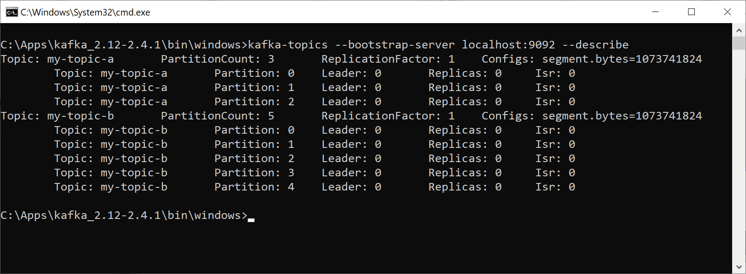
Describing Topics
To describe topics:
kafka-topics --bootstrap-server localhost:9092 --describe
Isr means
"in-sync replicas"

Slide 24
Deleting a Topic
To delete a topic (and all its partitions):
NOTE: This might cause an exception, based on file system permissions!
kafka-topics --delete ^
--bootstrap-server localhost:9092 ^
--topic my-topic-b

Slide 25
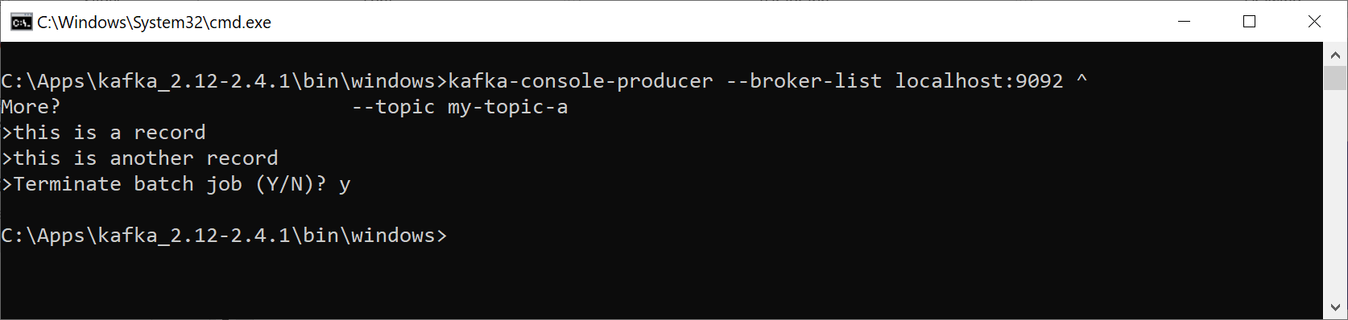
Publishing Records to a Topic (1 of 2)
To publish records from the console to a topic:
In this example, we've just specified record values
We haven't specified record keys
So Kafka will round-robin the records to partitions
kafka-console-producer --broker-list localhost:9092 ^
--topic my-topic-a

Slide 26
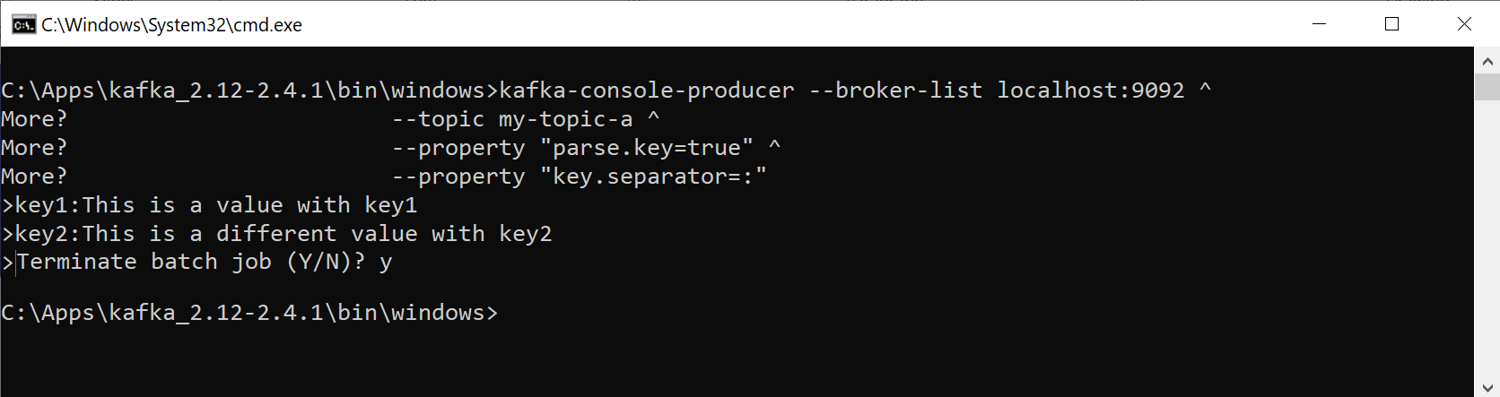
Publishing Records to a Topic (2 of 2)
To publish a record (key + value) to a topic:
kafka-console-producer --broker-list localhost:9092 ^
--topic my-topic-a ^
--property "parse.key=true" ^
--property "key.separator=:"

Slide 27
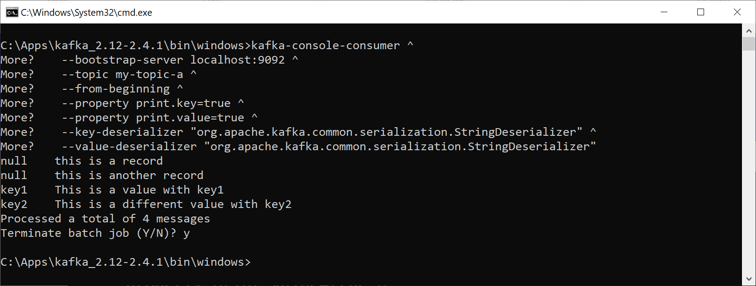
Consuming Records from a Topic (1 of 2)
To consume records from a topic to the console:
kafka-console-consumer ^
--bootstrap-server localhost:9092 ^
--topic my-topic-a ^
--from-beginning ^
--property print.key=true ^
--property print.value=true ^
--key-deserializer "org.apache.kafka.common.serialization.StringDeserializer" ^
--value-deserializer "org.apache.kafka.common.serialization.StringDeserializer"

Slide 28
Consuming Records from a Topic (2 of 2)
A consumer is in control over which records it consumes, e.g. kafka-console-consumer has these options:
--from-beginning - get all records from beginning
--offset - get records from offset for a partition
--max-messages - max number of records, then exit
Example:
kafka-console-consumer ^
--bootstrap-server localhost:9092 ^
--topic my-topic-a ^
--partition 2 ^
--offset 1 ^
--max-messages 2 ^
--property print.key=true ^
--property print.value=true ^
--key-deserializer "org.apache.kafka.common.serialization.StringDeserializer" ^
--value-deserializer "org.apache.kafka.common.serialization.StringDeserializer"

Slide 29
Summary
Topics and partitions
Partitions and replication
Consumers
Kafka commands

