Slide 1
Task Execution and Scheduling
Task execution
Task scheduling
Async and scheduled methods
Demo project: demo-task-execution-scheduling

Slide 2
1. Task Execution
Overview
The TaskExecutor interface
How to use a TaskExecutor
Synchronous execution
Simple asynchronous execution
Asynchronous execution with pooling
Submitting callable tasks
Additional task executor classes available
Demo package: demo.taskexecution

Slide 3
Overview
Spring provides mechanisms that allow you to execute and schedule tasks asynchronously
Very similar to the executor/scheduler API in Java
You should use the Spring APIs, rather than the analogous Java APIs
More idiomatic in Spring
Easier to configure bean properties (e.g. thread pooling, etc.)
Easier to inject as beans into other components in your app

Slide 4
The TaskExecutor Interface
Spring defines a TaskExecutor interface, to execute a Runnable task
Identical to java.util.concurrent.Executor
Various implementations of TaskExecutor are available, allowing tasks to be executed just how you like:
Synchronously in the calling thread
In a newly created thread
In a thread from the thread pool
In a customized implementation of TaskExecutor
import org.springframework.core.task.TaskExecutor;
public interface TaskExecutor {
void execute(Runnable r);
}

Slide 5
How to use a TaskExecutor
If you want multithreading in Spring, use TaskExecutor rather than creating threads yourself
The executor framework decouples the code that creates runnable tasks from the execution policy for those tasks
For example, rather than doing this:
… you should do this:
☹️
Thread thread = new Thread(new MyRunnableTask());
thread.start();
TaskExecutor executor = … some TaskExecutor implementation …
executor.execute(new MyRunnableTask1());
executor.execute(new MyRunnableTask2());
😛

Slide 6
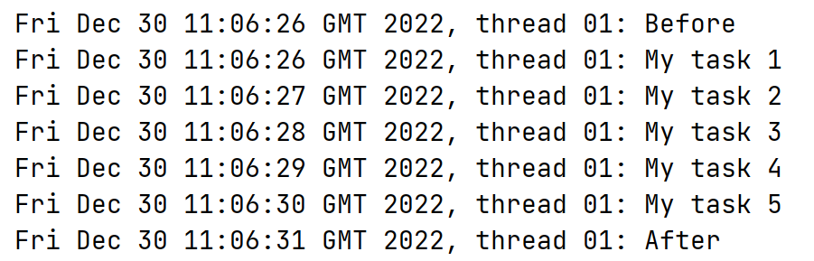
Synchronous Execution
Spring provides a SyncTaskExecutor class
Executes task synchronously on the calling thread
Example
@Configuration
public class MyConfig {
@Bean
public TaskExecutor syncTaskExecutor() {
return new SyncTaskExecutor();
}
}
MyConfig.java
public static void demoSync(ApplicationContext ctx) {
TaskExecutor ex = ctx.getBean("syncTaskExecutor", TaskExecutor.class);
Util.display("Before");
ex.execute(new MyRunnableTask("My task", 5));
Util.display("After");
}
Application.java

Slide 7
Simple Asynchronous Execution (1 of 3)
Spring provides a SimpleAsyncTaskExecutor class
Executes task asynchronously on a new thread
Creates a brand new thread for the task (i.e. no thread pooling)
By default, the amount of concurrency is unlimited
i.e. you can execute as many concurrent tasks as you like
You can limit concurrency, to prevent runaway processing
Set the concurrencyLimit bean property
Blocks new tasks from starting if already at the concurrency limit
You can also influence threading via other bean properties
daemon, threadPriority, threadGroup, threadFactory
Etc.

Slide 8
Simple Asynchronous Execution (2 of 3)
Example creating a SimpleAsyncTaskExecutor
Note we've set the concurrency limit to 3
The client code executes 10 tasks
But only 3 tasks will be executed concurrently, others will block
@Bean
public TaskExecutor simpleAsyncTaskExecutor() {
SimpleAsyncTaskExecutor executor = new SimpleAsyncTaskExecutor();
executor.setConcurrencyLimit(3);
return executor;
}
MyConfig.java
public static void demoSimpleAsync(ApplicationContext ctx) {
TaskExecutor ex = ctx.getBean("simpleAsyncTaskExecutor", TaskExecutor.class);
Util.display("Before");
for (int i = 0; i < 10; i++)
ex.execute(new MyRunnableTask("My task " + i, 5));
Util.display("After");
}
Application.java

Slide 9
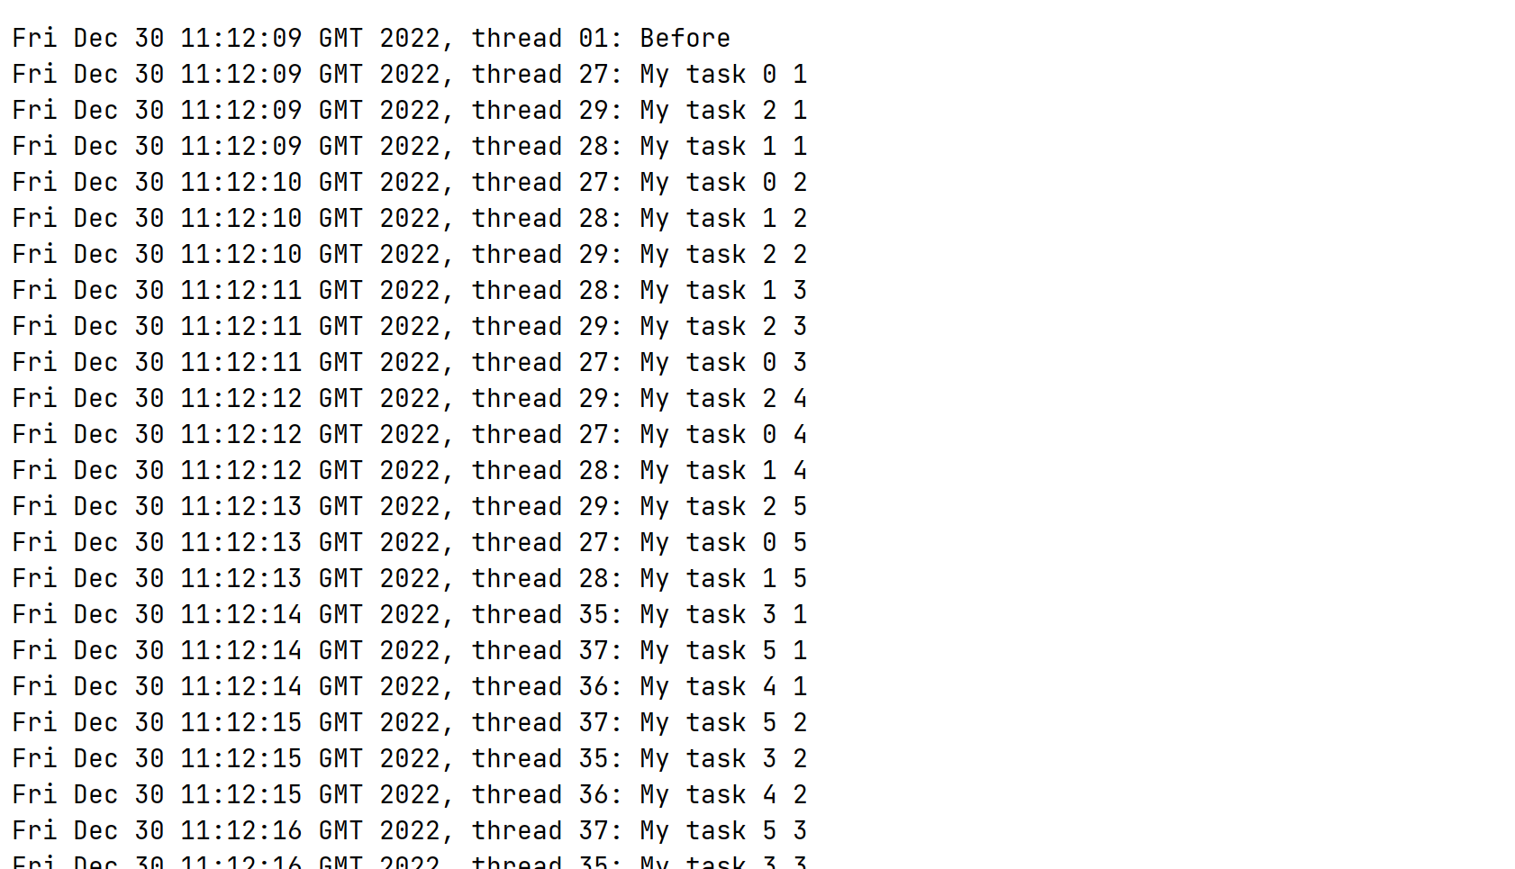
Simple Asynchronous Execution (3 of 3)
Here's the console output… note the following points:
Up to 3 tasks are running concurrently at any given time
Other tasks are blocked from executing, due to concurrency limit
Each task runs in a new thread (i.e. no thread pooling)

Slide 10
Asynchronous Execution with Pooling (1 of 3)
Spring provides a ThreadPoolTaskExecutor class
This is the most commonly used task executor class ☺
(Under the covers, it wraps a Java ThreadPoolExecutor)
Executes task asynchronously, using a thread from a thread pool
You can completely configure the thread pool
Core size of thread pool
Maximum size of thread pool
How long to keep unused threads in the thread pool
A blocking queue, to hold tasks while waiting for available thread
The policy about what to do if no threads/blocking queue space

Slide 11
Asynchronous Execution with Pooling (2 of 3)
Example creating a ThreadPoolTaskExecutor
Note we've configured various aspects about thread pooling
The client code executes 10 tasks
They run as concurrently as possible, using thread-pool threads
@Bean
public TaskExecutor threadPoolTaskExecutor() {
ThreadPoolTaskExecutor executor = new ThreadPoolTaskExecutor();
executor.setCorePoolSize(2);
executor.setMaxPoolSize(4);
executor.setKeepAliveSeconds(10);
executor.setQueueCapacity(2);
executor.setRejectedExecutionHandler(new ThreadPoolExecutor.CallerRunsPolicy());
return executor;
}
MyConfig.java
public static void demoAsyncUsingThreadPool(ApplicationContext ctx) {
TaskExecutor ex = ctx.getBean("threadPoolTaskExecutor", TaskExecutor.class);
Util.display("Before");
for (int i = 0; i < 10; i++)
ex.execute(new MyRunnableTask("My task " + i, i + 1));
Util.display("After");
}
Application.java

Slide 12
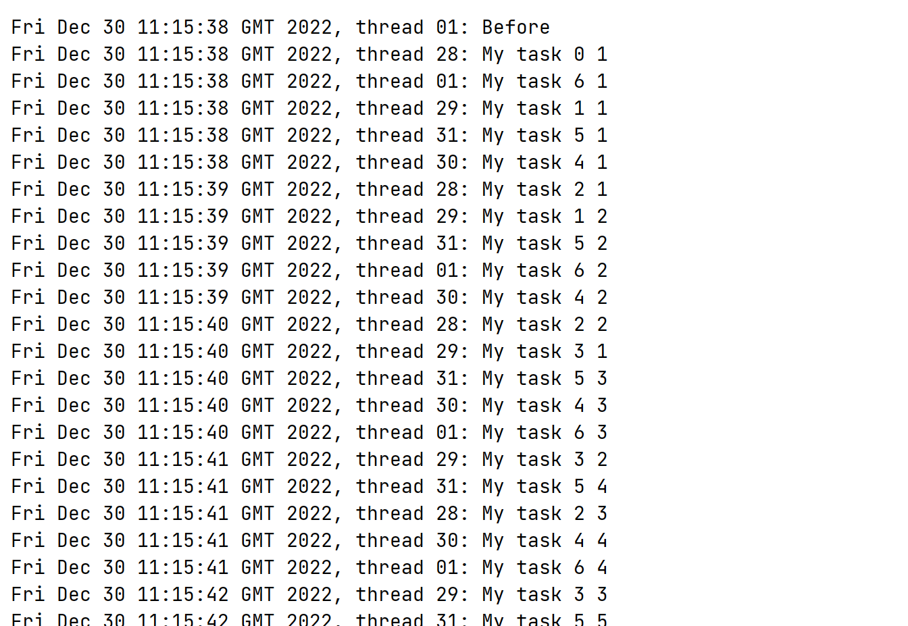
Asynchronous Execution with Pooling (3 of 3)
Here's the console output… note the following points:
Up to 4 tasks are running concurrently on threads from the thread pool (thread IDs 12, 14, 13, and 11 in this screenshot)
Surplus tasks are all executed on the calling thread (thread ID 01)

Slide 13
Submitting Callable Tasks
All the examples so far have executed Runnable tasks
i.e. no return value
ThreadPoolTaskExecutor also allows you to submit Callable<T> tasks, which eventually return a result
Call submit()
Returns a Future<T> object, representing the pending result
For a complete example, see:
MyCallableTask class, implements Callable<Integer>
MyConfig class, see threadPoolTaskExecutor()
Main class, see demoAsyncUsingThreadPoolWithResults()

Slide 14
Additional Task Executor Classes Available
Spring provides several additional implementations of TaskExecutor, if you need even more control
ConcurrentTaskExecutor
SimpleThreadPoolTaskExecutor
WorkManagerTaskExecutor
See Spring docs for full details

Slide 15
2. Task Scheduling
Overview
The TaskScheduler interface
Creating a TaskScheduler bean
Scheduling tasks with a fixed delay
Scheduling tasks at a fixed rate
Scheduling tasks based on a trigger
Demo package: demo.taskscheduling

Slide 16
Overview
The previous section discussed TaskExecutor
Executes a task immediately (according to thread pool constraints, if you specified any)
Spring also provides a TaskScheduler interface
Schedules a task for execution at some time in the future
E.g. with a fixed delay
E.g. at a fixed rate
E.g. based on trigger info

Slide 17
The TaskScheduler Interface
Here's the definition of the TaskScheduler interface
Similar to java.util.concurrent.ScheduledThreadPoolExecutor
import org.springframework.scheduling.TaskScheduler;
public interface TaskScheduler {
ScheduledFuture scheduleWithFixedDelay(Runnable r, long delay);
ScheduledFuture scheduleWithFixedDelay(Runnable r, Date startTime, long delay);
ScheduledFuture scheduleAtFixedRate(Runnable r, long period);
ScheduledFuture scheduleAtFixedRate(Runnable r, Date startTime, long period);
ScheduledFuture schedule(Runnable r, Date startTime);
ScheduledFuture schedule(Runnable r, Trigger trigger);
}

Slide 18
Creating a TaskScheduler Bean
Spring provides the ThreadPoolTaskScheduler class, which is a simple implementation of TaskScheduler
This is perfectly adequate in most scenarios
Has various bean properties, e.g. pool size, thread priority, etc.
All the examples in this section will use the following bean:
@Configuration
public class MyConfig {
@Bean
public TaskScheduler taskScheduler() {
ThreadPoolTaskScheduler scheduler = new ThreadPoolTaskScheduler();
scheduler.setPoolSize(3);
return scheduler;
}
}
MyConfig.java

Slide 19
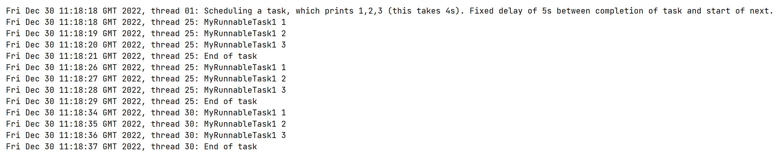
Scheduling Tasks with a Fixed Delay
scheduleWithFixedDelay() schedules tasks with a fixed delay after completion of the previous task
public static void demoFixedDelayExecution(ApplicationContext ctx) {
ThreadPoolTaskScheduler sch = ctx.getBean(ThreadPoolTaskScheduler.class);
Util.display("Scheduling a task, which prints 1,2,3 (this takes 4s). " +
"Fixed delay of 5s between completion of task and start of next.");
sch.scheduleWithFixedDelay(new MyRunnableTask("MyRunnableTask1", 3), 5_000);
try { Thread.sleep(20_000); } catch (InterruptedException e) {}
sch.shutdown();
}
Application.java

Slide 20
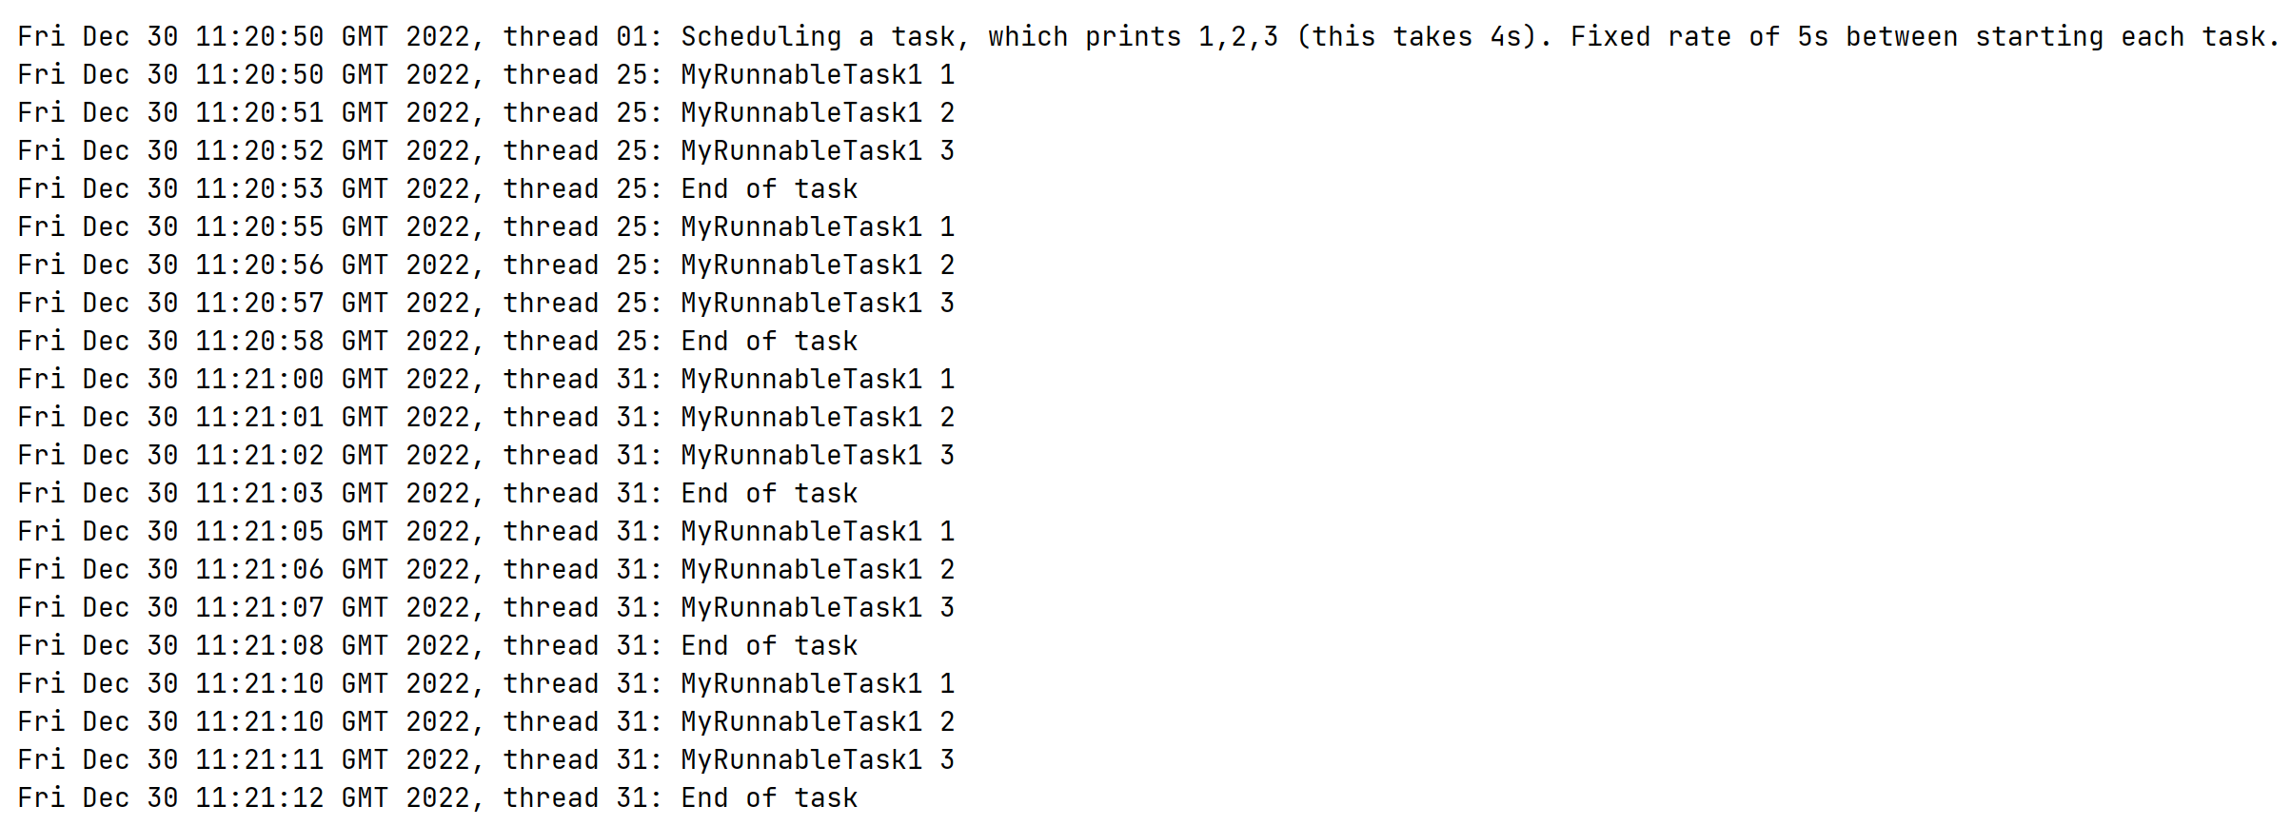
Scheduling Tasks at a Fixed Rate
scheduleAtFixedRate() schedules tasks at a fixed rate between tasks (regardless of when they complete)
public static void demoFixedRateExecution (ApplicationContext ctx) {
ThreadPoolTaskScheduler sch = ctx.getBean(ThreadPoolTaskScheduler.class);
Util.display("Scheduling a task, which prints 1,2,3 (this takes 4s). " +
"Fixed rate of 5s between starting each task.");
sch.scheduleAtFixedRate(new MyRunnableTask("MyRunnableTask1", 3), 5_000);
try { Thread.sleep(20_000); } catch (InterruptedException e) {}
sch.shutdown();
}
Application.java

Slide 21
Scheduling Tasks based on a Trigger
schedule() schedules tasks based on a Trigger, which you can pass as the 2nd argument
Trigger is an interface, Spring has 2 implementations:
PeriodicTrigger - Similar capabilities to previous 2 slides
CronTrigger - Schedules tasks based on cron expression
public static void demoCronTriggeredExecution(ApplicationContext ctx) {
ThreadPoolTaskScheduler sch = ctx.getBean(ThreadPoolTaskScheduler.class);
Util.display("Scheduling a task to run 15 minutes past each hour, " +
"but only for 9am-5pm, Monday to Friday.");
sch.schedule(new MyRunnableTask("MyRunnableTask1", 3),
new CronTrigger("0 15 9-17 * * MON-FRI"));
}
Application.java

Slide 22
3. Async and Scheduled Methods
Overview
Enabling async and scheduled methods
Defining async methods
Defining scheduled methods
Demo package: demo.asyncAndScheduledMethods

Slide 23
Overview
Spring has some special annotations that make it even easier to execute and schedule methods asynchronously…
You just provide a suitable TaskExecutor bean, and Spring will use it implicitly to achieve asynchrony
The @Async annotation…
You can annotate a bean method with @Async
When you invoke the method, Spring will automatically execute the method asynchronously via the TaskExecutor
The @Scheduled annotation…
You can annotate a bean method with @Scheduled
Spring will automatically schedule the method for execution on a suitable thread, according to the specified delay/rate/trigger

Slide 24
Enabling Async and Scheduled Methods
On any configuration class in your app, add one or both of the following annotations
@EnableAsync
@EnableScheduling
You must also provide Spring with a TaskExecutor bean
E.g. SimpleAsyncTaskExecutor
@Configuration
@EnableAsync
@EnableScheduling
public class MyConfig {
@Bean
public TaskExecutor taskExecutor() {
return new SimpleAsyncTaskExecutor();
}
}
MyConfig.java

Slide 25
Defining Async Methods
Here's an example of how to define async methods
The 2nd method shows how to return a result, via AsyncResult
@Component
public class MyBean {
@Async
public void myAsyncMethod() {
Util.display("Start of myAsyncMethod");
try {
Thread.sleep(5_000);
}
catch (InterruptedException e) {}
Util.display("End of myAsyncMethod");
}
@Async
public Future<Integer> myAsyncMethodWithResult() {
Util.display("Start of myAsyncMethodWithResult");
try {
Thread.sleep(5_000);
}
catch (InterruptedException e) {}
Util.display("End of myAsyncMethodWithResult");
return new AsyncResult<Integer>(42);
}
}
See Application.java for how to call async methods
MyBean.java

Slide 26
Defining Scheduled Methods
Here's an example of how to define scheduled methods
Scheduled methods can't return a result (because you don't invoke them yourself - Spring schedules execution automatically)
@Component
public class MyBean {
@Scheduled(fixedDelay=5000)
public void myScheduledMethodWithFixedDelay5Seconds() {
// Do some stuff…
}
@Scheduled(fixedRate=5000)
public void myScheduledMethodAtFixedRate5Seconds() {
// Do some stuff…
}
@Scheduled(cron="*/5 * * * * MON-FRI")
public void myScheduledMethodBasedOnCronTrigger() {
// Do some stuff…
}
}
MyBean.java

Slide 27
Summary
Task execution
Task scheduling
Async and scheduled methods

