Slide 1

Course Rundown

Slide 2
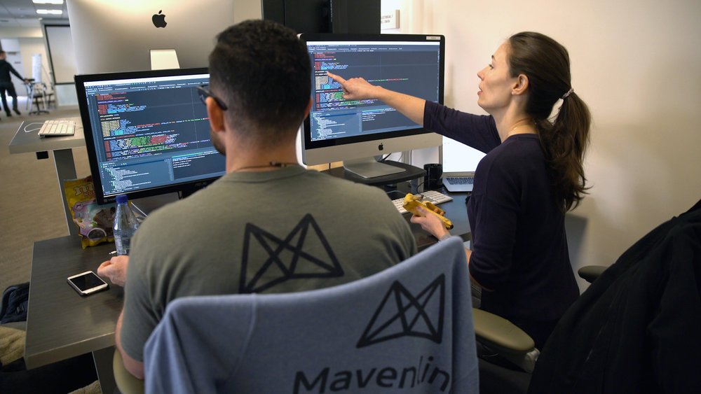
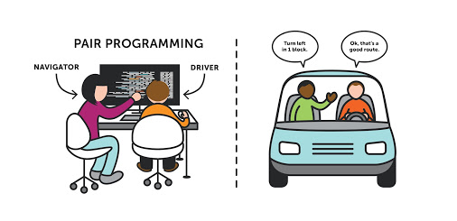
Pair Programming
All Development done in pairs.
2 Screens, 1 keyboard, 1 Mouse and 1 CPU.
One is Driver and another is Navigator , roles switch regularly.
Setup may vary.

Slide 3

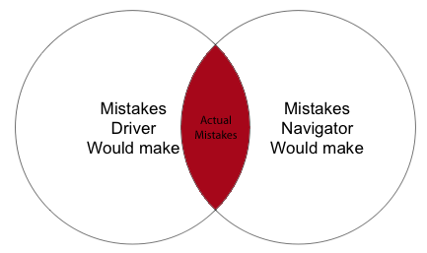
Proven Benefits
Code Generation time slightly more than doubled.
Defects reduced by 15% which reduces delivery time by 25%.
Improved problem solving and code quality.
Better Communication.
Knowledge sharing and mentoring.
Code review while developing.

Slide 4
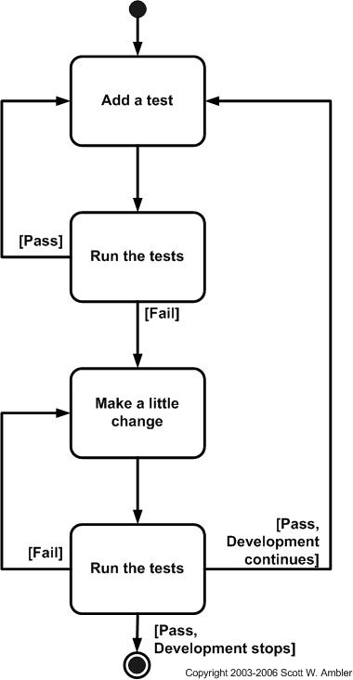

Test Driven Development
TDD is a process for writing code using tests to define and then confirm the software’s behavior.
Characterized by a set of steps known as “Red – Green – Refactor”.

Slide 5


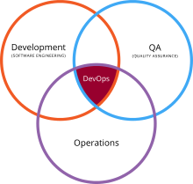


DevOps
DevOps is a set of practices that automates the processes between software development and IT teams, in order that they can build, test, and release software faster and more reliably.
DevOps is a culture, a movement, a philosophy.
Infrastructure as code allowed us to perform 10x more builds without adding a single person to our team

Slide 6

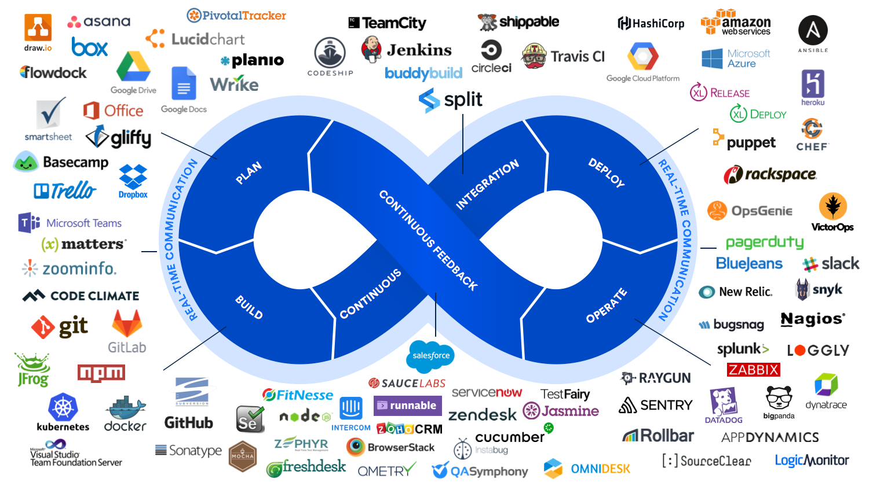

Slide 7

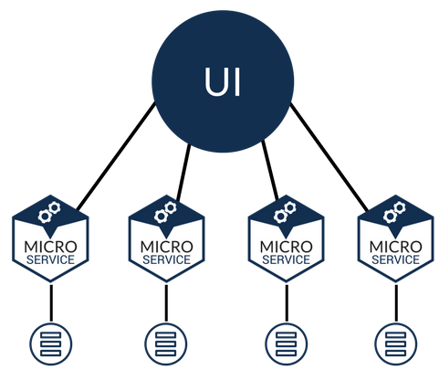
Microservices
Microservices are a software development technique.
Each of those pieces provides a particular function via a well-defined and carefully managed API.
Independently deployable, service oriented and testable.
Monoliths are big ball of mud while microservices gives you leverage of agility.

Slide 8
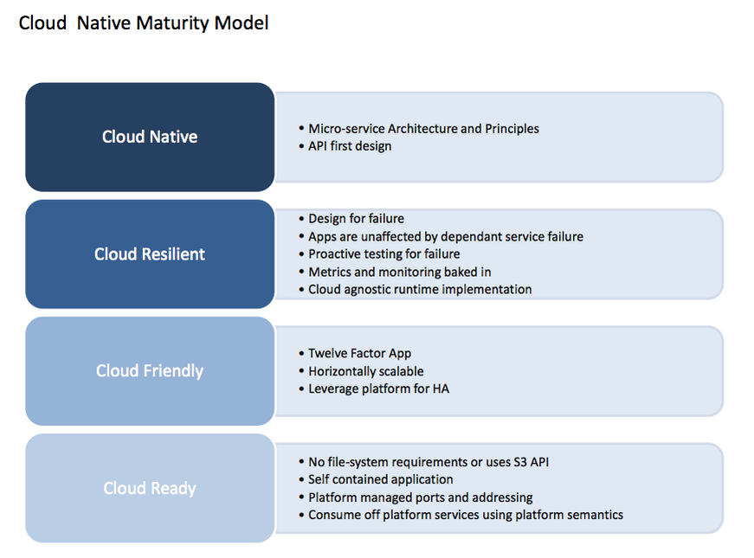
Cloud Native Maturity Model

Slide 9
Course Content
Intro to Cloud
Intro to PCF
CF CLI
Logging
Pivotal App Manager
Maven vs Gradle
GIT
CD With PCF
ERT Architecture.
Buildpacks
Marketplace and CUPS
Data Persistance
High Availability
DevOps and CI/CD
Cloud Native
Domain Driven Design
Microservice Ground
Service Registration
Circuit Breakers.
Distributed Tracing
Telemetry

