Slide 1

Pivotal Cloud Foundry – Basic Concepts

Slide 2
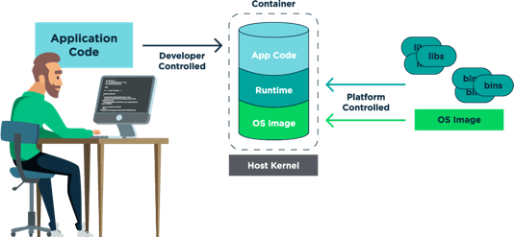
Developer With PCF

Slide 3
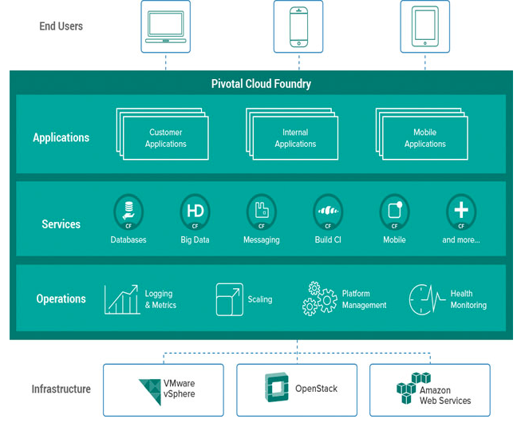
PCF in picture

Slide 4
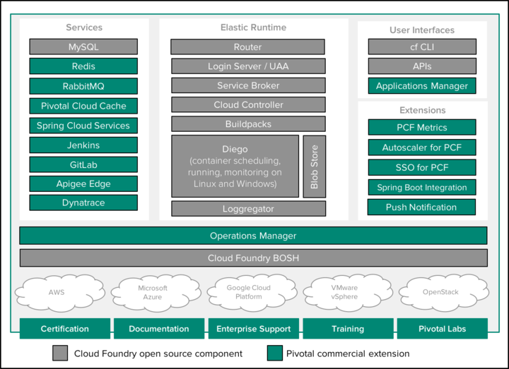
Cloud Foundry with Pivotal

Slide 5
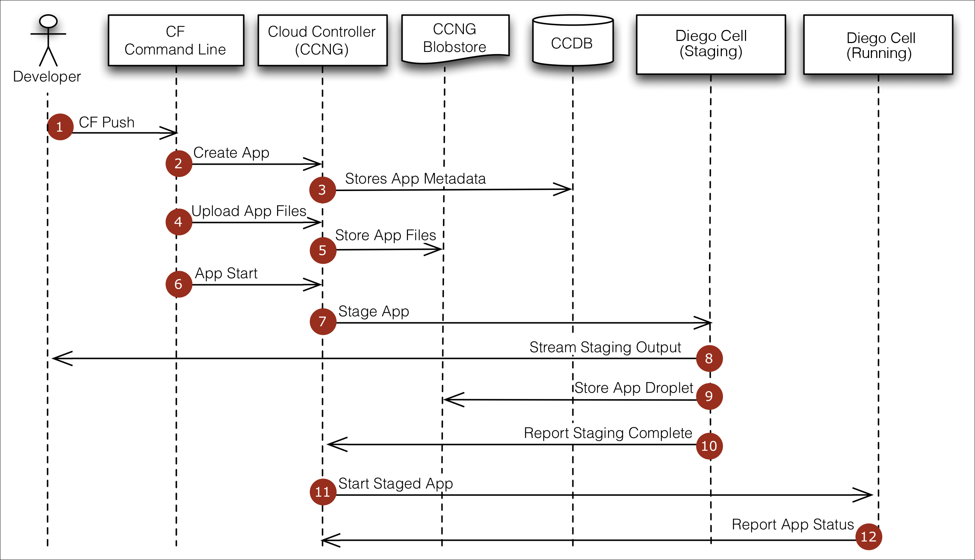
CF Push Flow

Slide 6
At the command line, the developer enters the directory containing her application source code and uses the Cloud Foundry Command Line Interface (cf CLI) to issue a push command.
The cf CLI tells the Cloud Controller to create a record for the application.
The Cloud Controller stores the application metadata. Application metadata can include the app name, number of instances the user specified, and the buildpack, and other information about the application.
Before uploading all the application source files, the cf CLI issues a resource match request to the Cloud Controller to determine if any of the application files already exist in the resource cache. When the application files are uploaded, the cf CLI omits files that exist in the resource cache by supplying the result of the resource match request. The uploaded application files are combined with the files from the resource cache to create the application package.
The Cloud Controller stores the application package in the blobstore.
The cf CLI issues an app start command.
The Cloud Controller issues a staging request to Diego, which then schedules a Diego cell(“Cell”) to run the staging task (“Task”). The Task downloads buildpacks and the app’s buildpack cache, if present. It then uses the buildpack that is detected automatically or specified with the -b flag to compile and stage the application.
The Cell streams the output of the staging process so the developer can troubleshoot application staging problems.
The Task packages the resulting compiled and staged application into a tarball called a “droplet” and the Cell stores the droplet in the blobstore. The Task also uploads the buildpack cache to the blobstore for use the next time the application is staged.
The Diego Bulletin Board System reports to the Cloud Controller that staging is complete. Staging must complete within 15 minutes or the staging is considered failed. Apps are given a minimum of 1GB memory to stage, even if the requested running memory is smaller.
Diego schedules the application as a Long Running Process on one or more Diego cells.
The Diego cells report the status of the application to the Cloud Controller.

Slide 7

Pivotal Cloud Foundry Provides…
Agility
Developer | Operation

Slide 8
Pivotal Cloud Foundry Provides…
Scalability
Horizontal | Vertical

Slide 9
Pivotal Cloud Foundry Provides…
Security
Container | UAA | Oauth | RBAC | ASG

Slide 10
Pivotal Cloud Foundry Provides…
High Availability
Availability Zones | Health Management
Process Monitoring | Resurrection for VMs

Slide 11
Pivotal Cloud Foundry Supports…
Resiliency
Fault Tolerance

Slide 12
Pivotal Cloud Foundry Supports…
Visibility
APP Manager | OPS Manager

Slide 13
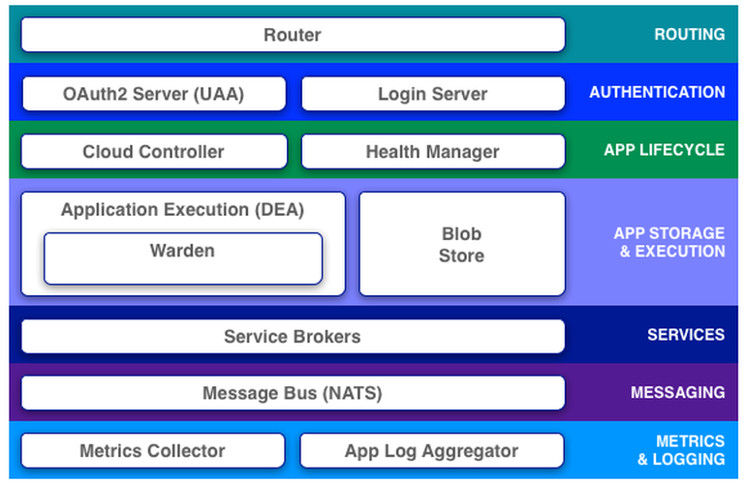
Elastic Runtime Architecture

Slide 14
How the Cloud Balances Its Load
Clouds balance their processing loads over multiple machines, optimizing for efficiency and resilience against point failure. A Cloud Foundry installation accomplishes this at three levels:
BOSH creates and deploys virtual machines (VMs) on top of a physical computing infrastructure, and deploys and runs Cloud Foundry on top of this cloud. To configure the deployment, BOSH follows a manifest document.
The CF Cloud Controller runs the apps and other processes on the cloud’s VMs, balancing demand and managing app lifecycles.
The router routes incoming traffic from the world to the VMs that are running the apps that the traffic demands, usually working with a customer-provided load balancer.

Slide 15
First Step to Cloud Native
Execute the app as one or more stateless processes.
Export Services via port binding.
Treat Logs as event streams.
No file system usage.
Fast Startup and graceful shutdown.

