Slide 1

GIT

Slide 2
What is Git?
Git manages changes to a tree of files over time
Git is optimized for:
• Distributed development
• Large file counts
• Complex merges
• Making trial branches
• Being very fast
• Being robust

Slide 3
What’s So Special about GIT?
Everyone can...
• Clone the tree
• Make and test local changes
• Submit the changes as patches via mail
• OR submit them as a published repository
• Track the upstream to revise if needed
• Every “object” has a SHA1 to uniquely identify it
• A “working tree” has a “.git” dir at the top level
• Unlike CVS, SVN: no pollution of deeper
Directories
• Many protocols to transfer between repos
rsync, http, https, git, ssh, local files

Slide 4
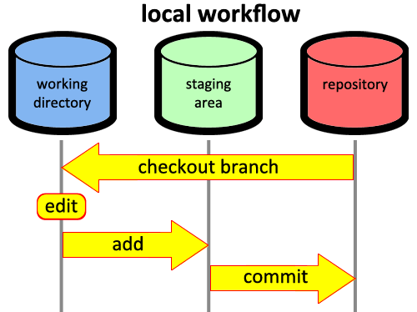
GIT Workflow
Modified
Staged
Commited

Slide 5

Lab:
Go to GitHub and create a repository there.
Copy the git repo url of newly created repository.
Go to local project path.
Use command “git init”.
Now stage your files to local repo using “git add *”.
Now commit your command from staging to local repo using “git commit –m <comment>”.
Connect central repo with local repo using “git remote add origin <url>”
Now Push your local repo to central repo using “ git push origin master”.
NOTE : IF SSL error occurs, use “git config –global http.sslVerify false”

Slide 6

Commands
git remote add [alias] [url]
git pull
git status
git diff
git branch [branch-name]
git checkout [branch-name]
git clone [url]
git rm [file]
git reset --hard [commit]
git fetch [alias]
git merge [alias]/[branch]

Slide 7

What’s Next ?
Before Starting any lab:
Git pull origin master.
Git branch <branch_name>
Git checkout <branch_name>
After Completing lab:
Git add *
Git commit –m <comment>
Git push origin master
Pull request from github.
Merge into Master.

