Slide 1

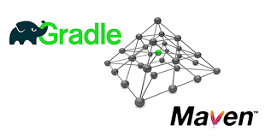

Slide 2
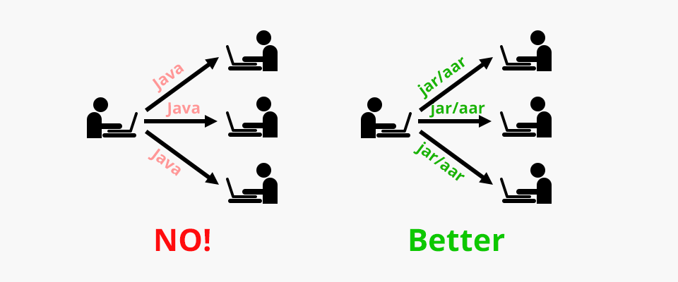
Before and After build tools

Slide 3

Build Tool
Build tools are programs that automate the creation of executable applications from source code.
Basically build automation is the act of scripting or automating a wide variety of tasks that software developers do in their day-to-day activities like:
Downloading dependencies.
Compiling source code into binary code.
Packaging that binary code.
Running tests.
Pre and Post build activities.

Slide 4


Maven Vs Gradle
Much larger user base (Been around for a long time)
Don’t have to learn groovy.
Huge central repository for libraries.
Maven continues to use XML files just like Ant.
Uses Pom.xml for conventions.
Maven’s strict conventions come with a price of being a lot less flexible than Ant.
Much faster build of all types.
Creating a highly customized build is not nightmare.
Very flexible using groovy scripts.
Uses build.gradle and settings.gradle for configuration.
Uses Maven central repository for libraries.

Slide 5
Market Usage
Ant
Ivy
Maven
2017
Gradle

Slide 6

Gradle Demo
@RestController
public class AppController {
@RequestMapping("/")
public String gradleEndpoint(){
return “Apps is Running";
}
@RequestMapping("/gradle")
public String gradleEndpoint(){
return "This is my gradle version";
}
}
Go to start.spring.io
Enter group and artifact name.
Select packaging type as jar/war whatever you like.
Select gradle as build type.
Add web dependency.
Generate project.
Run command ‘gradle eclipse’ in your package directory.
Import project in STS as gradle project.
Do Git pre lab steps like pull master, create branch and checkout branch.
Create New package named controller and create class in that named AppController.
Create endpoint for gradle.
Build your app using “gradle build”.
Run your code locally “gradle boot:run”.
Push you code to CF.
Test Your code for gradle endpoint.
Do Git post lab steps like stage, commit, push, Pull request and Merge.
Branch Name : GradleLab
Commit Comment : Pushing Gradle Lab

