Slide 1

Logging

Slide 2
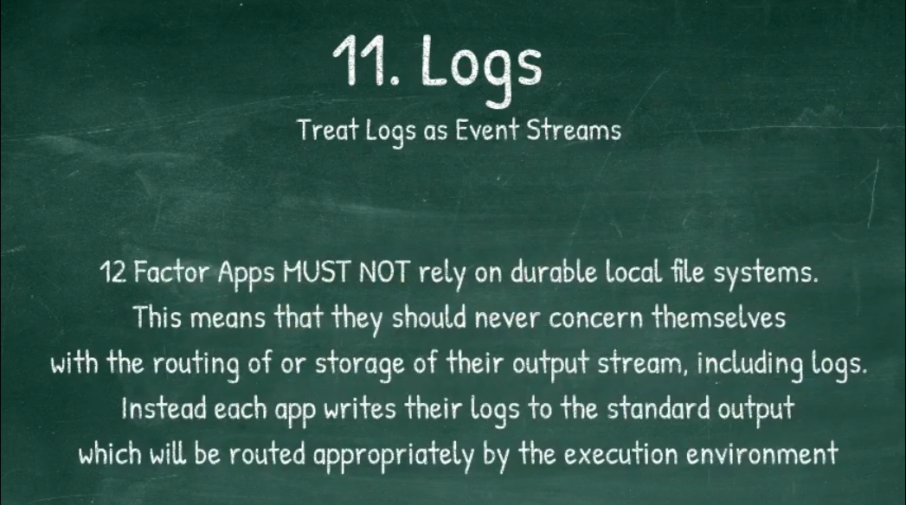
12 Factor

Slide 3

Loggregator : Metron Forward logs to the Loggregator subsystem
Cell
Rep
Executor
Loggregator
Metron

Slide 4
Loggregator : Doppler Gather logs from Metron
Loggregator
Cell
Doppler
Metron
App Syslog Drain:
Splunk
Appdynamics

Slide 5
Loggregator : Traffic Controller Handle Client requests for logs.
Loggregator
Cell
Doppler
Traffic Controller
Metron
App Syslog Drain:
Splunk
Appdynamics
cf logs <APP NAME>

Slide 6
Log Classification and Standards
STG
API
CELL
RTR
STD OUT
STD ERR

