Slide 1

Buildpack

Slide 2
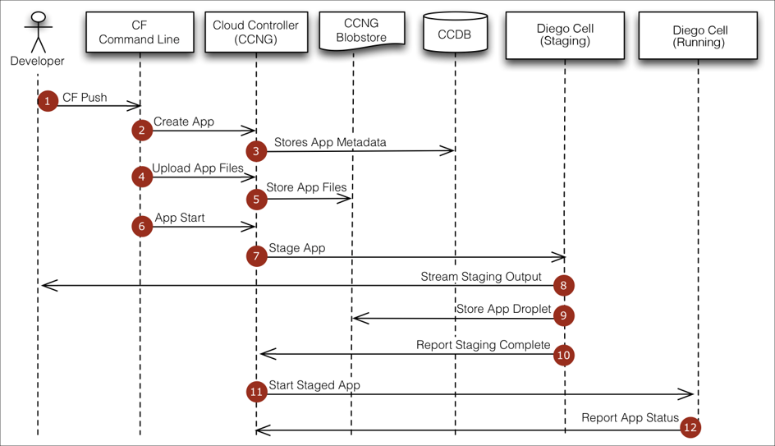
Lets Review our Push Process

Slide 3


Droplet
Application
Buildpack
Container
Libraries
Diego
Runtime
Tar Ball
Operating System

Slide 4

So, what are Buildpack ?
Buildpacks provide framework and runtime support for apps.
Buildpacks typically examine your apps to determine what dependencies to download and how to configure the apps to communicate with bound services.
When you push an app, Cloud Foundry automatically detects an appropriate buildpack for it. This buildpack is used to compile or prepare your app for launch.
Buildpacks are open sourced by CF, which can be configured by enterprise further.
For Example : https://github.com/cloudfoundry/java-buildpack

Slide 5
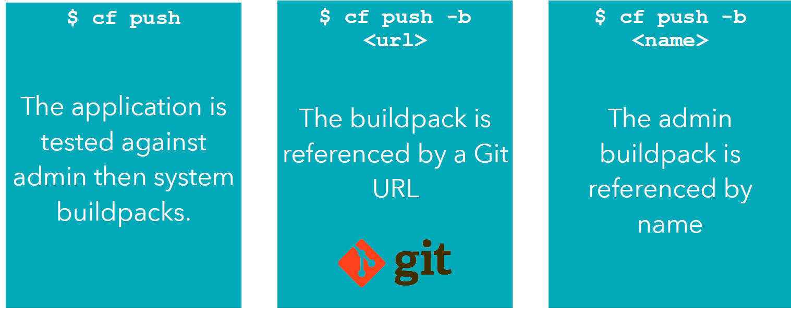
Buildpack selection

Slide 6
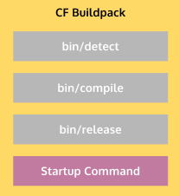
Buildpack API
bin/detect
Determines Weather buildpack can stage the application and which buildpack is needed to compile this app.
bin/compile
Compiles the app using detected buildpack and create droplet.
bin/release
Provides info on how to run the specific app using run commands.

Slide 7
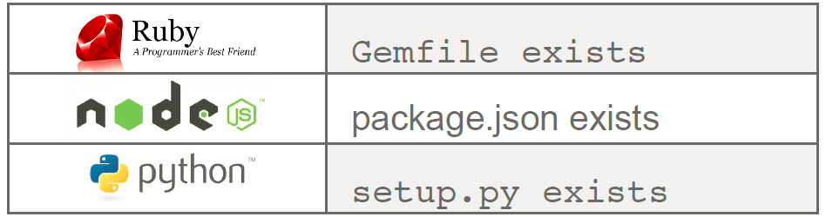
bin/detect
Inspect the app bits to determine if the buildpack knows how to handle the application
On match, return exit code 0 and write to STDOUT a string identifying the buildpack

Slide 8
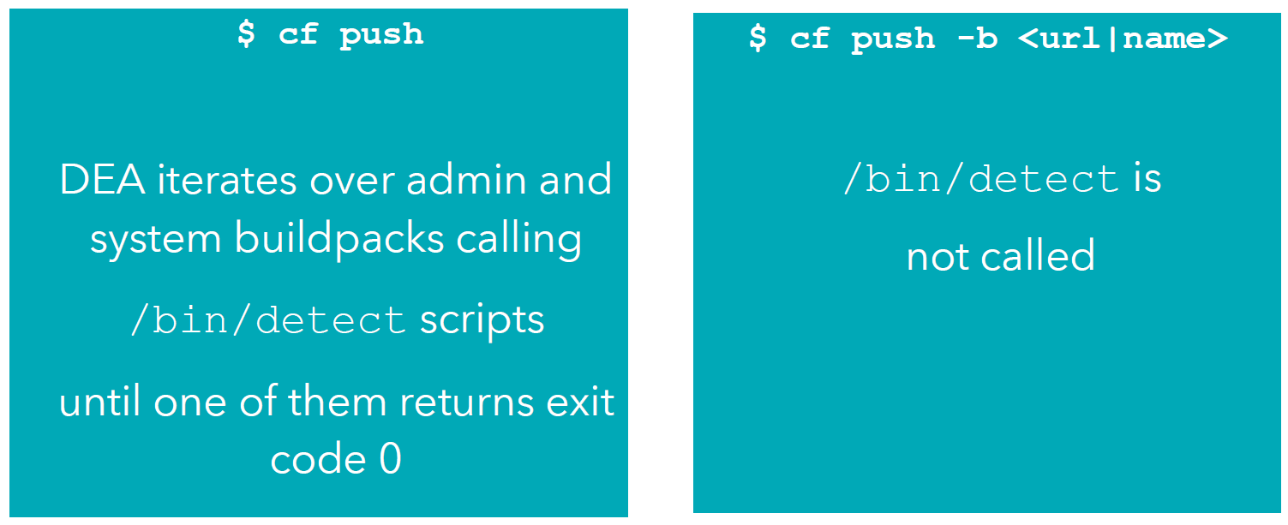
bin/detect

Slide 9
bin/compile
Download and install any necessary
runtime (Java VM, Ruby interpreter, JavaScript interpreter)
container (web server)
support libraries, packages, modules (Ruby gems, NPM
packages)
… and then installing the app bits into the runtime or container
Runtime, container, and support packages are downloaded from sources external to Cloud Foundry

Slide 10
bin/release
Creates the Start Command for your app on the basis of your app runtime and type.

Slide 11
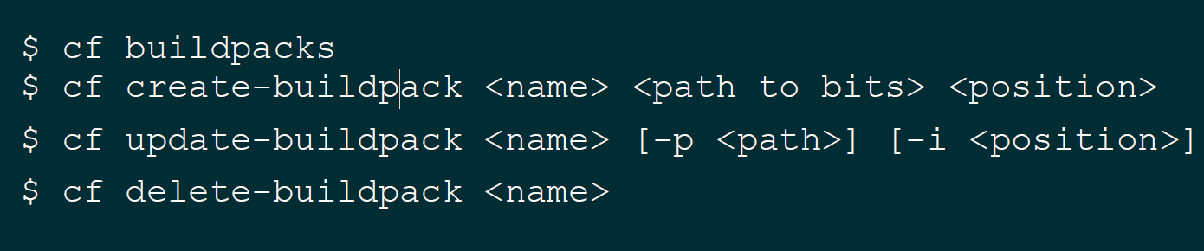
Buildpack Commands

Slide 12

Java Buildpacks
Supports a variety of JVM languages, containers, and frameworks
with a modular, configurable, and extensible design

Slide 13
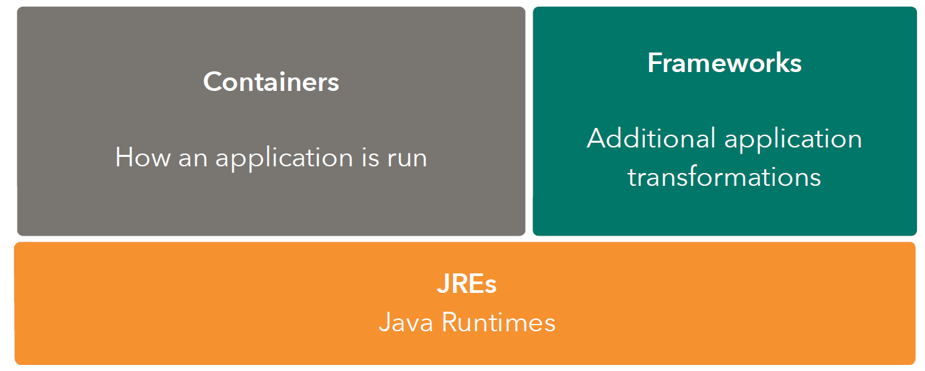
Java Buildpack Concept

Slide 14
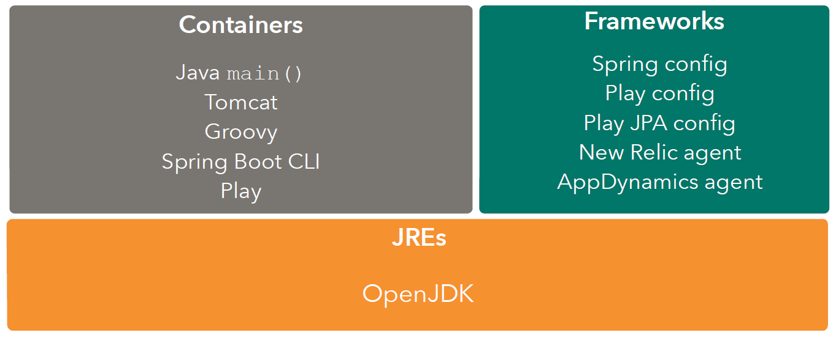
Java Buildpack Concept

Slide 15
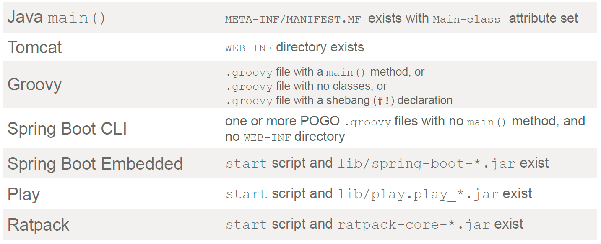
Container Detection Criteria

Slide 16
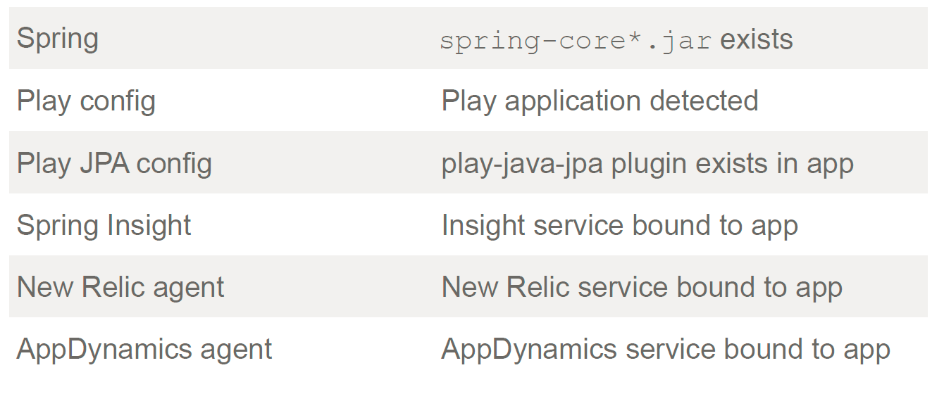
Framework Detection Criteria

Slide 17

Lets do the LAB

