Slide 1
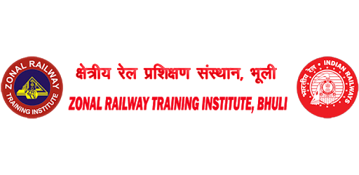
S/L working on Double line in Absolute Block System
Dhananjay Kumar Singh
Transportation Instructor
ZRTI/Bhuli

Slide 2
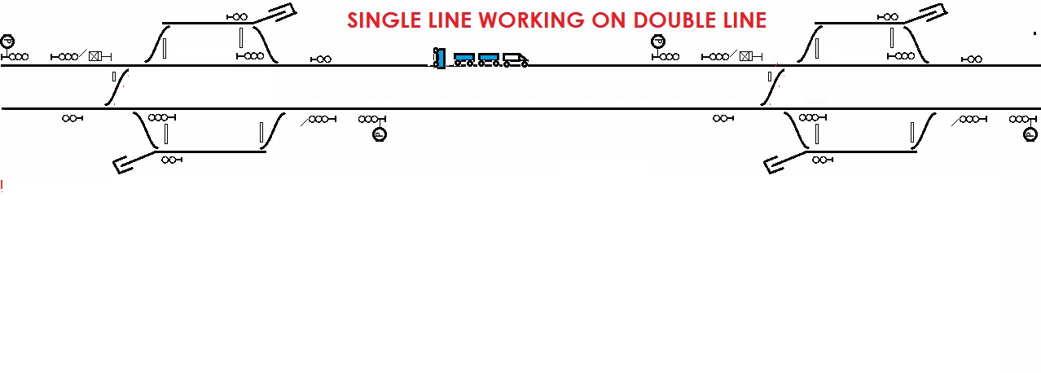
S/L working on Double line in Absolute Block System
Whenever an accident to a train or track or other obstruction takes place on a double line, the traffic may temporarily worked under the following systems:

Slide 3
S/L working on Double line in Absolute Block System
By obtaining ‘line clear’ on electric speaking instruments,
By the installation of single line block instruments and SLB demarcating the block section in the wrong direction, if the affected line is likely to remain out of use for a substantial period.

Slide 4
S/L working on Double line in Absolute Block System
On receipt of reliable information in writing that one line is clear, SM, in consultation with SCNL and the SM of the station at the other end of the section shall take steps to introduce S/L working.
In case of doubt, Track Fit/Safe Certificate shall be obtained by the engineering Official not less than the rank of an Inspector.

Slide 5
S/L working on Double line in Absolute Block System
SL working shall be introduced between the nearest stations provided with cross-over between Up and Down lines.
IBS and other intervening stations shall be kept closed and the commutators of the related block instruments shall be locked in ‘TOL’ position.

Slide 6
S/L working on Double line in Absolute Block System
SM proposing S/L working shall issue a message, to the SM at the other end of affected section, containing the following information (9 point message) under exchange of Private Numbers.

Slide 7
S/L working on Double line in Absolute Block System
9 POINT MESSAGE:
Cause of introduction of SL working.
The line in which the SL working is proposed.
Source of information that the said line is clear.

Slide 8
S/L working on Double line in Absolute Block System
Place of obstruction.
Assurance that if the train is running on the right line, the last stop signal shall be kept in the ON position. In case the train is running on the wrong line, all fixed signals shall be kept in the ON position.
Speed restriction already imposed.

Slide 9
S/L working on Double line in Absolute Block System
Assurance that the trap points, if any have been spiked or clamped and padlocked.
Names of intermediate stations if any, which would be out of use.
Arrival and departure of last train.

Slide 10
S/L working on Double line in Absolute Block System
After exchanging of the above information, line clear shall be obtained through the available means of communication.

Slide 11
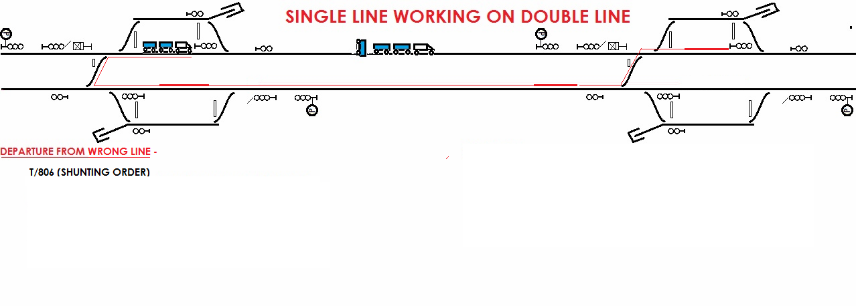
S/L working on Double line in Absolute Block System
Authority:
Wrong line –
T / 806 (shunting from right line to wrong line)

Slide 12
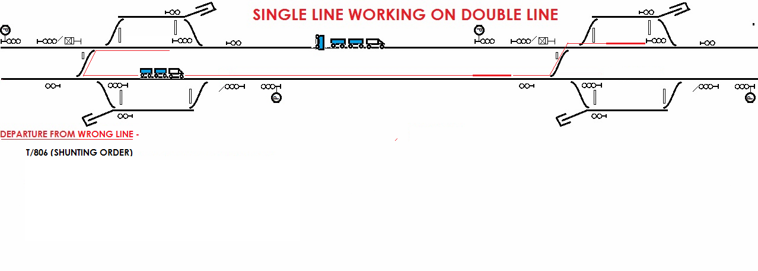
S/L working on Double line in Absolute Block System
Authority:
b. Wrong line –
T / D 602 and
T / 511 ( Starting order from non signalled line)

Slide 13
S/L working on Double line in Absolute Block System
Three parts of T / D 602 are as under:
a. Line clear ticket;
b. Authority to pass signals in ON
position; and
c. Caution Order in which the following
are mentioned –

Slide 14
S/L working on Double line in Absolute Block System
Line on which the train is going and place of obstruction,
Speed of the first train shall be 25 km/h subject to observance of other speed restrictions in force,
Warning to observe neutral section for the train going on wrong line in electrified section and clamping / spiking of trap points if any, and
Other speed restrictions in force.
Information to gangman & gateman.

Slide 15
S/L working on Double line in Absolute Block System
Loco Pilot of the first train shall inform all Gatemen and Gang men on the way about the introduction of SL working specifying the road on which the trains will run.
The Loco Pilot of the train proceeding on the wrong line shall switch ON the flasher light and sound frequently short whistles.
Second and subsequent trains may run at their booked speed subject to observance of other speed restrictions in force.

Slide 16
S/L working on Double line in Absolute Block System
RECEPTION:
Trains proceeding on the wrong line shall stop opposite the first stop signal of the right line or at the lass stop signal of the wrong line whichever comes first.
SM shall depute a railway servant with a written authority to stop the train on danger hand signal and thereafter pilot the train into the station.

Slide 17
S/L working on Double line in Absolute Block System
Authority:
Right line –
T / D 602
Three parts of T / D 602 are as under:
a. Line clear ticket;
b. Authority to pass signals in ON
position; and
c. Caution Order in which the following
are mentioned –

Slide 18
S/L working on Double line in Absolute Block System
Loco Pilot of the first train shall inform all Gatemen and Gang men on the way about the introduction of SL working specifying the road on which the trains will run.
The Loco Pilot of the train proceeding on the wrong line shall switch ON the flasher light and sound frequently short whistles.
Second and subsequent trains may run at their booked speed subject to observance of other speed restrictions in force.

Slide 19
S/L working on Double line in Absolute Block System
RECEPTION:
Trains proceeding on the right line shall be received by taking ‘Off’ the approach stop signals.
When a train is stopped between stations on account of accident, failure, obstruction or other exceptional cause and the Loco Pilot finds that it cannot proceed, it shall be protected as per GR 6.03.

Slide 20
S/L working on Double line in Absolute Block System
RESUMPTION OF NORMAL WORKING:
On receipt of a written certificate from a responsible engineering ‘Official that the obstructed track is free and safe for passage of trains, SM shall issue a message to the other station / stations under exchange of Private Number and in consultation with the SCOR, normal working shall be resumed.
Block instruments and all fixed signals including those of IBH which were treated as closed shall be brought into use immediately.
An entry shall also be made in the TSR of all stations concerned showing the time of suspension of double line working, introduction of single line working and resumption of normal working.

Slide 21
S/L working on Double line in Absolute Block System
Loco Pilot of the first train entering the section after resumption of normal working shall inform all Gatemen and Gang men on the way about the resumption of normal working.
All the records in connection with the TSL working shall be retained at the station and the TI of the section must scrutinise and submit his report to the DRM within 7 days of the resumption of normal working.

Slide 22

D.K.SINGH
Instructor Transportation
ZRTI, Bhuli

