Slide 1

TOTAL FAILURE OF COMMUNICATION ON DOUBLE LINE ABSOLUTE BLOCK SYSTEM
Dhananjay Kumar Singh
Transportation Instructor
ZRTI/Bhuli

Slide 2
TOTAL FAILURE OF COMMUNICATION ON DOUBLE LINE ABSOLUTE BLOCK SYSTEM
When line clear for a train can’t be obtained from adjacent station by any of the means of communication available at the station, such a situation is termed as total failure of communication

Slide 3
TOTAL FAILURE OF COMMUNICATION ON DOUBLE LINE ABSOLUTE BLOCK SYSTEM
MEANS OF COMMUNICATION
Block Instrument, Track Circuit & Axle Counter
Block Telephone
Control Phone
VHF Set
Station to Station fixed telephone or BSNL Phone

Slide 4
TOTAL FAILURE OF COMMUNICATION ON DOUBLE LINE ABSOLUTE BLOCK SYSTEM
The SM will stop the trains to go towards the affected block section
The Guard & Driver of the train will be informed about the fact by the SM
If the Driver is not convergent with the rules for working of trains under such situation the SM shall explain it in presence of Guard

Slide 5
TOTAL FAILURE OF COMMUNICATION ON DOUBLE LINE ABSOLUTE BLOCK SYSTEM
The SM will issue form T/C 602 to the driver and obtain the signature of Guard & Driver on the form.
The form T/C 602 includes the following items:
Authority to proceed without Line Clear
Authority to pass departure signals at ‘ON’
Caution Order: The Speed of the train will be restricted to:
i) 25kmph – during day and when visibility is clear
ii) 10kmph – during night and when visibility is not clear
iii) walking pace – during thick foggy weather & dust storm

Slide 6
TOTAL FAILURE OF COMMUNICATION ON DOUBLE LINE ABSOLUTE BLOCK SYSTEM
Dispatching of Trains:
Route shall be set correctly and all facing point shall be locked properly.
Fixed Signal, except LSS shall be taken ‘OFF’ (if possible).
2nd & subsequent trains will be dispatched after 30 minutes of interval along with the same forms & with same speed restriction as already mentioned above till normal working is resumed.

Slide 7
TOTAL FAILURE OF COMMUNICATION ON DOUBLE LINE ABSOLUTE BLOCK SYSTEM
Reception of Train:
The train will stop at the foot of FSS, there from it will be received by taking ‘OFF’ signal/signals or otherwise.
On arrival of the train at the station, the Driver will handover the form T/C 602 to the SM on duty.
The SM will keep this form in his safe custody for inspection by TI(M) who will prepare a report on the working of trains and shall forward the same to DRM, within 7 days of resumption of normal working.
The SM will record all particulars in the TSR
The train must continue to work on this system until anyone of the means of communication is restored and T/I 602 is filled.

Slide 8
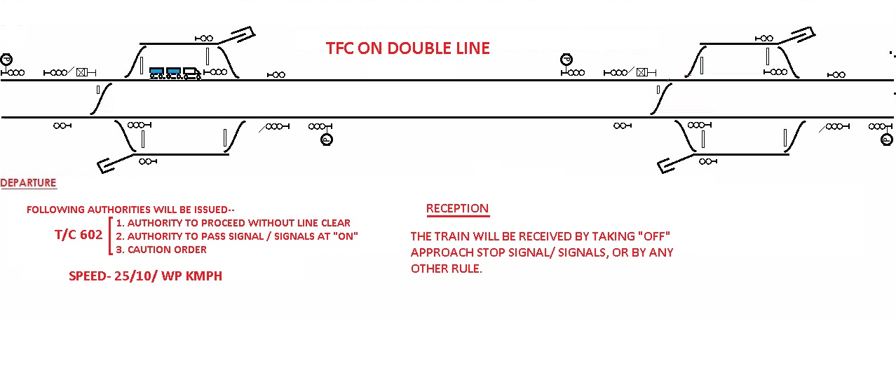
TOTAL FAILURE OF COMMUNICATION ON DOUBLE LINE ABSOLUTE BLOCK SYSTEM

Slide 9

Dhananjay kumar singh
Transportation Instructor
ZRTI/Bhuli

