Slide 1
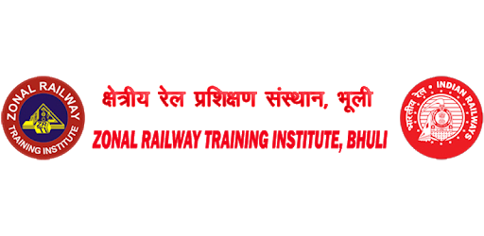
SENDING OF ASSISTING ENGINE IN AUTOMATIC BLOCK SECTION
Dhananjay Kumar Singh
Instructor
ZRTI / Bhuli

Slide 2
SENDING OF ASSISTING ENGINE IN AUTOMATIC BLOCK SECTION
If it is necessary to send an assisting train in to obstructed block section to assist a disabled train, the SM will take following Actions:-
Inform the SM of the other end of the section on telephone. The section controller shall be informed.
Advise the Guard and Loco Pilot of the assisting train of the circumstance.

Slide 3
SENDING OF ASSISTING ENGINE IN AUTOMATIC BLOCK SECTION
c) Prepare and hand over the prescribed authorities to the Loco Pilot of the assisting train form
T/C 912 (authority to proceed for Relief Engine/train into an occupied block section) which contains:-
Authority to proceed without line clear.
Authority to pass the signal/signals at ON or T/511 to start train from non-signaled line.
Caution order 15/10/WP kmph.
T/A 912, Authority to pass automatic /semiautomatic /manually operated/gate stop signals

Slide 4
SENDING OF ASSISTING ENGINE IN AUTOMATIC BLOCK SECTION
The Loco Pilot of assisting train shall be informed about the kilometers of obstruction and the station where the train is to be cleared.
When the assisting Engine/Train enters the section the SM inform the LP,GUARD and SM of other end.

Slide 5
SENDING OF ASSISTING ENGINE IN AUTOMATIC BLOCK SECTION
The section controller shall also be informed about the time of departure of Assisting Engine/ Train.
Speed must not exceed 25 KMPH over the straight line with clear view and 10 KMPH when approaching or passing any portion of the line where the view ahead is not clear due to curve, obstruction, rain, fog or any other cause subject to the observance of speed restriction imposed and speed over facing points restricted to 15 KMPH.

Slide 6
SENDING OF ASSISTING ENGINE IN AUTOMATIC BLOCK SECTION
Both by day or night a tunnel must not be entered until the Driver has ascertained that it is clear. Should there be any doubt on this point, the train should be piloted by a Railway Employee equipped with lighted hand signals and detonators.
When approaching the nominated point ahead, the Driver must bring his train / engine to stand and sound one long whistle and act to the instructions of the competent authority.

Slide 7

Dhananjay Kumar Singh
Instructor
ZRTI / Bhuli

