Slide 1
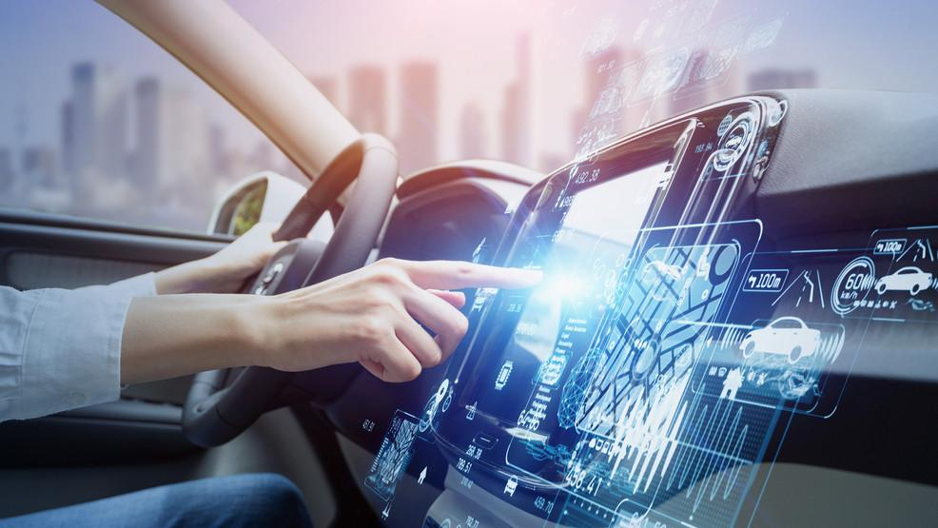
Vehicle Security System Using Deep Learning

Slide 2
About The Project
Automotive theft and accidents are arguably the growing type of crime which are least-solved in our country. While a majority of stolen vehicles are motorcycles, scooters, cars and remaining are heavy vehicles like trucks.
The use of Face recognition plays an important role in both security and surveillance which is already being used in different fields, its use and applications are rapidly spreading one of which is the implementation of Machine learning trained face recognition based automotive ignition system, which provides enhanced security and safety to both the user and vehicle.

Slide 3
Teammate
Rishikesh Chouksey - 11904832
Paritosh Parihar - 11909576
Sahyogvir Singh - 11904949
Prateek Tripathi - 11908181

Slide 4
Technology
OPEN CV
TKINTER
MACHINE LEARNING
PYTHON

Slide 5
OPEN CV
OpenCV (Open Source Computer Vision Library) is an open source computer vision and machine learning software library. OpenCV was built to provide a common infrastructure for computer vision applications and to accelerate the use of machine perception in the commercial products. Being a Berkely Software Distribution - licensed product, OpenCV makes it easy for businesses to utilize and modify the code.
TKINTER
The Tkinter package (“Tk interface”) is the standard Python interface to the Tcl/Tk GUI toolkit.Tkinter is not a thin wrapper, but adds a fair amount of its own logic to make the experience more pythonic.

Slide 6
MACHINE LEARNING
Facial recognition is a technology that is capable of recognizing a person based on their face. It employs machine learning algorithms which find, capture, store and analyse facial features in order to match them with images of individuals in a pre-existing database.
PYTHON FOR VOICE SOUNDS
The query for the assistant can be manipulated as per the user's need. Speech recognition is the process of converting audio into text. This is commonly used in voice assistants like Alexa, Siri, etc.

Slide 7
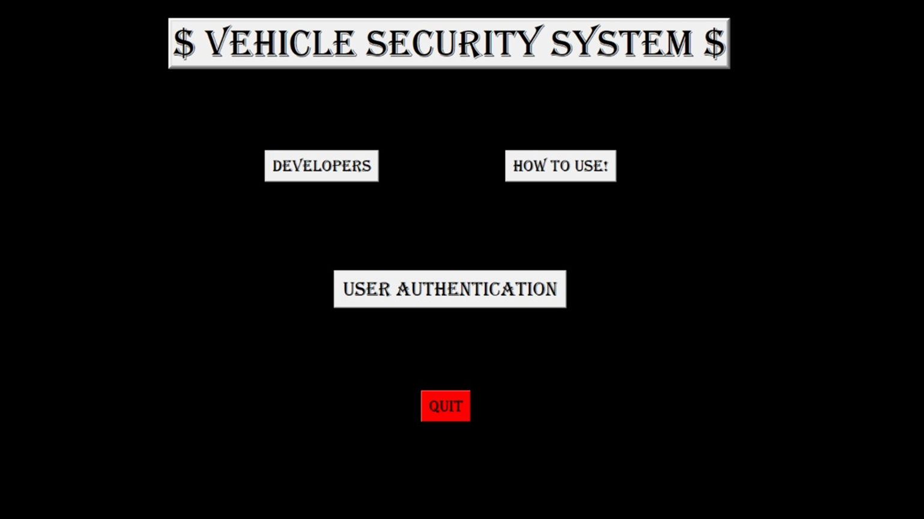
FROM THIS SCREEN USER WILL BE ABLE TO NAVIGATE TO :-
DEVELOPERS PAGE
HOW TO USE PAGE
USER AUTHENTICATION

Slide 8
HOME SCREEN
DEVELOPERS
HOW TO USE
THIS WILL SHOW THE DETAILS OF DEVELOPERS
ONCE THE USER WILL SEE THE DETAILS THEY CAN GO BACK
THIS WILL HELP USER TO KNOW HOW TO USE
ONCE THE USER WILL SEE THE DETAILS THEY CAN GO BACK

Slide 9
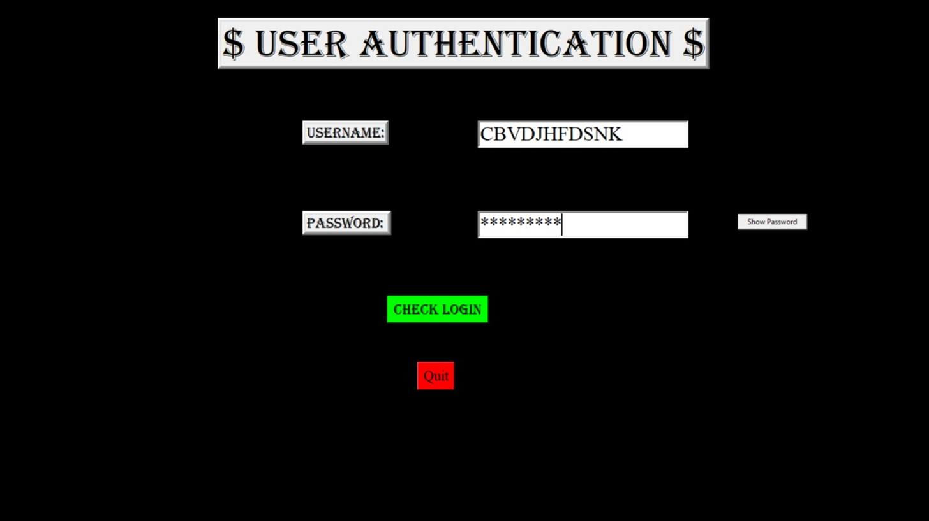
USER AUTHENTICATION IS THE FIRST PRIORITY OF OUR SYSTEM AND BEFORE THE FACIAL RECOGNITION, USER MUST KNOW THE CREDENTIALS PROVIDED BY THE CAR COMPANY.

Slide 10
USER AUTHENTICATION
CONTINUE TO FACIAL RECOGNITION
ADD NEW USER
SYSTEM WILL RECOGNISE THE FACE
USER CAN ADD NEW USER
ONCE THE USER WILL ADD NEW USER THEY CAN GO BACK
IF THE FACE IS RECOGNISED PROPERLY. USER IS GOOD TO GO
IF FACE MATCHING DEALS WITH ANY PROBLEM USER CAN USE MASTER PASSWORD.

Slide 11
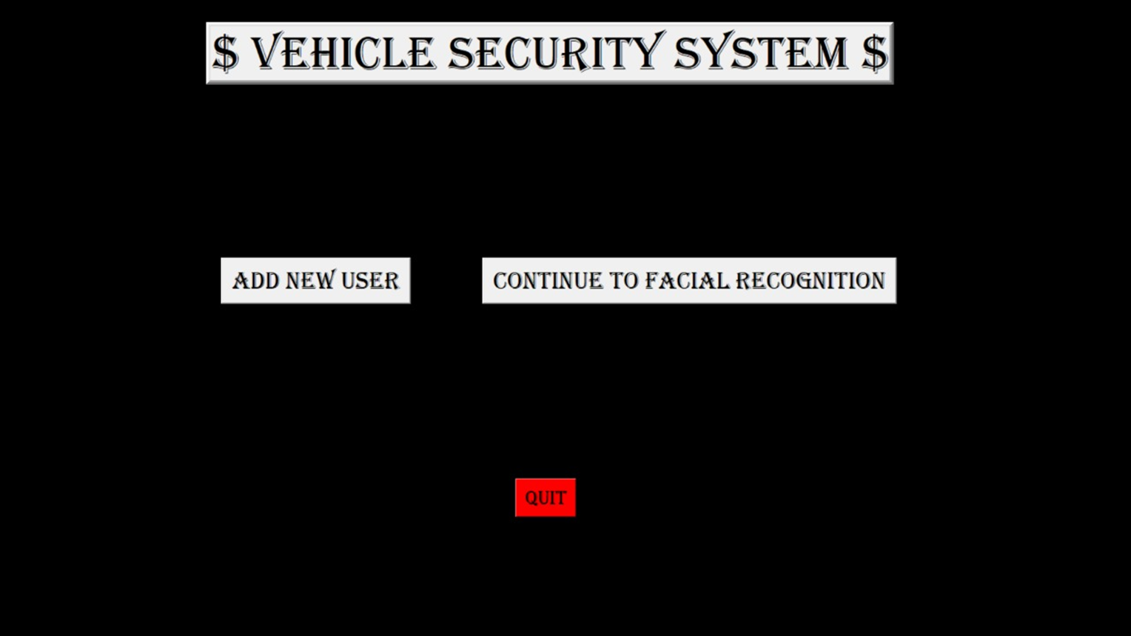
AFTER THE SUCCESSFUL VERIFICATION,
USER CAN ADD SOME MORE NEW USERS OR CAN CONTINUE WITH THE FACE RECOGNITION .
IF THE FACE IS NOT RECOGNISED USER CAN USE MASTER PASSWORD PROVIDED BY THE COMPANY.
IN CASE IF THE MASTER PASSWORD IS WRONG, ALARM WILL START AND USER WILL GET THE NOTIFICATION.

Slide 12
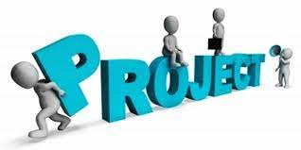
NOW LET’S PROCEED TO OUR PROJECT

