Slide 1
Minor Project
For Academic Batch 2009
III year

Slide 2

Introduction of Developers…
SHREY KUMAR JAIN
ASHISH JAIN
AKASH JAIN
RAHUL JAIN

Slide 3
Our Creations…
Generic:
  Monitoring System.
  Web Browser
  Windows Logon Changer
  Desktop Changer with Intervals
  Mark sheet Generator
Management:
  Car showroom
  Hospital
  Cinema

Slide 4
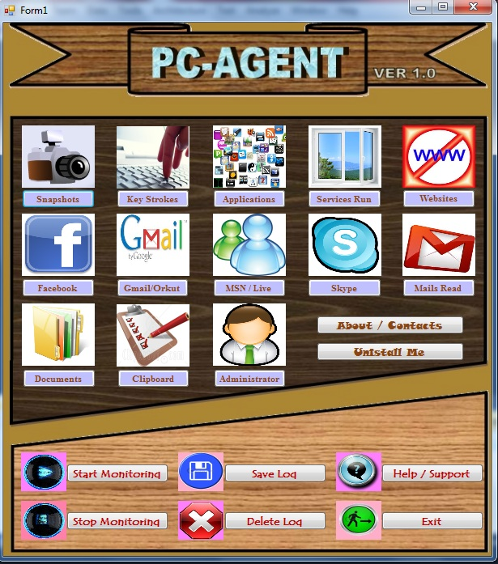
System Monitoring
SHREY KUMAR JAIN

Slide 5
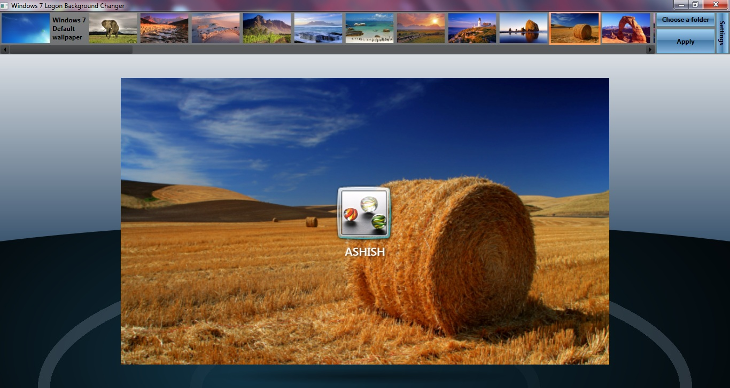
Logon Changer

Slide 6
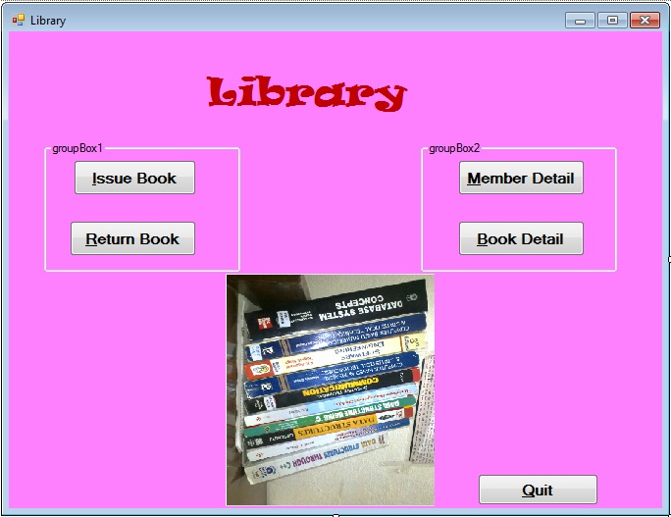
Library Management

Slide 7
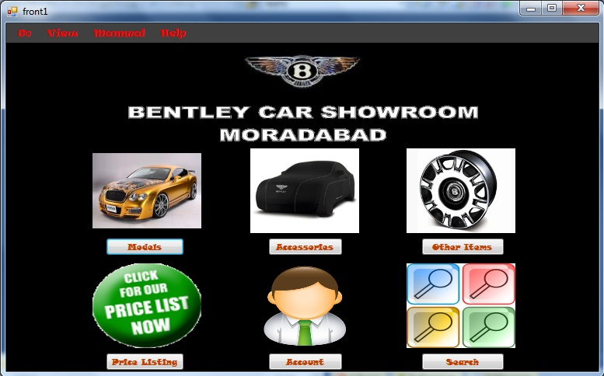
Car Showroom 1

Slide 8
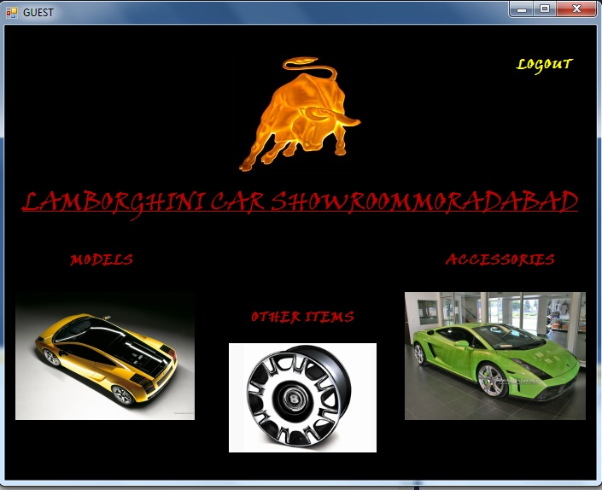
Car Showroom 2

Slide 9
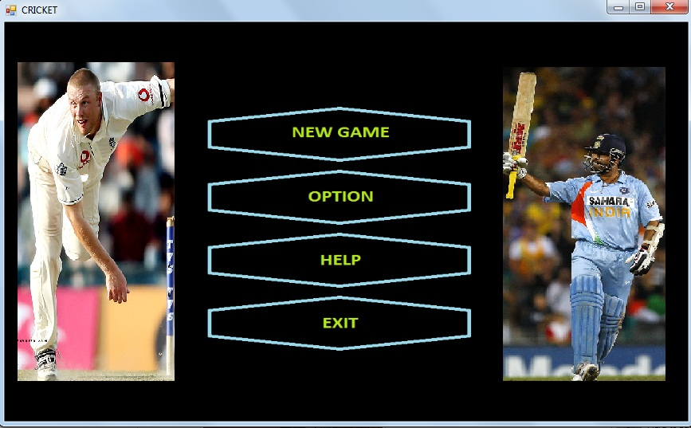
Cricket Game

Slide 10
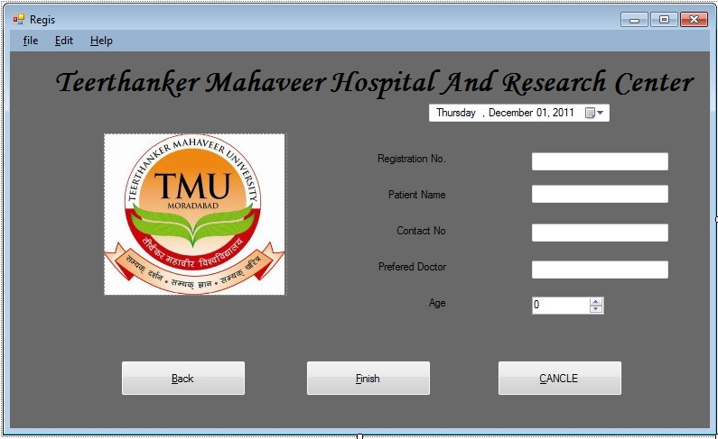
Hospital Management

Slide 11
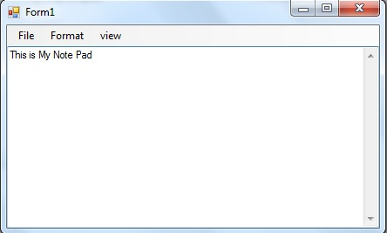
Notepad

Slide 12
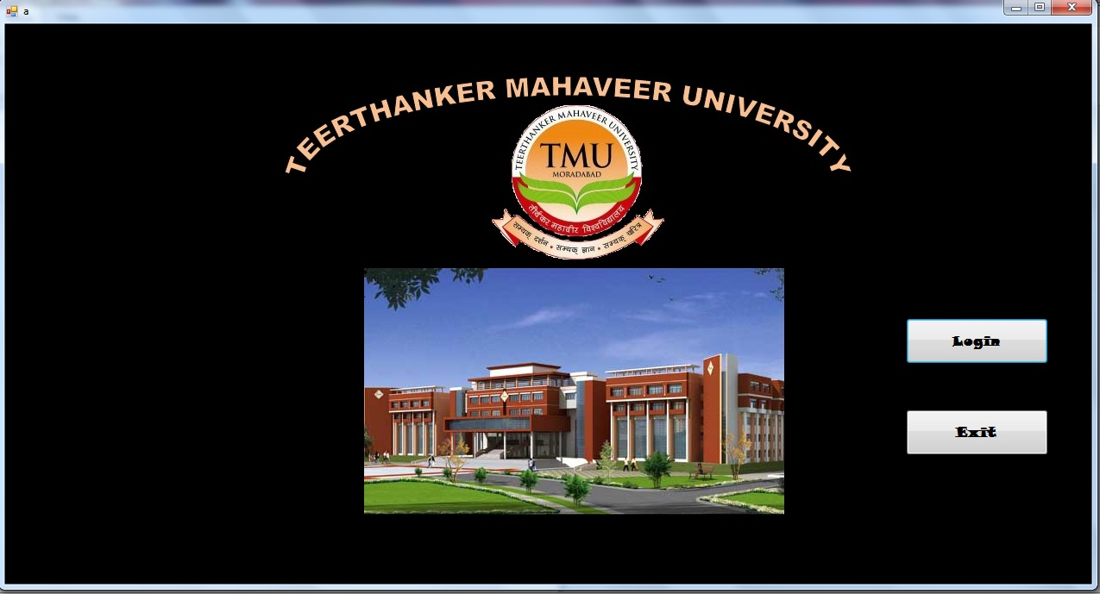
Mark sheet Generator

Slide 13
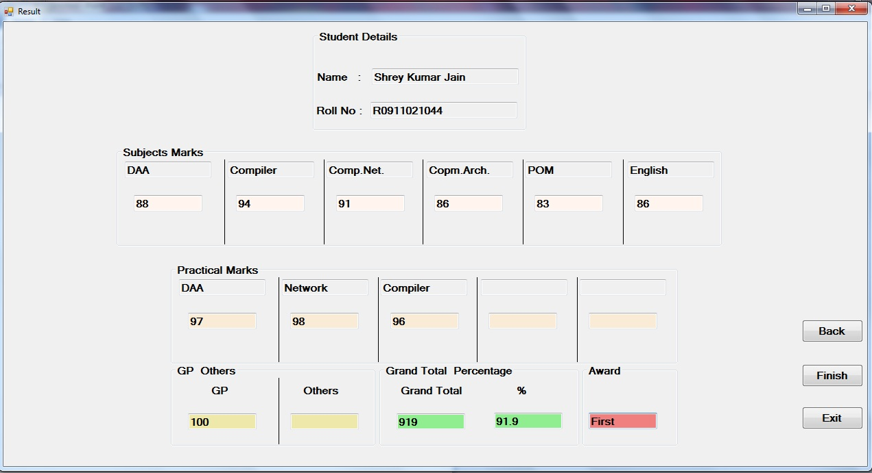

Slide 14
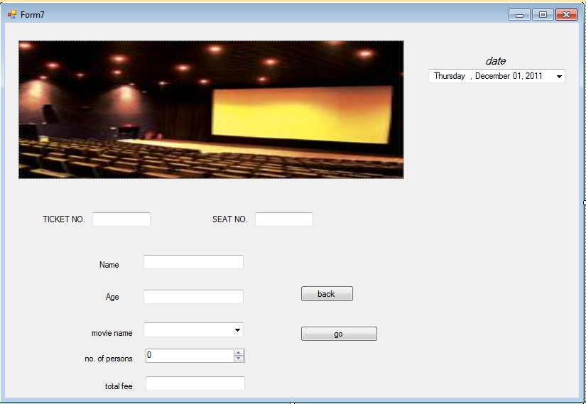
Cinema Management

Slide 15

And Number counting on....

Slide 16

OUR MINOR PROJECT

Slide 17
Web browser
We have developed:
  Net shikhar browser 1.0
  Net shikhar browser 1.1

Slide 18
Net Shikhar Browser 1.0
It Have:
  A address bar
  HTTPS support
  Internet Relay Chat (IRC)
  Direct conversion of Web page to HTML code

Slide 19
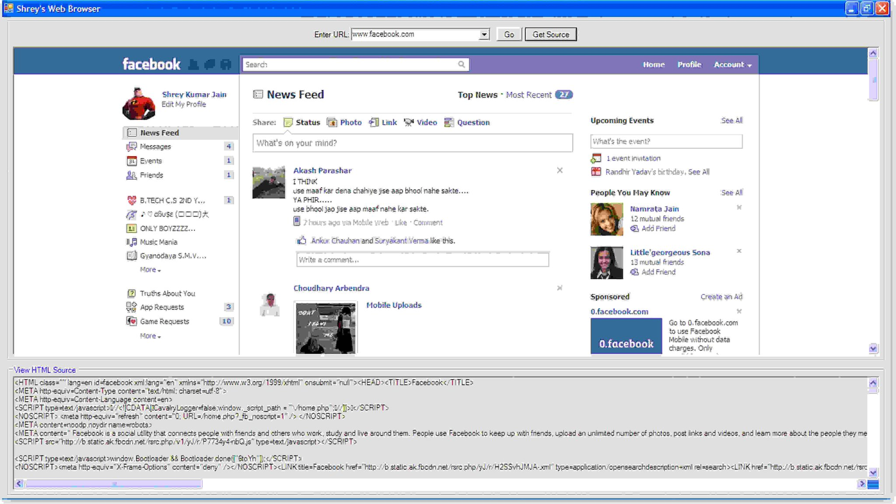
Net Shikhar Browser 1.0

Slide 20
Net Shikhar Browser 1.0
Limitation:
  No tabs
    One have to use one window to browse one website
  No history options
  No favorites and bookmarks
  No other options like
    Page save
    Print

Slide 21
To overcome the “Limitations”…
We developed a new Browser to overcome the limitations and also to add some other features.
It have the features that impressed us to submit it as our minor project…

Slide 22
The New Browser Got Name as:
Net Shikhar Browser 1.1

Slide 23
Why the name Net Shikhar Browser?
Shikhar word is a Hindi word which mean highest peak of mountain.
  as we want to reach at the highest position or the peek in the browsing field and also the user wants to browse the web pages at the highest level. So, we find the word “Shikhar” a good title for our project.

Slide 24
One more Reason…
One more reason to put Net Shikhar is that:
  when the project came to its completion till then we haven’t decided its name
  coincidently on the day of project completion we planned a journey to “Shikhar ji”
    which is a Holy place for Jains.
  So, we also got impressed when the name Net Shikhar flashed in our mind.

Slide 25
How it is different from other projects?
The full project is for Hindi users.
  The software can be easily used by the less literate or non English users.
    As you all know that the most of Indian people doesn’t know English but knows Hindi. So, we use Hindi in project so that our project can be very useful to them.
One more reason to make the project in Hindi is that our National language is also Hindi.

Slide 26
Functions:
1. Back and forward buttons
  to go back to the previous resource and forward respectively.
2. A refresh or reload button
  to reload the current resource.
3. A stop button
  to cancel loading the resource.
5. A home button
  to return to the user's home page.
6. An address bar
  to input the Uniform Resource Identifier (URI) of the desired resource and display it.
7. A search bar to input terms into a search engine.
  We use Google Search.
8. A status bar
  to display progress in loading the web page.

Slide 27
Benefits:
Have a new tab button.
To open any website in new tab
History options
Book marks
Instant Google search
Favorites and Bookmarks

Slide 28
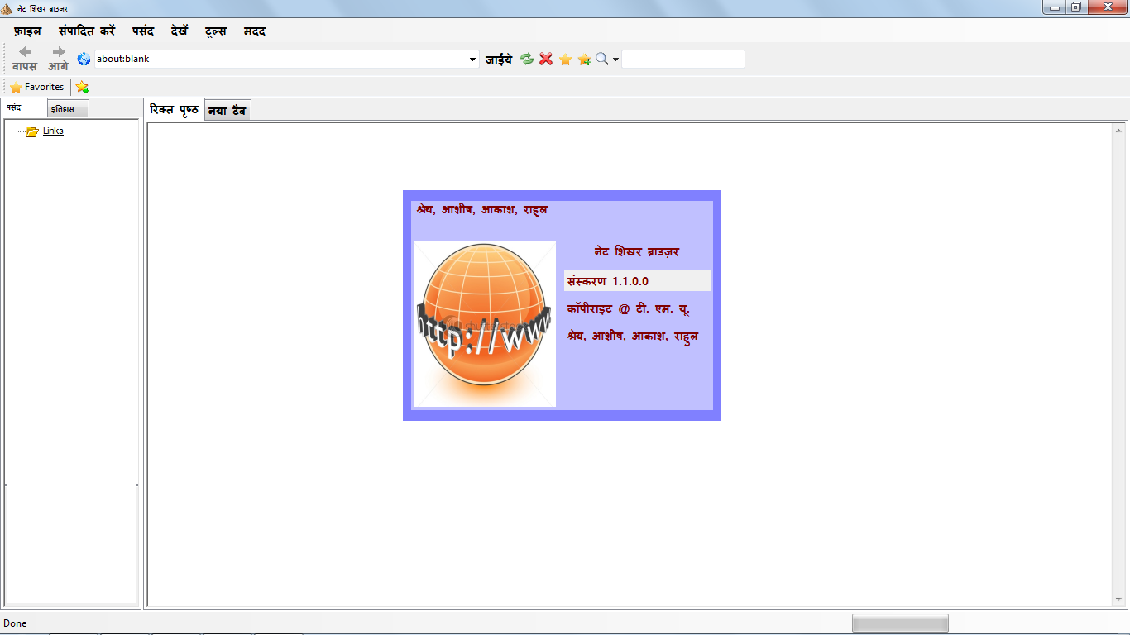
Have a look…….

Slide 29
Lets Watch the Demo…
From Installation to Working...

Slide 30
Limitations:
Extensions and plug-in are not available
You can not open a link in another tab by right clicking on it.
It does not support a multi pointing device (like double touch to zoom a web page).
It does not provide thumb nails like
  Opera
  Google Chrome.
It can not open PDF files
  but for this it can direct transfer the link to Internet explorer so that it can be opened.

Slide 31


