Slide 1
Cross Platform Applications
One code, multiple implementation: Actual portability

Slide 2
Portability ?
Compiled code runs on multiple devices / operating systems
But build package?
What about the specific extension and the system call execution?

Slide 3
What we were doing till now ?
For a particular type of device / os:
Different developers teams.
Different technologies.
Different codes.
Different development time

Slide 4
Can we solve these issues?
Can we use same team for all devices and OS?
Can we use same development technology for all use cases?
Can we use the same code without any modification?
Can we deploy it at a same time in all platforms?

Slide 5
Answer is :
Yes, we can

Slide 6
Is this a kind of sorcery or a lie ?
No, not at all
We are now in world where everything that we can think of is possible.

Slide 7





Cross platform development
We have:
ElectronJS
Ionic framework
Phonegap
Cordova
Flutter

Slide 8

What I chose ?
ElectronJs

Slide 9
What it does ?
With one code, you can build desktop apps for
Windows
Linux
Mac

Slide 10
Let’s start with initializing the app
npm init

Slide 11
Installing ElectronJs dependency
npm install --save-dev electron

Slide 12
Creating the base file
Creating app.js

Slide 13
Create the application
We will just create an HTML file

Slide 14
Starting and testing the application
npm start

Slide 15
Building package
We will require:
Icon for the package
Package builder : npm install electron-builder --save
Script describing target
Building: npm run dist

Slide 16
Let me show a good example
Text editor:
https://gitlab.com/flutura.in0128/text-editor.git

Slide 17
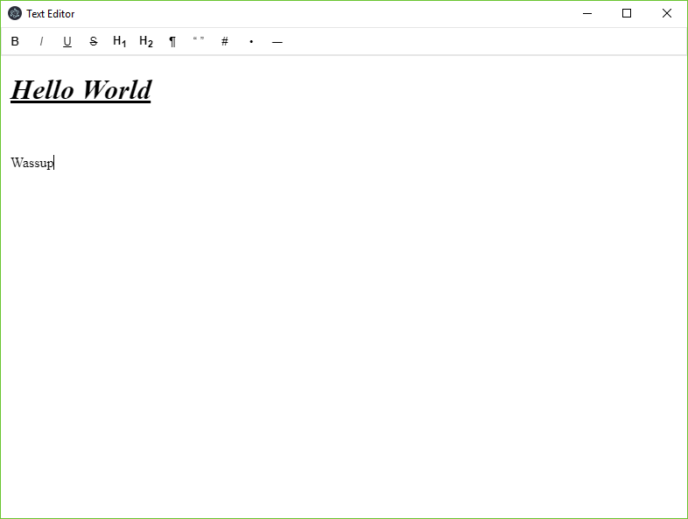

Slide 18

Thank you so much
Lets make
Great Again

