Slide 1
DEPARTMENT OF ELECTRONICS AND TELECOMMUNICATIONS SATELLITE LINK BUDGET ANALYSIS FOR DOWNLINK
BY – SMRUTI SNIGDHA PANI (1902070103)
Pratima nag (1902070105)
subhasish Patnaik (1902070106)
Kunwar Dilshad khan (1902070107)
Anurag nayak (1902070109)
DATE : 28.11.2022 sidhant Patnaik (1902070110)

Slide 2
CONTENT
INTRODUCTION TO SATELLITE LINK DESIGN
COMPLETE LINK DESIGN
DOWNLINK DESIGN
SYSTEM NOISE TEMPERATURE, T_{s}
NOISE POWER, NOISE TEMPERATURE AND NOISE FIGURE
C / N RATIO
G / T RATIO
EFFECT OF RAIN ON DOWNLINK (INCLUDES OTHER FACTORS)
REFERENCES

Slide 3
INTRODUCTION TO SATELLITE LINK DESIGN
The design of satellite link gives the estimate of :
(1) Power that the satellite receive from transmitting earth station (P_{T}), that is Transmitting Power Calculation.
(2) Power that the satellite transmit to receiving earth station (P_{R}), that is Receiving Power Calculation.
In general, these Power Calculations are known as Link Budget Calculations and the unit of power is dB.

Slide 4
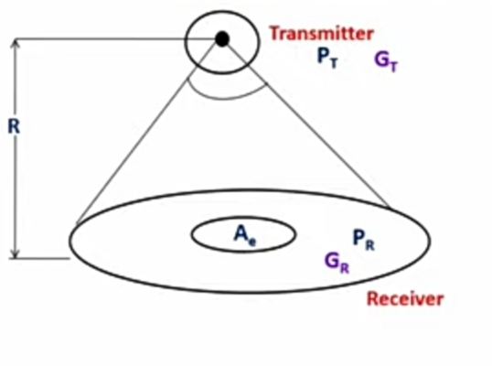
CONT…
Consider a transmitting source is radiating power, P_{T} Watt uniformly in all directions, such type of source is known as isotropic.
Flux density in the direction of antenna at a distance R is :
F = P_{T} G_{T}/4 π R²
The product P_{T} G_{T} is known as Effective Isotropic Radiated Power(E I R P).
If the receiving antenna aperture area is A_{R} m² then power received is :
P_{R} = F.A_{R}
In case of practical antenna, the relation between aperture area, A_{R} and effective aperture, A_{e} is
A_{e} = η.A_{R}
where η is aperture efficiency of antenna

Slide 5
CONT…
So, Power received by real antenna with receiving area A_{R} and effective aperture area A_{e} :
P_{R} = P_{T} G_{T} A_{e} /4 π R²
The relation between receiving antenna gain G_{R} and effective aperture area A_{e} is :
G_{R} = (4 π / λ² ) A_{e}
So, P_{R} = P_{T} G_{T} G_{R}(λ / 4 π R)²
which is, Power received = (EIRP x Receiving antenna gain)/Path loss
This equation is known as Friis Transmission Equation and the path loss/free-space loss is :
L_{FS} = (4 π R / λ)²
The received power in dB is :
P_{R} = EIRP + G_{R} – L_{FS}
where, P_{R} = received power in dBW
G_{R} = receiving antenna gain in dB
L_{FS} = path loss/free-space loss in dB

Slide 6
CONT…
In real scenario, there may be some additional losses :
L_{ta} : Losses due to transmitting antenna
L_{ra} : Losses due to receiving antenna
L_{POL} : Losses due to polarization mismatch
L_{point} : Losses due to antenna depointing
A_{rain} : attenuation due to precipitation and clouds
A_{AG} : attenuation due to atmosphere
The received power in dB is :
[P_{R}] = EIRP + G_{R} – L_{FS} – [L_{ta}] – [L_{ra}] – [L_{POL}] – [L_{point}] – [A_{rain}] – [A_{AG}]

Slide 7
COMPLETE LINK DESIGN
A complete link consist of two earth stations and a satellite, so complete link is made up of uplink and downlink.
So, the quality of information received on earth station depends on uplink, satellite transponder and downlink.
The uplink is characterized by (C / N_{o})_{U} at the transponder input and downlink is characterized by (C / N_{o})_{D.}
The carrier to noise power spectral density ratio is (C / N_{o})_{T} at the receiving earth station by considering uplink and downlink.
(C / N_{o})_{T}⁻¹ = (C / N_{o})_{U}⁻¹ + (C / N_{o})_{D}⁻¹
Normally, (C / N_{o})_{U} is much greater than (C / N_{o})_{D} . So, (C / N_{o})_{T} = (C / N_{o})_{D}
Complete link design depends on quality of downlink, especially on (C / N_{o})_{D}

Slide 8
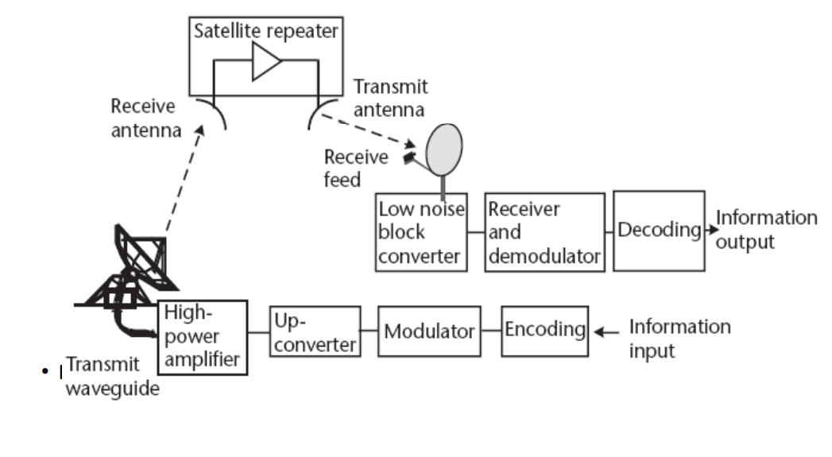
Design Of Satellite Link

Slide 9
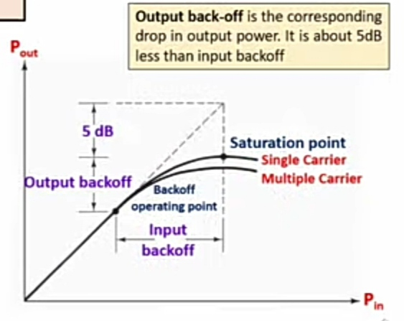
DOWNLINK DESIGN
The downlink of a satellite circuit is the one in which the satellite is transmitting the signal and the earth station is receiving it.
Design of downlink is difficult as compared to uplink.
When the input backoff (in uplink design) is employed, a corresponding output backoff must be allowed. The backoff is required for the operation of Travelling wave tube (TWT).
Due to non-linear characteristics of TWT amplifier, the input backoff and output backoff are not the same.
Therefore, above the saturation, the linear characteristics are extrapolated and backoff is taken 5 dB below the extrapolated linear characteristics.

Slide 10
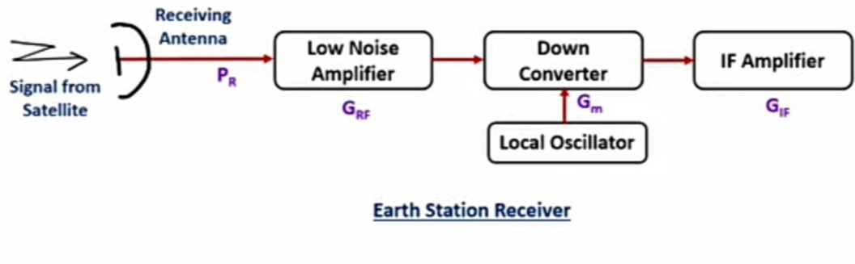
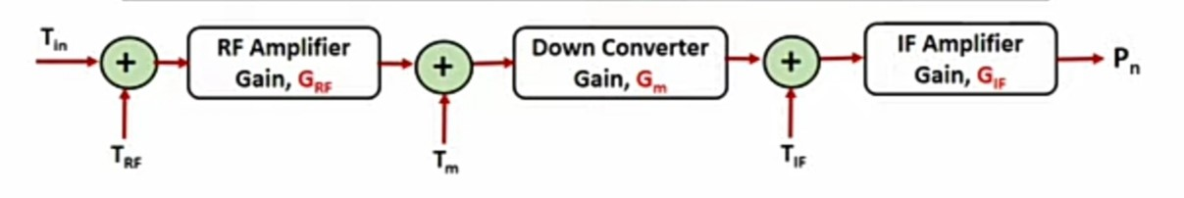
SYSTEM NOISE TEMPERATURE, T_{s}
The receiver system performance is determined by system noise temperature . It is also known as effective input noise temperature of receiver.
Equivalent circuit of Receiver where each device is replaced by single noise source

Slide 11
CONT...
Equivalent circuit of Receiver where each device is replaced by single noise source
Total noise power at the output of IF amplifier is :
P_{n} = G_{IF} K T_{IF} B + G_{IF} G_{m} K T_{m} B + G_{RF} G_{m} G_{IF} K B (T_{in} + T_{RF} )
=> P_{n} = G_{IF} G_{m} G_{RF} K B[T_{RF} + T_{in} + T_{m} / G_{RF} + T_{IF} / G_{m} G_{RF}]
With system noise temperature T_{S} , the noise power P_{n} at the output of IF amplifier is :
P_{n} = G_{RF} G_{m} G_{IF} K T_{s} B

Slide 12
CONT…
=> G_{RF} G_{m} G_{IF} K T_{s} B = G_{IF} G_{m} G_{RF} K B[T_{RF} + T_{in} + T_{m} / G_{RF} + T_{IF} / G_{m} G_{RF}]
So, T_{S} = [T_{RF} + T_{in} + T_{m} / G_{RF} + T_{IF} / G_{m} G_{RF}]
Since the gain of each stage is added in the receiver, so the succeeding stages contribute less and less noise.

Slide 13
NOISE POWER, NOISE TEMPERATURE AND NOISE FIGURE
The major source of noise in equipment, arises from the lossy components of antenna in receiver. The noise power from a thermal noise source is :
P_{N} = k T_{N} B
where, T_{N} = equivalent noise temperature
B = Bandwidth
K = Boltzmann’s constant (1.38 x 10 ⁻²³ J / K)
The noise power per unit bandwidth is known as noise power spectral density, N_{O}
N_{O} = P_{N} / B = k T_{N}
Noise temperature ( T_{D} ) is a very important parameter as it provides a way of determining thermal noise generated in receiver. The noise temperature is directly related to physical temperature of noise source but not always equal to it.
Noise figure is frequently used to specify the noise generated within the device.
Noise figure, NF = (S / N)_{IN} / (S / N)_{OUT}
The relation between noise temperature and noise figure is :
T_{D} = T_{O} (NF-1) where, T_{O} = Reference temperature usually 290 K

Slide 14
C / N RATIO
If overall gain of receiver is G, then noise power at demodulator input is :
P_{N} = k T_{N} B G
If P_{R} is the signal power at the input to the receiver then signal power at demodulator input is :
C = P_{R} G
Hence, carrier to noise ratio is : C / N = P_{R} G / K T_{S} B G
So, C / N = P_{R} / K T_{S} B
We know, P_{R} = P_{T} G_{T} G_{R}(λ / 4 π R)²
C / N = P_{T} G_{T} G_{R}(λ)² / K T_{S} B (4 π R)²
Ratio of carrier to noise power spectral density (N_{O}),
C / N_{O} = P_{T} G_{T} G_{R}(λ)² / K T_{S} (4 π R)² where, N_{O} = N / B

Slide 15
G / T RATIO
G / T (dB / K) ratio is a figure of merit, which is widely used to specify quality of an earth station.
We know, C / N = P_{T} G_{T} G_{R}(λ)² / K T_{S} B (4 π R)²
Hence, C / N α G_{R} / T_{S} where, T_{s} is sky temp.
Carrier to noise power ratio in dB is :
(C / N)_{dB} = 10 log P_{T} G_{T} – 20 log (4 π R / λ) + 10 log (G_{R} / T_{S} ) – 10 log (K) – 10 log (B)
Carrier to noise power spectral density ratio in dB is :
(C / N_{o})_{dB} = 10 log P_{T} G_{T} – 20 log (4 π R / λ) + 10 log (G_{R} / T_{S} ) – 10 log (K)
where, N_{o} = N / B

Slide 16
EFFECT OF RAIN ON DOWNLINK
Rainfall results in attenuation of radio waves by scattering and by absorption of energy from the wave.
Rain attenuation increases with increasing frequency and is worse in Ku band in comparison to C band.
Rainfall impacts both Uplink and Downlink.
In case of Downlink, rainfall introduces attenuation by various factors like :
(1) Absorption
(2) Scattering of signal energy
Let [A] dB represents the rain attenuation caused by absorption then associated power loss ratio is : A = 10 ^{(A) /10}
The effective noise temperature due to rain is expressed as :
T_{RAIN} = T_{a} ( 1 – 1/A )
The total sky noise temperature is : T_{SKY} = T_{S} + T_{RAIN}
The relation between Downlink ( C / N_{o} ) power ratio and clear sky is :
( N_{O} / C )_{RAIN} = ( N_{O} / C ) [ A + ( A – 1 )T_{a} / T_{S} ] where, T_{a} = Apparent temperature, (270 – 290)◦ K

Slide 17
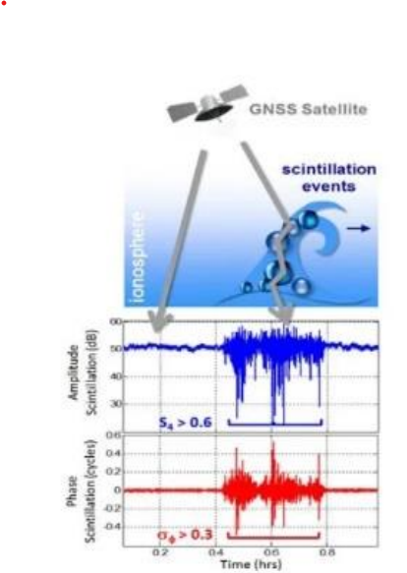
EFFECT OF Scintillation ON DOWNLINK
Rapid Fluctuation of the amplitude and the phase of a radio wave caused by small scale irregularities in the transmission path with time.
In propagation, scintillation refers to the rapid variation of the amplitude and phase of a received signal.
Scintillation is produced by structure in the ionosphere.
Specifically, scintillation at the received is produced by constructive and destructive interference of refracted and diffracted components if the broadcast signal.

Slide 18
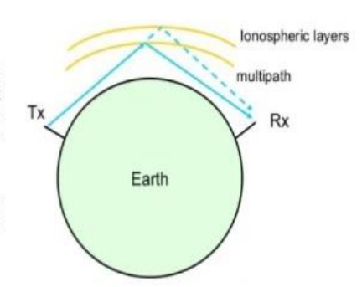
EFFECT OF Multipath ON DOWNLINK
This occurs when a transmitted radio wave reaching the receiving antenna by two or more propagation path. Multipath can result from refractive index irregularities in the troposphere or ionosphere; or from structural and terrain scattering on the earth’s surface.
Causes of multipath include atmospheric ducting, ionospheric reflection and refraction from water bodies and terrestrial objects such as mountains and building.

Slide 19
REFERENCES
https://www.tutorialspoint.com/satellite_communication/images/satellite-communication-mini-logo.jpg
https://www.aero.iitb.ac.in/satelliteWiki/index.php/Link_Budget
https://electronicsdesk.com/satellite-link-budget.html
https://electronicsdesk.com/satellite-link-budget.html

Slide 20
THANK YOU...

