Slide 1

Saswat Subhadarsi Sarangi (1902070111)
Divya Mahananda
(1902070112)
Sillan Kumar Sahani
(1902070114)
Subhransu Sekhar Mohanty (1902070115)
Sai Samarpita(1902070116)
Sarthak Padhy(1902070117)
Modulation Schemes in Satellite Communication
ELECTRONICS & TELECOMMUNICATION ENGINEERING

Slide 2
CONTENTS
Modulation
Why Modulation
Analog Modulation
AM
FM
PM
Digital Modulation
ASK
FSK
PSK(BPSK, QPSK)

Slide 3
MODULATION
A process of varying one or more properties of carrier signals with message/modulation signal.
Properties can be amplitude, frequency and phase.

Slide 4
WHY MODULATION?
Enables the adjustment of antenna in terms of size.
Enables long distance communication
Reduces the effect of noise on the signal.
Need of digital modulation because digital modulation provides flexibility.
Flexibility indicates ruggedity, compression, encryption, and possibility of error correction.

Slide 5
WHY MODULATION?(Cont.)
C=B*log2(1+S/N)
Here, C: channel capacity in bits/second
B:bandwidth of the channel in Hz
S: Signal power in watts
N:Noise power in watts
Keeping the bandwidth constant, does it mean that infinite bits can be transmitted over a channel by varying the signal to noise ratio?

Slide 6
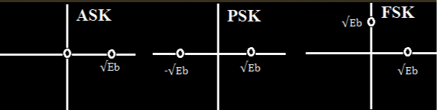
WHY MODULATION?(Cont.)

Slide 7
Analog Modulation
A procedure of transmitting low-frequency baseband signals along with a
high-frequency carrier signal
A bandpass channel is required where it corresponds to the specific range
of frequencies
The carrier signal is represented as:
Ac*cos (2∏fct + Ф)
Where; Ac- amplitude, fc - frequency and Ф - phase of the carrier signal

Slide 8
Amplitude Modulation
In amplitude modulation ,the amplitude of the carrier signal is varied in accordance with the amplitude of the modulating signal by maintaining frequency and phase at constant.
The modulating (input signal) represented as : i(t) = Aicos(2∏fit)
The carrier signal is represented as: c(t) = Accos(2∏fct)
In the expressions, Ai and Ac represent the amplitudes of two waves while fi and fc are the frequencies of the two waves correspondingly.
Solving the two expressions, a modulated wave is represented as:
M(t) = Ai + Accos (2∏ (fi+ fc)t)
The modulating signal is twice the band-width of the message signal.

Slide 9
Frequency Modulation
In frequency modulation, the frequency of the carrier signal is varied in correspondence
with the amplitude of the modulating signal by maintaining amplitude and phase
at constant.
When the modulating (input signal) is represented as i(t) and the carrier signal is
represented as c(t) = Accos(2∏fct) , then the frequency- modulated
wave is M(t) = A cos (2∏fc + ks(t)t + Ф)
The bandwidth of the FM modulated wave is cosidered in two cases:
In narrowband FM, the bandwidth is two times the maximum frequency of the FM.
In wideband FM, the bandwidth is very large of the FM spectrum.

Slide 10
Phase Modulation
In phase modulation, the phase of the carrier signal is varied in correspondence with the amplitude of the modulating signal by maintaining amplitude and frequency at constant.
P(t) = Accos[Wct + kpm(t)]
Here Ac represents the amplitude of the carrier signal
Wc represents the carrier signal’s angular frequency 2∏fc
And m(t) represents the modulating signal

Slide 11
Digital Modulation
parameter of analog carrier is varied between two or more discrete states.
Historically known as “Shift Keying”
Power of digital signal processing makes digital modulation a natural choice.

Slide 12
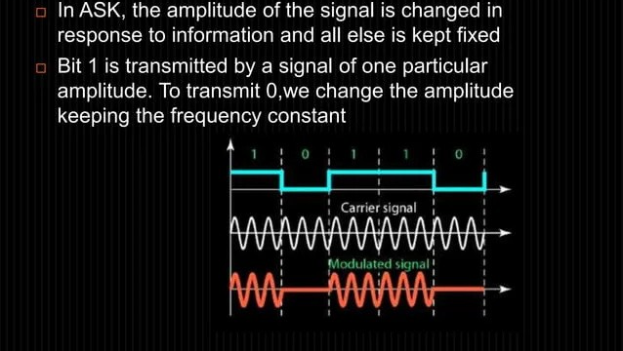
Amplitude Shift Keying

Slide 13
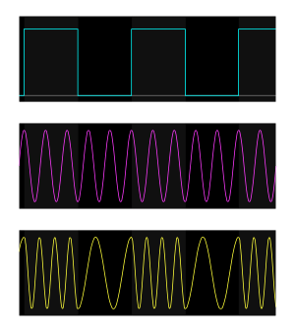
Frequency Shift Keying
- In FSK, frequency of the carrier wave is changed according to the discrete baseband signal
- One particular frequency is used for a ‘1’ and another frequency for a ‘0’

Slide 14
Phase Shift Keying
A digital modulation scheme that conveys data by changing the phase of carrier signal
Universally used for satellite links
Phase of carrier is set into one of m states according to the value of a modulating voltage
phase state of the transmitted signal represents a symbol, which can convey more than one bit.

Slide 15
Binary Phase Shift Keying
Digital modulation technique that conveys data by modulating two different phases of carrier wave(reference) separated by 180⁰.
Also known as 2-PSK
Use different phased signals to represent binary values.
0 = In phase with reference
1= Out of phase with reference

Slide 16
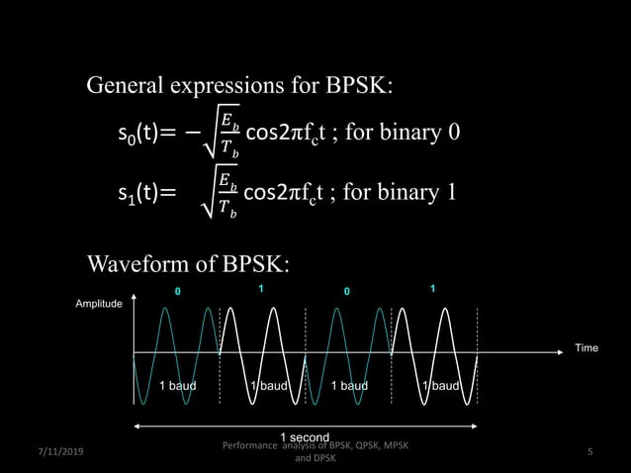
BPSK (Cont.)

Slide 17
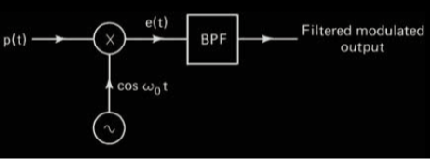
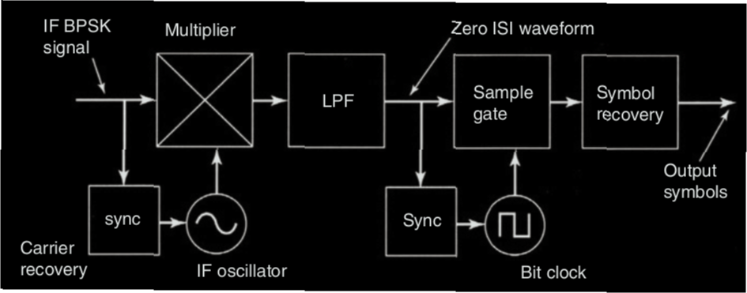
BPSK Modulator and Demodulator

Slide 18
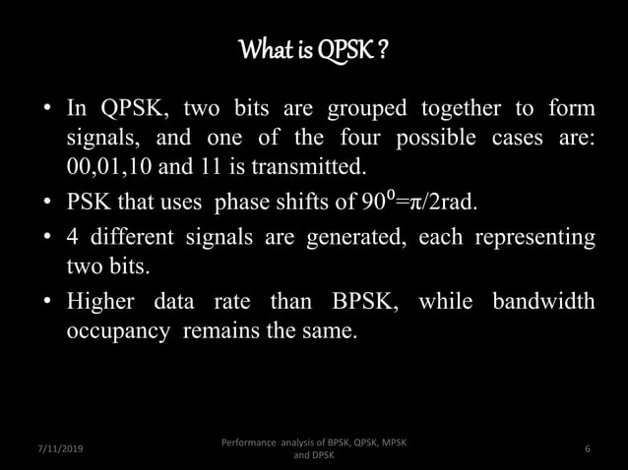
QUADRATURE PHASE SHIFT KEYING

Slide 19
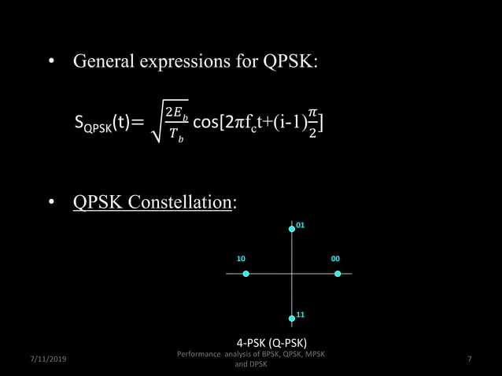
QPSK(Cont.)

Slide 20
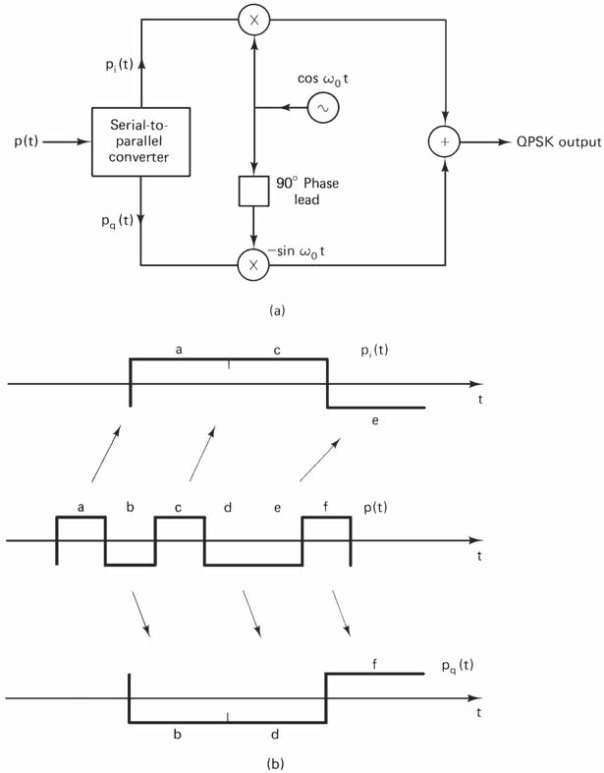
QPSK Modulator

Slide 21
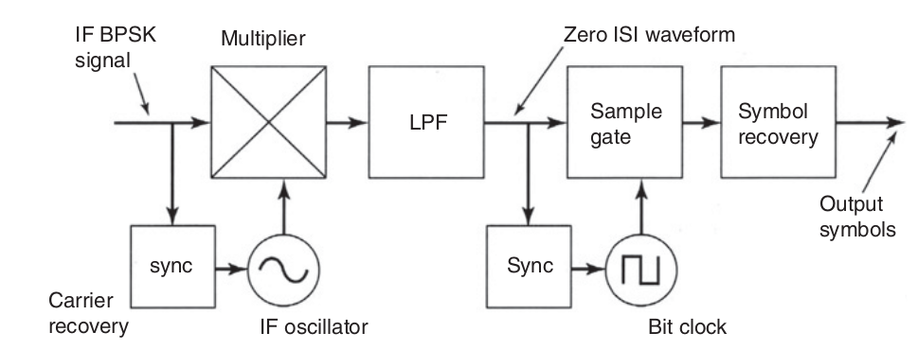
QPSK Demodulator

