Slide 1
Human Activity Recognition

Slide 2
Introduction
Download a publicly available dataset of your choice.
Using R or Python perform one of the following tasks:
Option 1: Supervised learning: build a predictive model
Option 2: Unsupervised learning: perform clustering or anomaly detection
Option 3: Any other analysis of your choice

Slide 3
Human Activity Recognition
Supervised Learning to predict human activity from phone data
UC Irvine Machine Learning Repository maintain 559 data sets for ML
data with the almost raw phone data files of 30 subjects already split into 70% train and 30% test data
Ships with 561 features engineered from the raw data by signal analysis techniques such as Fourier Transform and aggregate functions (using domain knowledge)
Each sample row is 2.56 seconds (128 vector of measurements at 50Hz) labelled with one of 6 activities and the subject number of the actor

Slide 4
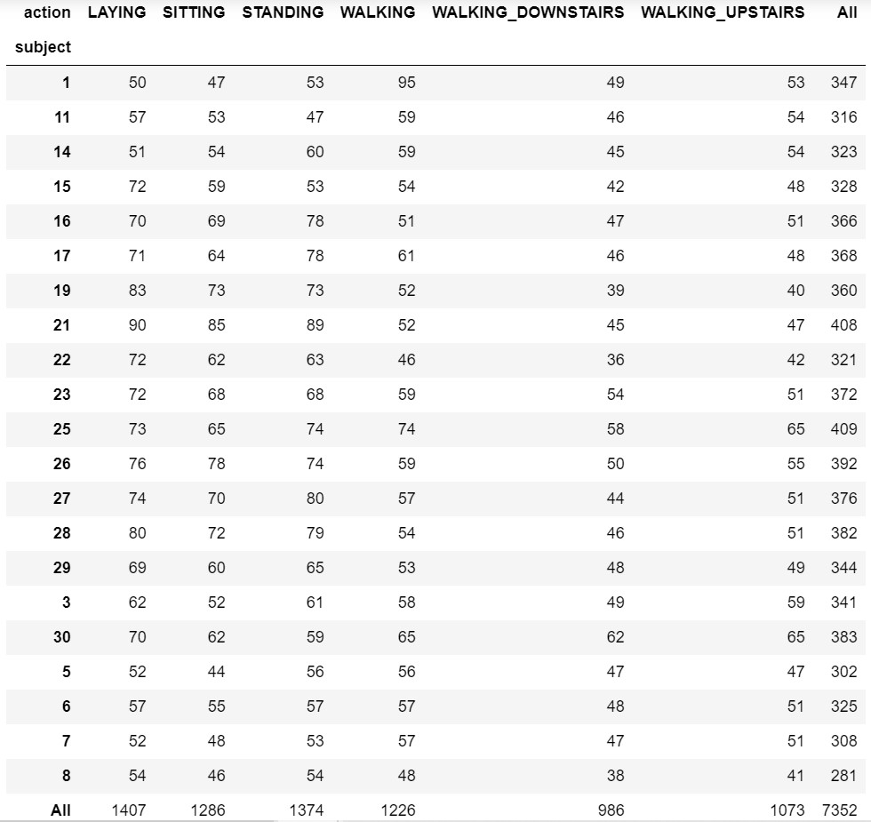
Data cross tabulation of actors against activities

Slide 5
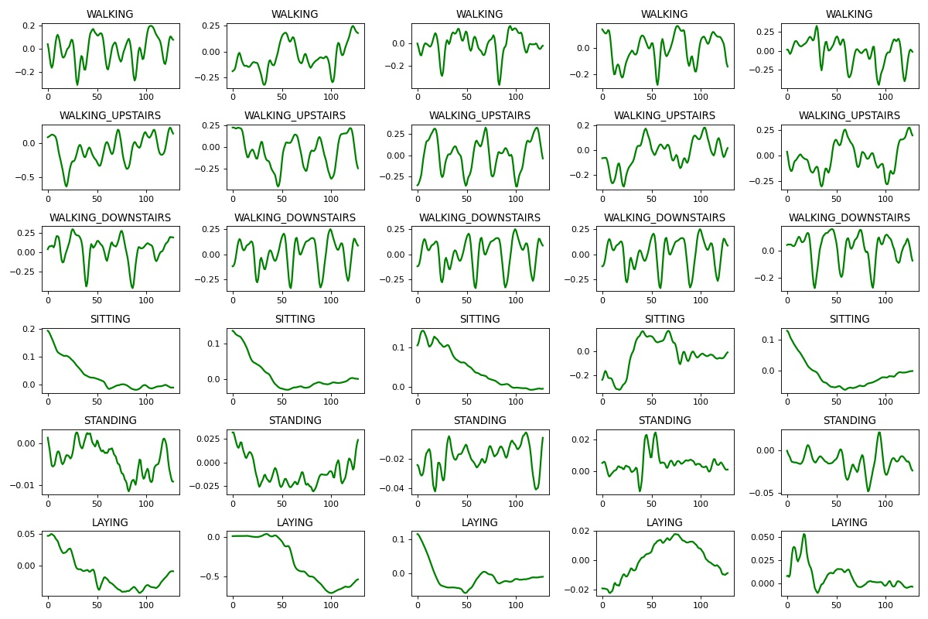
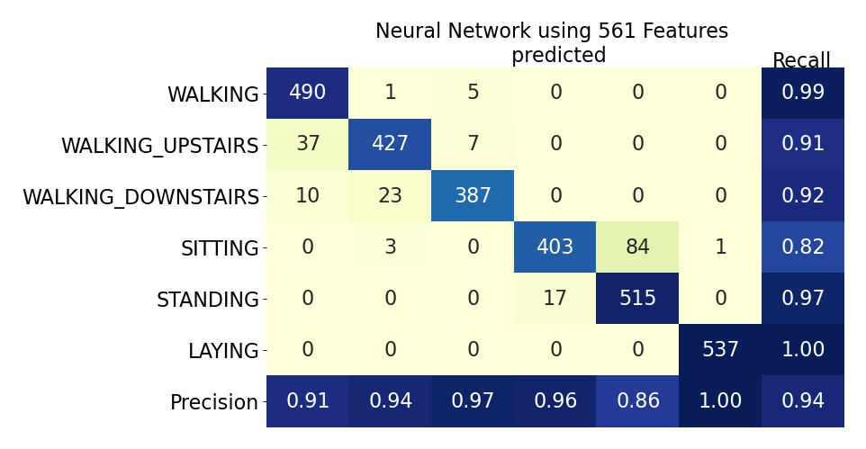
Features and raw data
plot of a random set of 5 of each of the 6 actions over a single 2.56 second period.

Slide 6
Feature Extraction using Dynamic Time Warp
algorithm for comparing similar curves by elastic correlation of time indices
perform Dynamic Time Warp for each sample against a random set of test samples and average the warp distances per label
54 features <= 6 aggregated difference measurements (each activity) from each of the 9 data files (x, y, z for linear body acceleration, linear gravity acceleration and angular velocity).
Gives distance matrix which can be scatter plotted using Multi-Dimensional Scaling

Slide 7
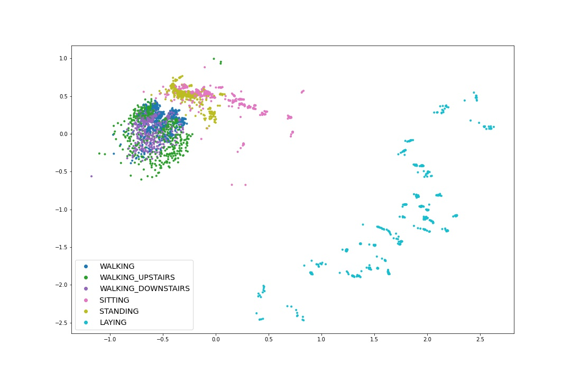
Multi Dimensional Scaling plot using DTW extracted features

Slide 8
Models Trained
K- Nearest Neighbours – Assign classification by proximity using scaled features: Hyper parameters k – number of neighbours used, proximity metric
Decision Trees – Binary splitting on successive features: Hyper parameters: tree depth, minimum samples per split
Logistic Regression – Fit linear coefficients to scaled features. Hyper parameters: One versus rest/ cross entropy
Random Forests – Averaging of decision trees. Hyper parameters: number of trees per forest, number of features per tree
Supposrt Vector Machines – Decision boundaries. Hyper parameters: linear/ polynomial, loss function
Neural Network – Train feature weights through hidden layers of activation functions. Hyper parameters: optimizer, activation function, layer structure

Slide 9
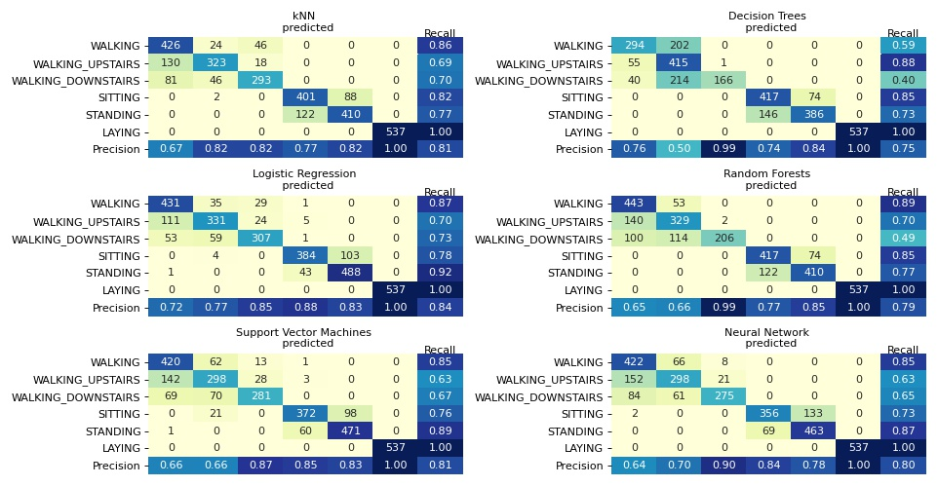
Machine Learning results on DTW distance matrix

Slide 10
Conclusion
An alternative way of extracting features from the data was examined
fewer features than the computed features included by the data supplier
The plots show that the best predictions are achieved by Logistic Regression followed by kNN and SVM
The features extracted don’t require domain knowledge. Just using direct comparison with labelled samples

