Slide 1
Instructions for the Data Analysis Demos
1
You have 3 minutes to present – load your slides into PowerPoint (or whatever program you use), put it into “slide show” mode so the slides are full-screen (without the toolbar, etc.), and be ready to share your screen when your group is called. Practice first! There are five people in your group: hold a short Zoom session to practice sharing in full-screen presentation mode. We can only offer you one opportunity to present so make the most of it.
The next few slides give you all the alternatives for how to present your Data Analysis for swift feedback. Select only the slides that fit your RQ. Before presenting DELETE all slides and text (and instructions) that you do not use (including this slide). You can then enlarge your selection, so it is clearly visible on the slide.
Appointment slots will appear on Canvas soon (calendar) and will take place on Monday during your usual tutorial slots. Sign up early. When space runs out, we cannot issue any further slots. If you do not turn up at the start of your slot you will not be given another opportunity. All the group members should attend but select one person to present. DO NOT SIGN UP unless you can attend. You will not be graded on this presentation but if you do not attend your booked space, your group will have 5 points deducted from the Data Analysis assignment.
At this point we assume you are using your allocated datasets. We are not going to check during the presentation, but your assignment will not be graded if the dataset you use in the analysis has not been allocated to your group.
We look forward to giving you feedback. If your group is not presenting, still attend the tutorial as the feedback will help you too.

Slide 2
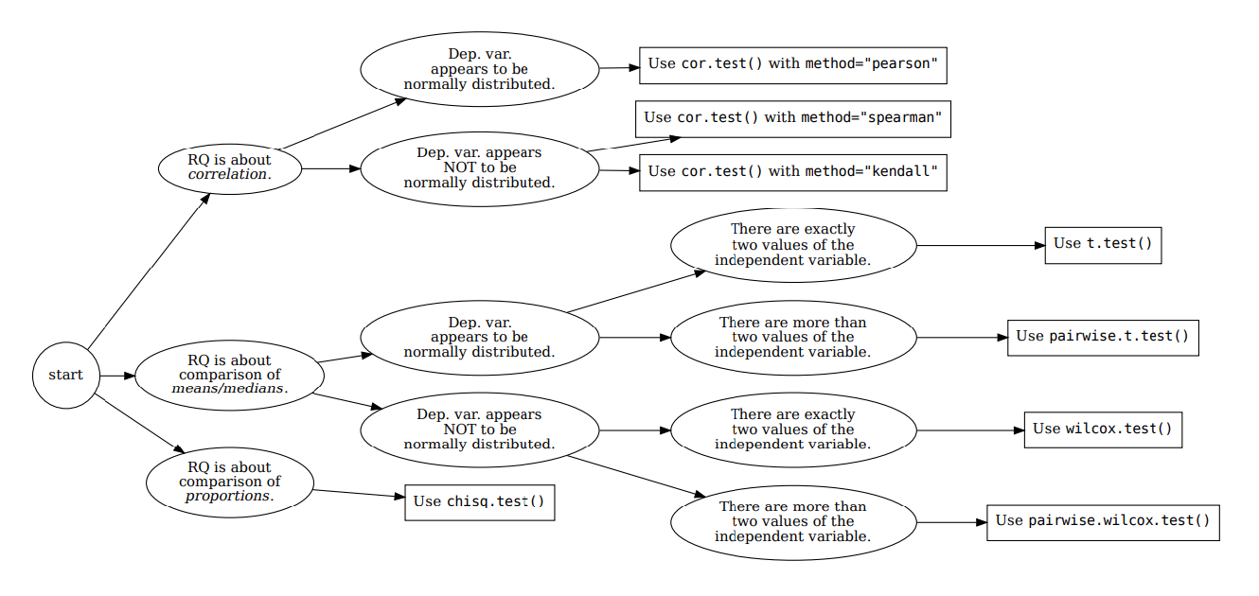







How your RQ + distribution of data (Histogram) leads to a statistical test. Visualization requirements highlighted in yellow.
Histogram & Scatterplots
Histogram and Boxplots
Stacked bar chart (no histogram)
Figure: Decision tree – how Research Questions relate to Visualizations and Statistical Test.

Slide 3

7COM1079-2022 Student Group No: Names of Student Attendees Hodan Abdi, Esika Arifin Rumky, Jason Banks, Azubuike Precious Iheayichukwu, MD Humayun Kibria Shakib
3
Group Id: A238 Name of Student Presenting:
Data Analysis – Tutorial Presentation for Feedback Date:

Slide 4
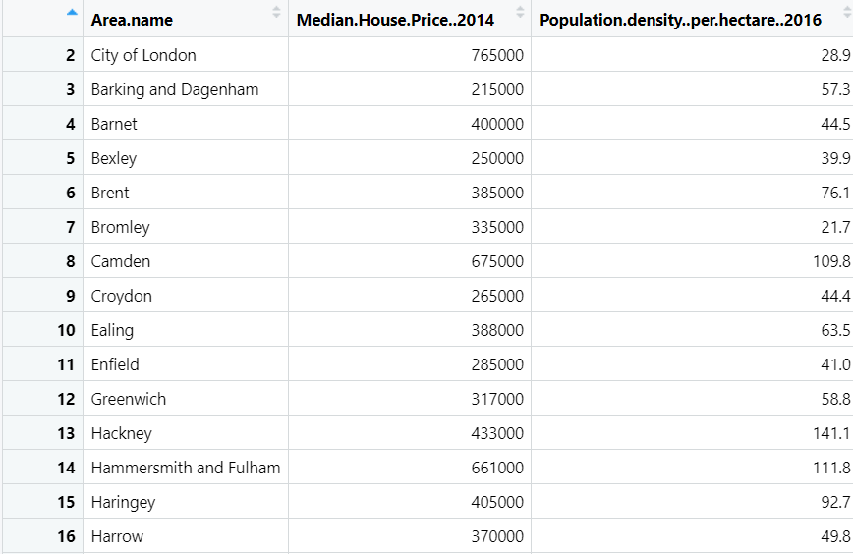
7COM1079-2022 Student Group ID:
We are using the dataset: DS161 London-Boroughs to answer our research question : Is there a correlation between median house prices in London boroughs (2014) and their population density per hectare (2016)
4
List the following:
The dataset has 33 rows for each London borough
The dependent variable³ is Median House Price
The independent variable⁴ is Population density per hectare
¹ Follow one of the three prescribed RQ Templates – If you do not have a correctly formulated RQ, we will stop your presentation here.
² The variable name in your RQ may differ from the column name in cases where the column names are abbreviations.
^{3.4.}Be sure to identify which variable is your dependent variable and which one is your independent variable on this slide
Notes:
4

Slide 5
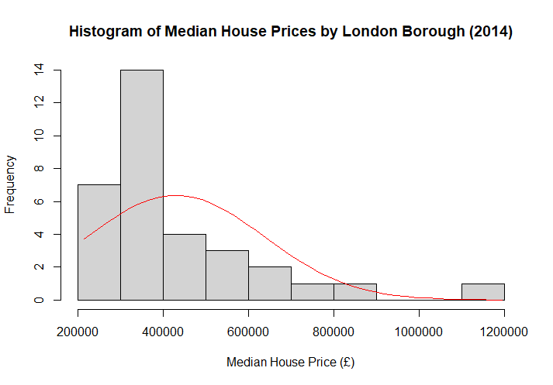
Here is a Histogram showing the frequencies of our dependent variable to include the normal curve overlay.
Our RQ asks about Correlation
The normal curve overlay does not follow the shape of the underlying data, so for our analysis we use the non-parametric test for correlation that does not assume normality: Spearman’s Rho.
5
Notes:
5

Slide 6
R Script and Results (For ALL types of test) – The Analysis: Spearman’s Rho
PRE 7COM1079-2022 Student Group No: ?????
6
Include a snippet of the R code you use to calculate your test statistic.
Give the value of the test statistic? S =2998.5
Tell us the p-value. Is it > or < 0.05?
The p-value is 0.003122 which is below the 0.05. This means we ca reject the null hypothesis and conclude there is a statistically significant relationship
Is the result significant? Yes
Do you accept or reject the null hypothesis? Reject
What does the result actually mean in the wider context of learning something useful / answering your RQ?
The correlation coefficient of 0.4989 suggest a moderate positive relationship between population density and median house prices. This means in general as population density increases in a London borough, median house prices also tend to be higher, although the relationship is not perfectly linear
Notes:
6

