Slide 1
DATA VISUALIZATION (Practical)
Amanpal Singh Rayat

Slide 2
Create a visualization to demonstrate the:
concepts of parameters in Tableau.
concepts of filters in Tableau.
concepts of groups in Tableau.
concepts of sets in the Tableau.
concepts of joins in Tableau.
concepts of data blending in Tableau.
various charts in the Tableau.
concept of clustering in Tableau.
mathematical functions in Tableau.
LOD expressions in Tableau.
animations in Tableau.
dashboard in Tableau.
story telling in Tableau.
difference between live and extract
connection in Tableau.

Slide 3
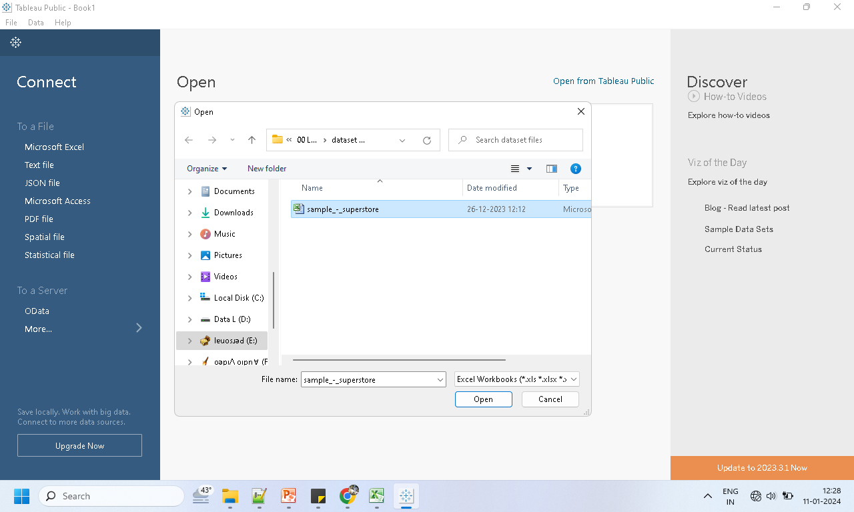
1. concepts of parameters in Tableau.

Slide 4
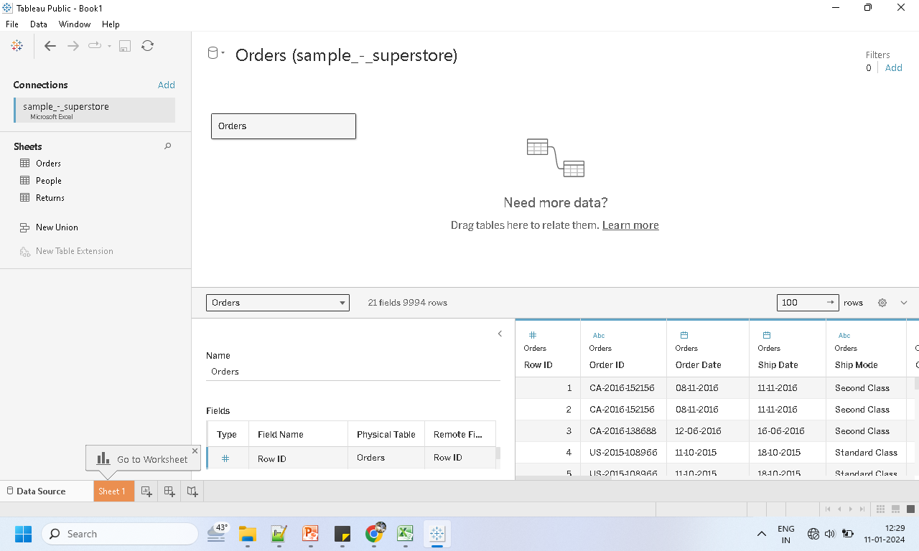
Drag Order Table

Slide 5
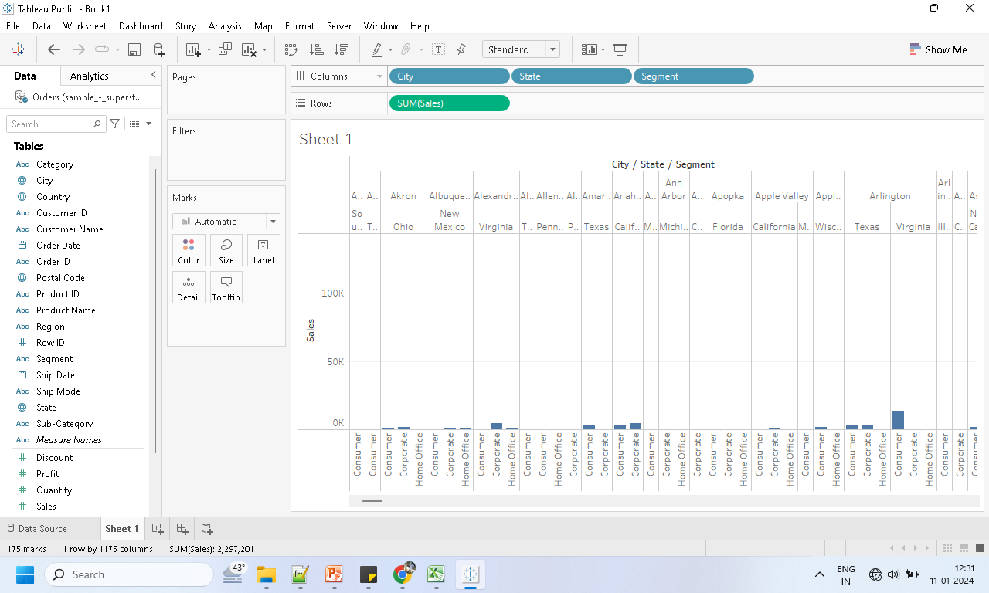
Drag the pill as per requirement

Slide 6
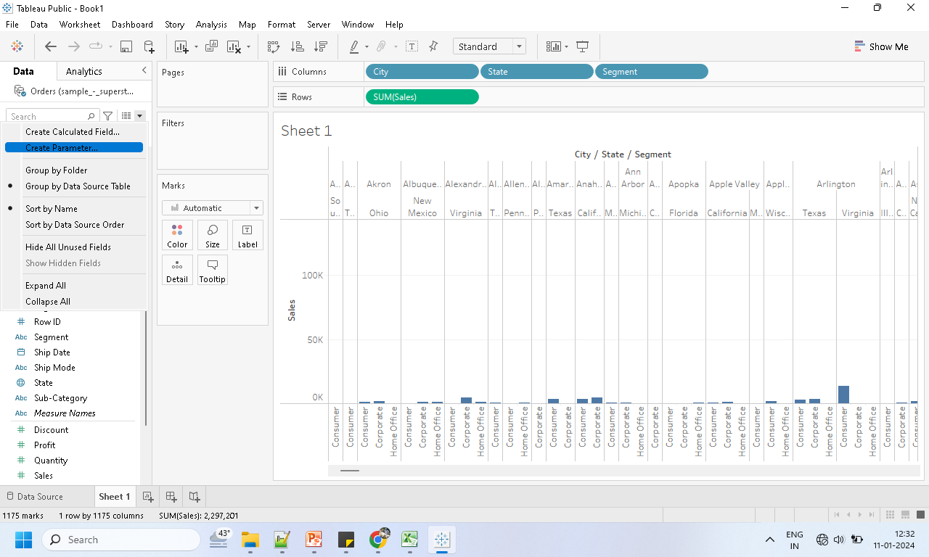
Click on the create Parameter

Slide 7
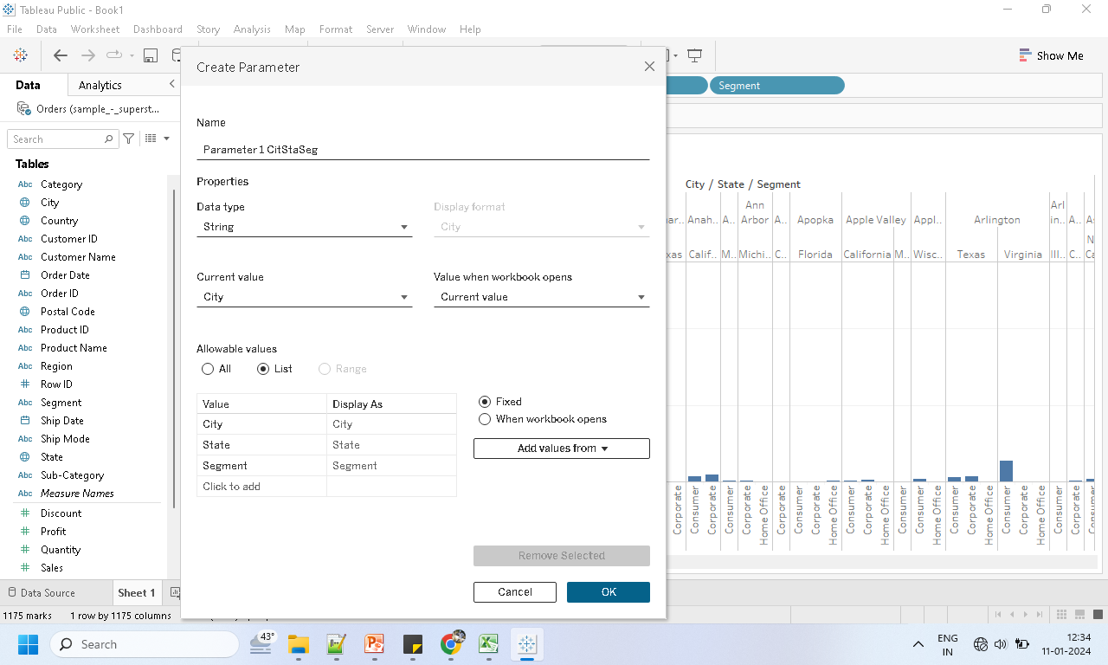
Fill the list as per the requirement

Slide 8
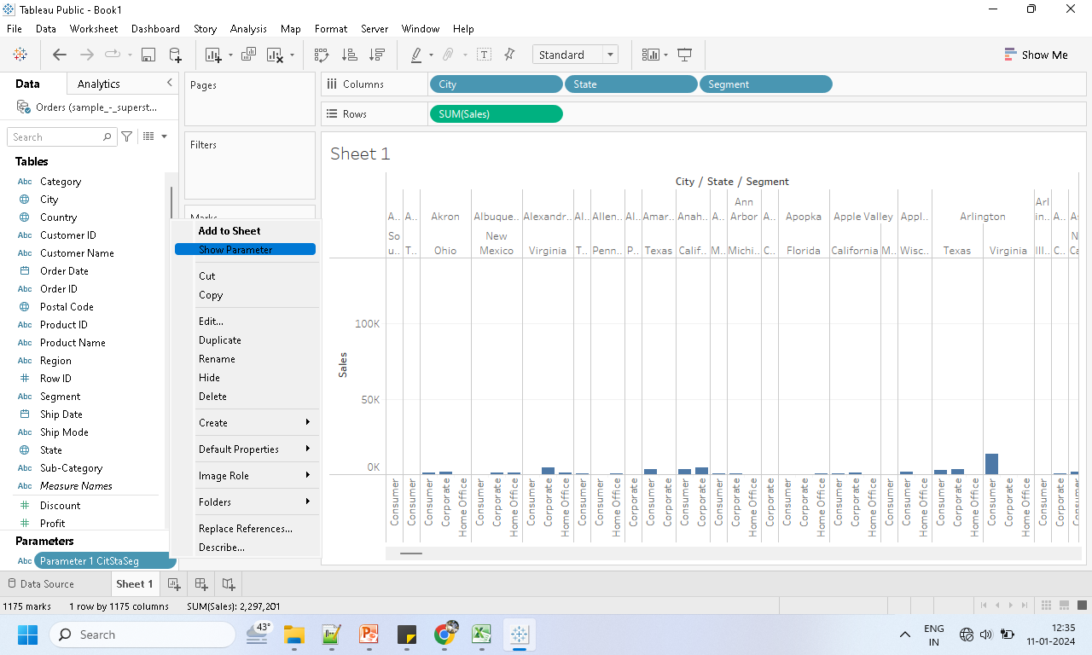
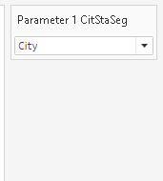
Click on >> Show Parameter

Slide 9
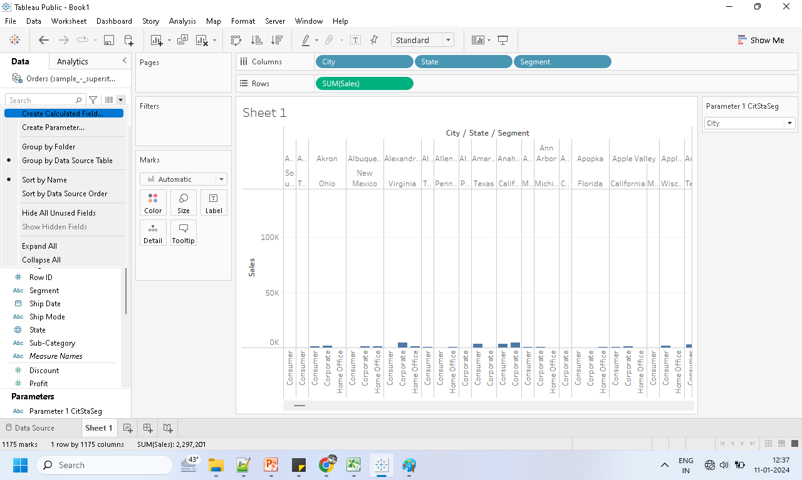
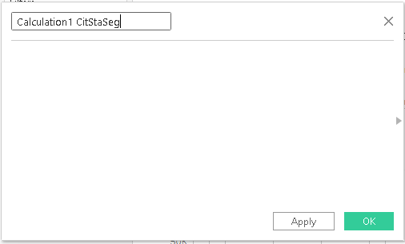
Click>> Create Calculated Field

Slide 10
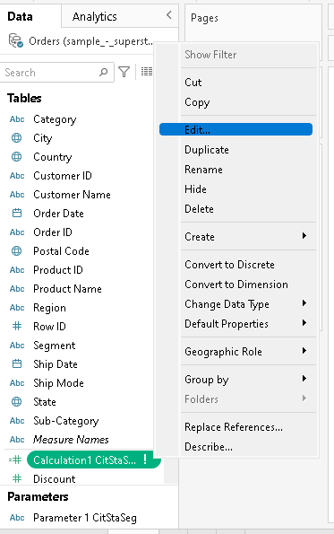
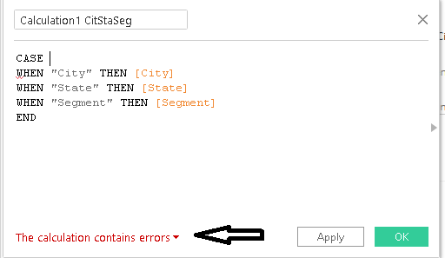
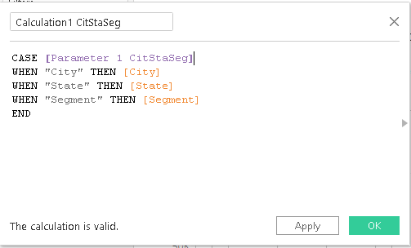
Code for the calculative field

Slide 11
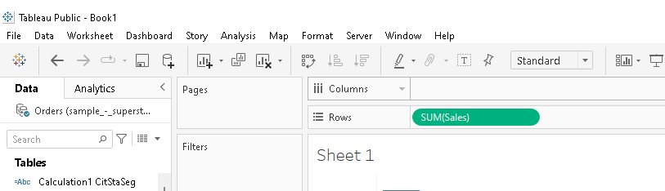
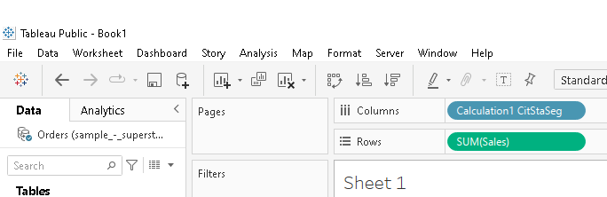
Remove columns, add calculated field

Slide 12
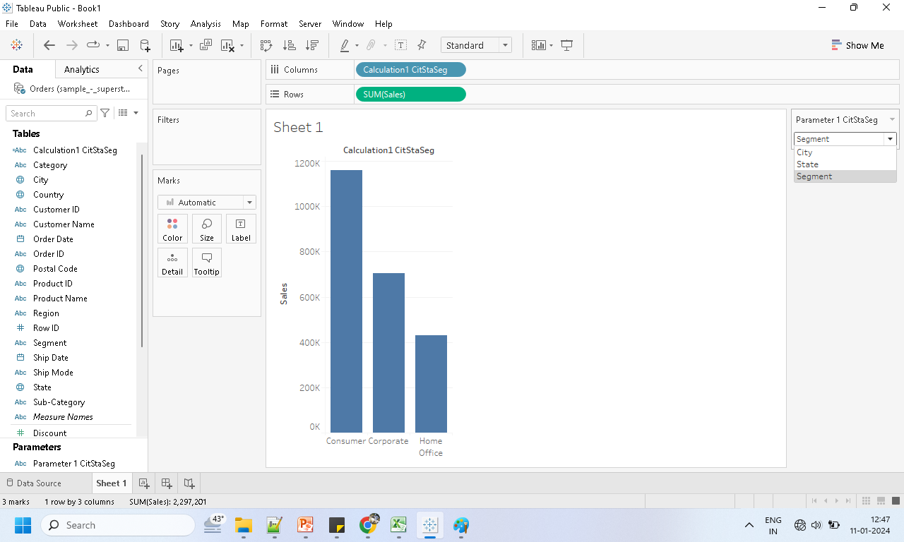
Select the desired Parameter

Slide 13
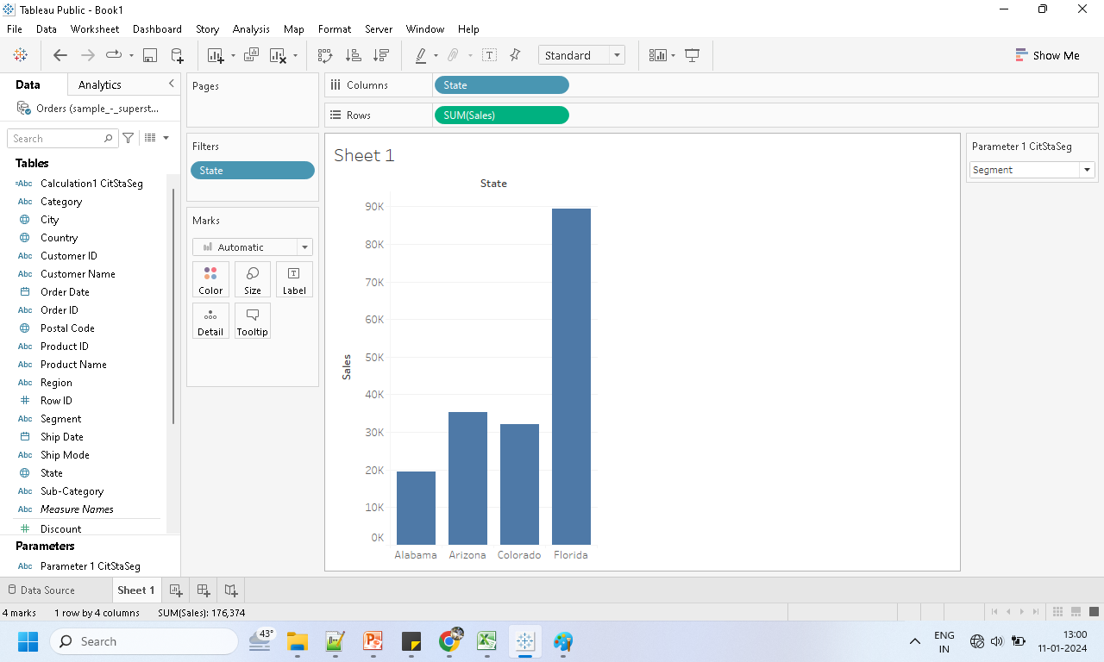
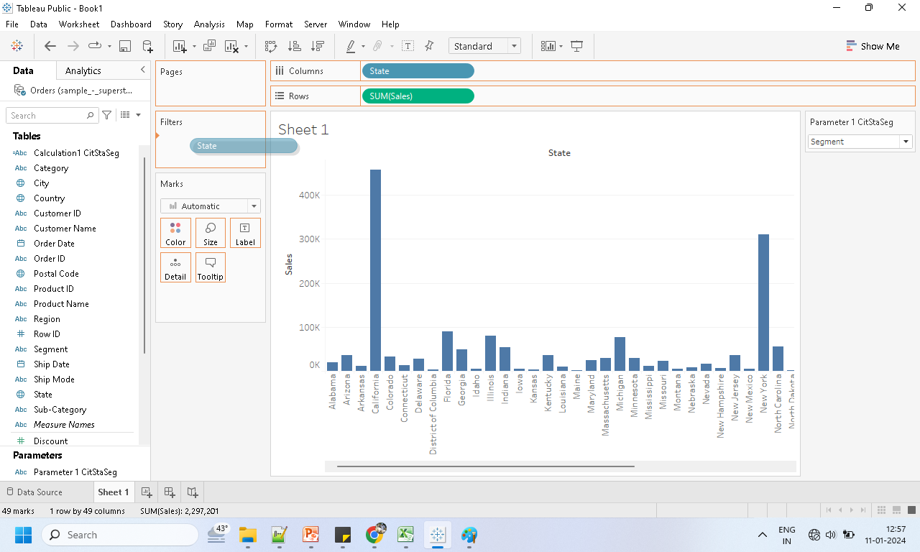
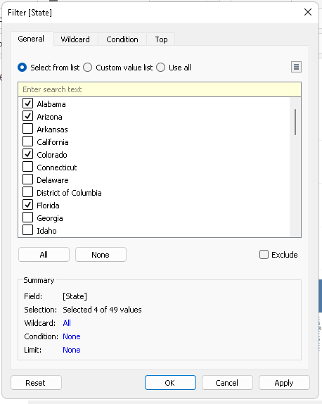
2. Concepts of filters in Tableau.

Slide 14

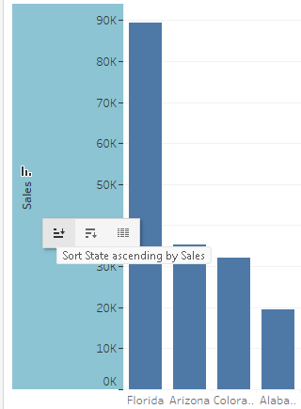
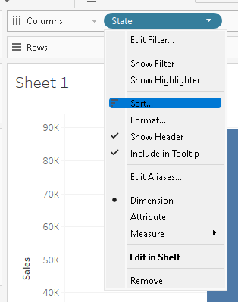
Explore Filter option for more / sorting ways

Slide 15
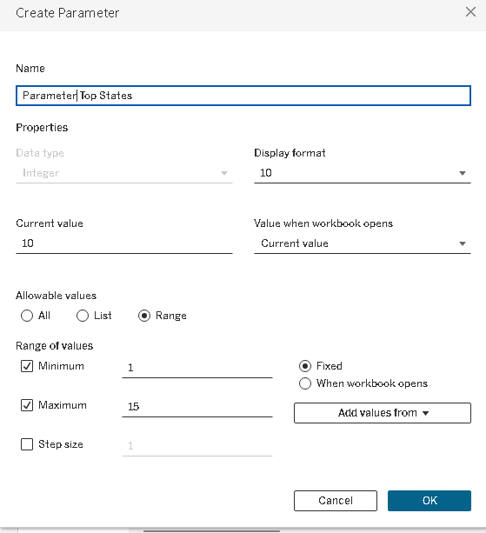
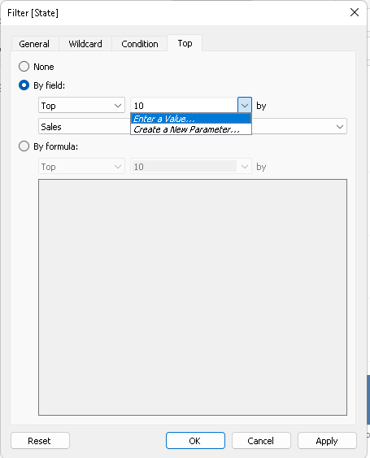
Parameters option inside Filter

Slide 16
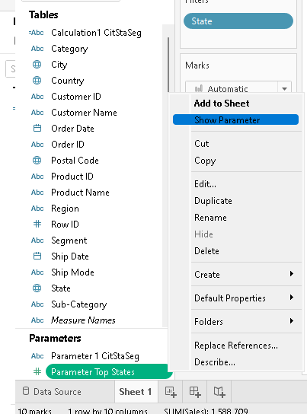
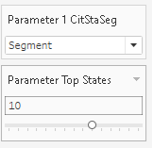
Show parameter

Slide 17
4. Concepts of groups in Tableau
A collection of multiple members in a single dimension that is combined to form a higher category.
Tableau allows single-dimensional members to be grouped together and automatically creates a new dimension with the Tableau Group at the end of the name.
Tableau makes no adjustments to the members’ original dimensions.
Notes:
https://hevodata.com/learn/tableau-groups/#:~:text=In%20Tableau%2C%20grouping%20is%20the,used%20to%20process%20Tableau%20Groups.

Slide 18
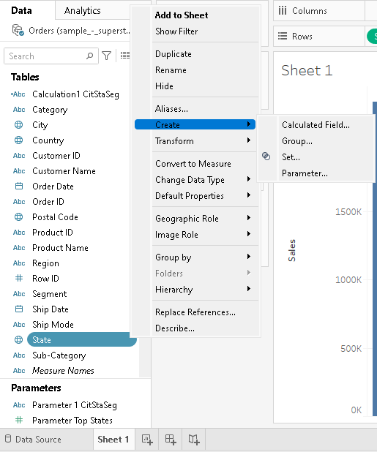
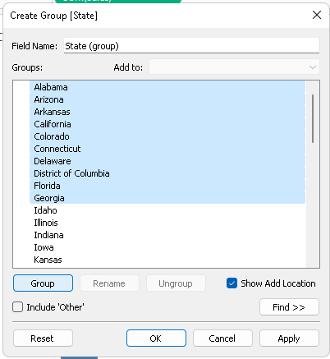
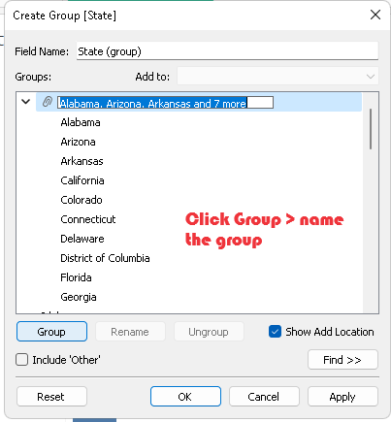
Select Group >> select and click Group

Slide 19
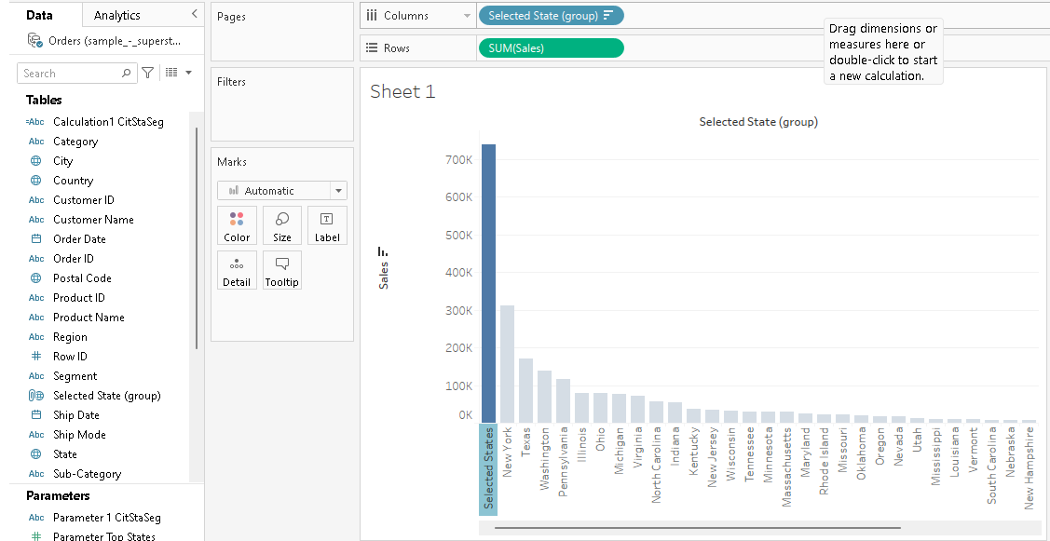
Drag Group into column

Slide 20
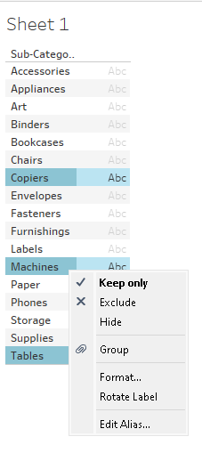
Alt way group

Slide 21
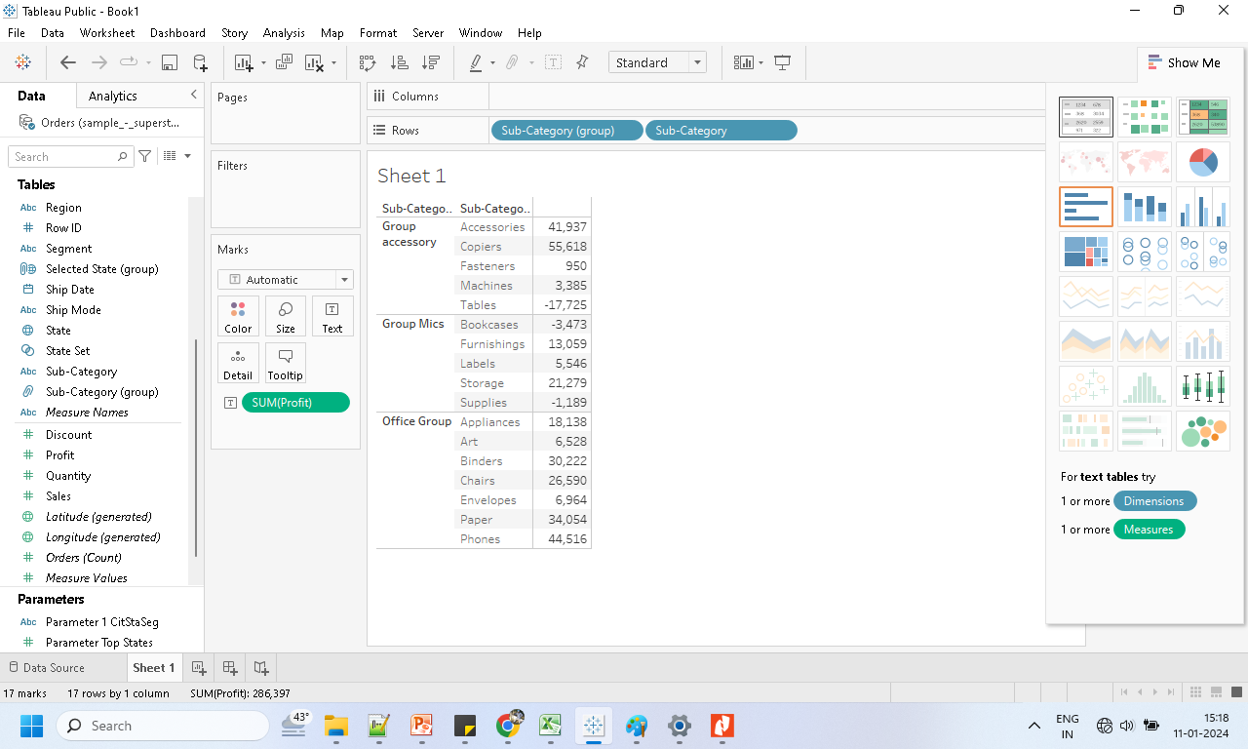
Implement the group with sub-cat.

Slide 22
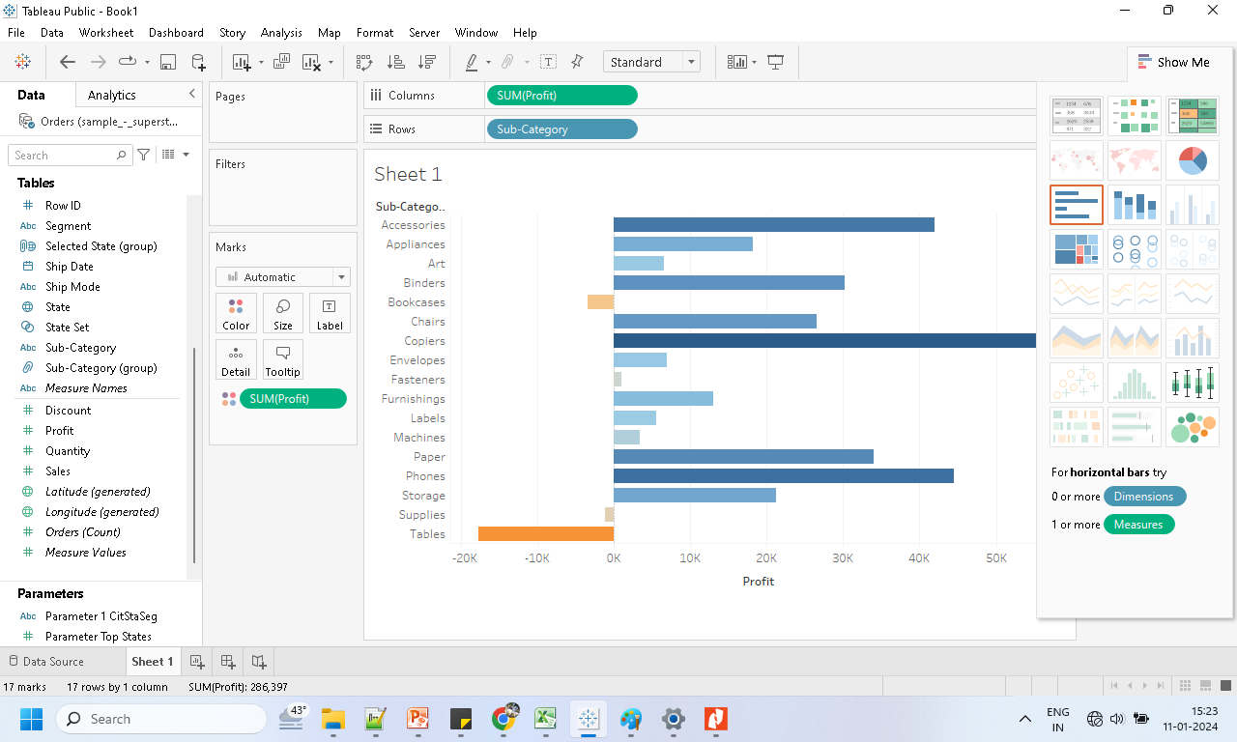
Group output

Slide 23
Concepts of sets in the Tableau.
Custom fields that are used to keep a subset of data based on a condition.
Can also be used to create subsets of data based on user-defined conditions.
For instance, a Tableau Set could be created to contain a subset of data from the top ten customers with the highest sales.
Tableau Sets allow you to control aspects of your analysis by interacting directly with visualizations or dashboards.
Notes:
https://hevodata.com/learn/tableau-groups/#:~:text=In%20Tableau%2C%20grouping%20is%20the,used%20to%20process%20Tableau%20Groups.

Slide 24
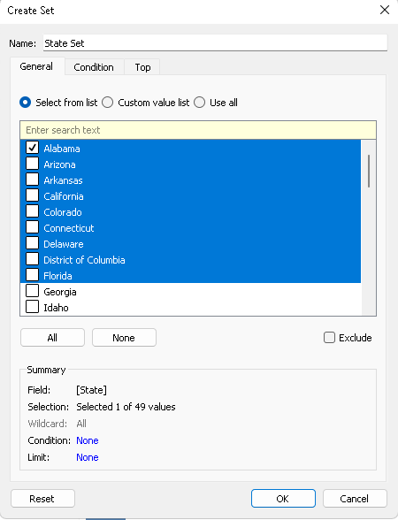
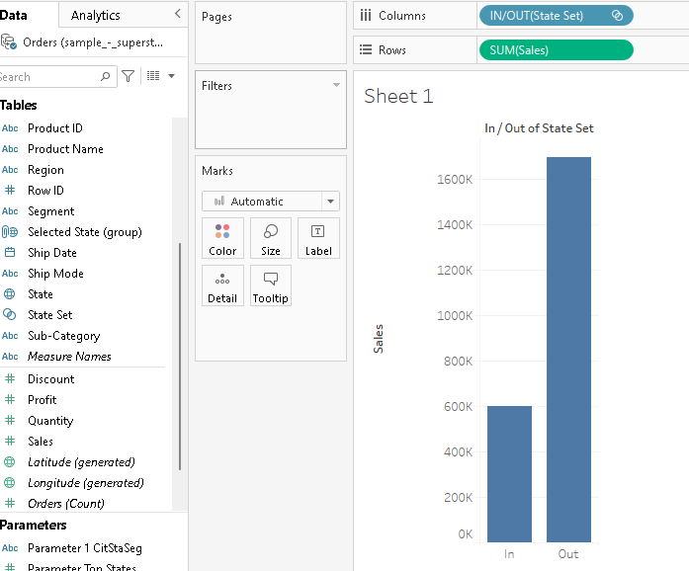
Set

Slide 25
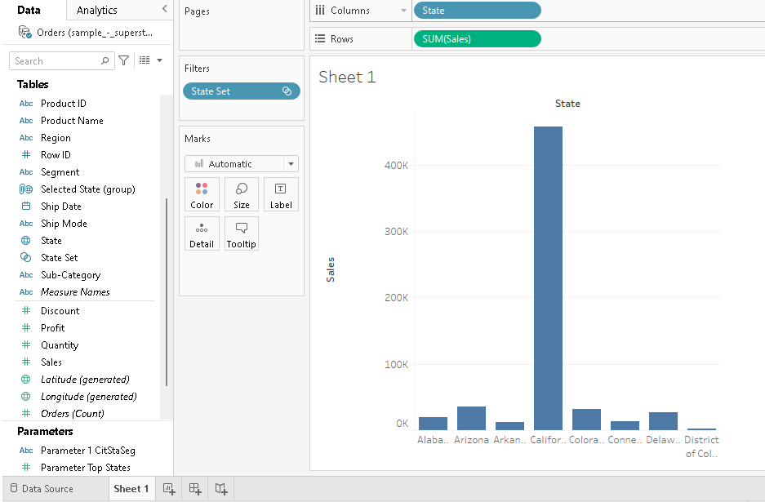
Set as a filter

Slide 26
Group Vs Set
The process of combining multiple members from a single dimension into a higher category,
whereas creating a set is the process of combining members from multi-dimensions and/or conditions into a dynamic or constant Group.
Standard dimensions filters are used to process Tableau Groups.

Slide 27
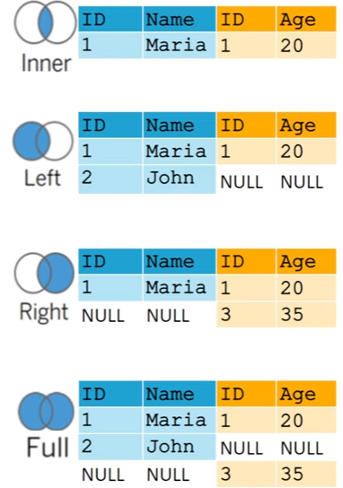
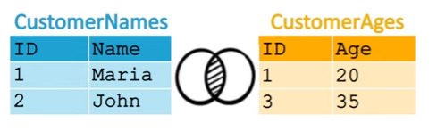
5. Concepts of joins in Tableau.
Reference: https://www.youtube.com/watch?v=F2szczrXXqQ

Slide 28
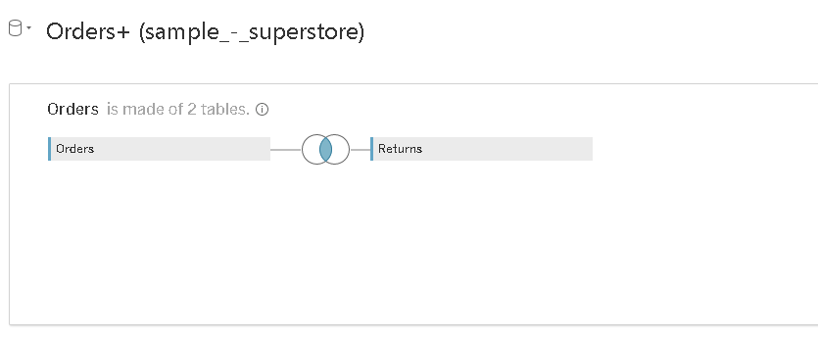
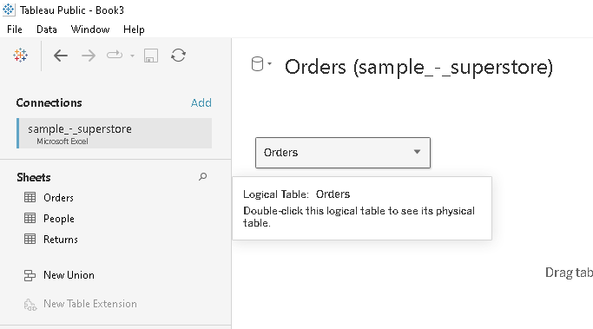
Joins are created in physical layer in tableau
Drag another sheet/table to the physical layer to create the JOIN

Slide 29
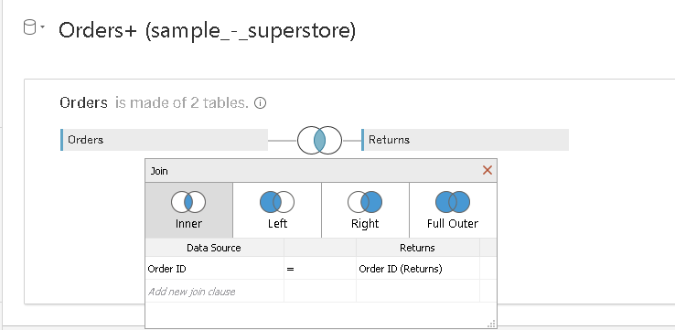

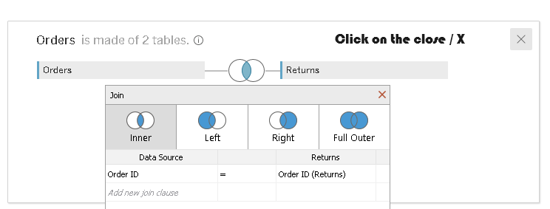
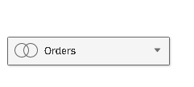
Click on the join to have more options
Symbol without join
Symbol with join
Close it to return to the logical view

Slide 30
6. concepts of data blending in Tableau
Is a method for combining data from multiple sources.
It brings in additional information from a secondary data source and
displays it with data from the primary data source directly in the view.
useful when the blend relationship—the linking fields—need to vary on a sheet-by-sheet basis.

Slide 31
Blends
Unlike relationships or joins, never combine the data directly.
Instead, blends query each data source independently,
Aggregate the results to the appropriate level, then present the results together visually in the view.
It can handle different levels of detail and also work with published data sources.
Blends don't create a new, blended data source Instead, they are simply blended results visualized per sheet.
Watch: https://www.youtube.com/watch?v=LSrM_ZDl1yc

