Slide 1
UNIT 1 B

Slide 2
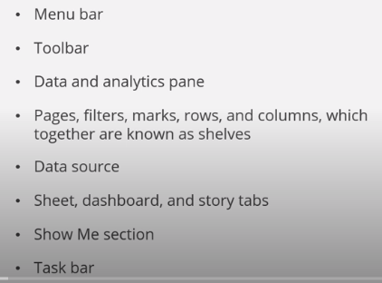
Tableau’s user interface

Slide 3
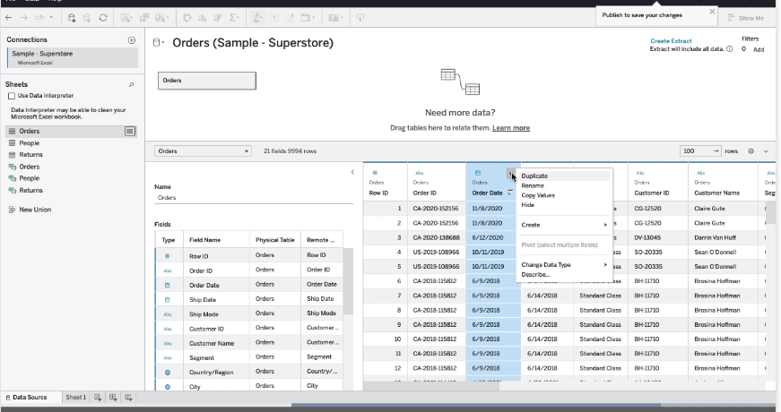

Slide 4
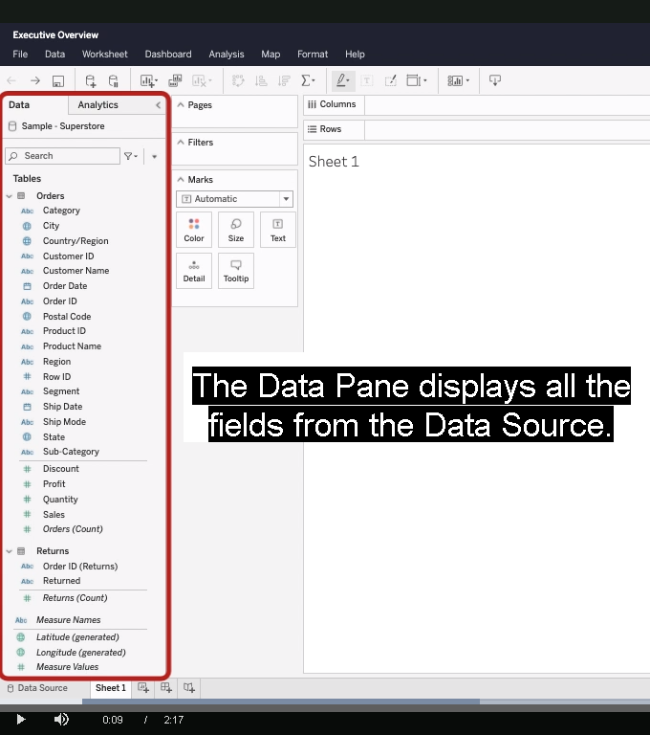

Slide 5
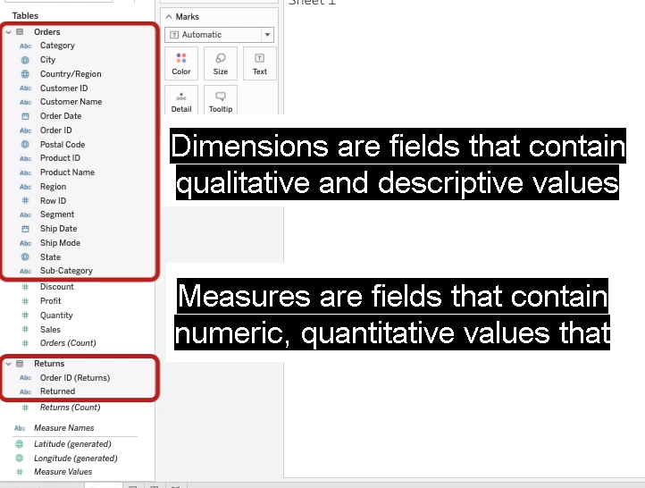

Slide 7
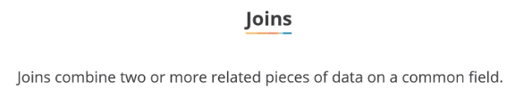
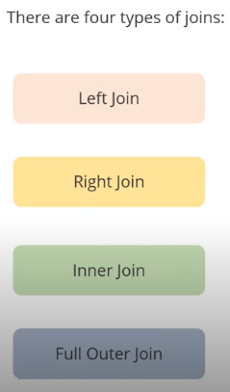
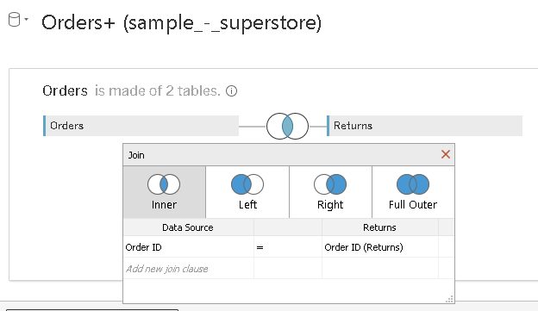
Right Click: Order >>click add
Dreg Return to the canvas [inner join form by default]
Click on the Venn diagram

Slide 8

joins can only match fields with unique values, but relationships can combine fields with non-unique values

Slide 9
