Slide 1
QUEUES

Slide 2
It is a linear data structure in which new elements are inserted at one end and elements are deleted from the other end.
This mechanism is called First-In-First-Out (FIFO).
Placing an item in a queue is called “insertion or enqueue”, which is done at the end of the queue called “rear”(or tail).
Removing an item from a queue is called “deletion or dequeue”, which is done at the other end of the queue called “front”(head).

Slide 3
BASIC QUEUE OPERATIONS
ENQUEUE:
The enqueue operations is used to insert a new element to the rear of the queue .After the enqueue operation, the element that has just been inserted becomes the rear, Each enqueue operations increases the number of elements in the queue by one.

Slide 4
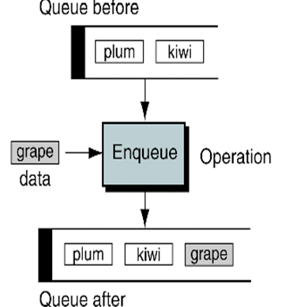
Enqueue

Slide 5
DEQUEUE:
This is used to remove the existing element from the front of the queue.
After removing the element from the front,the next older element becomes the front of the queue.
Each dequeue operation reduces the number of element in the queue by one.

Slide 6
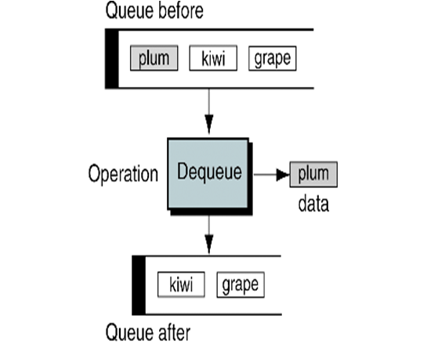
Dequeue

Slide 7
ENQUEUE
ENQUEUE(Q,FRONT,REAR,MAXSIZE,ITEM): Given Q be a 1-D array representing the queue that can contain MAXSIZE elements where MAXSIZE is the size of the array. Te variables FRONT and REAR keep the track of array index of the front and rear elements of queue respectively. We assume that initially queue is empty and variables FRONT and REAR have values 1 and 0 respectively. The algo inserts ITEM at to the rear of the queue.

Slide 8
1.[check for underflow state of queue]
If REAR=0 then
Write ”Underflow”.
return
[End of If structure]
2.ITEM←Q[FRONT] [Copy element at FRONT to ITEM]
3.If FRONT < REAR then
FRONT←FRONT+1 [Increment FRONT by 1]
Else If FRONT=REAR [Queue contain only 1 element]
FRONT←1, REAR←0 [Queue becomes empty]
[End of If Structure]
4. Return(ITEM)

Slide 9
Linked Representation Of Queue

Slide 10
ENQ_LINKQUEUE(FRONT,REAR,AVAIL,ITEM)-Given a linked queue with pointers FRONT and REAR pointing to front and rear of the linked queue respectively .The AVAIL pointer points to the first node of the availablitiy list.The algorithm addes an ITEM into the queue.
1.[check for overflow,Availablity list empty]
If AVAIL=NULL then
Write “overflow”
Return
[end of if strucutre]

Slide 11
2.NEW←AVAIL
3.AVAIL←LINK(AVAIL)
4.INFO(NEW)←ITEM [Copy ITEM into INFO part]
5.[check if queue is empty or not]
If FRONT=NULL then
A)FRONT←NEW
B)REAR←NEW
Else [queue is not empty]

Slide 12
[update REAR to point to new node]
A)LINK(REAR)←NEW
B)REAR←NEW
[end of if structure]
6[set link part of new node to NULL]
LINK(NEW)←NULL
7.RETURN

Slide 13
DELETION IN QUEUE
DEQ_LINKQUEUE(FRONT,REAR,AVAIL,ITEM)-Given a linked queue with pointers FRONT and REAR pointing to the front and rear of the linked list resp. The AVAIL pointers points to the first node of the availability list. This algo deletes the front element of the linked queue and assign it to the variable ITEM. Here ‘SAVE’ is local pointer variable which points to the deleted node.

Slide 14
1.[empty list?]
If FRONT=NULL then
Write “Underflow”.
return
[End of If structure]
2.ITEM←INFO(FRONT)
3.SAVE←FRONT [Assign front to temporary variables]
4.[Reset Front to point to next node in link queue]
FRONT←LINK(SAVE)
5.LINK[SAVE]←AVAIL
6.AVAIL←SAVE
7.Return(ITEM)

Slide 15
DEQUE
A deque(double ended queue) is one of variation of a queue.
A deque is a linear link that allows insertion and deletion at either end,i.e. at the front or rear of the queue but not in the middle.
Generally the leftmost element represents the front and the rightmost elements represent the rear.

Slide 16
There are various ways of representing a deque in a computer
Unless it is otherwise stated or implied ,we will assume our deque is maintained by circular array DEQUE with pointers LEFT and RIGHT ,which point to the two ends of the deque
Circular comes from the fact that we assume that DEQUE[1] comes after DEQUE[N] in the array.

Slide 17
The four basic operations that can be performed on deque are insertLeft,insertRight,deleteLeft and deleteRight.
The insertLeft and deleteLeft inserts and deletes an element to/from the left of the deque repectively
The insertRight and deleteRight inserts and deletes an element to/from the right of the deque respectively.
There are multiple ways of implementing a deque,but most commomly used implementations are circular array and doubly linked list.

Slide 18
Deque can be classified as
input restricted deque.
output restricted deque.
In input restricted deque,the insertion of an element is restricted to one end only but deletion can take place at both the ends.
The operations that are possible on input restricted deque are insertRight,deleteRight and deleteLeft.

Slide 19
An output restricted deque is a deque which allows deletion at only one end of the list but allow insertion at both ends of the list.
The operations that are possible on output restricted deque are deleteLeft,insertRight and insertLeft.

Slide 20
Consider the following queue of characters ,Where QUEUE is a circular array which is allocated six memory cells:
FRONT=2 ,REAR=4, QUEUE:___,A,C,D,__,__
(For notational convenience ,we use “__” to denote an empty memory cell)Describe the queue as the following operations take place:
a)F is added to the queue f)two letters are deleted
B)two letters are deleted g)S is added to the queue
C)K,L,M are added to the queue h)two letters are deleted
D)two letters are deleted i)one letter is deleted
E)R is added to the queue j)one letter is deleted.

Slide 21
PRIORITY QUEUE

Slide 22
A priority queue is a collection of elements such that each element has been assigned a priority and such that the order in which elements are deleted and processed comes from the following rules:
1)An element of higher priority is processed before any element of lower priority
2)two elements of the same priority are processed according to the order in which they were added to the queue

