Slide 1
MATLAB TUTORIAL
Computational Photography
15-463/663/862
Slides courtesy Martial Hebert

Slide 2
Introduction to MATLAB

Slide 3
What & Why
MATrix LABoratory
Basically a high level language
With many built-in functions (matrix, data analysis, visualization)
Many specialized toolboxes for making many things easier
Advantages for Computer Vision
Strong on matrix manipulation
Strong visualization tools
Many online Computer Vision libraries
Interfaces with C (mex), Fortran, and Java
Installation
http://www.cmu.edu/computing/software/all/matlab/download.html

Slide 4
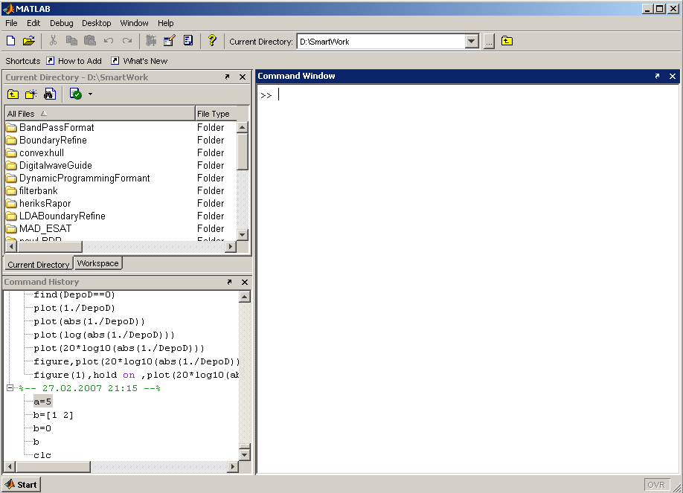
MATLAB Screen
Command Window
type commands
Current Directory
View folders and m-files
Workspace
View program variables
Double click on a variable
to see it in the Array Editor
Command History
view past commands
save a whole session
using diary
Slide from İ.Yücel Özbek

Slide 5

Variables
Semicolon?
No need to define variables
Variables are created when they are used
All variables are created as matrices with “some” type (unless specified)
int a;
a=1;
double b;
b=2+4;
>>a=1;
>>b=2+4;
C language
MATLAB
Let’s see some examples!

Slide 6
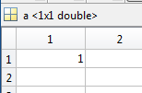


Variables
a = 1;
b = false;

Slide 7
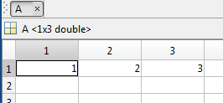

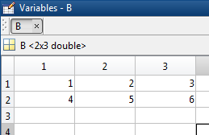

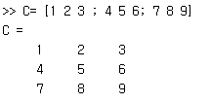
Variables
%% Define a vector/Matrix/n-D Array: NO MEMORY ALLOCATION or PRIOR DECLARATION of variables is required
A = [1, 2, 3]
B = [1,2,3;4,5,6]
C=[1 2 3;4 5 6;7 8 9]
Notes:
Size can change dynamically (when you assign something)

Slide 8

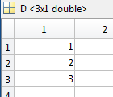

Variables
D=[1 ; 2 ; 3]
E=[1 2 3]’

Slide 9



Variables

Slide 10
Pointwise (element by element) Operations
% addition of vectors/matrices and multiplication by a scalar
% are done "element by element"
a = [1 2 3 4]; % vector
2 * a % scalar multiplication
a / 4 % scalar multiplication
b = [5 6 7 8]; % vector
a + b % pointwise vector addition
a - b % pointwise vector addition
a .^ 2 % pointise vector squaring (note .)
a .* b % pointwise vector multiply (note .)
a ./ b % pointwise vector divide (note .)
log( [1 2 3 4] ) % pointwise arithmetic operation
round( [1.5 2; 2.2 3.1] ) % pointwise arithmetic operation

Slide 11
Vector Operations
% Built-in matlab functions operate on vectors, if a matrix is given, % then the function operates on each column of the matrix
a = [1 4 6 3] % vector
sum(a) % sum of vector elements
mean(a) % mean of vector elements
var(a) % variance
std(a) % standard deviation
max(a) % maximum
a = [1 2 3; 4 5 6] % matrix
a(:) % vectorized version of the matrix
mean(a) % mean of each column
max(a) % max of each column
max(max(a)) % to obtain max of matrix
max(a(:)) % or...

Slide 12


Variables
C = ‘Hello World!';

Slide 13
Variable Creation from Functions
A = zeros(3);
B = magic(4);
C = ones(5);
D = rand(100,2);
E = eye(20);
F = sprintf('%02d\n',9);

Slide 14
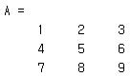




Matrix Index
Matrix indices begin from 1 (not 0!!!)
Matrix indices must be positive integers
Column-Major Order

Slide 15
Matrix Index
>> A(2,2:3)
ans =
5 6
>> A(2,1:end)
ans =
4 5 6
>> A(2,:)
ans =
4 5 6
>> A(:)
ans =
1
4
7
2
5
8
3
6
9
>> A(2,1:2:3)
ans =
4 6
>> A(2,[1 3])
ans =
4 6

Slide 16
Matrix Index
Accessing Elements
A = magic(4);
A(2,3)
A(:,2)
A(end,:)
A([1,2],[1,3])
A(1:2,3:end)
http://www.mathworks.com/company/newsletters/articles/matrix-indexing-in-matlab.html

Slide 17
Matrix Operation(1/3)
+ addition
Subtraction
multiplication
^ power
‘ complex conjugate transpose

Slide 18
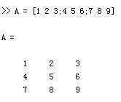
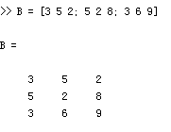
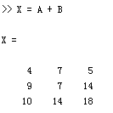
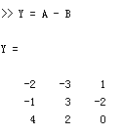
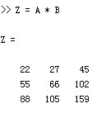
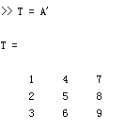
Matrix Operation(1/3)
Given A and B:
Addition
Subtraction
Product
Transpose
Slide from İ.Yücel Özbek

Slide 19
Matrix Operation (2/3)
.* element-by-element multiplication
./ element-by-element division
.^ element-by-element power
Slide from İ.Yücel Özbek

Slide 20
Matrix Operation (2/3)
A = [1 2 3; 5 1 4; 3 2 1]
A =
1 2 3
5 1 4
3 2 -1
x = A(1,:)
x=
1 2 3
y = A(3 ,:)
y=
3 4 -1
b = x .* y
b=
3 8 -3
c = x . / y
c=
0.33 0.5 -3
d = x .^y
d=
1 16 0.33
Slide from İ.Yücel Özbek

Slide 21
Matrix Operation (3/3)
A/B Solve linear equation xA=B for x
A\B Solve linear equation Ax=B for x

Slide 22


Matrix Concatenation
X=[1 2], Y=[3 4]

Slide 23
Strings
A =‘CMU computational photography’
strfind(A,'CMU')
strcmp(A,'computational')
B = strcat(A,' 15463')
c = [A,' 15463']
D = sprintf('I am %02d years old.\n',9)
int2str, str2num, str2double
http://www.mathworks.com/help/matlab/ref/strings.html

Slide 24


Cell and Structure
Cells
a = {}; a = cell(1)
b = {1,2,3}
c = {{1,2},2,{3}}
D = {'cat','dog','sheep','cow'}
E = {'cat',4}
Structures
A = struct('name','1.jpg','height',640,'width',480);
A.name = '1.jpg‘
http://www.mathworks.com/help/matlab/matlab_prog/cell-vs-struct-arrays.html

Slide 25
Operators
== Equal to
~= Not equal to
< Strictly smaller
> Strictly greater
<= Smaller than or equal to
>= Greater than equal to
& And operator
| Or operator

Slide 26
Flow Control
if, for, while ….
for i=1:100
Some Matlab Commands;
end
for j=1:3:200
Some Matlab Commands;
end
for k=[0.1 0.3 -13 12 7 -9.3]
Some Matlab Commands;
end
if (a<3)
Some Matlab Commands;
elseif (b~=5)
Some Matlab Commands;
end
while ((a>3) & (b==5))
Some Matlab Commands;
end
http://www.mathworks.com/help/matlab/control-flow.html
Slide from İ.Yücel Özbek

Slide 27
Vectorization
Optimized for Operations with Matrices and Vectors
Examples
In other languages:
In MATLAB:
http://www.mathworks.com/help/matlab/matlab_prog/vectorization.html
tic; i = 0; for t = 0:.001:1000 i = i + 1; y(i) = sin(t); end; toc;
Elapsed time is 0.509381 seconds.
tic; t = 0:.001:1000; y = sin(t); toc;
Elapsed time is 0.011212 seconds.

Slide 28
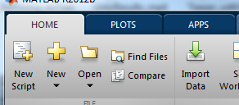
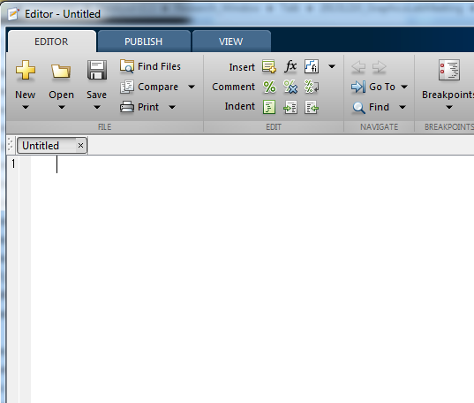
Write your code using M-File
Click to create a new M-File
A text file containing script or function or program to run
Extension “.m”

Slide 29
Write your own functions
For example,
Implement your own function Add3()
B = Add3(A)
How to?
Create a M-file with the function name
Use the function definition at the beginning
function out1=functionname(in1)
function out1=functionname(in1,in2,in3)
function [out1,out2]=functionname(in1,in2)

Slide 30
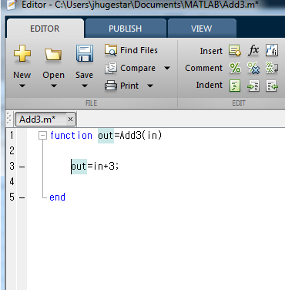
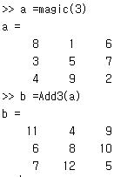
Write your own functions

Slide 31
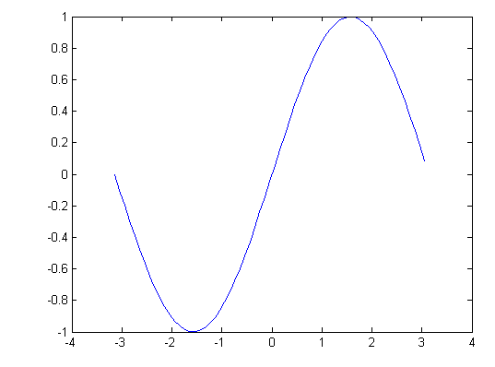
Display
Many functions
plot, plot3d, bar, area, hist, contour, mesh
x = -pi:.1:pi;
y = sin(x);
plot(x,y)

Slide 32
Saving your work
save mysession % creates mysession.mat with all variables
save mysession a b % save only variables a and b
clear all % clear all variables
clear a b % clear variables a and b
load mysession % load session
a
b

Slide 33
Useful Commands
help functionName
doc functionName

Slide 34
References
MATLAB Documentation
http://www.mathworks.com/help/matlab/
Cheat Sheets
http://web.mit.edu/18.06/www/Spring09/matlab-cheatsheet.pdf
http://www.geog.ucsb.edu/~pingel/210b/general/matlab_refcard.pdf

Slide 35
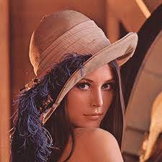
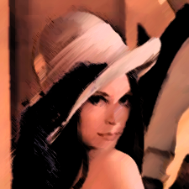
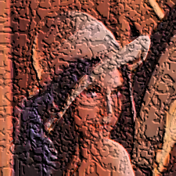
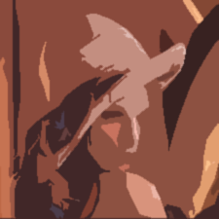
Image Processing with MATLAB

Slide 36
Outline
Introduction
Image processing using MATLAB
Video processing
References

Slide 37


1. Introduction
The MATrix LABoratory
Dynamically typed language
Variables require no declaration
Create them just by initialization (x=10;)
All variables are treated as matrices
Scalar: 1×1 matrix; Vector: N×1 or 1×N matrix
Calculations are much faster
Advantages
Fast implementation and debugging
Natural matrix operation
Powerful image processing toolbox

Slide 38
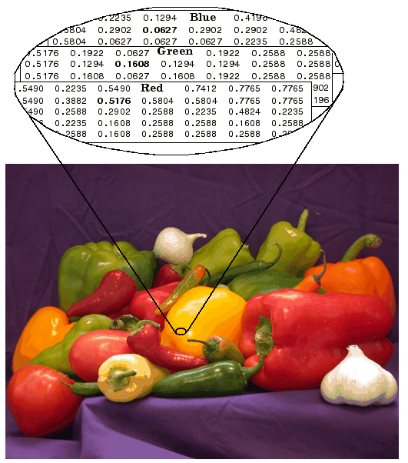
2.1 Image Data Structure
Image as matrices
Gray image: m × n
RGB image: m × n × 3
Format:
[0, 255] uint8
[0, 1] double
I(1,1,3)
I(1,1,1)
I(1,n,3)
m
I(m,n,3)
n
I(m,n,1)
Notes:
Manipulating an image is just the same as manipulating a matrix in Matlab.

Slide 39
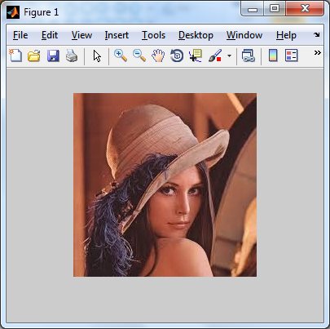
2.2 Image Import / Export / Display
% Read image (support bmp, jpg, png, ppm, etc)
I = imread('lena.jpg');
% Save image
imwrite(I, 'lena_out.jpg');
% Display image
imshow(I);
% Alternatives to imshow
imagesc(I);
imtool(I);
image(I);

Slide 40
2.3 Display multiple images together
subplot(rows, cols, current)
figure(1); subplot(1,2,1); % 'subplot 121' is also legal syntax
imshow(I)
I2 = imread(‘lena-edges.jpg’);
subplot 122, imshow(I2);

Slide 41
2.4 Meta-data for image matrices
%Note that the image is class UINT8 rather than normal DOUBLEs we've dealt with so far.
%% Get the type of the variable
class(I)
%% Get the size of the image
imSize = size(I)

Slide 42
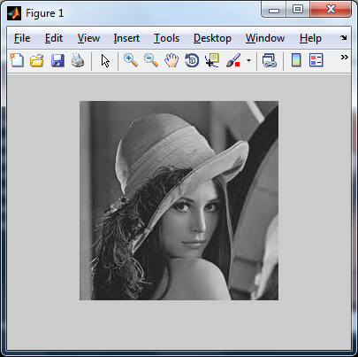
2.5 Image Conversion
% Type conversion
% MAJOR PAIN 1: The arithmetic operations are not defined over uint8 % variables so first convert them into double
I1 = im2double(I);
% MAJOR PAIN 2: The image display assumes the doubles in an image % to be between 0 and 1. If it is not, it chops the intensities outside % this range... (This causes bigger problems with 'imagesc') % % So, try casting the result to unit8 before displaying
I2 = im2uint8(I);
% Convert from RGB to grayscale
I3 = rgb2gray(I);
Notes:
figure(2); imshow(I3);

Slide 43
2.6 Thresholding an image
%Composite statement
% %
thresh = 150;
tImage = (I3>thresh) .* (I3); %% use of pointwise multiplication

Slide 44
2.7 The Coordinate System in MATLAB (x,y)
%% MAJOR PAIN 3: THE COORDINATE SYSTEM IN MATLAB (X,Y)
%% X - Column, Y – Row
imshow(I);
%% Getting coordinates or image values
% - 'ginput' gets coordinates selected with the mouse - IN X/Y!!
% - 'impixel' can return values and/or coordinates (in ROW/COL)
% using the mouse or for specified locations
[x,y] = ginput(1)
[c, r, val] = impixel(I)

Slide 45

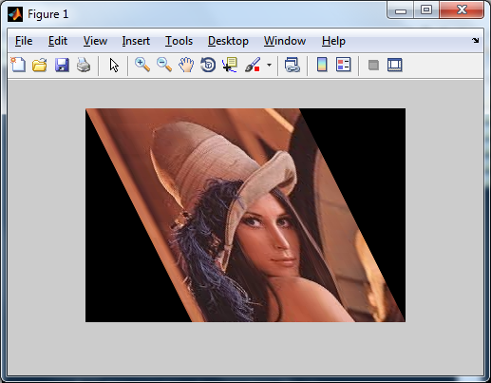
2.8 Image Operations
% Resize image as 60% smaller
Ires = imresize(I, 0.6);
% Crop image from user’s input
imshow(I);
Rect = getrect;
Icrp = imcrop(I, Rect);
% Rotate image by 45 degrees
Irot = imrotate(I, 45);
% Affine transformation
A = [1 0 0; .5 1 0; 0 0 1];
tform = maketform('affine', A);
Itran = imtransform(I, tform);
Notes:
What you have implemented in hw0 can be done in three lines in Matlab.

Slide 46
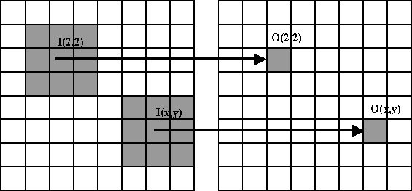
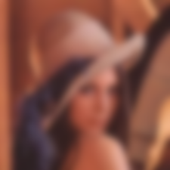

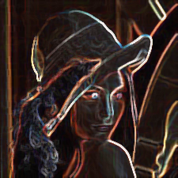

2.9 Image Filtering / Convolution
A filter (or called mask, kernel, neighborhood) is N×N matrix.
Filters help us perform different kinds of operations:
Blurring Sharpening Edge detection Noise removal

Slide 47
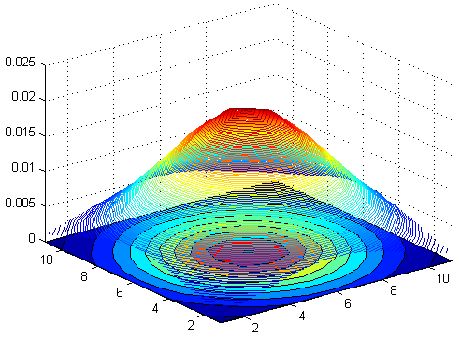
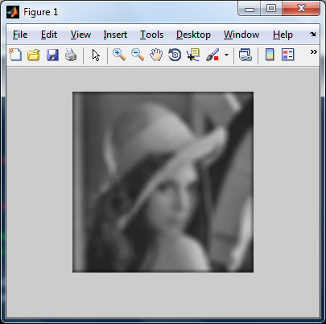
2.10 Image Filtering: Blurring
% Create a 11x11 Gaussian filter
f = fspecial('gaussian',11,3);
% Display it as a 3D surface: % surf(f); %% SEE 'help surf' or 'mesh'
% Filtering on gray image
Ig = im2double(rgb2gray(I));
If = filter2(f, Ig);

Slide 48

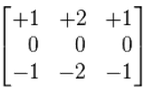
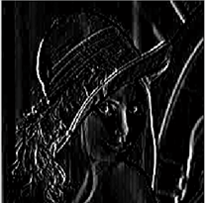
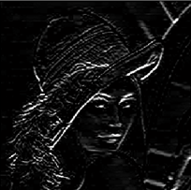
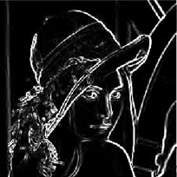
2.11 Image Filtering: Edge Detection
% Sobel edge detection by filtering
fx = [-1,0,1; -2,0,2; -1,0,1];
fy = [ 1,2,1; 0,0,0; -1,-2,-1];
Ix = filter2(fx, Ig);
Iy = filter2(fy, Ig);
Isob = Ix.^2 + Iy.^2;
fx
fy
Ix
Iy
Isob

Slide 49
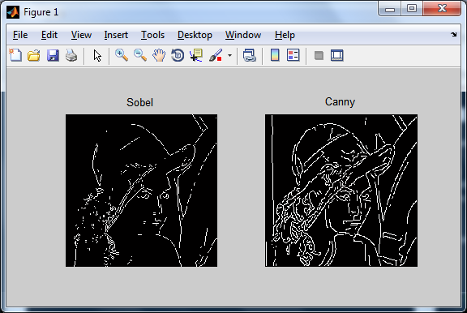
2.12 Image Filtering: Edge Detection
% More discussions will be given in class
Ig = im2double(rgb2gray(I));
Isob = edge(Ig, 'sobel'); % Sobel edge detection
Ican = edge(Ig, 'canny'); % Canny edge detection

Slide 50

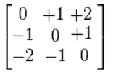
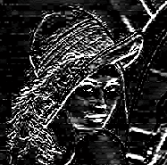
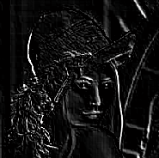
2.13 Image Filtering: Customized
% Customize a stronger edge detector
f1 = [3,10,3; 0,0,0; -3,-10,-3];
I1 = filter2(f1, Ig);
% Customize a diagonal edge detector
f2 = [0,1,2; -1,0,1; -2,-1,0];
I2 = filter2(f2, Ig);
f1
f2
I1
I2

Slide 51
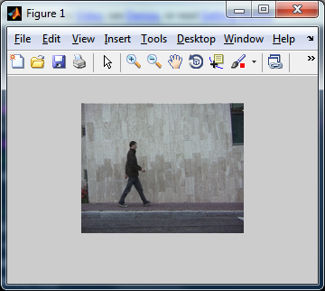
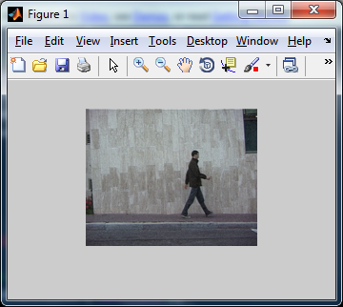
3. Video Processing: Read Videos
% Construct video object to read video data
vidobj = VideoReader('walk.avi');
% Display frame-by-frame
for iFrm = 1 : vidobj.NumberOfFrames
I = read(vidobj, iFrm); % Read frame
imshow(I);
pause(.1);
end

Slide 52
3. Video Processing: Write Videos
% Construct video object to write video data
vidout = VideoWriter('walk_out.avi’);
% Start writing content
open(vidout);
for iFrm = 1 : nFrm
writeVideo(vidout, I);
end
close(vidout);

Slide 53
4. References
More tutorials
http://cseweb.ucsd.edu/~sjb/classes/matlab/matlab.intro.html
http://www.cs.cmu.edu/afs/cs/academic/class/15385-s12/www/lec_slides/matlab_ops_tutorial.m
http://www.cs.cmu.edu/afs/cs/academic/class/15385-s12/www/lec_slides/matlab_prog_tutorial.m
http://www.cs.cmu.edu/afs/cs/academic/class/15385-s12/www/lec_slides/matlab_image_tutorial.m
Matlab course @ ETHZ (http://goo.gl/W2jmZJ)
Introductory Digital Processing @ IIT (http://goo.gl/U0osD2)

Slide 54
4. References
Open source CV algorithms with Matlab interface
VLFeat (http://www.vlfeat.org/)
Piotr Dollar’s toolbox (http://vision.ucsd.edu/~pdollar/toolbox/)
Mexopencv (http://www.cs.stonybrook.edu/~kyamagu/mexopencv/)
Optimization
CVX (http://cvxr.com/cvx/)

