Slide 1
Introduction to Matlab

Slide 2
What is MATLAB?
A high-performance language for technical computing (Mathworks, 1998)
The name is derived from MATrix Laboratory
Typical uses of MATLAB
Mathematical computations
Algorithmic development
Model prototyping
Data analysis and exploration of data (visualization)
Scientific and engineering graphics for presentation

Slide 3
Why Matlab?
Because it simplifies the analysis of mathematical models
It frees you from coding in high-level languages (saves a lot of time - with some computational speed penalties)
Provides an extensible programming/visualization environment
Provides professional looking graphs

Slide 4
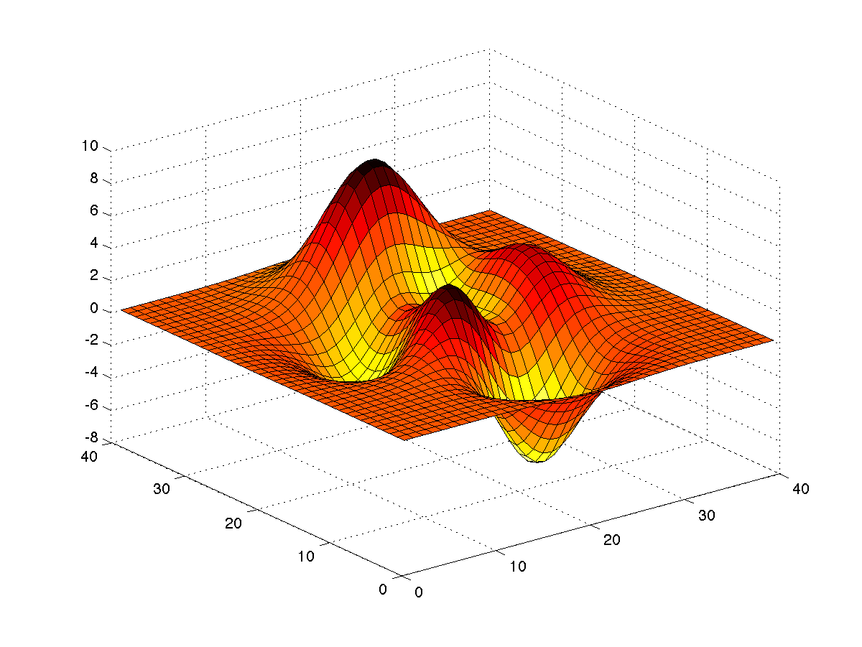
Matlab
The Matlab Environment
Variables; operations on variables
Programming
Visualization

Slide 5
Matlab
The Matlab Environment
Variables; operations on variables
Programming
Visualization

Slide 6
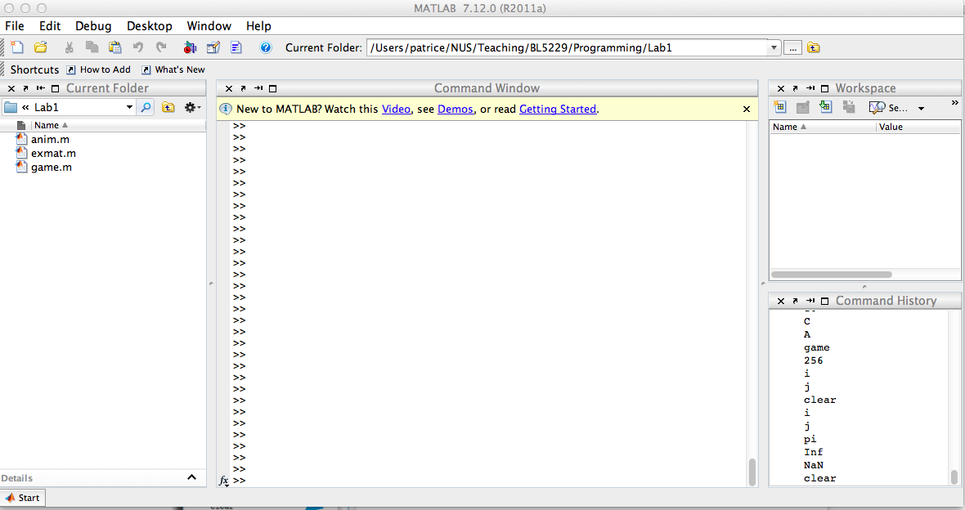
The Matlab Environment
Workspace
Current
folder
Command Window
Command
history

Slide 7
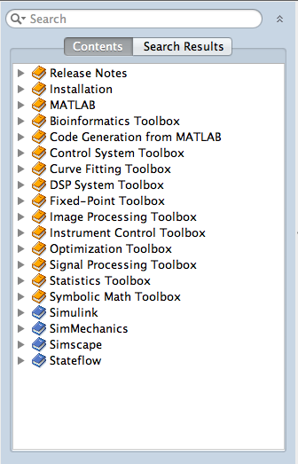
Help in Matlab
Help Browser
-> Product Help
Command line:
>> help <command>
Example:
>> help sqrt

Slide 8
Matlab
The Matlab Environment
Variables; operations on variables
Programming
Visualization

Slide 9
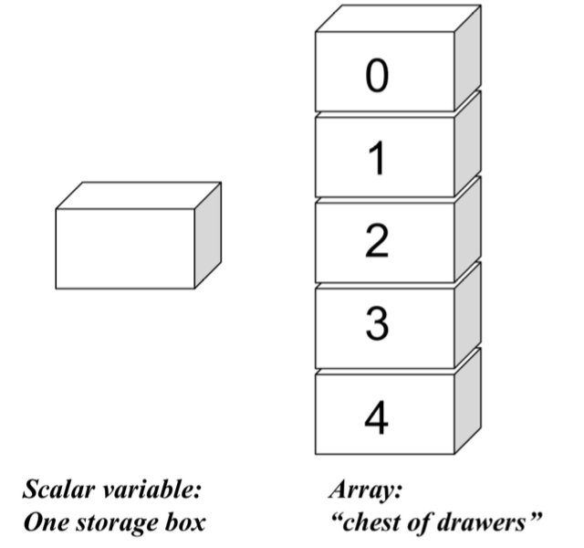
1
2
3
4
5

Slide 10
Variables in Matlab
Begin with an alphabetic character: a
Case sensitive: a, A
No data typing: a=10; a=‘OK’; a=2.5
Default output variable: ans
Built-in constants: pi i j Inf
clear removes variables
who lists variables
whos list variables and gives size
Special characters : [] () {} ; % : = . ... @

Slide 11
Vectors in Matlab
Row vectors
>> R1 = [1 6 3 8 5]
>> R2 = [1 : 5]
>> R3 = [-pi : pi/3 : pi]
Column vectors
>> C1 = [1; 2; 3; 4; 5]
>> C2 = R2'

Slide 12
Matrices in Matlab
Creating a matrix
>> A = [1 2.5 5 0; 1 1.3 pi 4] >> A = [R1; R2]
>> A = zeros(10,5)
>> A = ones(10,5)
>> A = eye(10)
Accessing elements
>> A(1,1)
>> A(1:2, 2:4)
>> A(:,2)

Slide 13
Matrix Operations
Operators + and –
>> X = [1 2 3]
>> Y = [4 5 6]
>> A = X + Y
A= 5 7 9
Operators *, /, and ^
>> Ainv = A^-1 Matrix math is default!

Slide 14
Element wise operations
Operators .*, ./, and .^
>> Z = [2 3 4]’
>> B = [Z.^2 Z Z.^0]
B= 4 2 1
9 3 1
16 4 1

Slide 15
Matlab
The Matlab Environment
Variables; operations on variables
Programming
Visualization

Slide 16
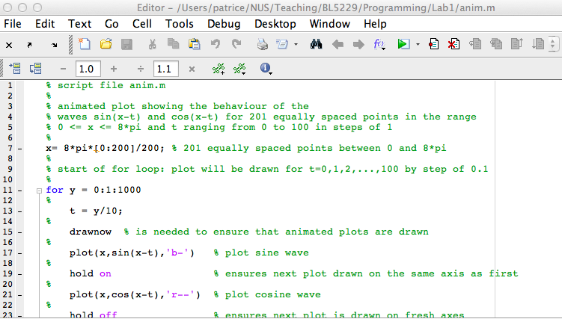
M-file programming
Script M-Files
Automate a series of steps.
Share workspace with other scripts and the command line interface.
Function M-Files
Extend the MATLAB language.
Can accept input arguments and return output arguments.
Store variables in internal workspace.

Slide 17
M-file programming
Always has one script M-File
Uses built-in and user-defined functions
Created in MATLAB Editor
>> edit model.m
Run from Command Line Window
>> model

Slide 18
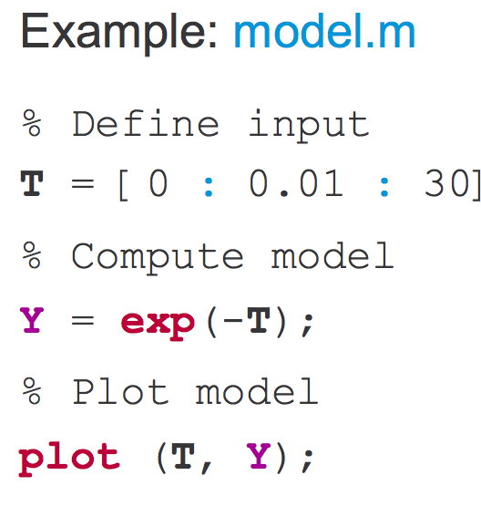
Example of script

Slide 19
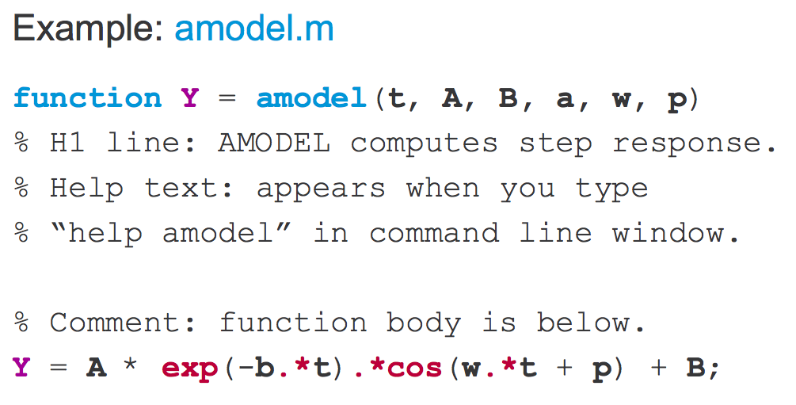
Example of function

Slide 20
Input / Output
Get input from command window:
>> num = input(‘What is the altitude :’)
>> str = input(‘Enter name of the planet’,’s’)
Display output in command window:
String
>> disp(‘The answer is:’)
String + number:
>> disp([‘The value of x is: ‘ num2str(x)])

Slide 21
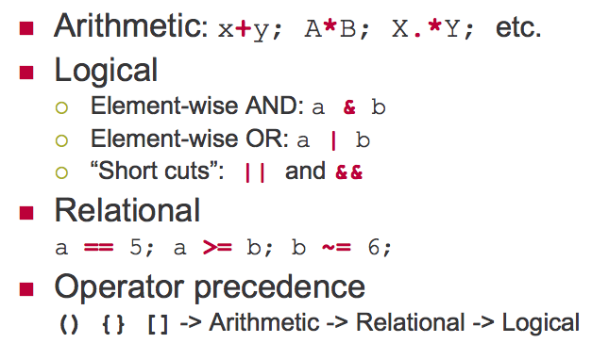
Operators

Slide 22
Program flow control: For
Simple program that sums the squares of all the elements of
a matrix A:
N = 10;
M = 20;
A = rand(10,20)
Sum = 0;
for i = 1:N
for j = 1:M
Sum = Sum + A(i,j)^2;
end
end
Note that this can be done in one line:
Sum2 = sum(sum(A.*A));

Slide 23
Program flow control: if
Simple program that compares two numbers a and b: set
j to 1 if a>b, -1 if a<b, and 0 if a = b:
if a > b
j = 1;
else if a < b
j = -1;
else
j = 0;
end

Slide 24
Other useful commands
Workspace
>> clear
>> who
>> whos
>> close
File operations
>> ls
>> dir
>> cd
>> pwd
>> mkdir

Slide 25
Matlab
The Matlab Environment
Variables; operations on variables
Programming
Visualization

Slide 26
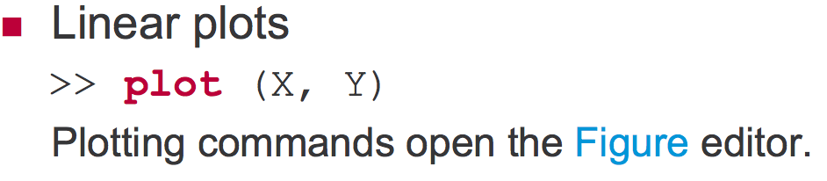
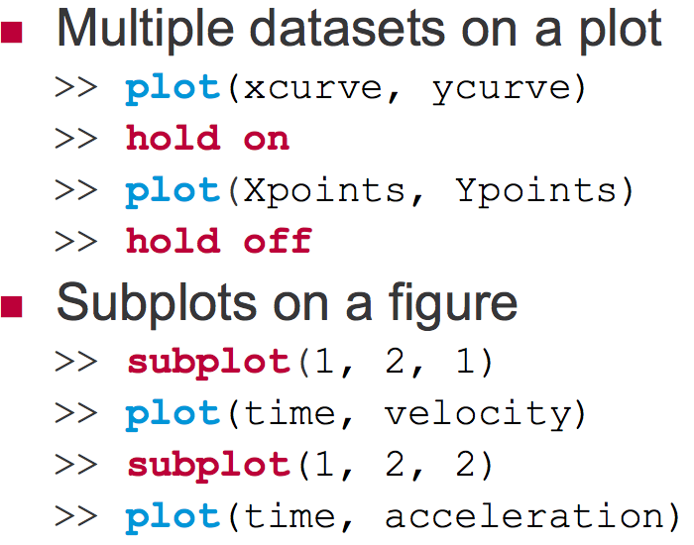

Slide 27
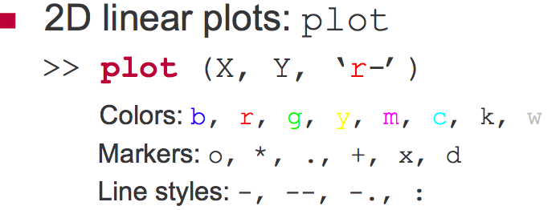
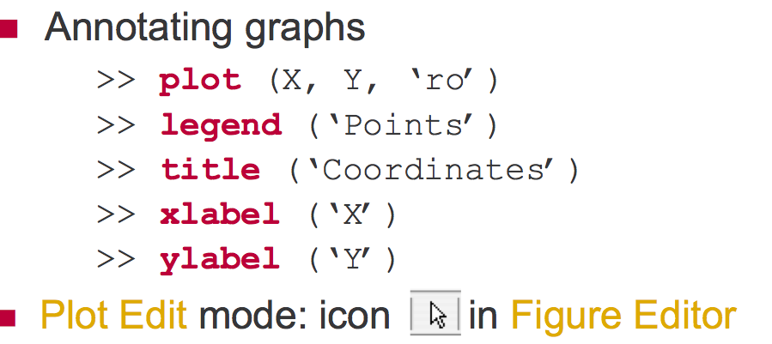

Slide 28
References
Violeta Ivanova, MIT
http://web.mit.edu/acmath/matlab/IAP2007/
Experiment with Matlab (Steve Moler):
http://www.mathworks.com/moler/exm/chapters.html
Matlab: learning by examples
http://www.mathworks.com/help/techdoc/matlab_prog/exampleindex.html

