Slide 1
What is this robot?
SCIENCECLAW HACK · MIT MEDIA LAB
Unlabeled channels. A noisy fingertip. No model file, and not even the type: arm, gantry, SCARA, or telescoping boom.
20/20
1.5 mm
4/4
structures right, on seeds the fixes never saw
median miss after 64 motions
faults where the swarm stays under 10 mm
Notes:
Ask the room what it is. Then say the swarm is not told either.

Slide 2
Six words the rest of the deck uses
THE WORDS
Channel
One number you can send. You are not told whether it turns a joint or slides one.
Tip
Where the fingertip is, in millimetres, plus about 2 mm of noise.
Structure
Hinge or slide, which axis, and the chain order. hz is a hinge about z. sx is a slide along x.
Reach error
Median miss, in mm, on targets the true body can reach. Brackets are a bootstrap 95% interval.
Champion
Lowest error on motions held out from the fit, after a replay check. A public rule crowns it.
Budget
64 motions, the same for the swarm, the pipeline, and both single agents.
Notes:
Units in code are metres and radians. Every number a person reads is in millimetres.

Slide 3
Four machines. One window.
THE PROBLEM
Arm
Gantry
SCARA
Telescope
Hinges only, three to five. A yaw at the base, then mostly pitch.
h · h · h · …
Three slides, like a printer or a liquid handler, then a rotating tool.
sx · sy · sz · hz
Two horizontal hinges, a vertical slide, and a wrist.
hz · hz · sz · hz
Yaw, pitch, a boom that extends, and a wrist pitch.
hz · hy · sz · hy
Link lengths are random. The same command interface hides all four.
Notes:
These are the generator's patterns. The swarm is not shown them, and the wires can arrive in any order.

Slide 4
Agents may use three things.
THE RULE
move(command)
Send one number per channel. Read back a fingertip, with noise.
Hidden from every agent
The spec, the MuJoCo model, the noiseless fingertip, the skeleton, and any URDF or MJCF. Those exist so the score can be true.
n_channels
How many numbers the command has. Not what they do.
limits
The smallest and largest legal command. The same window for every channel.
Notes:
If a judge asks whether it peeked: the spec, the MuJoCo model, and the true tip belong to the scorer.

Slide 5
Six bets, stated before the score
HYPOTHESES
H1 The path
H2 Agreement
H3 Collective
Sweep one channel. A straight path is a slide. An arc is a hinge. The line, or the arc's plane, is the axis.
A channel is settled only when two sweeps, from two poses, agree. If they disagree, every type stays on the board.
The same parts, free to disagree, beat one agent and a fixed pipeline when a part lies or dies. Same 64 motions.
H4 Change
H5 Refusal
H6 Known body
Repeated surprise on sentinel motions is enough to notice that the body changed.
The planner should decline a target the model has not earned, including anything past the body's reach.
When the structure is already known, the swarm should not cost accuracy.
Notes:
H3 is the collective-capability score. H6 is the one we expected might fail, and it did.

Slide 6
They share a board. Nobody calls anybody.
METHOD
Explorer ×2
Channel ×2 each
Review
Hypothesizers
Picks a motion where the competing models disagree.
Sweeps one channel from home, and again from a bent pose.
A third pose, when a channel is doubtful and the champion is still off.
Assemble a whole structure from findings, a prior, a library, or a model.
Modeler ×4
Validator ×2
Monitor
Planner
Two chain fits, a Gaussian mixture, and a neural net.
Replay the fit. Crown the lowest holdout error. The rule is public.
On repeated surprise, says the body changed and opens a new epoch.
Inverse kinematics on the champion. After an alarm, it refuses to move.
Notes:
The review agent and the monitor are the two single copies. Knocking out the review agent still left 20/20.

Slide 7
A line is a slide. An arc is a hinge.
METHOD · H1 AND H2
Hinge · hz
Slide · sx
The fingertip rides a circle. The axis is the normal of that plane. Confidence is how far this is from a straight line.
The fingertip rides a straight line. The axis is the direction of the line. Metres per command are learned with the length.
Both say hz
They disagree
The channel is settled. The finding goes on the board once, with both parents.
Disputed. Every type is proposed, and a review agent can sweep from a third pose.
Notes:
Two agents do this per channel. A disputed channel is not deleted. Every type is still proposed.

Slide 8
The crown is a held-out error
METHOD
1 · Propose
2 · Fit
3 · Replay, then crown
Hypothesizers turn channel findings into a chain, including the order of the wires. A prior, a library, and a language model can propose too, when a key is set.
A chain model turns that structure into lengths and axes. Two chain modelers use different seeds. A mixture model and a neural net fit the same motions without a chain.
A validator refits from scratch. The refit has to reproduce the score. The public rule picks the lowest holdout error. A near tie goes to the older candidate.
Any agent can compute the rule. A failed replay used to kill the whole job. It now fails that candidate only.
Notes:
Confidence is not the crown. A loud wrong hypothesis loses to a quiet model that predicts the holdout.

Slide 9
Four ways to spend the same 64 motions
THE COMPARISON
Swarm
Single probe
Pipeline
Single
Independent agents. Every role has a second copy, except review and the monitor. They can disagree, and the crown picks.
One agent. It sweeps channels, then fits one chain. No second opinion. No language-model slot.
The same parts as the swarm, one orchestrator, fixed order. The language-model stage has the last word.
One chain model, no channel sweeps. It searches structures without isolating a joint.
A neural net is the extra baseline on known arms. It never gets close, so it is not in the fault table.
Notes:
Say this out loud: same robots, same 64 motions, same scorer.

Slide 10
Judged on seeds the fixes never saw.
THE TEST
On seeds 1 and 2, one wrong channel finding or one crashed modeler sank the swarm. Version 2 added a second probe, a review agent, and a second chain modeler. Seeds 101 to 105 came after that.
1,938 jobs finished. 240 bodies, 480 damage, 800 faults, 320 noise, 48 real arms, 30 learning curves, 20 extrapolation runs. Language models were off, so a seed repeats.
Notes:
Designed on seeds 1 and 2. Scored on 101 to 105. If someone asks whether we tuned on the test, this is the answer.

Slide 11
Full structure on 20 robots out of 20
RESULTS · CLEAN BODIES
20/20
5/20
1.5 mm
Swarm, probe, and pipeline. Independent seeds.
Single agent, no sweeps.
Swarm median miss. Interval 1.4 to 1.9. n = 20.
Probe 1.3 mm
Pipeline 1.7 mm
Original seeds
Interval 1.0 to 1.7. The intervals overlap the swarm. On the original gantries the probe is genuinely closer: 0.9 against 1.8.
Interval 1.0 to 2.0. Probing works. The collective is not what finds a clean body.
Swarm, probe, and pipeline 40/40. Single agent 6/40. Swarm reach 1.6 mm, n = 40.
§1. The swarm spends 36 of its 64 motions sweeping, interval 32 to 40, n = 60.
Notes:
Give the 20/20, then give it away: the probe and the pipeline also get it. The swarm earns its keep under faults.

Slide 12
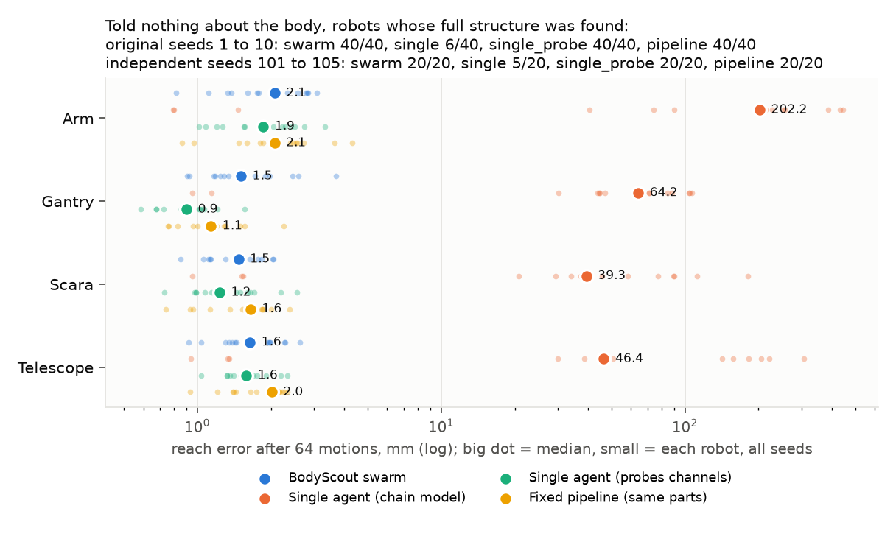
Three methods sit on the fingertip. One does not.
RESULTS
All seeds pooled. Log scale. Big dot is the median. §1.
Notes:
Point at the red cloud, then at the pile near 1 to 2 mm. That pile is the probe result. The swarm is not special yet.

Slide 13
Panda, UR5e, Gen3, ViperX. Shuffled too.
REAL ARMS
Arm | Channels | Swarm | Single | Observable
Panda | as built | 2.1 mm | 340 mm | 18/18
Panda | shuffled | 2.6 mm | 506 mm | 18/18
UR5e | as built | 1.9 mm | 285 mm | 15/15
UR5e | shuffled | 2.0 mm | 348 mm | 15/15
Gen3 | as built | 2.1 mm | 392 mm | 16/16
Gen3 | shuffled | 2.0 mm | 592 mm | 16/16
ViperX | as built | 2.4 mm | 297 mm | 15/15
ViperX | shuffled | 2.0 mm | 270 mm | 15/15
§2. n = 3 seeds each. Joints the fingertip cannot reveal are left out of the observable count. Panda shuffled is 19/21 of all joints.
Notes:
Three seeds is a small n. Say so. The gap to the single agent is not small.

Slide 14
Only the swarm stays under 10 mm on all four faults
WHICH IS BETTER · INDEPENDENT SEEDS
4/4
Swarm
3/4
Single probe
1/4
Pipeline
0/4
Single agent
What we broke | Swarm | Probe | Pipeline | Single
Nothing | 1.5 mm 20/20 | 1.3 mm 20/20 | 1.7 mm 20/20 | 45 mm 5/20
Wrong joint type | 1.5 mm 20/20 | 44 mm 1/20 | 41 mm 3/20 | no slot
Wrong hypothesis | 1.6 mm 20/20 | no slot | 27 mm 0/20 | no slot
Modeler dies | 1.7 mm 20/20 | 3.2 mm 20/20 | no model 18/20 | 54 mm
Sensor lies every sweep | 5.1 mm 13/20 | 3.7 mm 12/20 | 3.7 mm 14/20 | no slot
§5, seeds 101–105, n = 20. No model counts as a miss. No slot means the fault cannot reach that method. One swarm run had no model on the lying sensor.
Notes:
Read the lying-sensor row out loud. The 4/4 is true, and it is not the whole story.

Slide 15
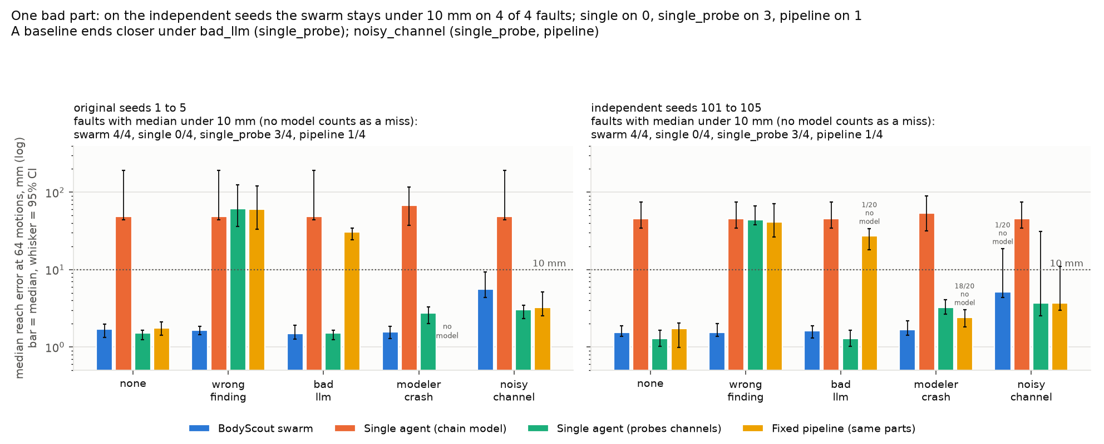
The second copy is for the day a part lies
WHICH IS BETTER
Wrong type, or a dead modeler
A confident wrong hypothesis
The other probe, or the other chain modeler, is still there. Probe falls to 1/20 on a wrong type. The pipeline has no model in 18 of 20 when its modeler dies.
The pipeline lets that stage decide: 0 of 20 structures, 27 mm. The swarm still crowns the findings. The probe has no such slot.
Right-hand panel is the independent seeds. Dashed line is 10 mm. Whiskers are the bootstrap interval. §5.
Notes:
Three wins come from a second opinion. The loss is two agents believing the same bad sensor.

Slide 16
Break it at motion 64. The alarm is the monitor.
DAMAGE
20/20
20/20
20/20
20/20
16/20
1/20
Locked joint
Longer link
Reversed motor
Tool change
Bent axis
Payload
97 / 120 alarms
59 / 120 trusted models
Payload, 1 / 20
The pipeline's monitor gets 95 / 120. Latency is 26 to 32 motions for the five kinds it can see. This belongs to the monitor.
At motion 128. The pipeline has one in 112 / 120. Both single agents have one in every run. Relearning is the open problem.
The fingertip still lands near 2 mm, so there is little surprise. The pipeline notices 0 of 20. The old model still reaches.
§3. Medians after damage skip runs with no model. A bent axis leaves 10 of 20 swarm runs with no model.
Notes:
Separate the alarm from the recovery. We notice about as well as the pipeline. We rebuild more slowly.

Slide 17
The cube still gets placed
A TASK
20/20
20/20
20/20
4/20
Swarm, before
Swarm, after
Single, before
Single, after
Place error 2.9 mm. Interval 2.3 to 3.7.
4.7 mm, interval 2.4 to 6.5. A replan in all 20.
3.1 mm, interval 2.0 to 4.7.
149 mm, interval 55 to 376. No replan.
§4. Pick and place. A link is lengthened at motion 48. n = 20 arms. Place error is only where the cube was placed.
Notes:
While the alarm is open, the planner refuses to move. That pause is why the swarm asks for a new plan.

Slide 18
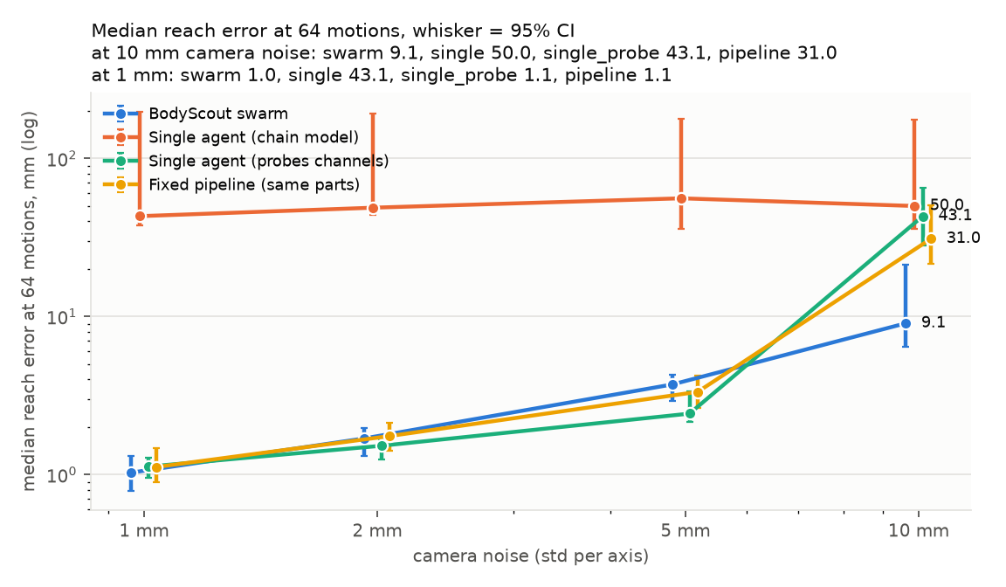
At 10 mm of noise, the swarm is still near the target
CAMERA NOISE
9.1 mm
31–50 mm
0 / 20
Swarm. Interval 6.4 to 21.2. Structure right on 13 of 20.
Pipeline 31, probe 43, single 50. Structures right on 4, 3, and 4 of 20.
False alarms at 1, 2, 5, and 10 mm, swarm and pipeline.
At 1, 2, and 5 mm the probe is as close or closer, and everyone who probes still names the structure. The gap opens when the noise gets large. This is noise on every reading, not the one-channel fault.
§6. n = 20 at each noise level.
Notes:
Name the two noise tests apart. One bad channel fools the swarm. Noise on every frame is where the extra sweeps pay.

Slide 19
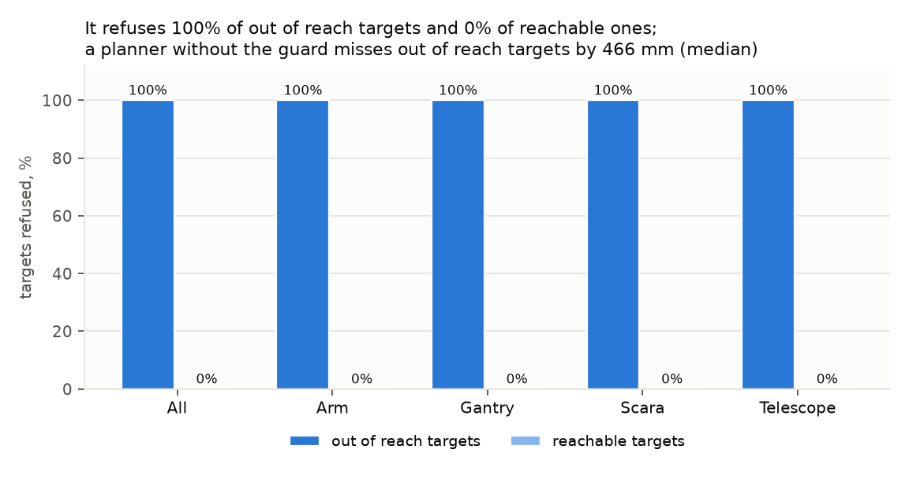
It declines a point it has not earned
H5
200/200
0/200
466 mm
Out-of-reach targets refused.
Reachable targets refused.
An unguarded planner, on those far targets. Interval 452 to 517.
§8. Out of reach means 1.3 times past the largest reach. n = 200, fifty per family. On reachable targets the unguarded miss is 2 mm.
Notes:
Zero false refusals is what makes the 200 out of 200 believable.

Slide 20
Remove one role. The structure still comes back.
REDUNDANCY
Ten knockouts, twenty unknown bodies each, removed at motion 24. Structure right 20/20 on every row. Reach stays between 1.4 and 1.7 mm.
findings
prior
library
one validator
one explorer
the monitor
every hypothesizer
one chain modeler
bent-pose probes
the review agent
The library was empty, so removing it changes nothing. Language-model hypothesizers were off, so that knockout was not run.
§7 and results/knockout.md.
Notes:
Knockout is a clean body. The fault slide is where a missing replica matters.

Slide 21
Six places a simpler method wins
HONEST LIMITS
1 A sensor that always lies
2 Relearning after damage
3 Payload
Swarm 5.1 mm and 13/20 structures. Probe and pipeline 3.7 mm. Agreeing twice on a biased sweep is worse than sweeping once.
A trusted model at motion 128 in 59 of 120 swarm runs. The pipeline has one in 112 of 120.
Noticed in 1 of 20. The reach error never really leaves 2 mm, so the monitor has almost nothing to see.
4 Nothing to discover
5 Clean bodies
6 Cost
On known arms the single agent wins at every checkpoint. At 64 motions, 1.5 mm against 2.4. n = 10. H6 fails.
Probe 1.3 and pipeline 1.7 tie the swarm's 1.5. On original-seed gantries the probe is ahead outright, 0.9 against 1.8.
91.5 seconds of agent CPU, interval 73 to 105. Pipeline 5.8. Probe 9.4. n = 60. The minute is the price of the second opinion.
§3, §5, §9, §10. The full list, including overlapping intervals, is 102 rows in results/summary.md.
Notes:
Do not rush this slide. A judge who finds one of these later will discount the 4/4.

Slide 22
What we would claim, and what we would not
AFTER THE EVIDENCE
Bet | Verdict | What the runs say
H1 Path | Holds | 20/20 structures. Probe and pipeline hold it too, so the sweep is the cause.
H2 Agreement | Holds | A wrong finding leaves the swarm at 1.5 mm and 20/20. The probe falls to 1/20.
H3 Collective | Three of four | Holds on a wrong finding, a bad hypothesis, and a dead modeler. Fails when one sensor lies every sweep. Ties when nothing is wrong.
H4 Change | Five kinds | 97/120 alarms. Payload is 1/20. The pipeline matches the alarm and rebuilds faster.
H5 Refusal | Holds | 200/200 far targets refused. 0/200 reachable ones refused.
H6 Known body | Fails | The single agent is closer at every checkpoint when there is nothing to discover.
Notes:
Leave this slide up during questions.

Slide 23
Every clean champion has seven kinds of agent behind it
AGENCY
7
39/40
Agent types in the ancestry. Range 6 to 8. n = 40 clean runs.
Champions fit while two or more sources had proposed structures that disagreed.
Parents are the proof
Disagreement is normal
A pipeline trace differs
Each note names the notes it came from. The crowned model traces back to raw motions. The dashboard draws that chain.
On a clean body the winning structure still came from the channel findings, after other sources had proposed something else.
Those parents are stages of one program, in order. They are not independent agents.
§11. Vision, added on the same board: 3.0 to 4.3 mm median triangulation error by family (§13). Dynamics predate version 2 and were not rerun.
Notes:
Open the dashboard if a judge wants a real trace. The count is the one-line version.

Slide 24
Three ways in. None of them need our robots.
FOR OTHER TEAMS
1 Call the skill
2 Point learn at your class
3 Take the files
robot_motion sends commands and returns the fingertip in millimetres. Nothing else. Another team's agent can probe a body without our swarm.
move, n_channels, and limits are enough to run. Add true_tip only if you want a score. Agents still cannot see it.
URDF, MJCF, body.json, and a report in millimetres. A length the motions could not pin is marked. Masses are placeholders.
Notes:
The skill, the command, and the files already exist.

Slide 25
From a fresh checkout
HOW TO RUN IT
python -m pytest -q
python demo.py
python demo.py --family scara
python -m bodyscout learn --robot examples/arm.py:Arm
--budget 64 --out export
python -m bodyscout learn --robot path.py:Class
--budget 64 --unknown --out export
python -m http.server 8000
--unknown
Turns the channel agents on. Use it when the body might include a slide.
--llm
Calls a model if a key is in .env. Off in every number in this deck.
Then open
This briefing at /judge/. The provenance dashboard at /dashboard/.
Notes:
One command per line. The last colon in --robot is the class name, so a Windows drive letter is safe.

Slide 26
Four files, and what your class must have
WHAT COMES OUT
robot.urdf
robot.xml
body.json
report.html
One link and one joint per channel, revolute or prismatic. A slide stores metres per command.
The same tree as MJCF. Each joint's scale is a custom number.
Chain order, which channel drives which joint, axes, and which lengths are identifiable.
The same facts in millimetres. Unpinned lengths are marked in all four.
Your class needs move, n_channels, and limits. A scored curve also needs a motion counter and true_tip. Agents read the first three only. Loading the MJCF and driving each joint with its scale reproduces the chain model to within 1 mm.
The skill, for another team's agent:
python scienceclaw_skill/robot_motion/scripts/robot_motion.py --family scara --seed 7 --n 5 --format json
Notes:
Hand a person the report. It is already in millimetres.

Slide 27
What this deck does not show
BEFORE YOU QUOTE IT
No physical servo
No language model in the score
Small n, in two places
MuJoCo, procedural or Menagerie. Backlash and cable stretch are future work. Fix the slow rebuild, and the sensor that lies, first.
Keys turn hypothesizers on. Their answers vary, so the sweep left them off. The bad-hypothesis fault simulates that slot.
Menagerie is 3 seeds. The known-arm curve is 10 arms. Body, fault, damage, and noise cells are 20.
Damage medians are conditional
Dynamics are the previous swarm
One numerical crash
Recovered error uses runs that still have a model. That share is 59/120 for the swarm. Read both.
They predate the second probe, the review agent, and the second modeler. They are not in the 4/4.
A validator replay hit an SVD failure and killed a job. A failed replay now fails that candidate. The job was rerun.
Notes:
The claim to stand on is the independent-seed table, with the six losses beside it.

Slide 28
A robot with no model file.
BODYSCOUT
A swarm that writes one, and writes it again when the body changes.
Briefing /judge/ Dashboard /dashboard/ Numbers results/summary.md
Notes:
Stop. Leave the verdict slide or this one up.

