Slide 1
Recommendation System
Based on Two-Tower Neural Network Model

Slide 2
Problem Statement
Business Problem
Preprocessing
Model Training
Post Processing
EVALUATION Methods
Deployment
Set-up and USAGE

Slide 3
Introduction
Yash Gupta | Data Scientist | Adidas

Slide 4
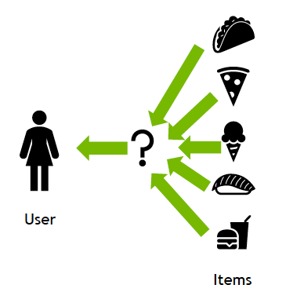
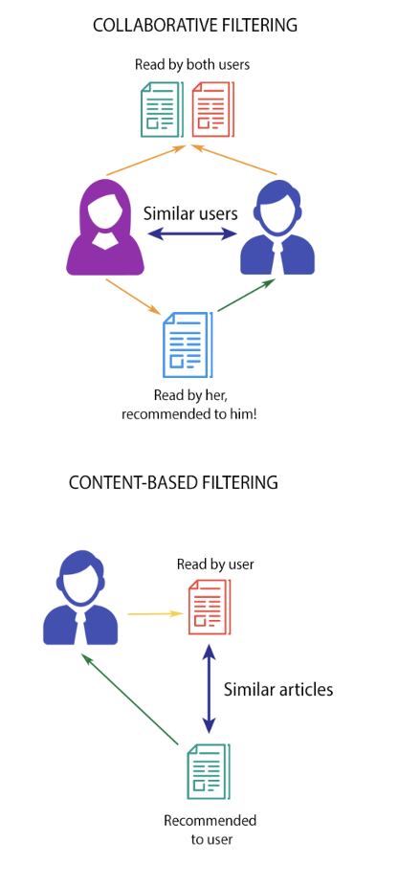
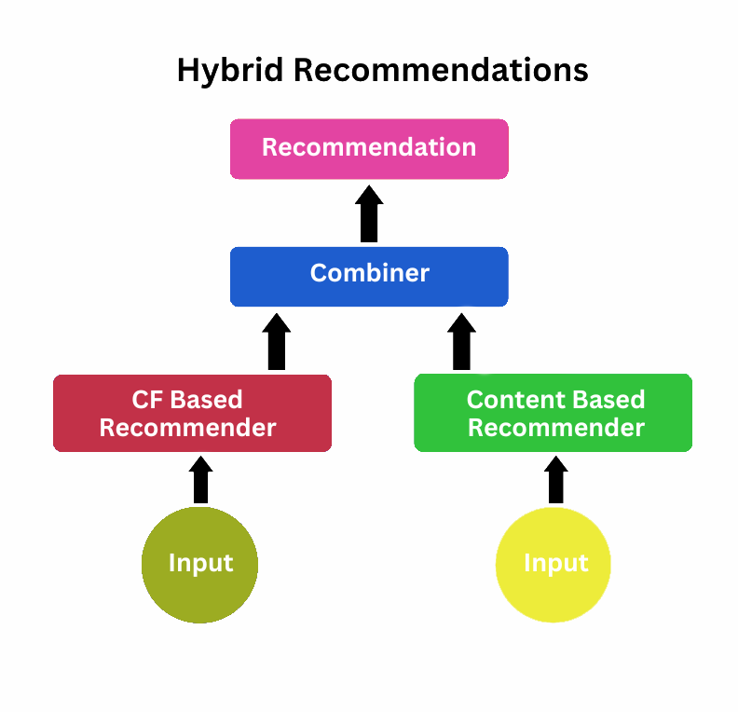
PROBLEM STATEMENT
Again, What is it ?
Objective: Build A Personalized Recommendation System That Connects Users To The Most Relevant Content Using Behavioural And Contextual Data.
Goal: Recommend The Top-k Items (e.g., News, Articles, Or Products) A User Is Most Likely To Engage With.
Inputs: User Metadata, App Activity, And Content Attributes.
Outputs: Ranked List Of Recommended Content For Each User.

Slide 5
BUSINESS PROBLEM
Again, Why is it ?
Users interact with hundreds of articles and products daily — personalization is key to retaining attention.
The platform’s challenge: Increase engagement and reduce bounce rate.
The Two-Tower model helps:
Improve CTR (Click-Through Rate).
Boost retention and session duration.
Enhance monetization by showing the most relevant items.

Slide 6
Preprocessing
What to do with Raw Data ?
Available Variables:
Useful Variable:
✅ Feature Engineering:
❌ Limitation of the Data:

Slide 7
Training
What to do with PROCESSED DATA?
USER FEATURES:
CONTENT FEATURES:
CONTENT BASED MODEL:
COLEBORATORE FILTERING BASED MODEL:
TWO TOWER NEURAL NETWORK BASED MODEL:
:

Slide 8
BATCH INFERENCING
What to do with PROCESSED DATA?
USER FEATURES:
CONTENT FEATURES:
CONTENT BASED MODEL:
COLEBORATORE FILTERING BASED MODEL:
TWO TOWER NEURAL NETWORK BASED MODEL:
:

Slide 9
Preprocessing
User Data Cleaning: Handle missing values and encode categorical features (platform, district, language_selected). Derived variables like days_since_signup, days_since_last_active. Content Data Preparation: Encode metadata such as newsType, newsLanguage, sourceName. Use text embeddings for article titles and descriptions (e.g., Sentence-BERT). Feature Engineering: Normalize numeric features. Save fitted encoders to ensure consistency between training and inference.

Slide 10
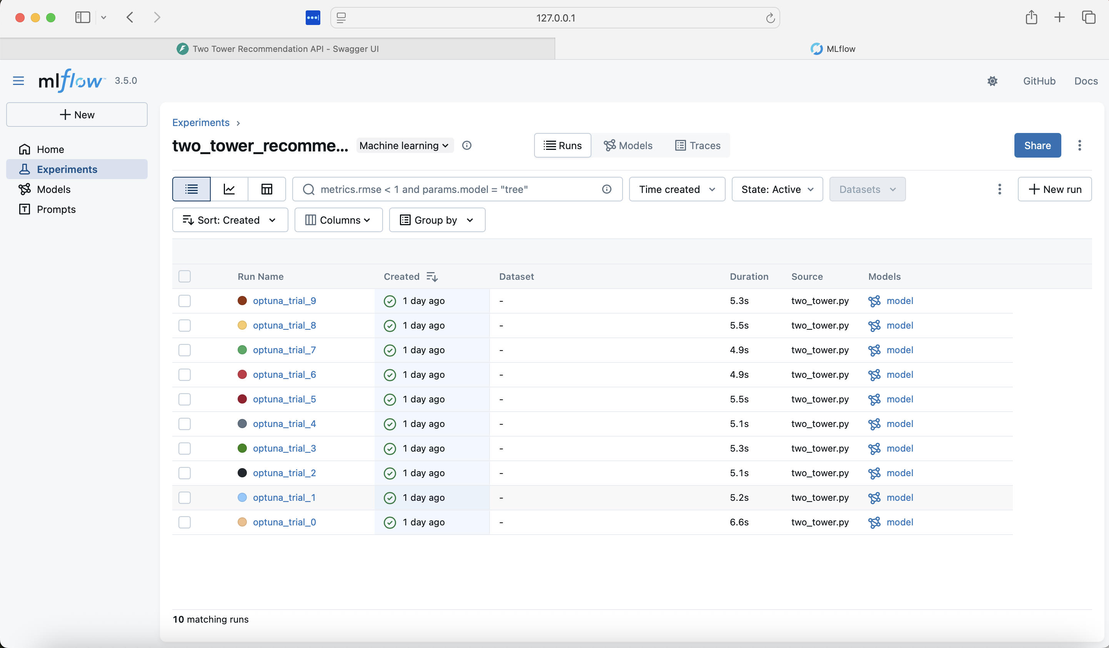
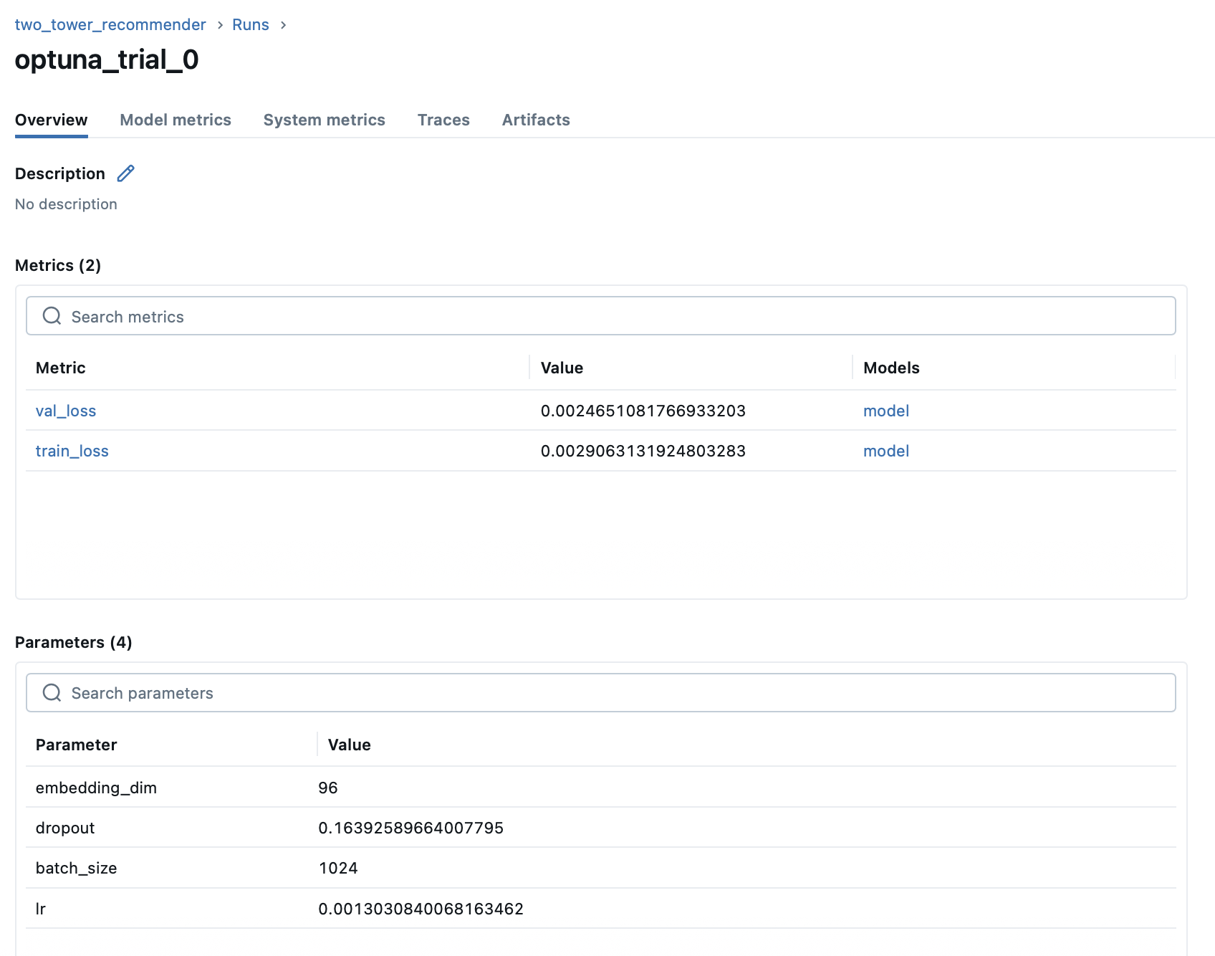
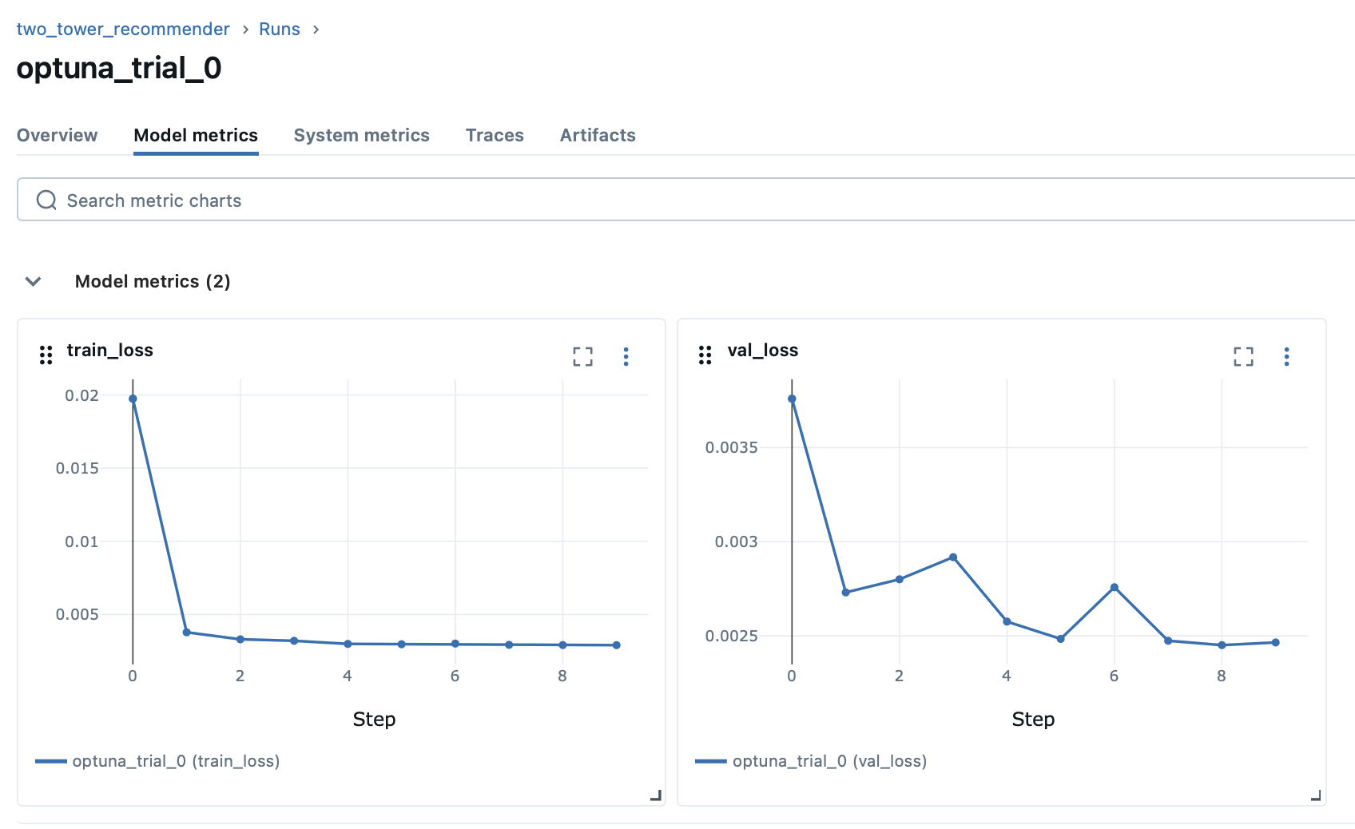
Screenshots from the MLflow UI Displaying the 0th trial details, hyperparameter configurations, training and validation loss curves, and the complete list of trials.

Slide 11
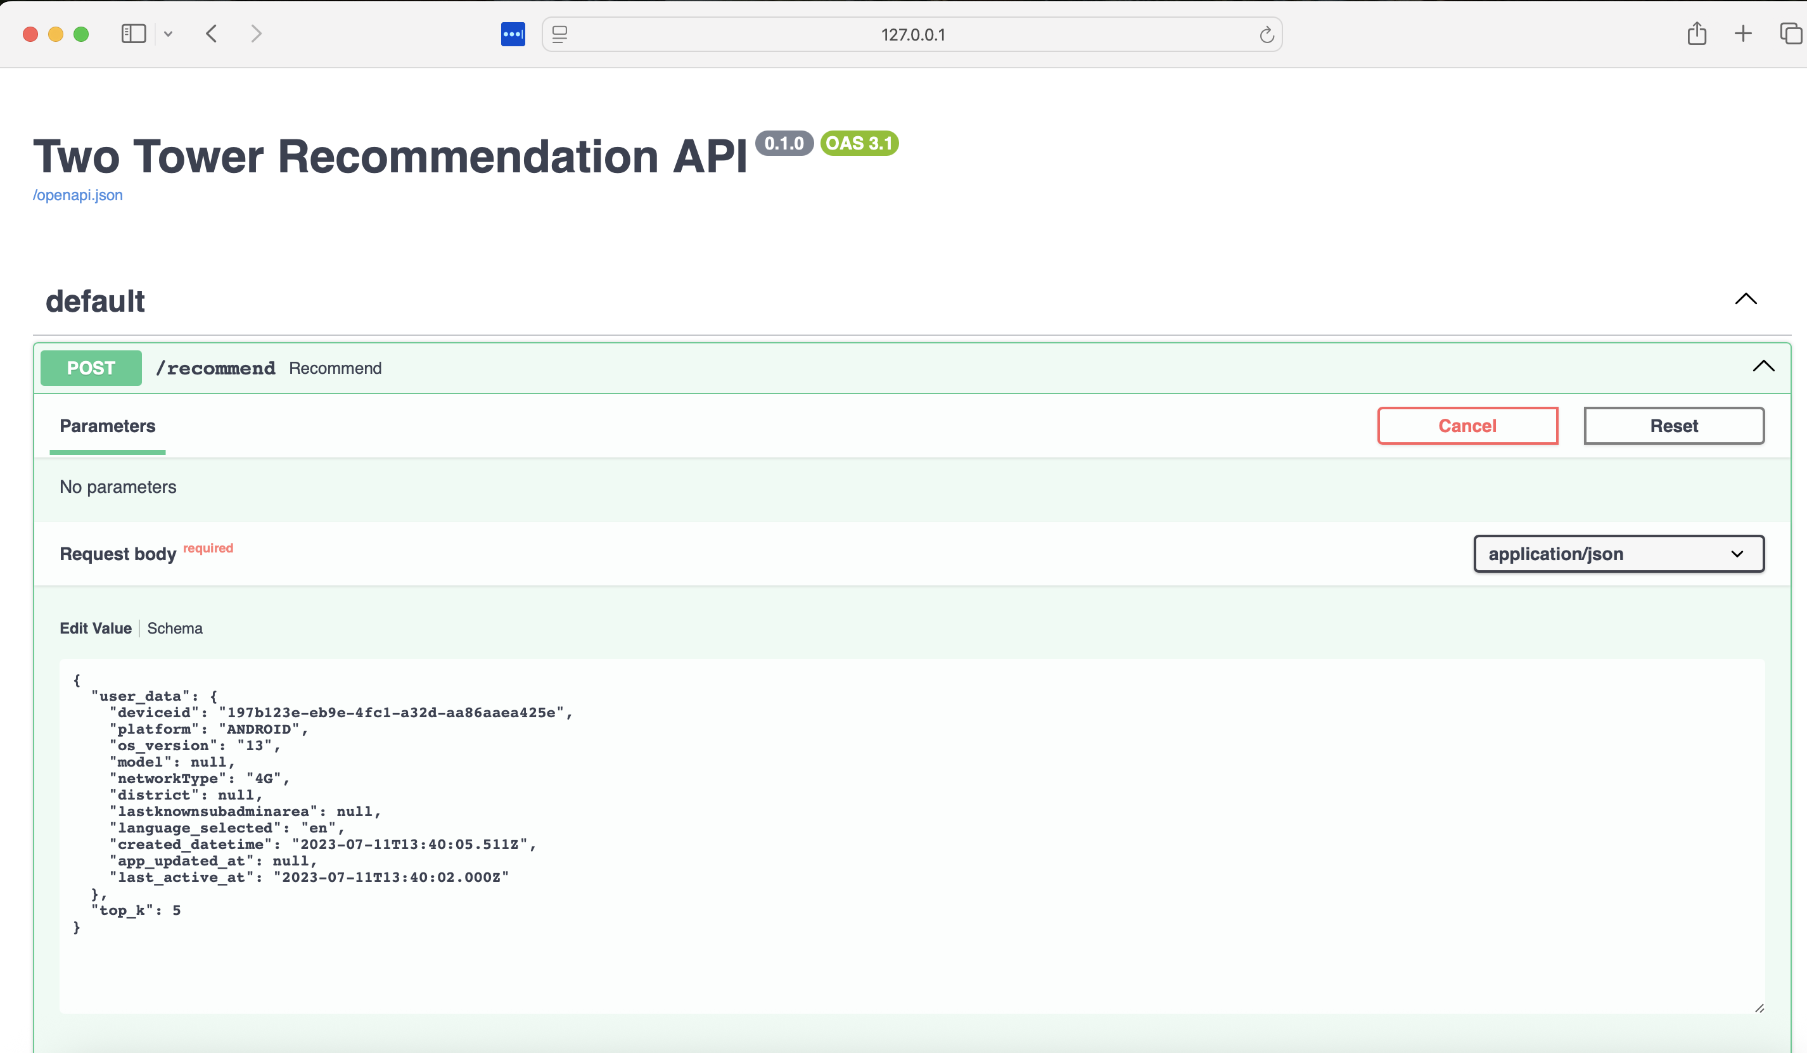
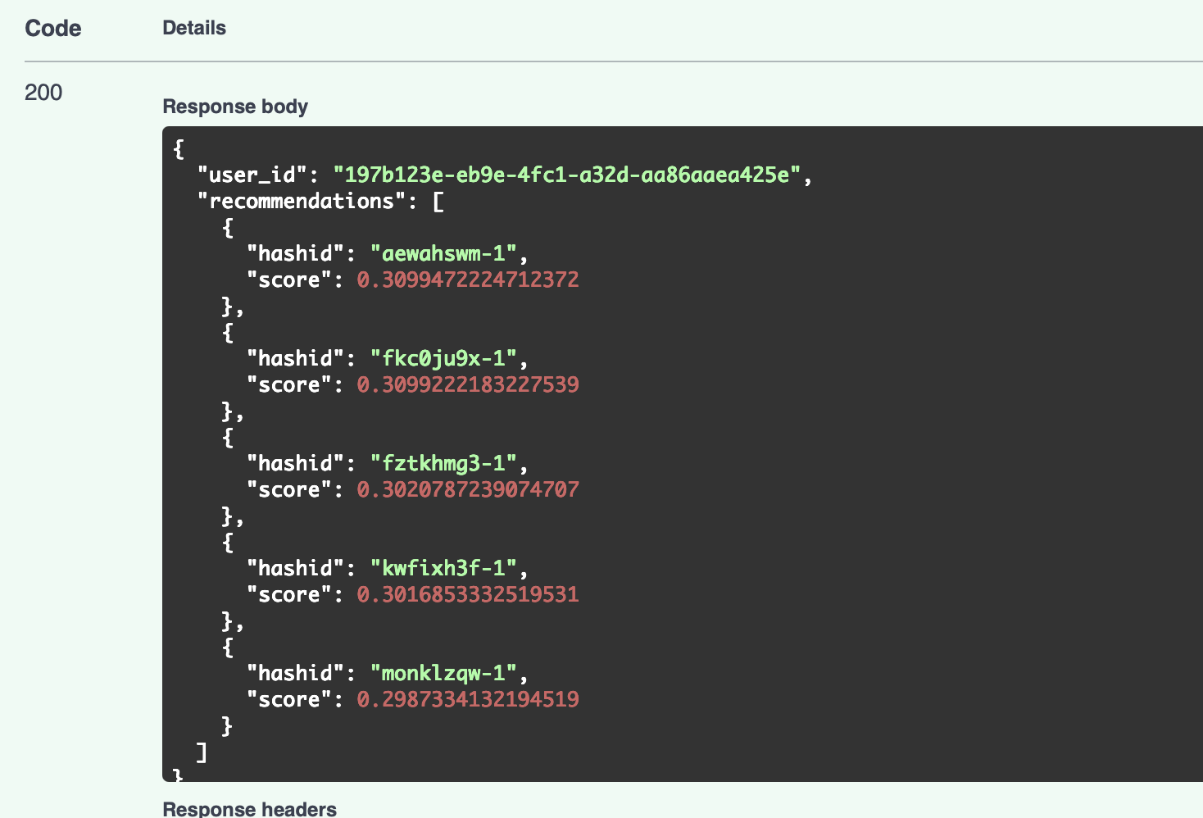
Real Time Inferencing as API

Slide 12
Thank you

