Slide 1
Recommendation System
Based on Two-Tower Neural Network Model

Slide 2
Problem Statement
Business Problem
Preprocessing
Model Training
Post Processing
EVALUATION MeTRICS
Deployment

Slide 3
Introduction
Yash Gupta | Data Scientist | Adidas

Slide 4
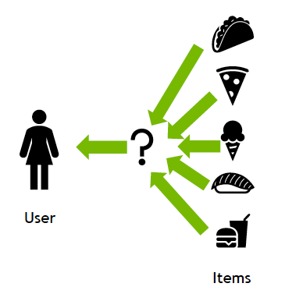
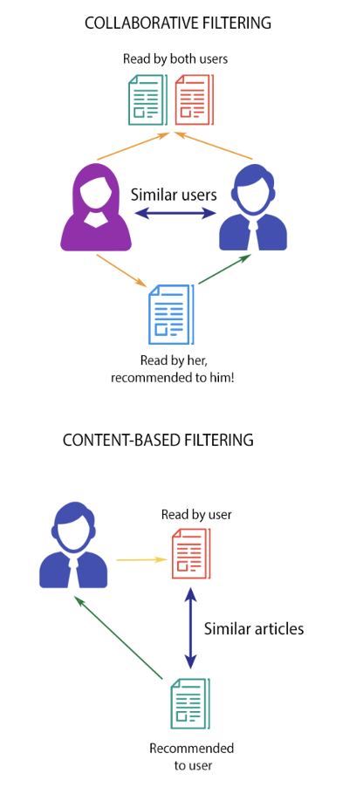
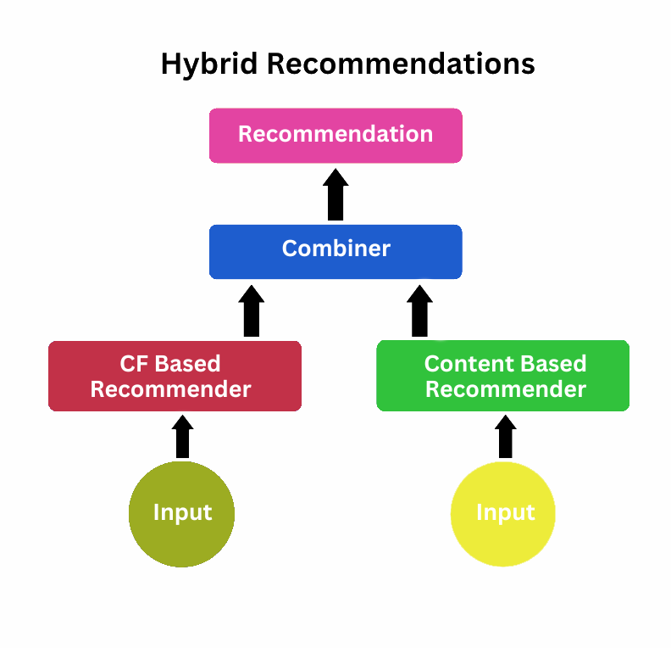
PROBLEM STATEMENT
Again, What is it ?
Objective: Build A Personalized Recommendation System That Connects Users To The Most Relevant Content Using Behavioural And Contextual Data.
Goal: Recommend The Top-k Items (e.g., News, Articles, Or Products) A User Is Most Likely To Engage With.
Inputs: User Metadata, App Activity, And Content Attributes.
Outputs: Ranked List Of Recommended Content For Each User.

Slide 5
BUSINESS PROBLEM
Again, Why is it ?
Users interact with hundreds of articles and products daily — personalization is key to retaining attention.
The platform’s challenge: Increase engagement and reduce bounce rate.
The Two-Tower model helps:
Improve CTR (Click-Through Rate).
Boost retention and session duration.
Enhance monetization by showing the most relevant items.

Slide 6
Preprocessing
What to do with Raw Data ?
How to Run (local): python -m scripts.preprocessing.preprocessing
Available Variables: User Features: Content Features:
✅ Feature Engineering: csxaxas
❌ Limitation with this Data: xasxasxs

Slide 7
Training
What to do with PROCESSED DATA?
How to Run (local): python -m scripts.training.two_tower
Feature Importance: Calculated using SHAP
Assumptions:
Models Used:
1. Content Based Model 2. Collaborative Filtering 3. Two Tower Neural Network
Log Hyper Parameters and Model Registory:
MLFlow

Slide 8
POST processing
Model to output?
How to Run (local): python -m scripts.postprocessing.batchinference (REST API) python -m scripts.postprocessing.realtimeinference
Batch Inferencing:
Real Time Inferencing:
FastAPI

Slide 9
EVALUATION METRICS
How will do it do?
How to Run (local): python -m scripts.postprocessing.evaluation
Metrics:
nDCG@K: Captures ranking quality considering position.
Hit@K: Measures whether relevant items appear in the top-K list.
MAP: Averages precision across users.

Slide 10
DEPLOYMENT
How will do it do?
How to Run (local): pre-commit install
Jenkins
AWS Sagemaker:
Docker:
Terraform:

Slide 11
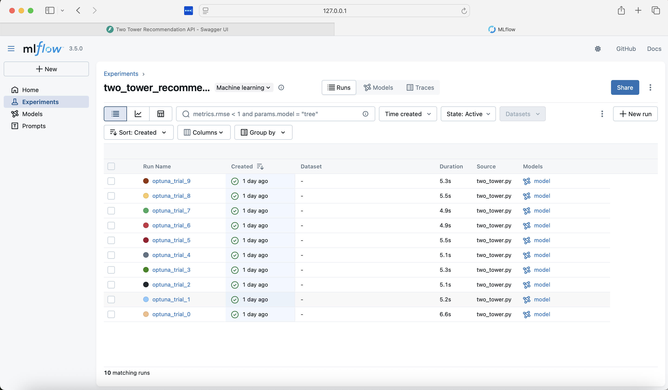
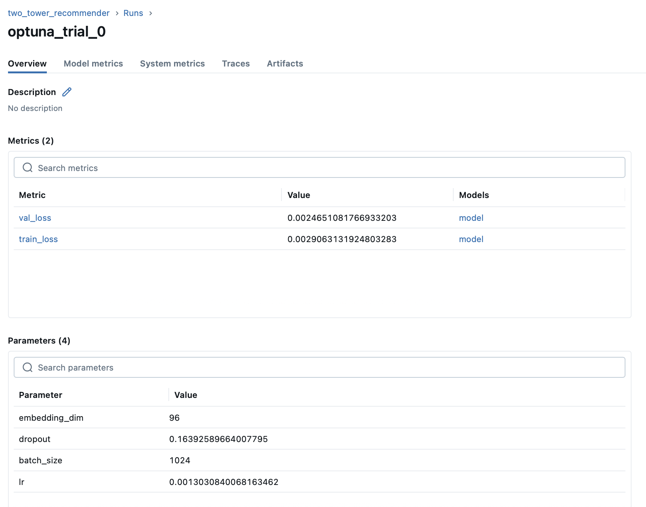
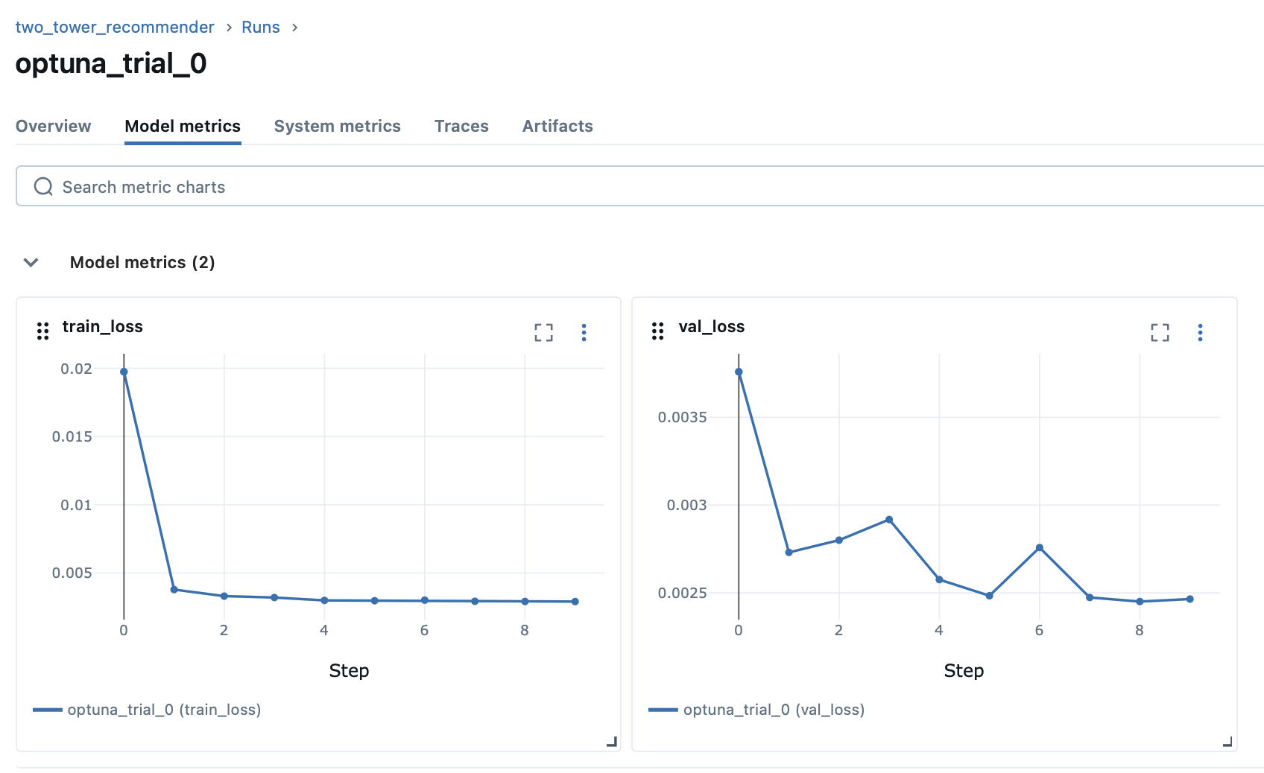
Screenshots from the MLflow UI Displaying the 0th trial details, hyperparameter configurations, training and validation loss curves, and the complete list of trials.

Slide 12
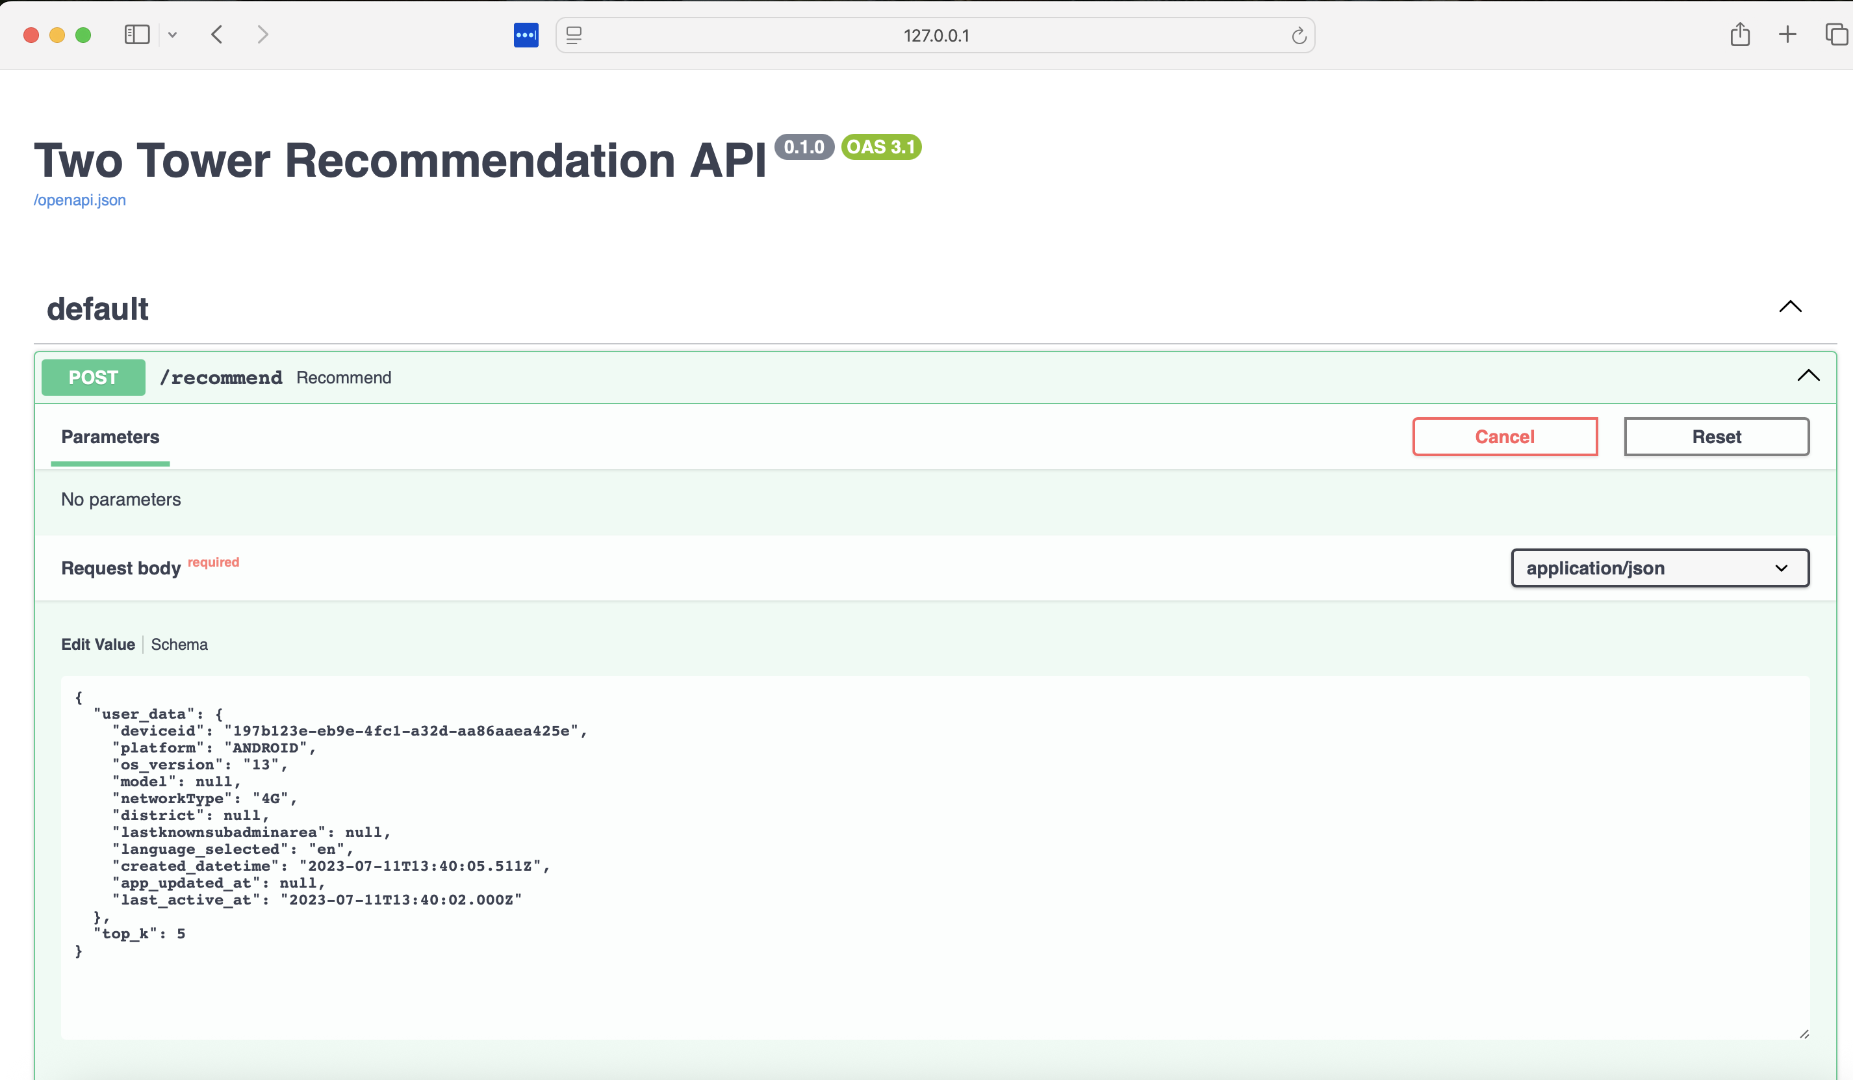
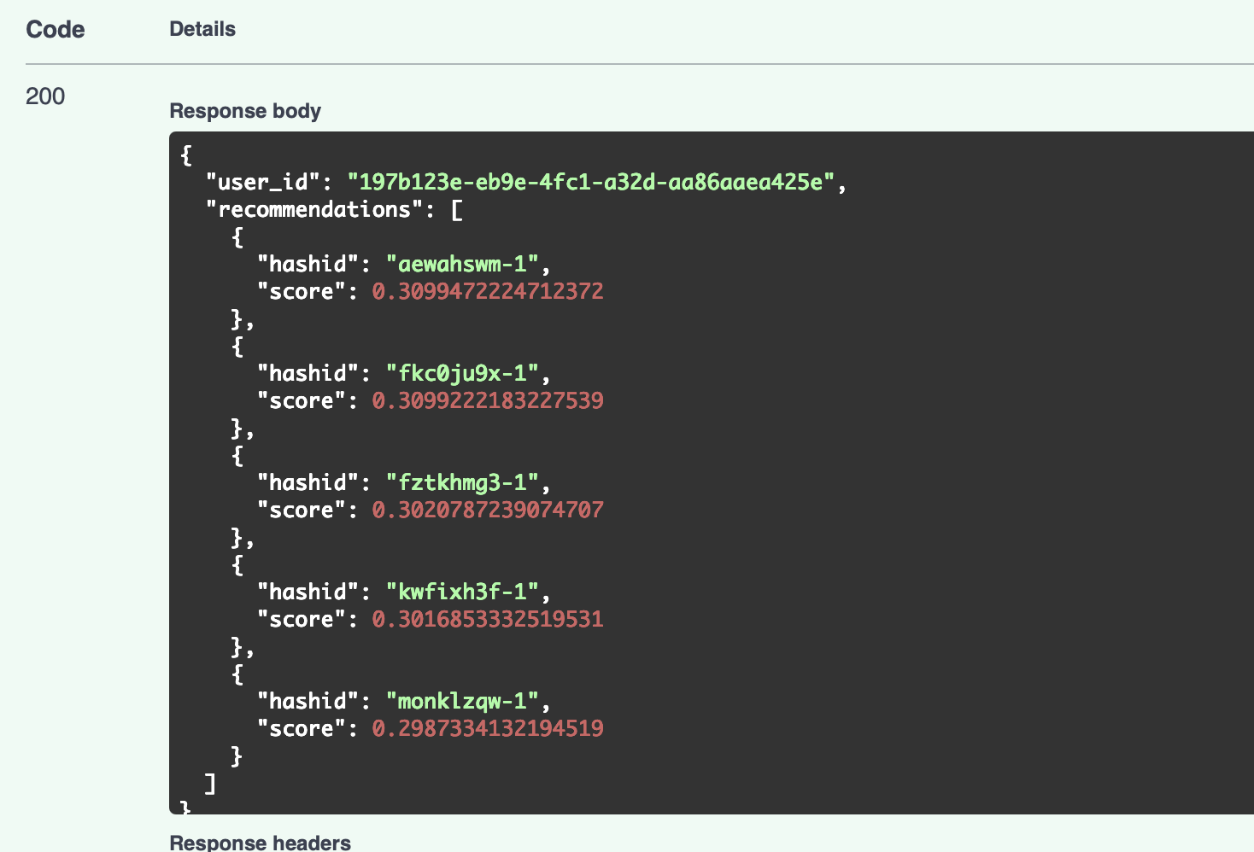
Real Time Inferencing as API

Slide 13
Thank you

