Slide 1
Recommendation System
Based on Two-Tower Neural Network Model

Slide 2
Problem Statement
Business Problem
Preprocessing
Model Training
Post Processing
EVALUATION Methods
Deployment
Set-up and USAGE

Slide 3
Introduction
Yash Gupta | Data Scientist | Adidas

Slide 4
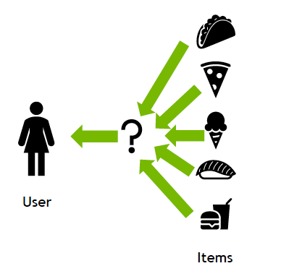
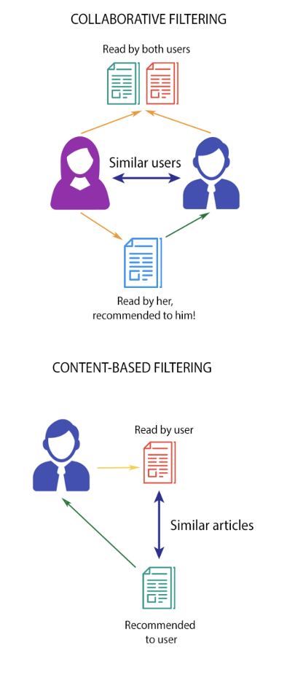
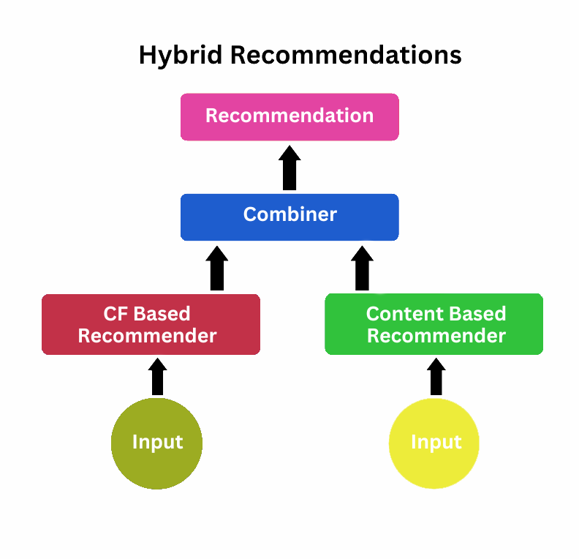
PROBLEM STATEMENT
Again, What is it ?
Objective: Build A Personalized Recommendation System That Connects Users To The Most Relevant Content Using Behavioural And Contextual Data.
Goal: Recommend The Top-k Items (e.g., News, Articles, Or Products) A User Is Most Likely To Engage With.
Inputs: User Metadata, App Activity, And Content Attributes.
Outputs: Ranked List Of Recommended Content For Each User.

Slide 5
BUSINESS PROBLEM
Again, Why is it ?
Users interact with hundreds of articles and products daily — personalization is key to retaining attention.
The platform’s challenge: Increase engagement and reduce bounce rate.
The Two-Tower model helps:
Improve CTR (Click-Through Rate).
Boost retention and session duration.
Enhance monetization by showing the most relevant items.

Slide 6
Preprocessing
User Data Cleaning: Handle missing values and encode categorical features (platform, district, language_selected). Derived variables like days_since_signup, days_since_last_active. Content Data Preparation: Encode metadata such as newsType, newsLanguage, sourceName. Use text embeddings for article titles and descriptions (e.g., Sentence-BERT). Feature Engineering: Normalize numeric features. Save fitted encoders to ensure consistency between training and inference.

Slide 7
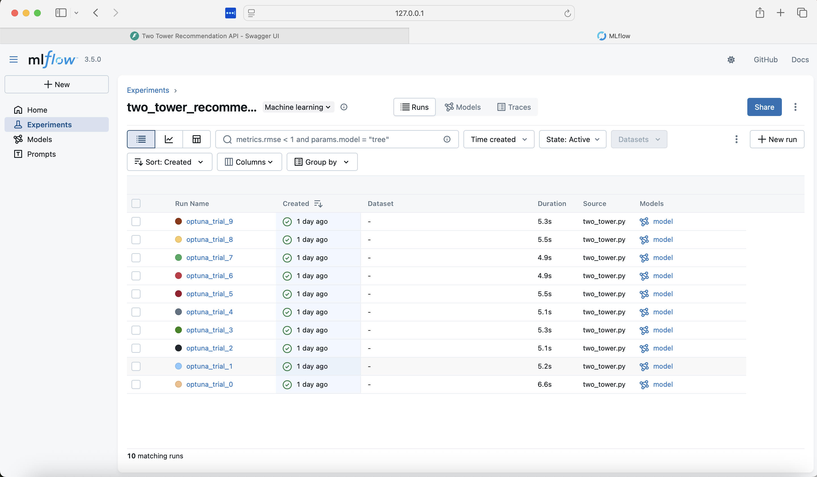
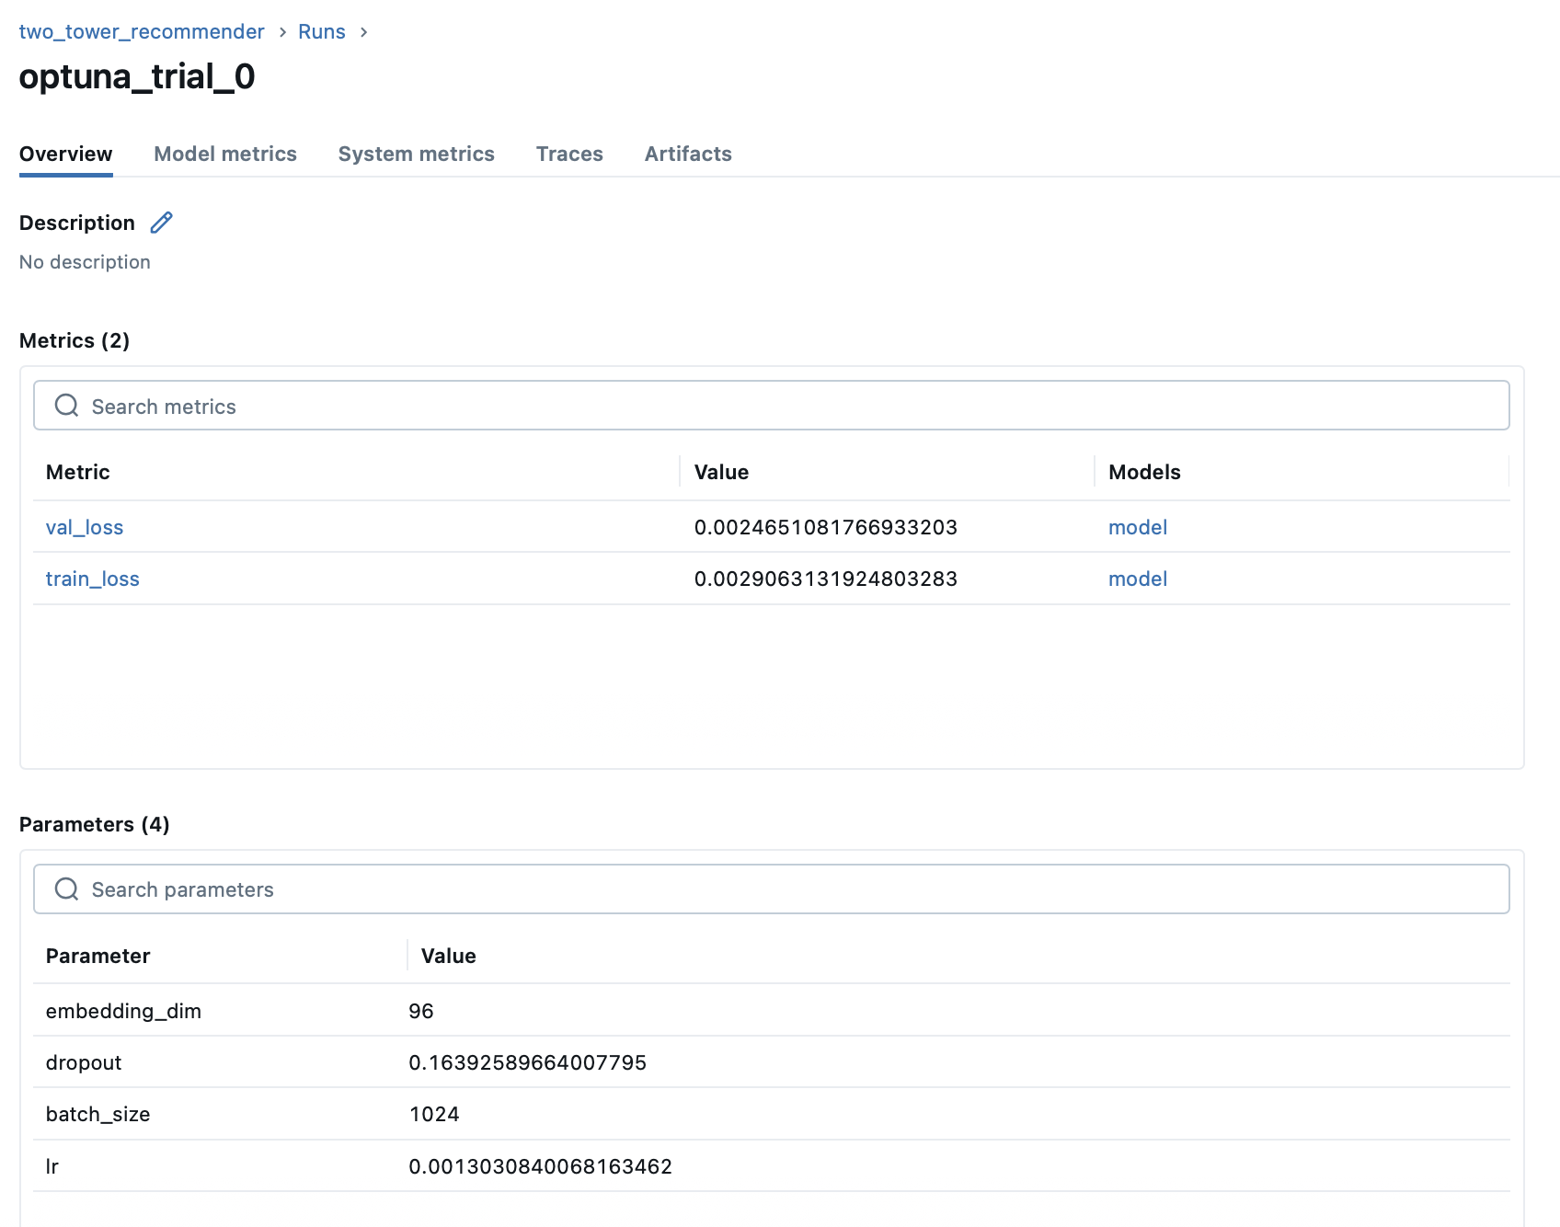
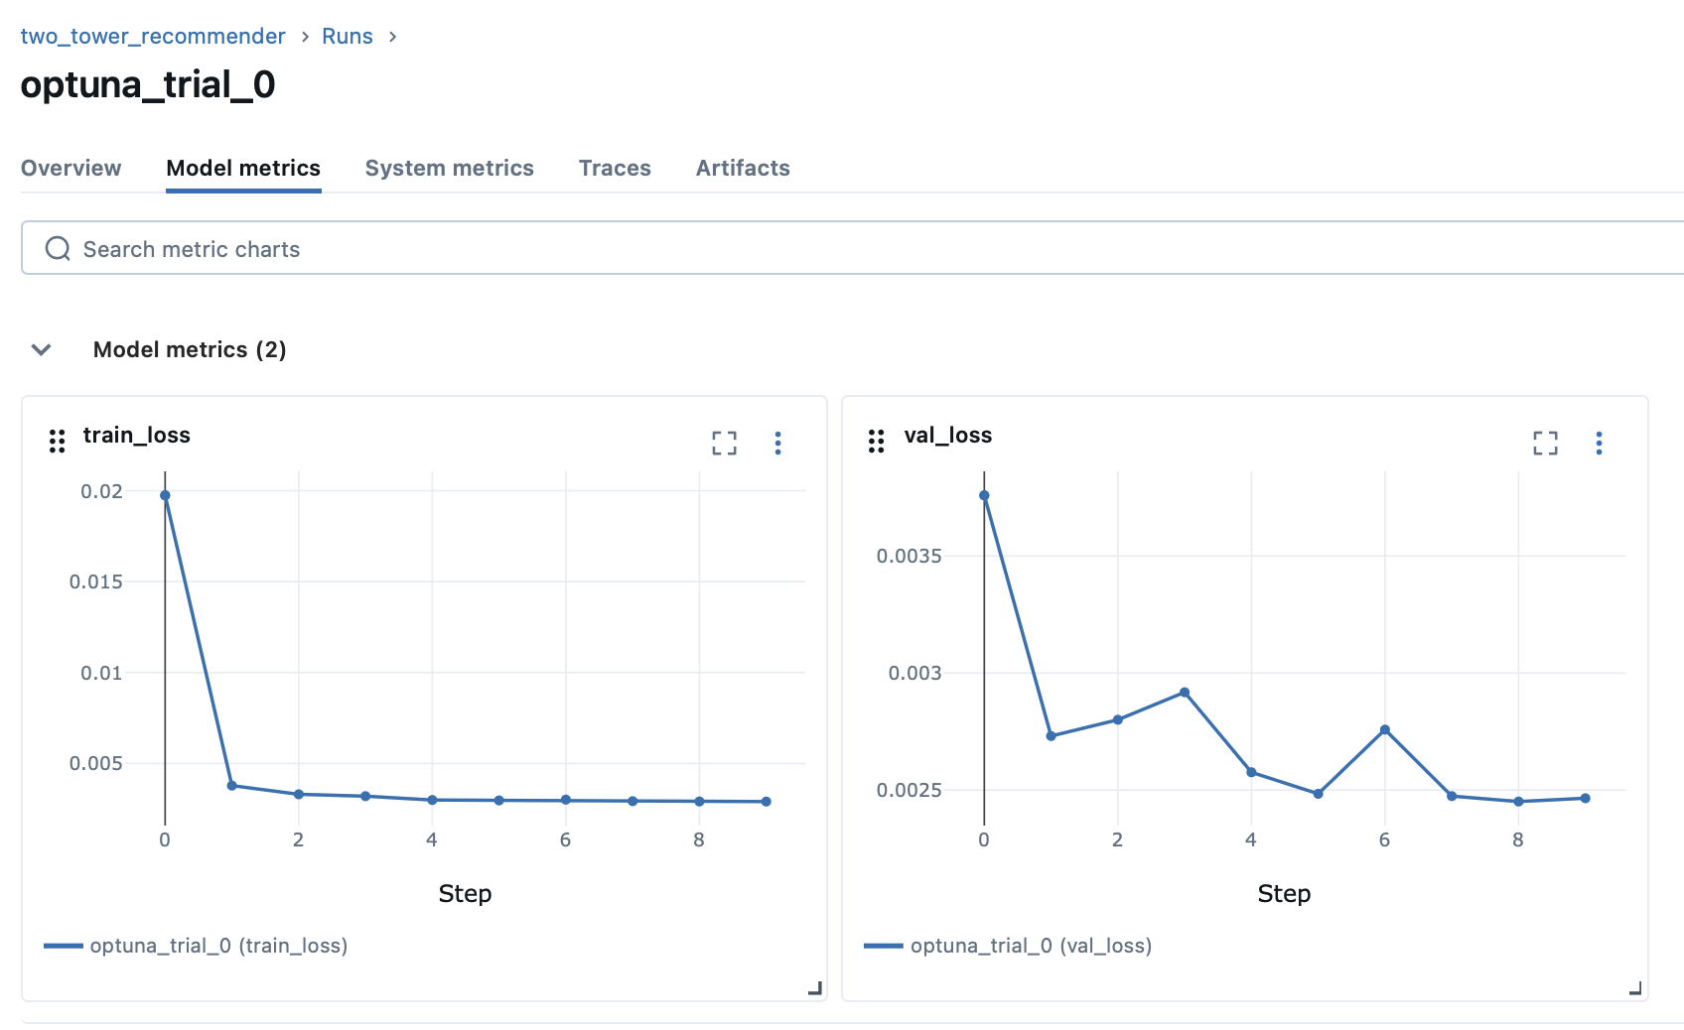
Screenshots from the MLflow UI Displaying the 0th trial details, hyperparameter configurations, training and validation loss curves, and the complete list of trials.

Slide 8
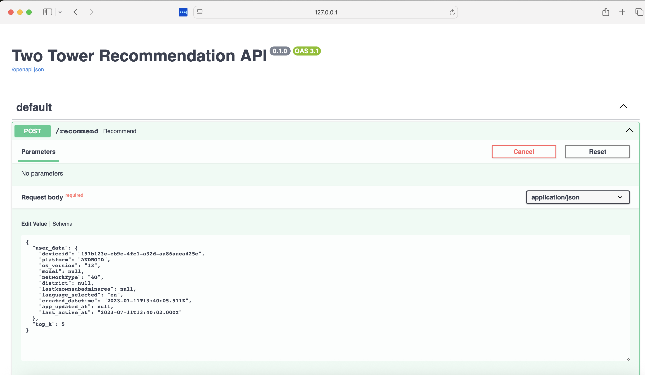
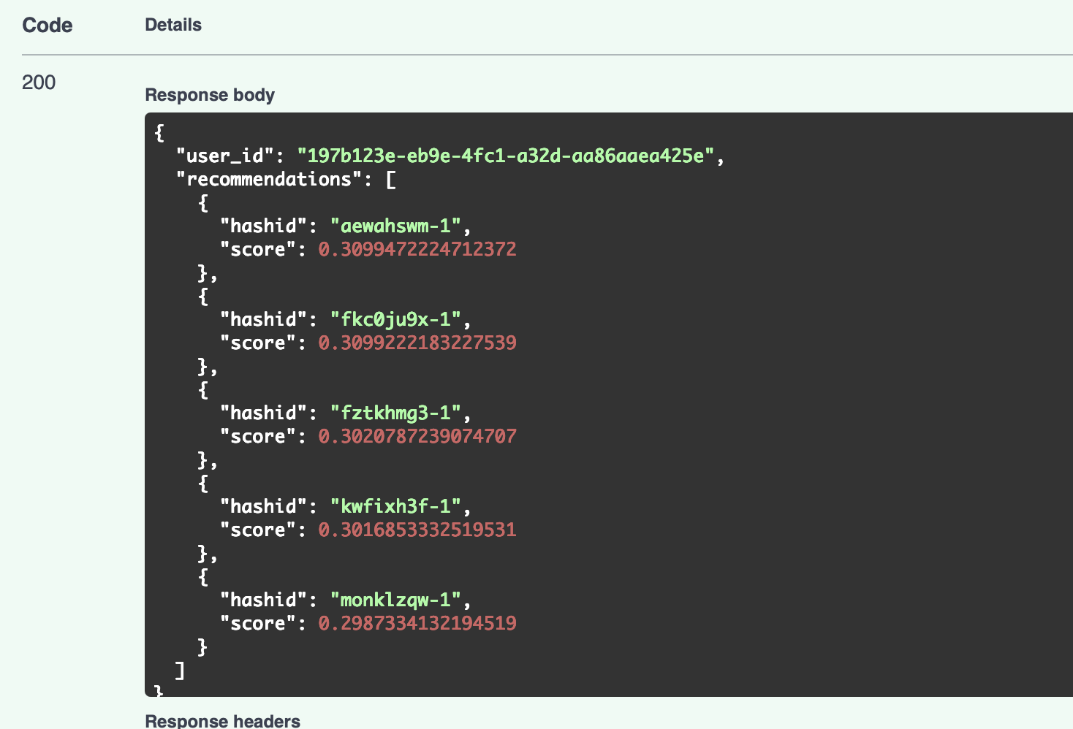
Real Time Inferencing as API

Slide 9
Thank you

