Slide 1

Smart Weather
Forecasting Station
Abhinav Tyagi (220350330001)
Ajit Kumar Das (220350330002)
Arun Vittal (220350330003)
Bhupendra (220350330004)

Slide 2
Contents
INTRODUCTION
AIM
DESIGN FLOW
BLOCK DIAGRAM
COMPONENTS
CIRCUIT DIAGRAM
CODE EXPLANATION
ABOUT THINGSPEAK
CONCLUSION

Slide 3
INTRODUCTION
Weather forecasting is the application of science and technology to predict the state of the atmosphere for a given location. Here this system will predict weather based on parameters such as temperature, humidity and wind. Weather warnings are special kind of short-range forecast carried out for the protection of human life.
The fundamental aim of metalogies is to understand the atmosperic processes and then predict the future weather as much ahead as possible.

Slide 4
AIM
The goal of weather prediction is to provide information to people and organizations, so they can use to reduce weather-related losses and enhance societal benefits, including protection of life and property, public health and safety, support of economic prosperity and quality of life.
The purpose of a weather forecast is to provide as accurate as possible prediction of what the weather will be like in the near future.

Slide 5
DESIGN FLOW
START
Check connectivity to ThingSpeak
(WiFi & MQTT)
NO
Try again for
Connectivity
NO
YES
Take reading through sensor
(Temp. & Humidity, Wind speed,Sunlight)
YES
Prediction
According to
Data
collected
Display it
on LED (At Station)
Send Data to
ThingSpeak
(For remote monitoring)
Go to sleep
for 15 sec

Slide 6
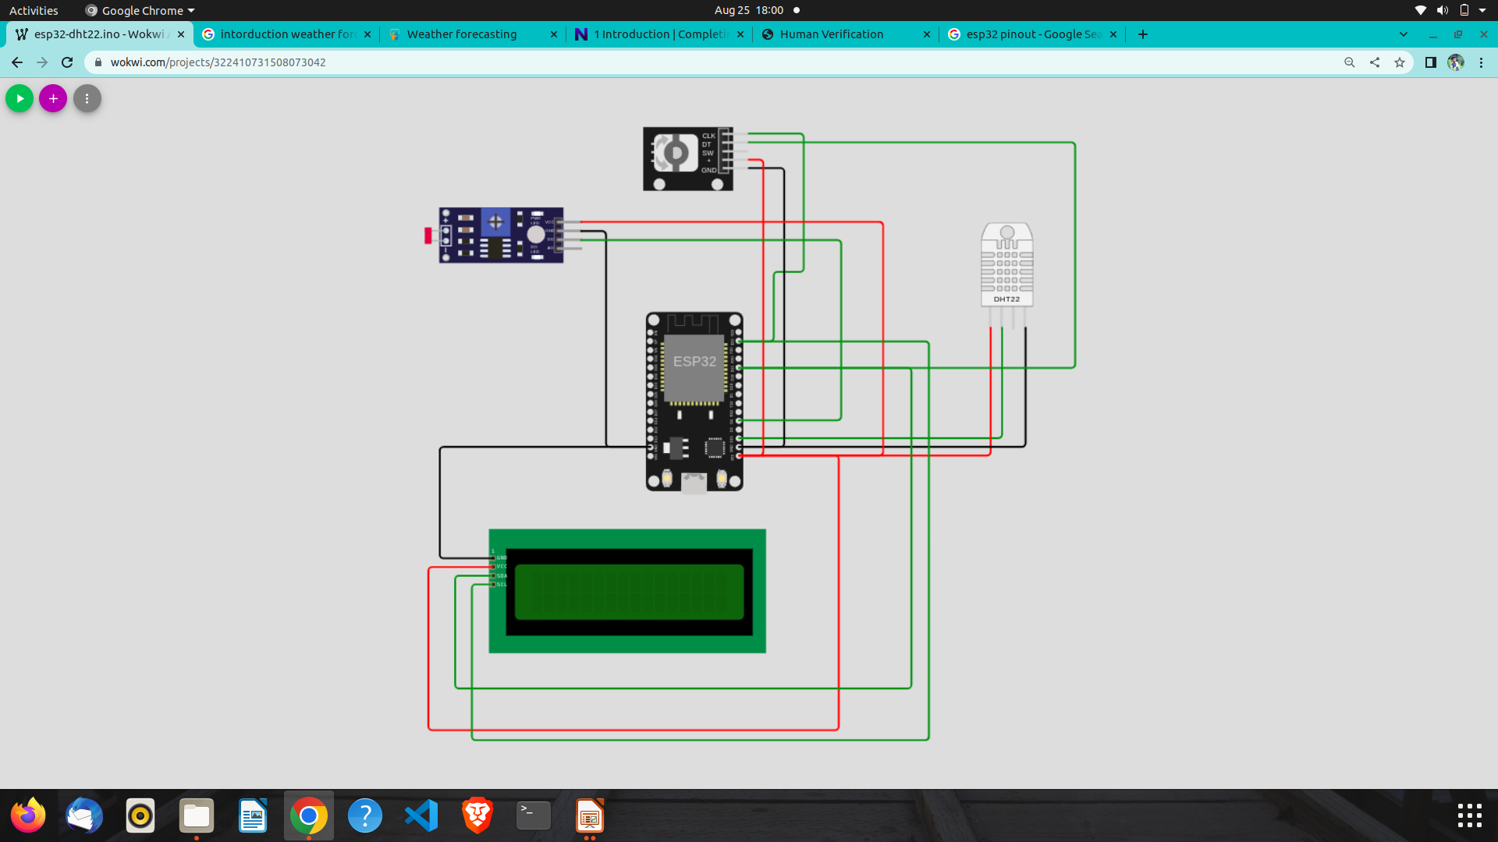
Circuit Diagram
ROTORY ENCODER
LDR
DHT 11
GROVE-LCD RGB BACKLIGHT

Slide 7
Block Diagram
GROVE-LCD RGB BACKLIGHT
THINGSPEAK
ESP-32
DHT 11
( TEMPERATURE &
HUMIDITY )
LDR
( SUNLIGHT
DETECTION )
ROTARY ENCODER
(WIND SPEED )

Slide 8
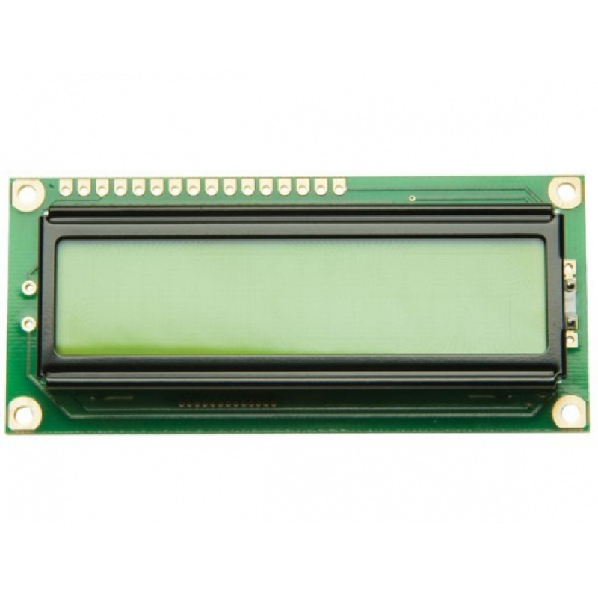
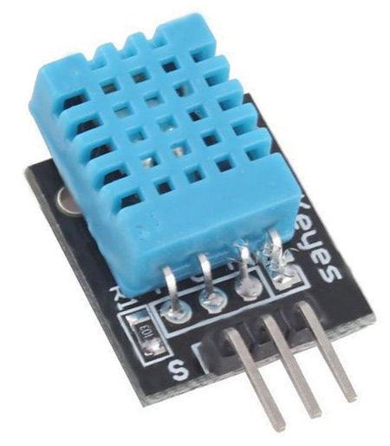
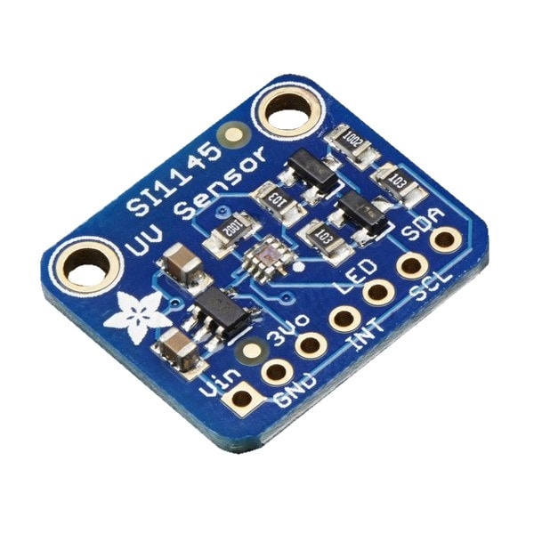
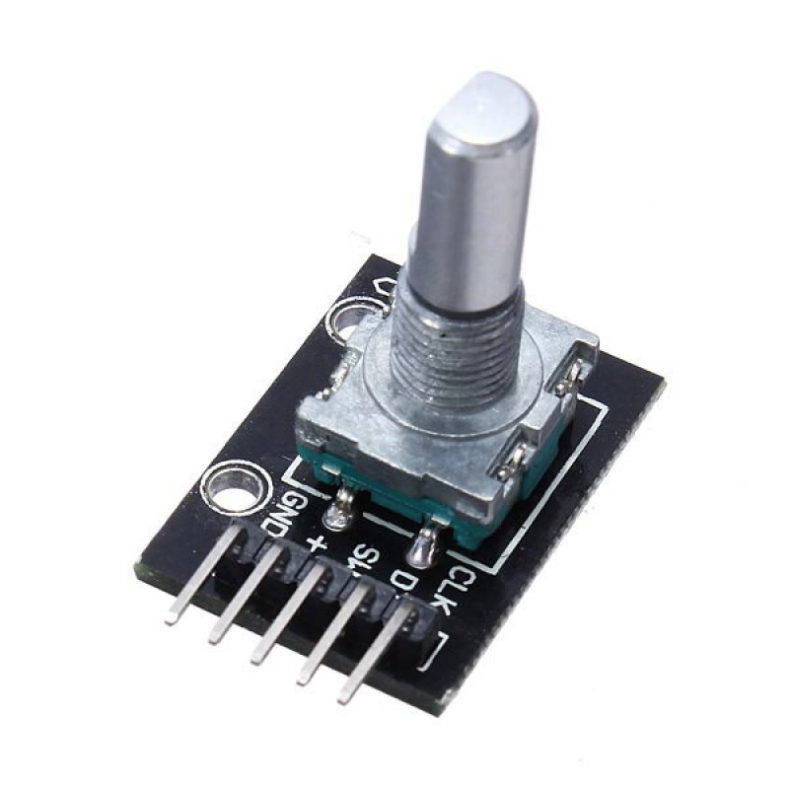
Components
Sr.no. | Task/ Functionality | Parameter | Sensor
1. | Min/ Max Temperature | Temperature | DHT11 / DS18B20
2. | Relative Humidity | Humidity | DHT11
3. | Cloud Detection | Light | Photoresistor (LDR) / SI1145
4. | Wind Speed | Speed | Rotary Encoder
5. | Display Parameters | Display | Grove-LCD (16 x 2)
DHT11
SI1145
ROTATORY ENCODER
GROVE-LCD (16 x 2)

Slide 9
DHT 11 / DS18B20
The DHT-11 Digital Temperature and Humidity Sensor is a basic, ultra low-cost digital temperature and humidity sensor. It uses a capacitive humidity sensor and a thermistor to measure the surrounding air and spits out a digital signal on the data pin.
It is a unique 1-wire programmable digital temperature sensor.
The operating voltage is 3.0V to 5.5V.
It provides an accuracy of ±5°C from -10°C to +85°C.
The operating temperature range is -67°F to +257°F or -55°C to +125°C.

Slide 10
SI1145 (not used in this project)
The SI1145 is a light sensor with a calibrated light sensing algorithm that can calculate UV Index. It doesn't contain an actual UV sensing element, instead it approximates it based on visible & IR light from the sun. The sensor also has individual visible and IR sensing elements so you can measure just about any kind of light.
Visible Light Sensor Spectrum: Wavelength: 400nm-800nm (centered on 530)
Voltage Supply: Power with 3-5VDC
Output Type: I2C address 0x60 (7-bit)
Operating Temperature: -40°C ~ 85°C

Slide 11
ROTATRY ENCODER
A 360 Degree Rotary Encoder is a extremely precise module that provides an indication of how much the knob has been rotated and what direction it is rotating in. It is an incremental electro-mechanical device that converts the angular position or motion of a shaft or axle to digital code. The output of incremental encoders provides information about the motion of the shaft, which is typically further processed in processor into information such as speed, distance, and position.
Supply Voltage: 3-5V
Left/Right rotary output pulse, each circle with 20 pulse
Built in 10k resistor
Cycles per revolution (CPR): 20

Slide 12
GROVE LCD(16X2)
Grove LCD is a 16x2 characters monochrome LCD display with high brightness backlight. It communicates via the two-row I2C bus.
Display of 2 lines of 16 characters each
Display mode STN (yellow green)
Built-in MCU
I2C interface
Support for English and Japanese fonts
It is used in displays for thermometers, clocks and other projects requiring simple display.

Slide 13
Benifical for
Supply Chain Optimization
Drought & Flood level forecasting
Efficient Farming
Prediction of cyclones, etc
To keep check on Global Warming

Slide 14
CONCLUSION
In this era of global warming, research in weather measurement, monitoring and forecasting are becoming more and more relevant, getting the latest weather forecast and taking the necessary precaution have become a major issue all over the world.
Weather monitoring plays an important role in human life.
This research demonstrates the design and Implementation of weather monitoring system that ensures flexibility, scalability and user friendly operations which can provide data of some weather variables including temperature, humidity, ambient light intensity with Real Time Data Logger.

Slide 15
CONCLUSION
In this era of global warming, research in weather measurement, monitoring and forecasting are becoming more and more relevant, getting the latest weather forecast and taking the necessary precaution have become a major issue all over the world.
Weather monitoring plays an important role in human life.
This research demonstrates the design and Implementation of weather monitoring system that ensures flexibility, scalability and user friendly operations which can provide data of some weather variables including temperature, humidity, ambient light intensity with Real Time Data Logger.

