Slide 1

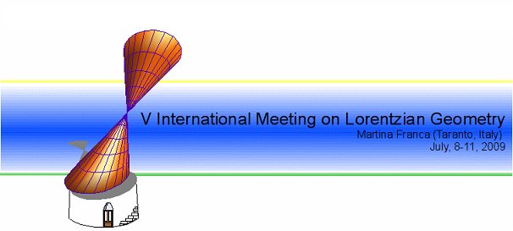
Riemannian Extensions and Curvature Operators
Joint work with M. E. Vázquez Abal and R. Vázquez Lorenzo
Esteban Calviño Louzao

Slide 3
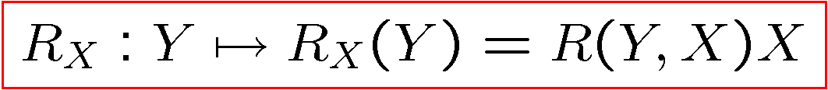
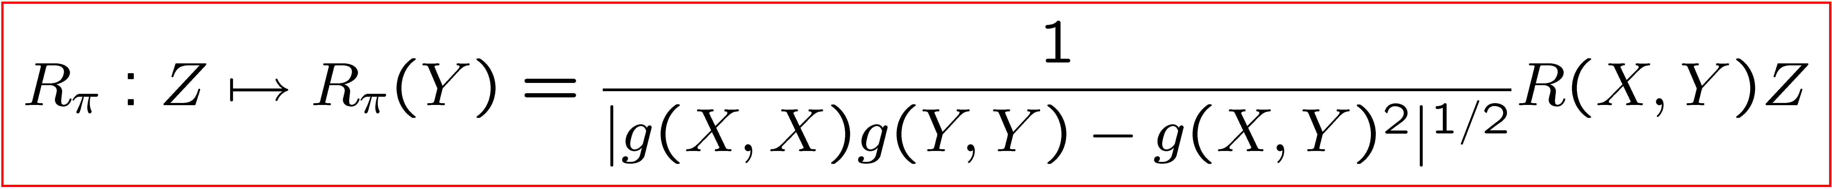
Curvature Operators

Slide 4
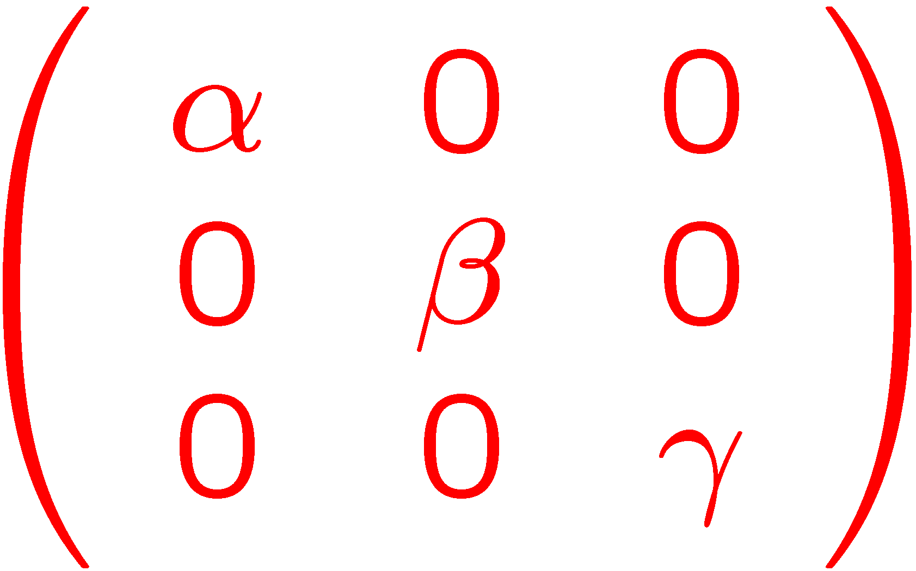
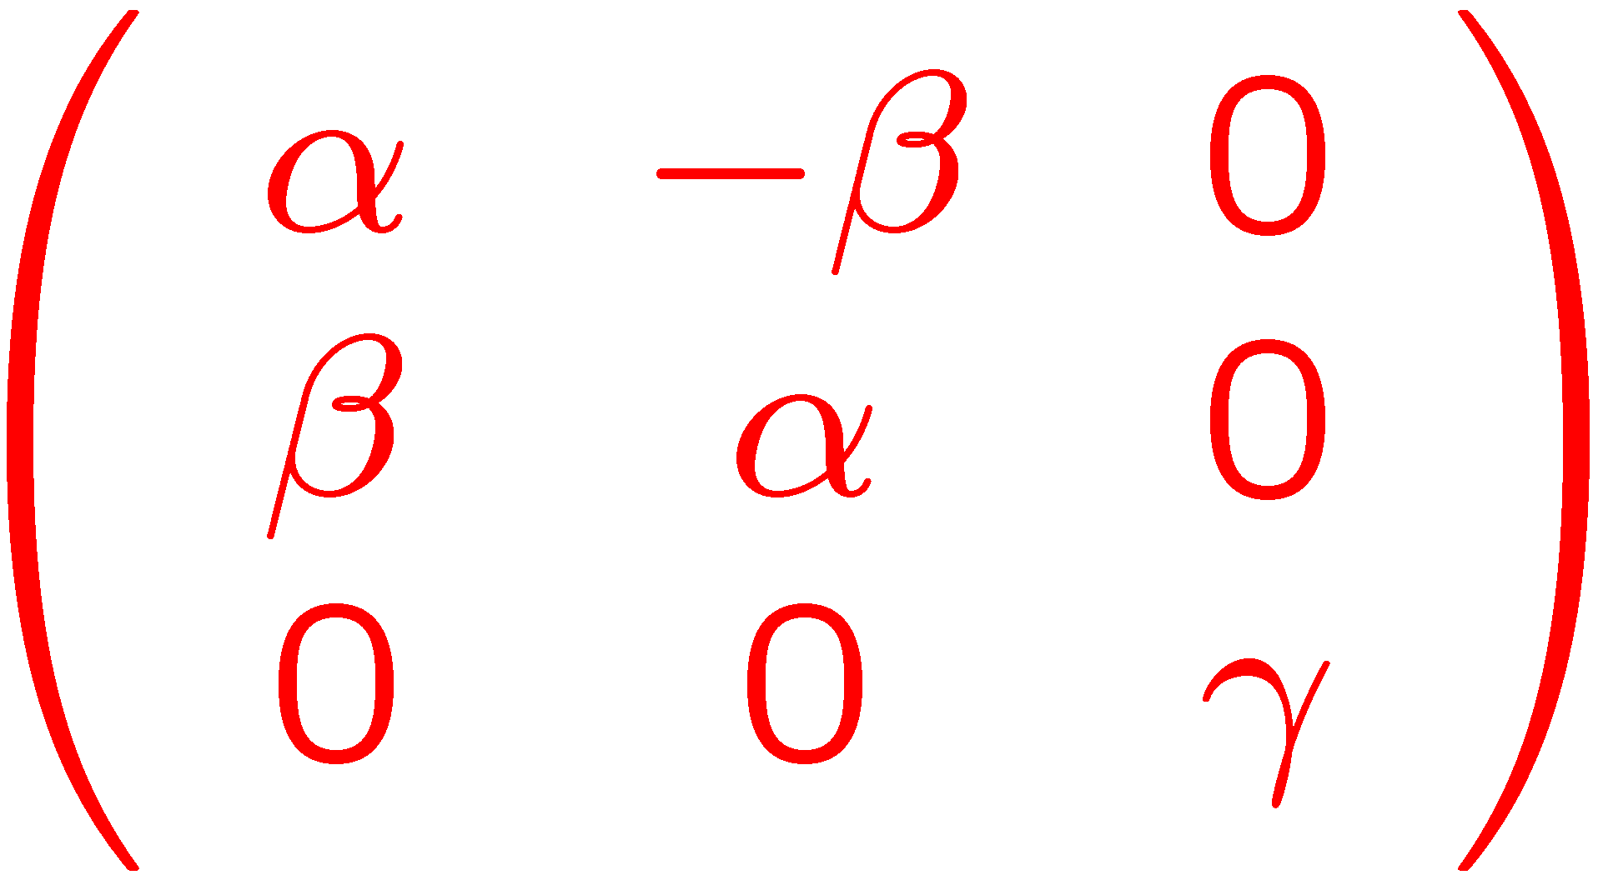
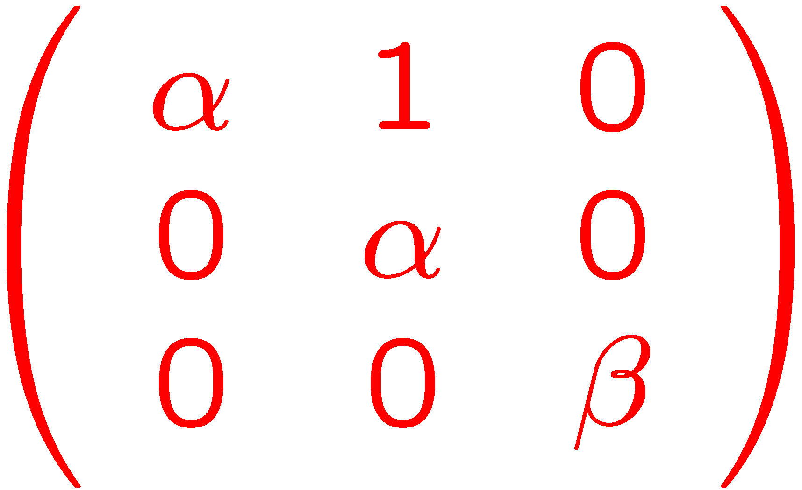
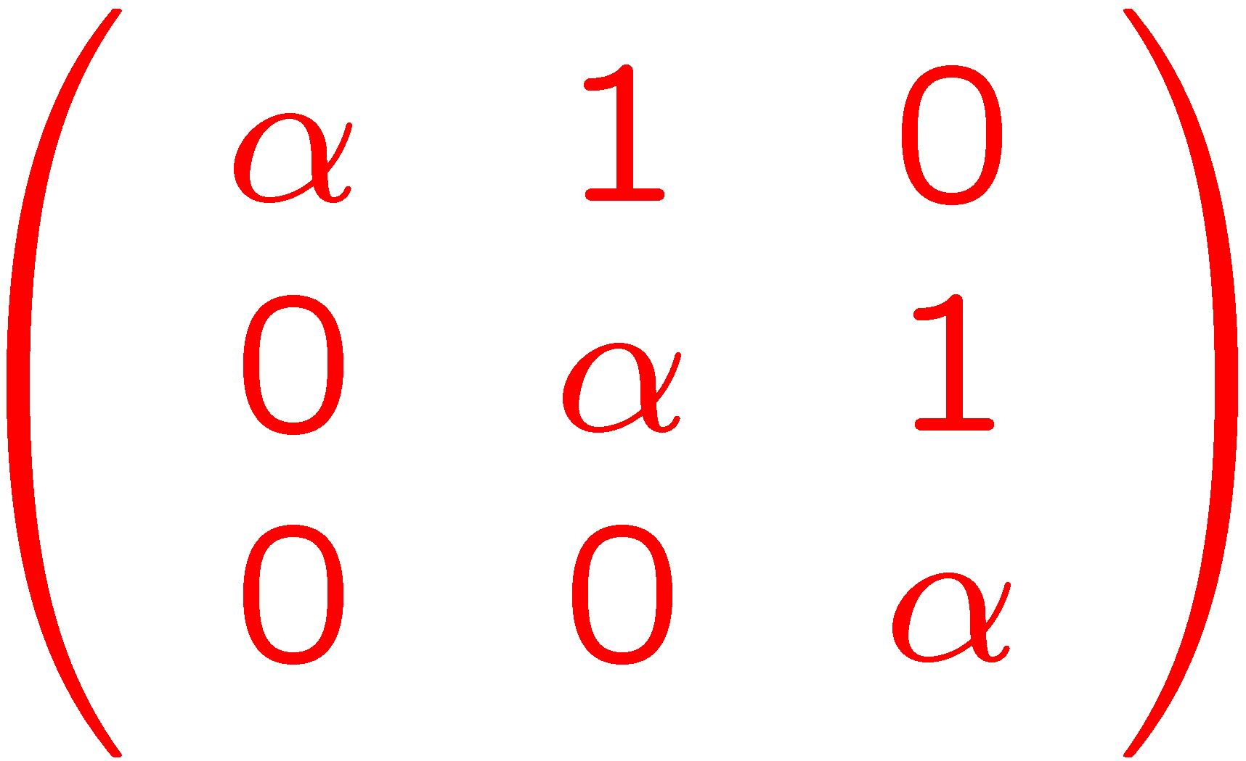





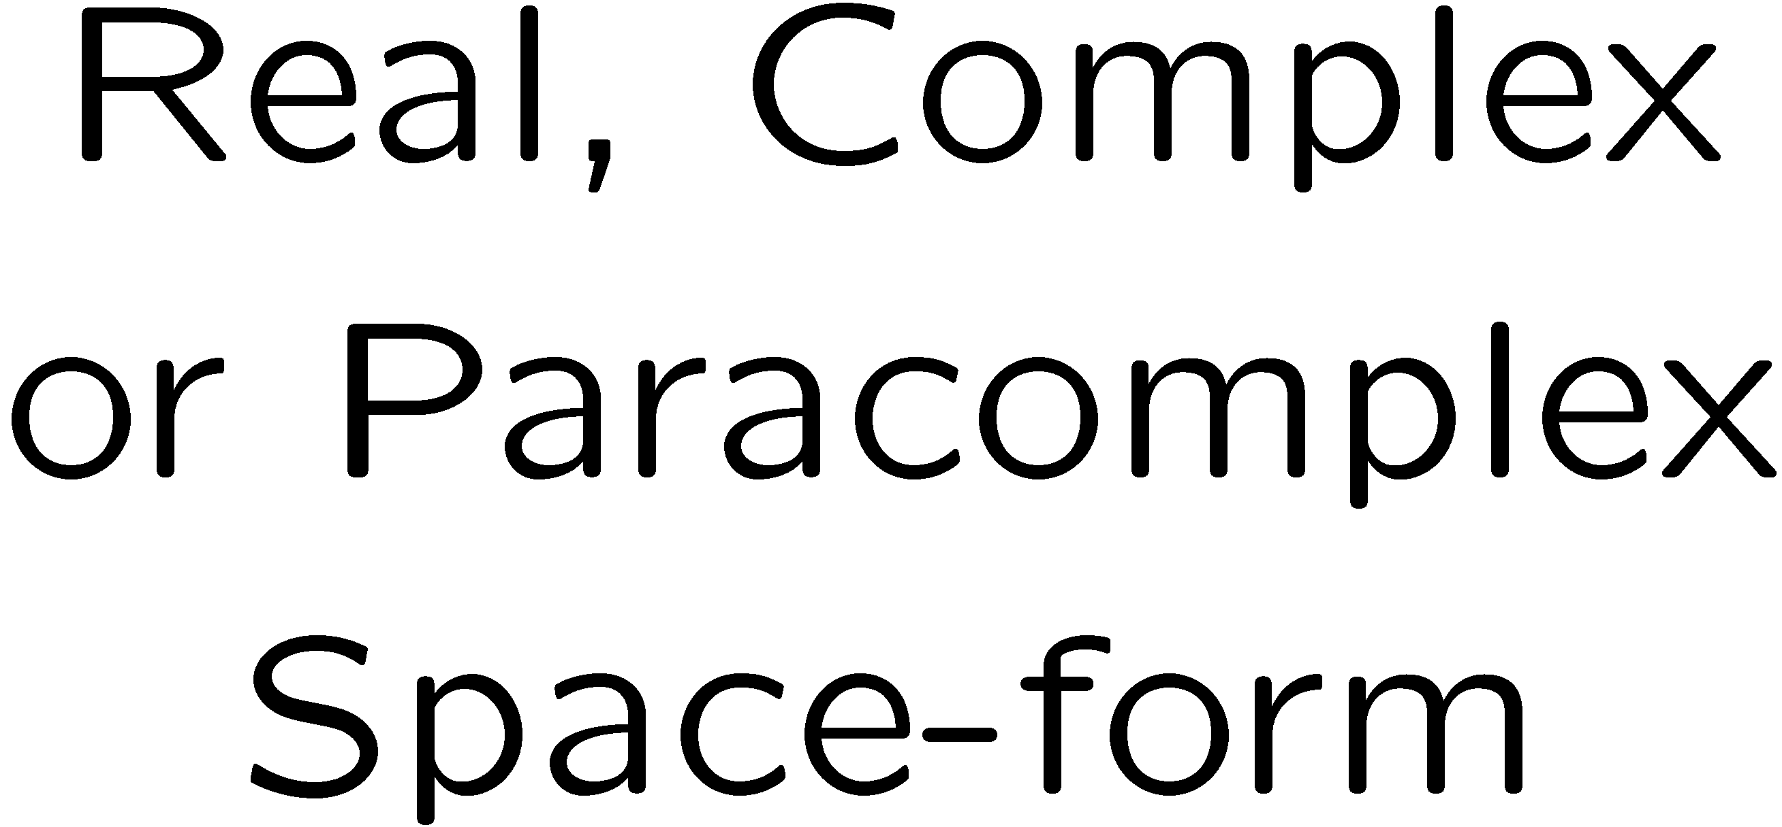
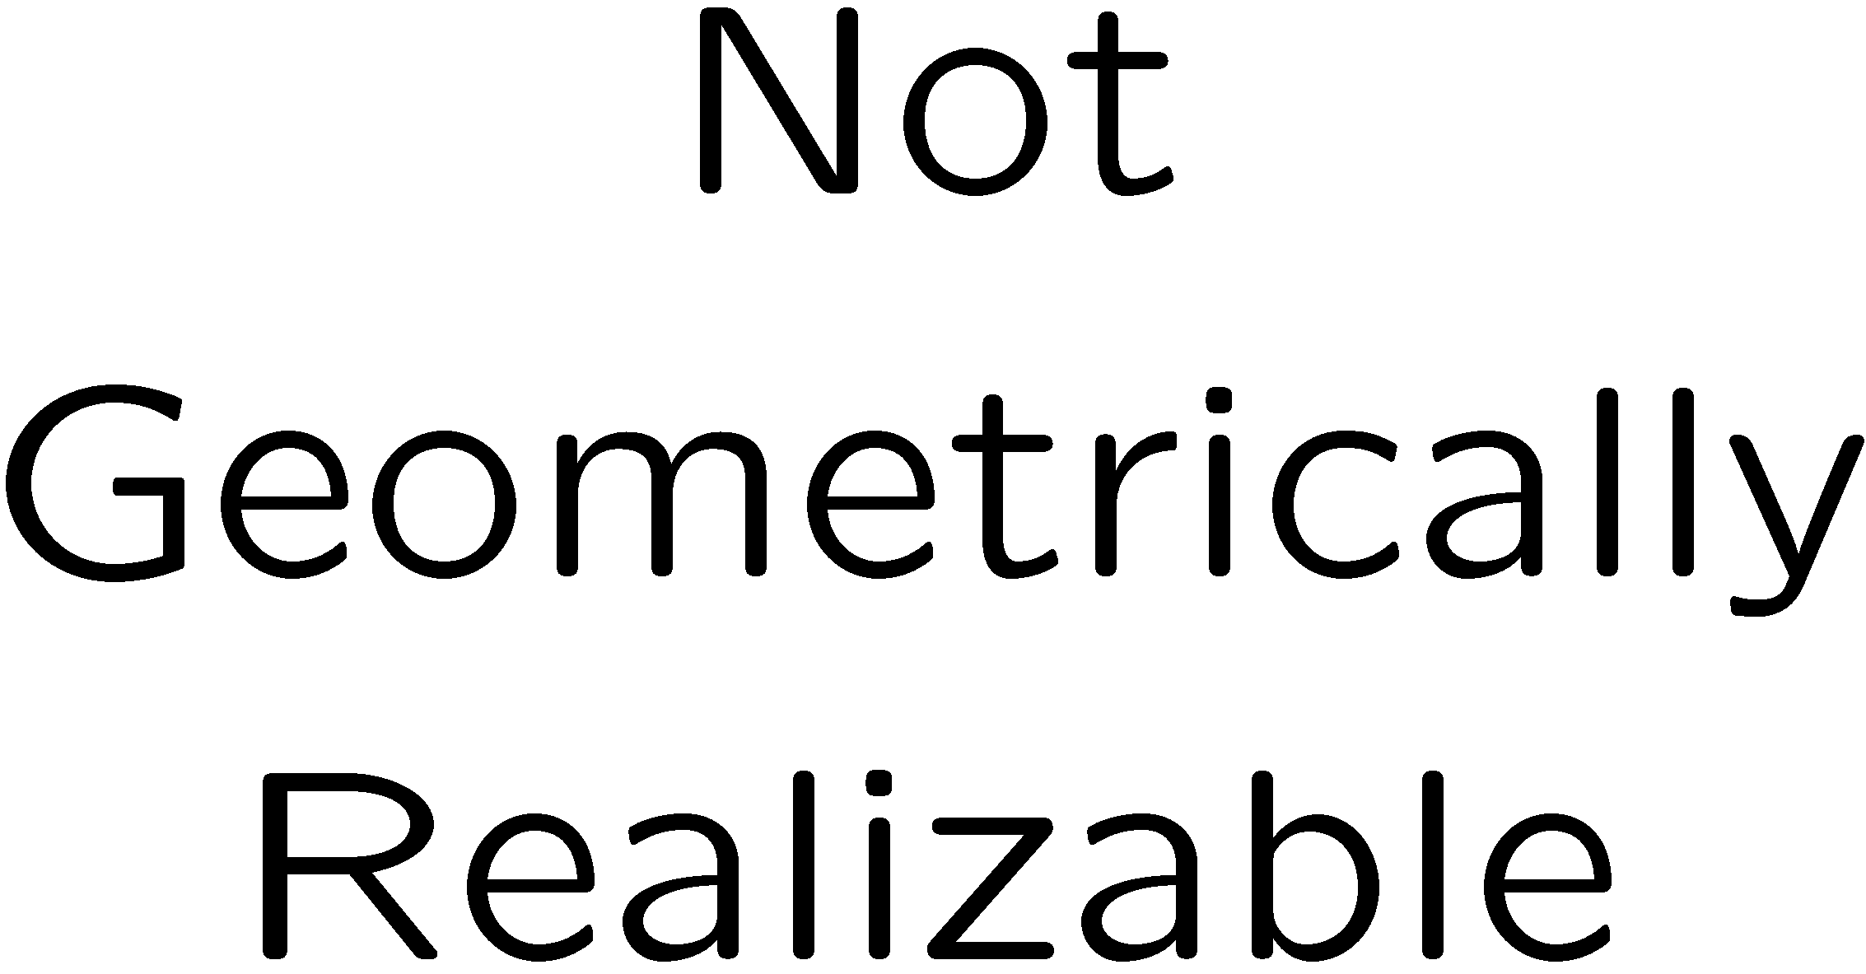
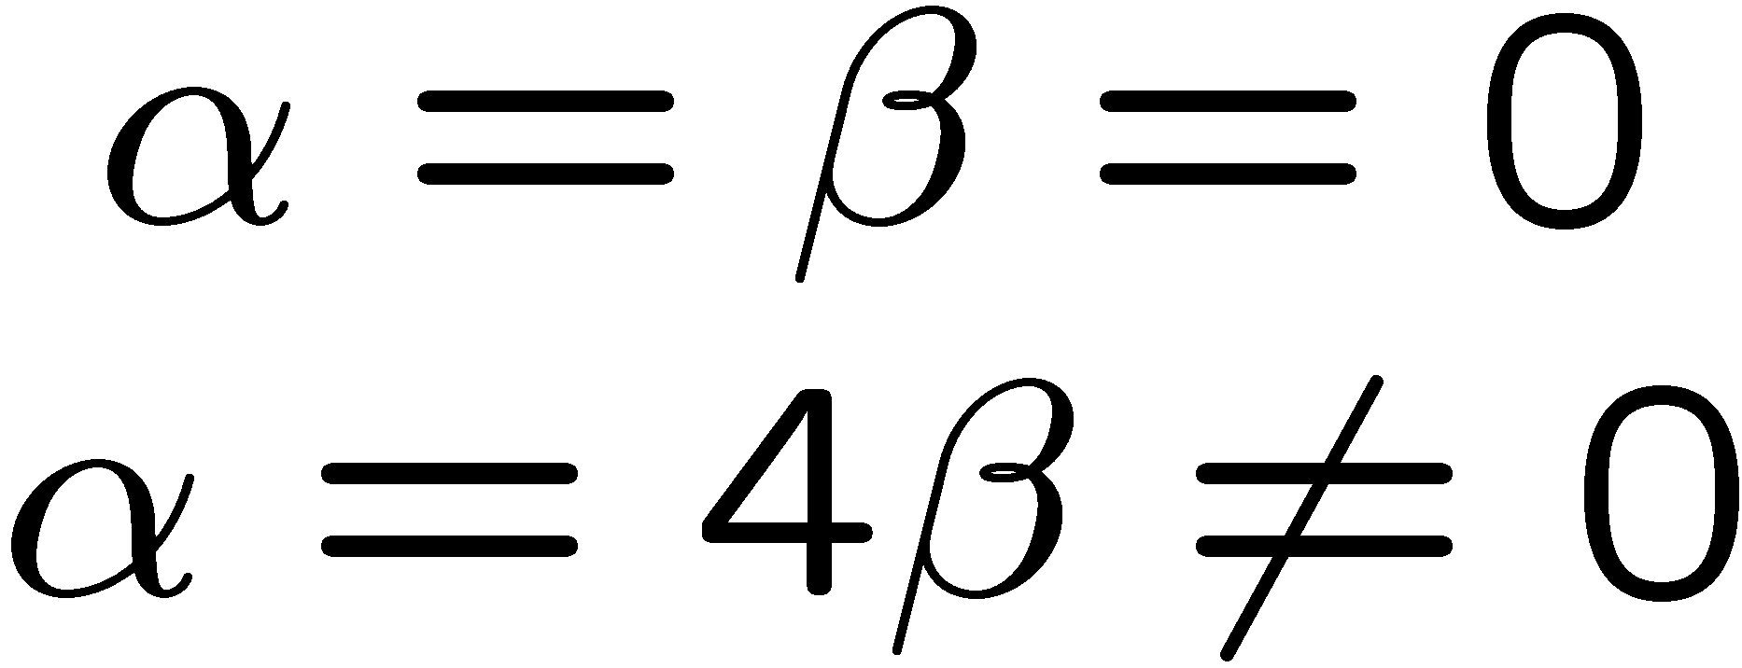
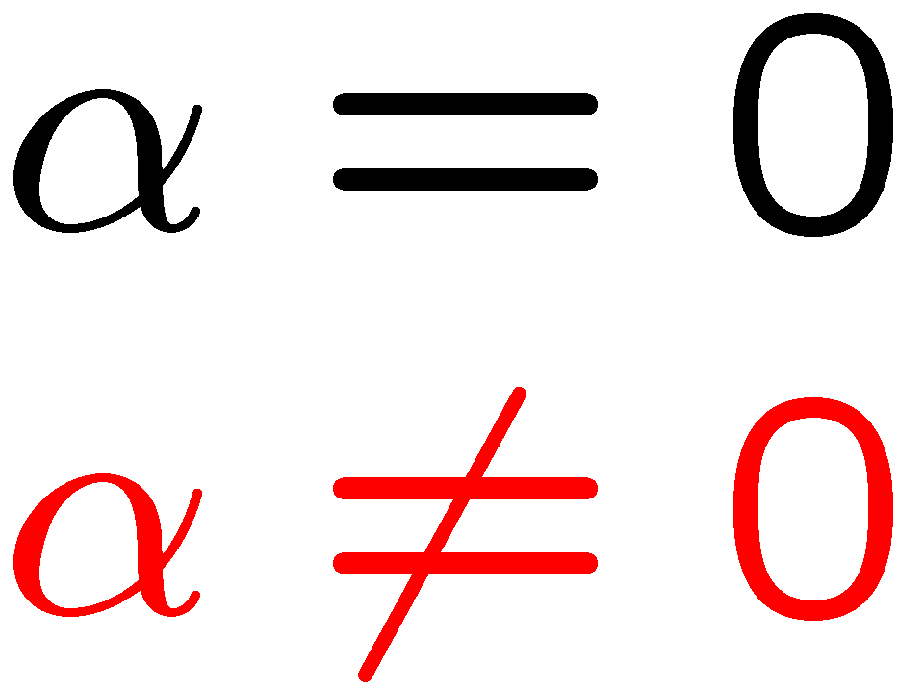
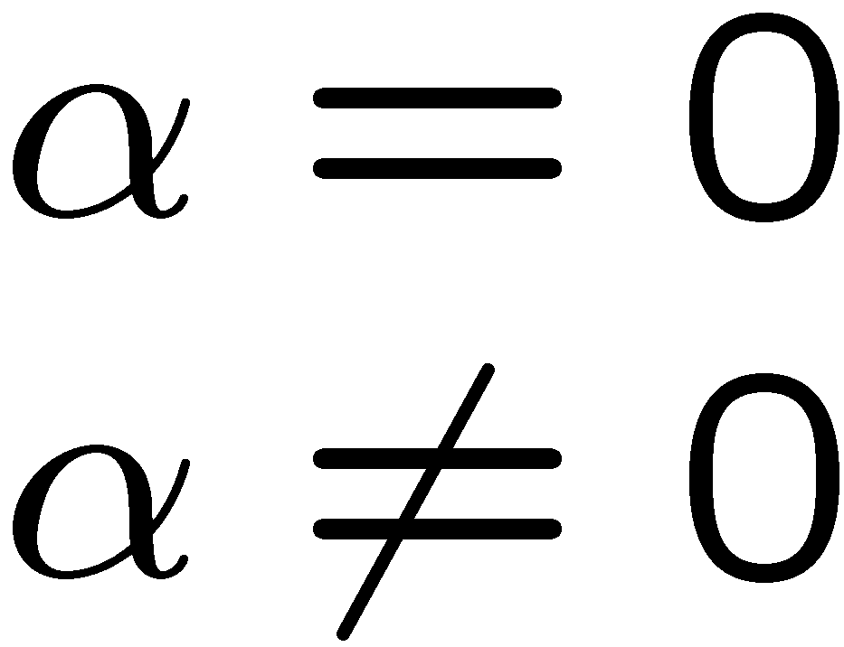
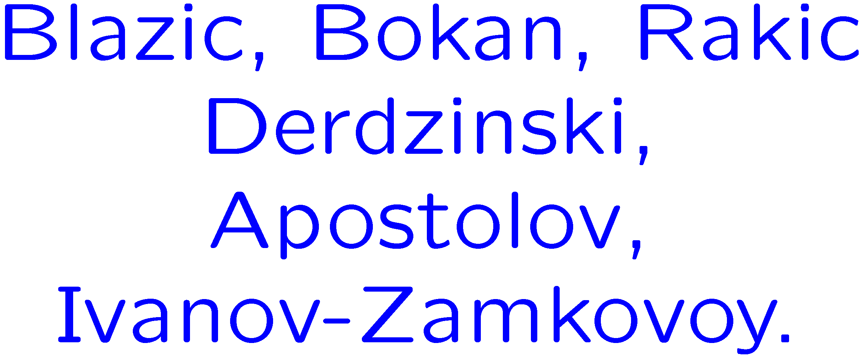




Four-dimensional Osserman Metrics

Slide 5
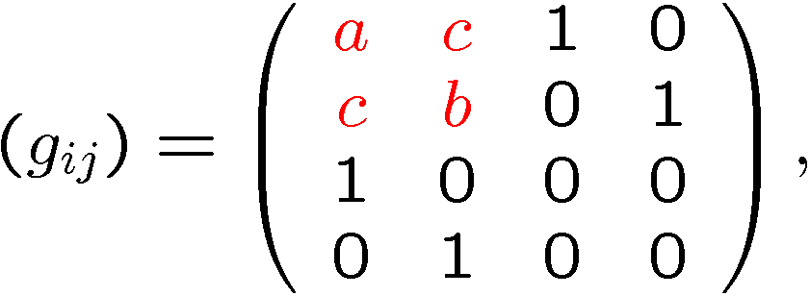
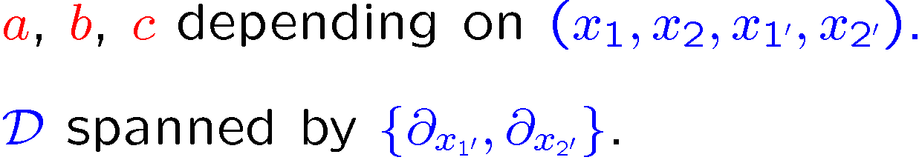
Four-dimensional Walker Metrics

Slide 6
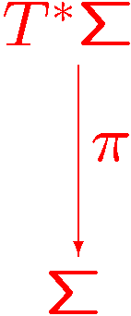
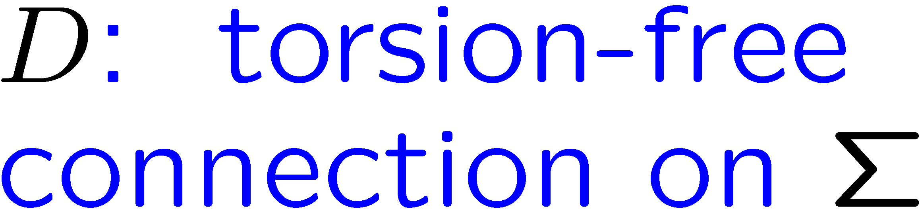

A special class of Walker metrics

Slide 7
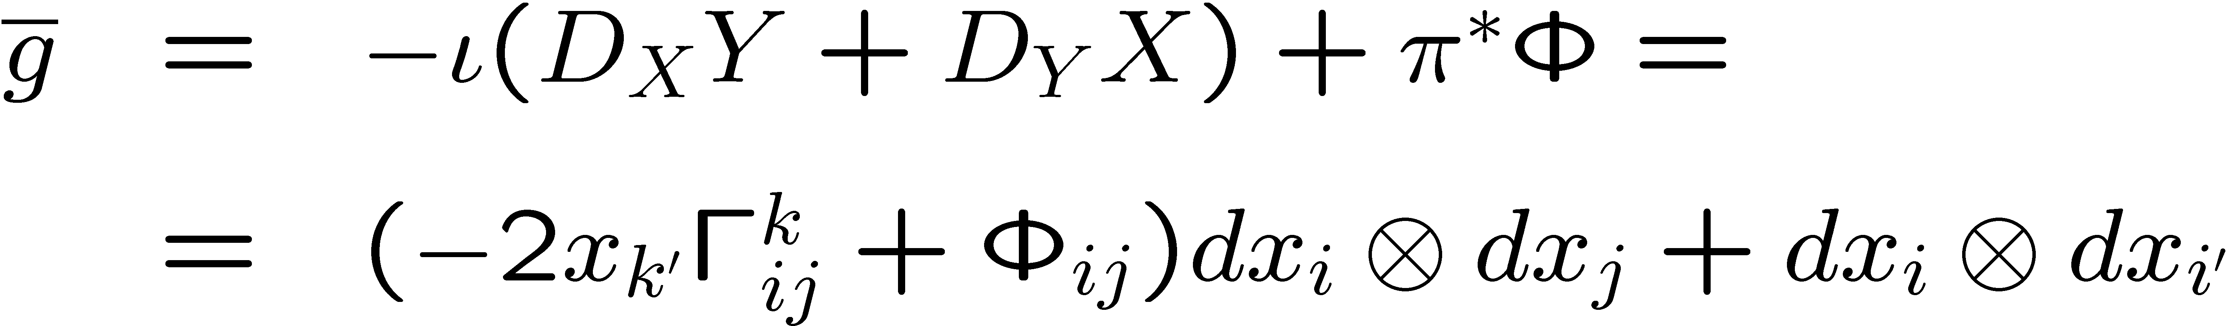
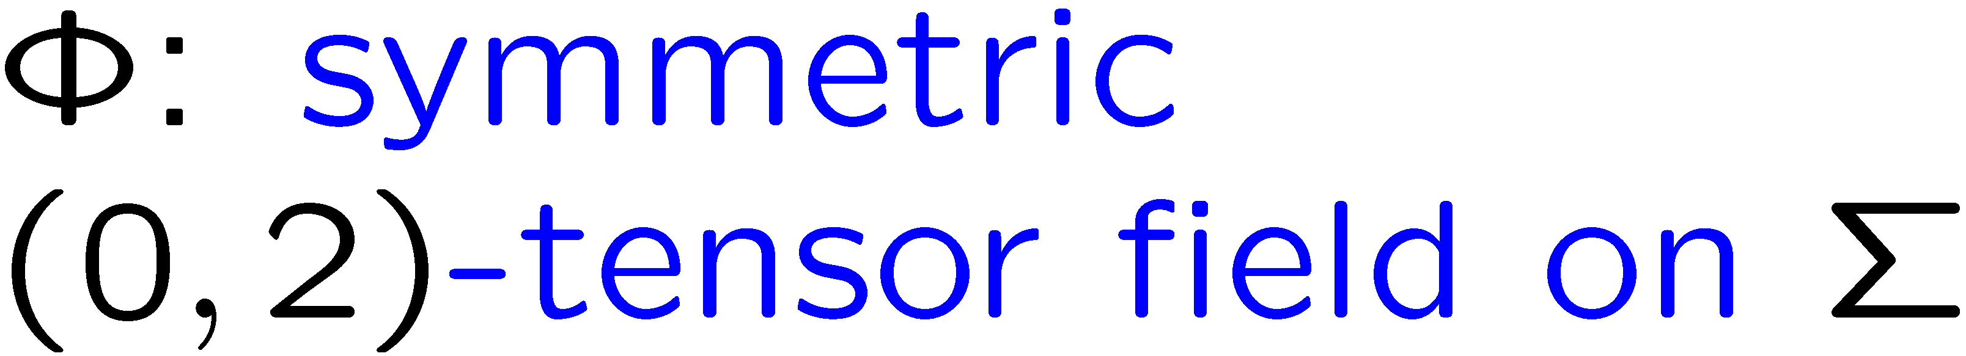
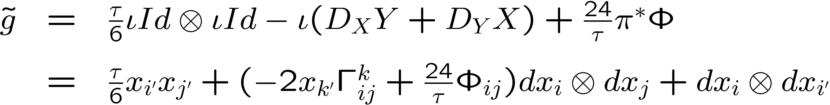
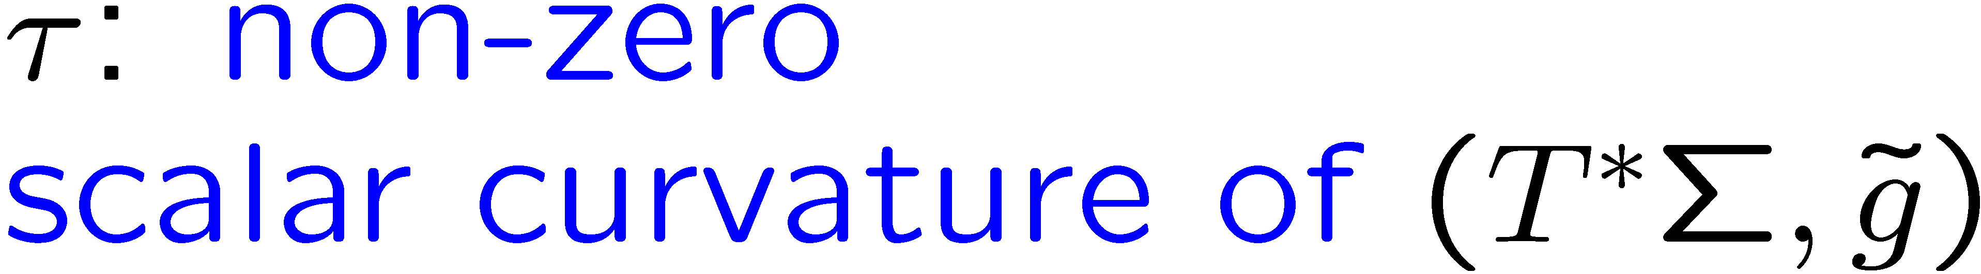
A special class of Walker metrics

Slide 8
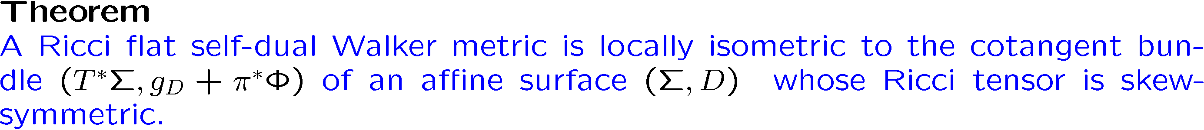
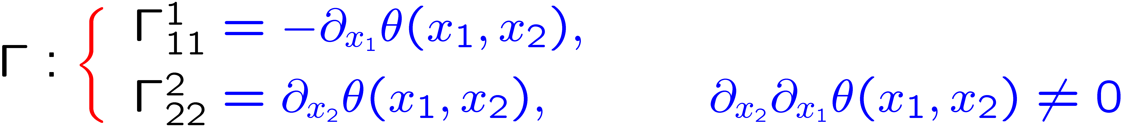
Nilpotent Osserman Metrics

Slide 9
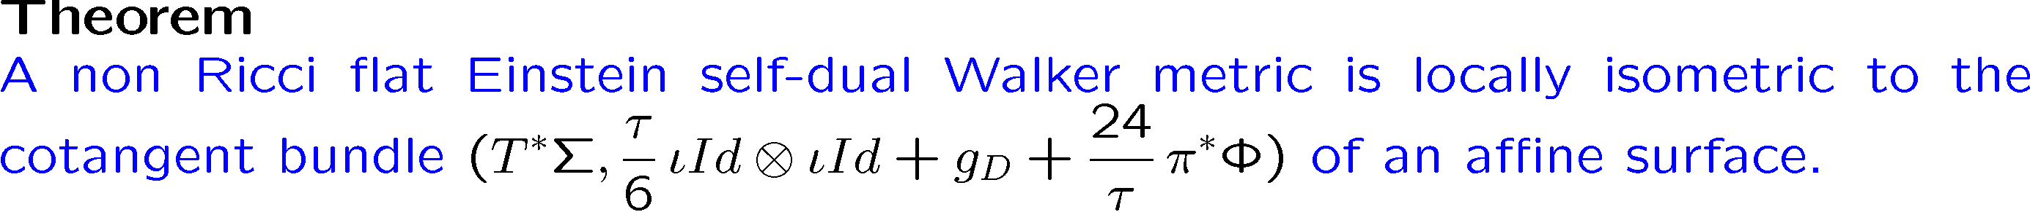
Type II Non-Nilpotent Osserman Metrics

Slide 10


Ivanov-Petrova metrics

Slide 11
Locally Homogeneous Affine Surfaces

Slide 12


Locally Homogeneous Affine Surfaces

Slide 13
Locally Homogeneous Affine Surfaces

Slide 14
Riemannian Extensions and Curvature Operators
Joint work with M. E. Vázquez Abal and R. Vázquez Lorenzo
Esteban Calviño Louzao

