Slide 1
London Bike Sharing Analysis

Slide 2
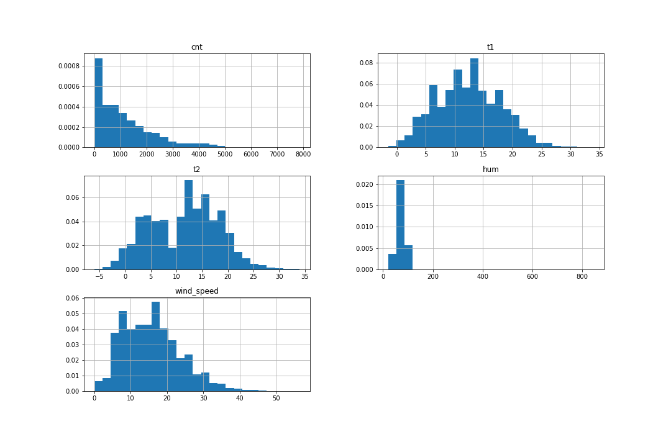
Exploratory data analysis
Data provided in csv:
Timestamp: hourly frequency between 1/1/2015 - 3/1/2017
cnt: the number of bikes used per hour
t1: the actual temperature
t2: the ‘feels like’ temperature
hum: humidity
wind speed
holidays
weekends
season (fall, summer, spring, winter)
Raw data observations:
Significant outliers seen for cnt and hum parameters
Most variables have a skewed distribution
No nulls in the raw data

Slide 3
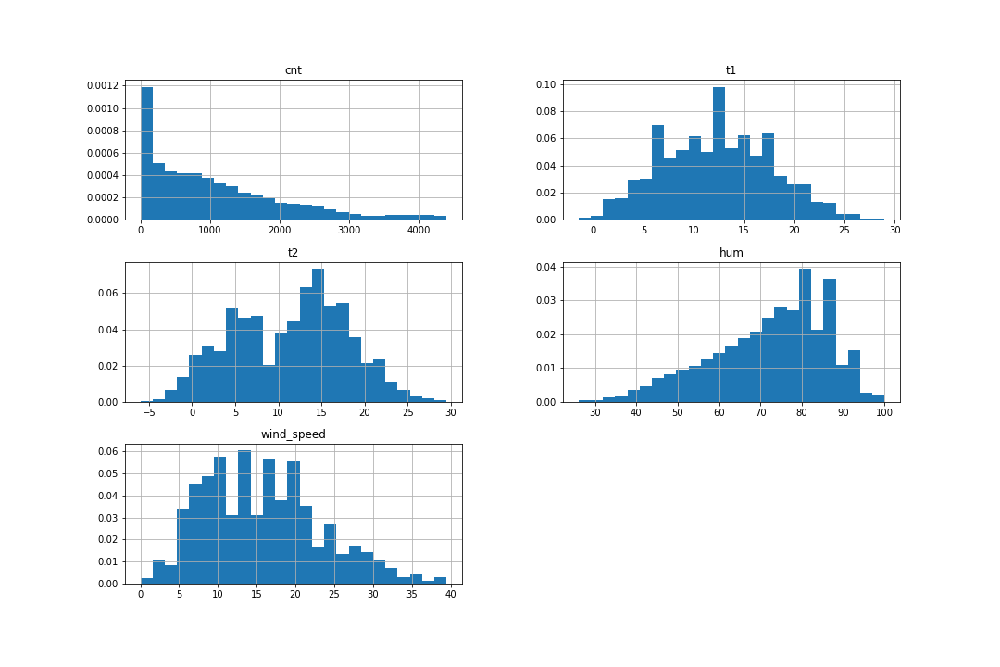
Exploratory data analysis
Outliers excluded using zscore with threshold of 3
2.4% of the data were outliers that were excluded

Slide 4
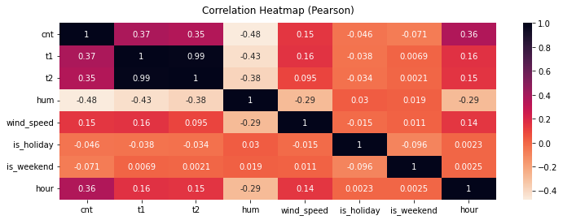
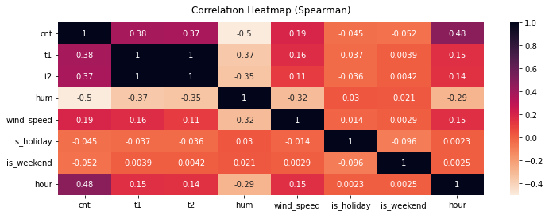
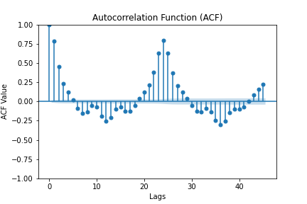
Exploratory data analysis
Correlation between variables & autocorrelation
Pearson vs Spearman methods: correlation coefficients are similar. Pearson correlation values (between cnt and other variables) are smaller which implies non-linear relationship
Hour and humidity seem to have a moderate relationship with cnt
Evidence of autocorrelation for cnt values

Slide 5
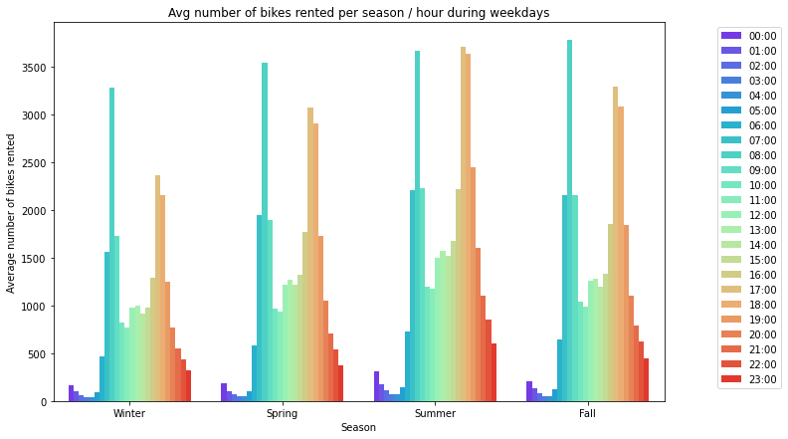
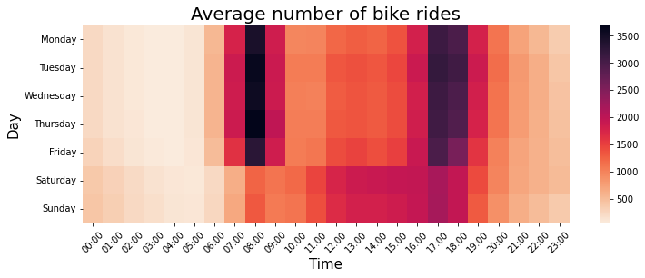
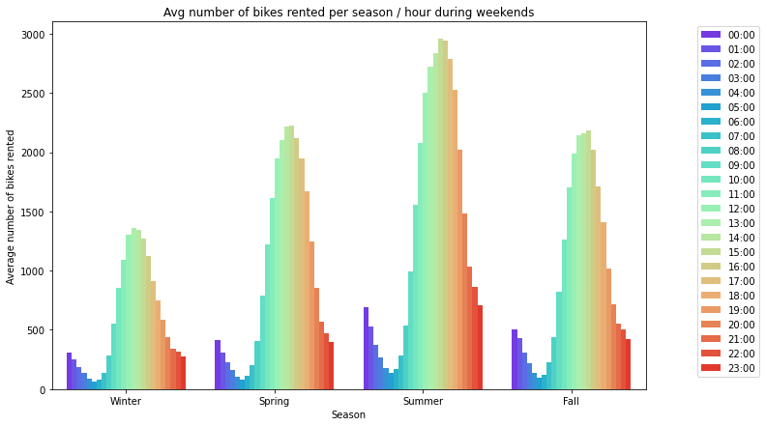
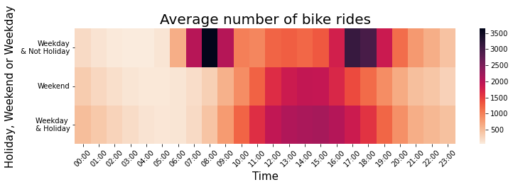
Exploratory data analysis
Peak times observed between 6:00-9:00 and 16:00-18:00 on weekdays (excl. holidays) and 11:00-16:00 on weekends or holidays
Similar across different seasons but the average number of bikes rented is higher during warmer months

Slide 6
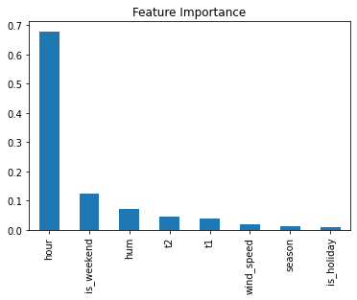
Predictive model – Random Forest Regression
Model training:
2015 data
Grid search cross validation (cv=5)
Test train data split
Model Parameters:
max_depth= None (should keep level of depth sensible in other scenarios)
min_samples_leaf= 1
min_samples_split= 5
n_estimators= 150
Results
Score (train): 0.981
Score (test 2015): 0.923
Score (test 2
​
 | Train | Test (2015) | Test (2016)
Score | 0.981 | 0.931 | 0.923
MAE | 77 | 152 | 183
MSE | 21366 | 75041 | 94922

Slide 7
Additional data
Rental duration
Pick up and drop off locations
Rainfall
casual vs registered users

Slide 8
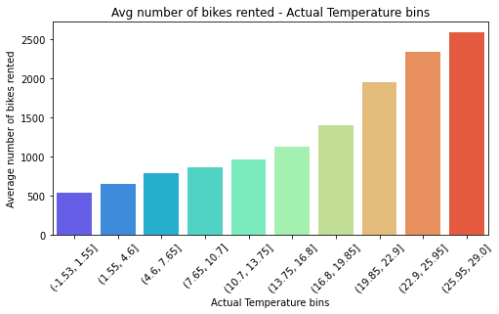
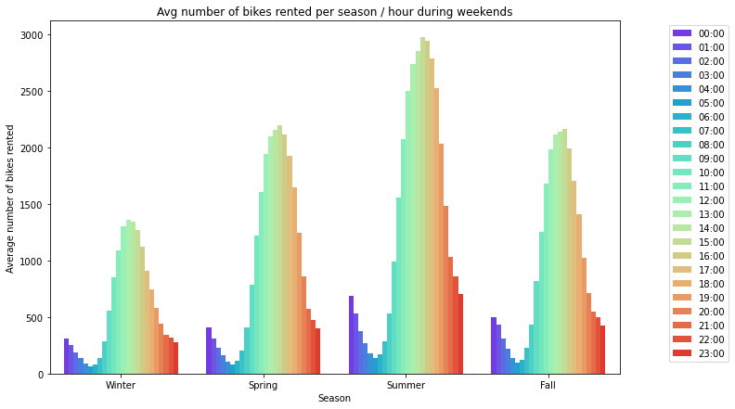
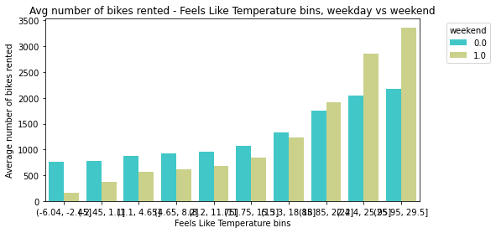
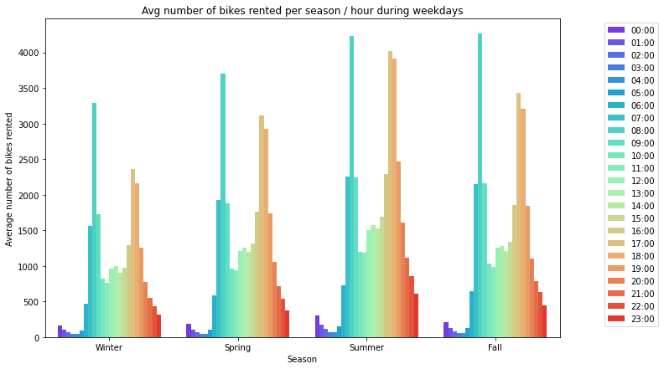
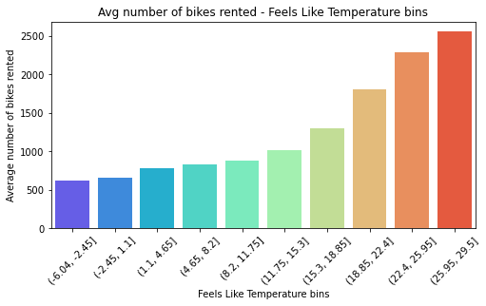
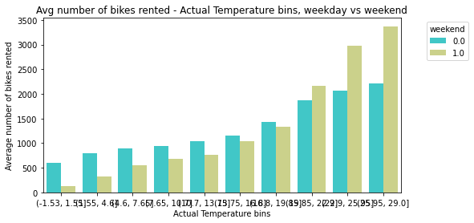
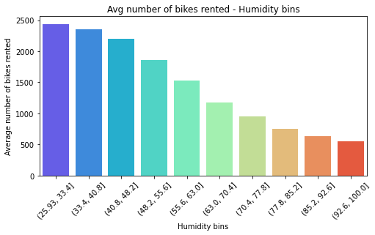
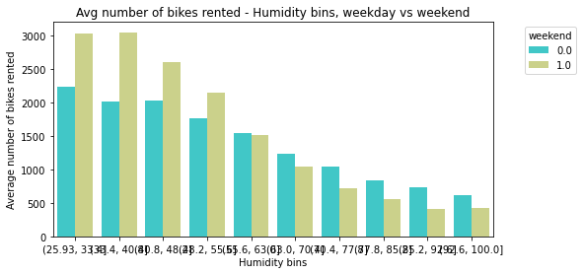
Appendix
K-nn
Best Hyperparameters: {'n_neighbors': 7, 'p': 1}
KNN (GridSearchCV) MAE: 437
KNN (GridSearchCV) MSE: 465697
Mean Squared Error: 465697
R-squared Score: 0.57

Slide 9
Appendix
K-nn
Best Hyperparameters: {'n_neighbors': 7, 'p': 1}
KNN (GridSearchCV) MAE: 437
KNN (GridSearchCV) MSE: 465697
Mean Squared Error: 465697
R-squared Score: 0.57

