Slide 1
SEMPY
Np-junctions

Slide 2
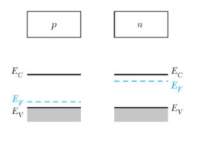
Where we currently are
Chapter 1: semiconductor
Chapter 2: transport properties.
- Calculating drift and diffusion properties under an electric field
Calculating current densities J.
Boil everything down to EM and PHYS102

Slide 3
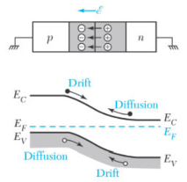
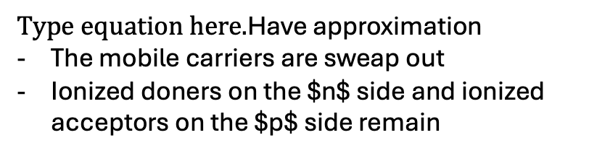
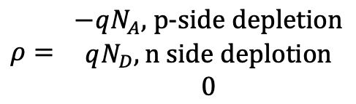
n-p
This is the picture
Have approximation
The mobile carriers are sweap out
Ionized doners on the $n$ side and ionized acceptors on the $p$ side remain
$$ρ= \begin{matrix}−qN_{A}\text{,} \text{p}\text{−}\text{side} \text{depletion} \\ qN_{D},\text{n} \text{side} \text{deplotion} \\ 0\end{matrix}$$

Slide 4
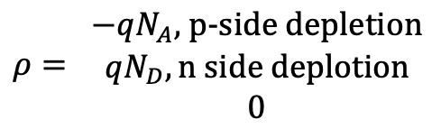
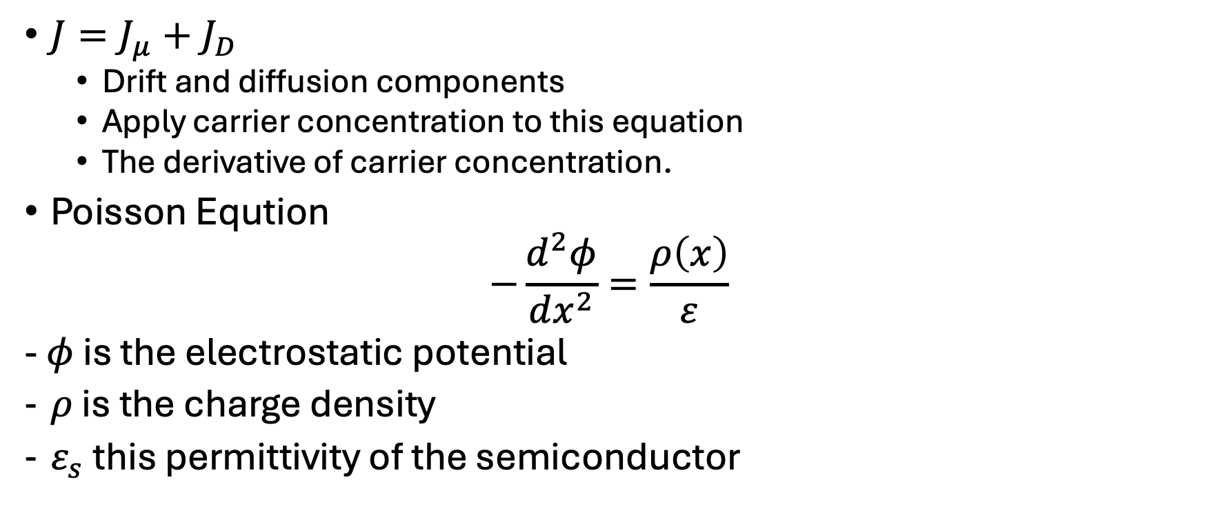
Equilibrium Fermi Levels
$J=J_{μ}+J_{D}$
  Drift and diffusion components
  Apply carrier concentration to this equation
  The derivative of carrier concentration.
Poisson Eqution
$$−\frac{d^{2}φ}{dx^{2}}=\frac{ρ\left(x\right)}{ε}$$
- $φ$ is the electrostatic potential
$ρ$ is the charge density
$ε_{s}$ this permittivity of the semiconductor
$$ρ= \begin{matrix}−qN_{A}\text{,} \text{p}\text{−}\text{side} \text{depletion} \\ qN_{D},\text{n} \text{side} \text{deplotion} \\ 0\end{matrix}$$

Slide 5
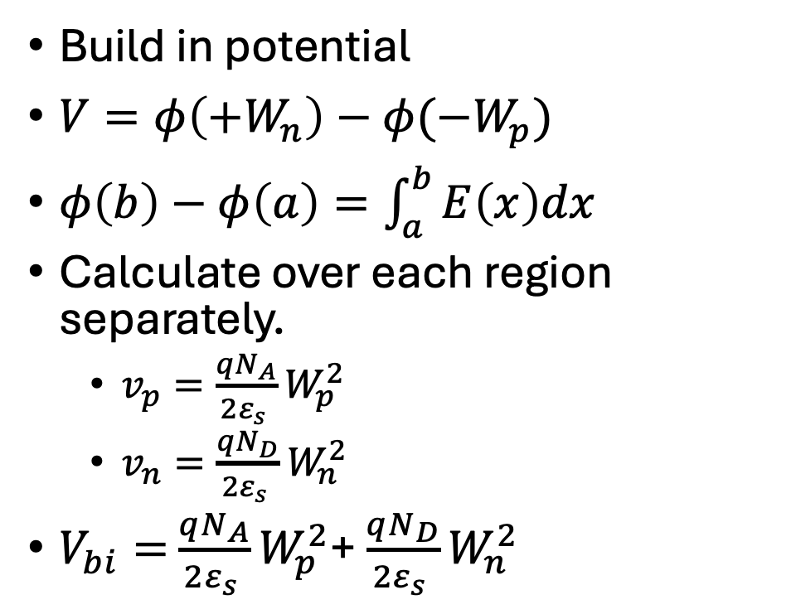
Integrate the electric field to get the potential drop
Build in potential
$V=φ\left(+W_{n}\right)−φ(−W_{p})$
$φ\left(b\right)−φ\left(a\right)=\int_{a}^{b}{E\left(x\right)dx}$
Calculate over each region separately.
  $v_{p}=\frac{qN_{A}}{2ε_{s} }W_{p}^{2}$
  $v_{n}=\frac{qN_{D}}{2ε_{s} }W_{n}^{2}$
$V_{bi}=$ $\frac{qN_{A}}{2ε_{s} }W_{p}^{2}$+ $\frac{qN_{D}}{2ε_{s} }W_{n}^{2}$

Slide 6
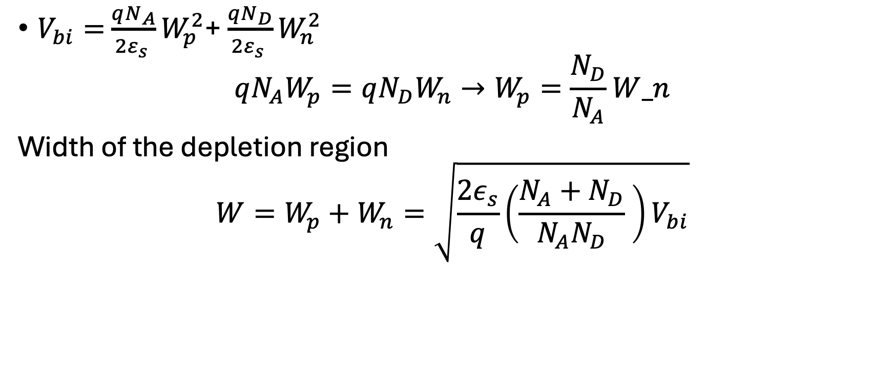
Apply charge neutrality
$V_{bi}=$ $\frac{qN_{A}}{2ε_{s} }W_{p}^{2}$+ $\frac{qN_{D}}{2ε_{s} }W_{n}^{2}$
$$qN_{A}W_{p}=qN_{D}W_{n}→W_{p}=\frac{N_{D}}{N_{A}}W_n$$
Width of the depletion region
$$W=W_{p}+W_{n}=\sqrt{\frac{2ε_{s}}{q}\left(\frac{N_{A}+N_{D}}{N_{A}N_{D}} \right)V_{bi}}$$

Slide 7
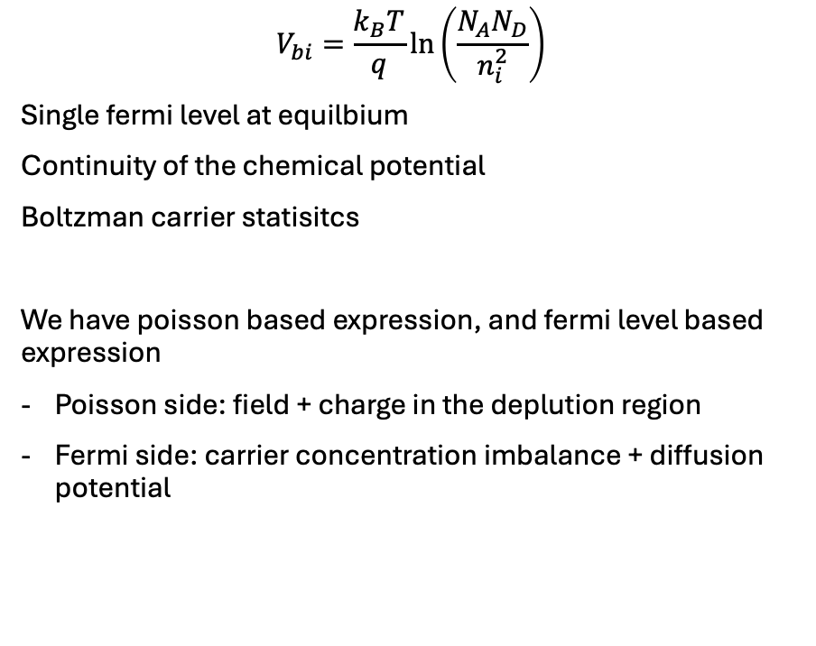
Connect this to thermodynamics
$$V_{bi}=\frac{k_{B}T}{q}\ln\left(\frac{N_{A}N_{D}}{n_{i}^{2}}\right)$$
Single fermi level at equilbium
Continuity of the chemical potential
Boltzman carrier statisitcs
We have poisson based expression, and fermi level based expression
Poisson side: field + charge in the deplution region
Fermi side: carrier concentration imbalance + diffusion potential
The built in potential is the potential barrier that present further diffusion of majority carriers
Balance diffusion (carrier concentration gradient)
Drift
At equilibrium
Drift current + diffusion current =0

Slide 8
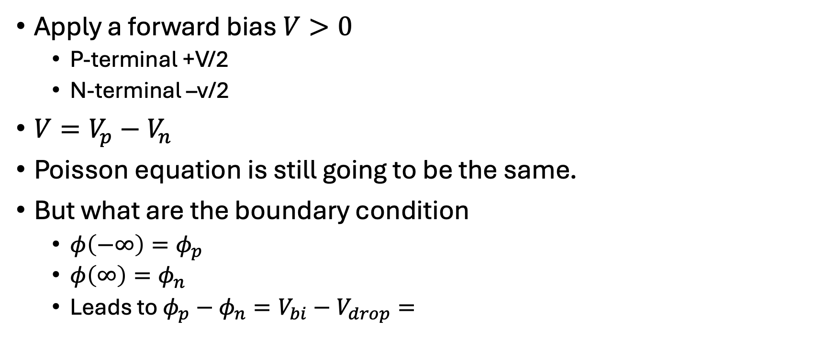
Application of Electric Fields (forward bias)
Apply a forward bias $V>0$
  P-terminal +V/2
  N-terminal –v/2
$V=V_{p}−V_{n}$
Poisson equation is still going to be the same.
But what are the boundary condition
  $φ\left(−∞\right)=φ_{p}$
  $φ\left(∞\right)=φ_{n}$
  Leads to $φ_{p}−φ_{n}=V_{bi}−V_{drop}=$

Slide 9
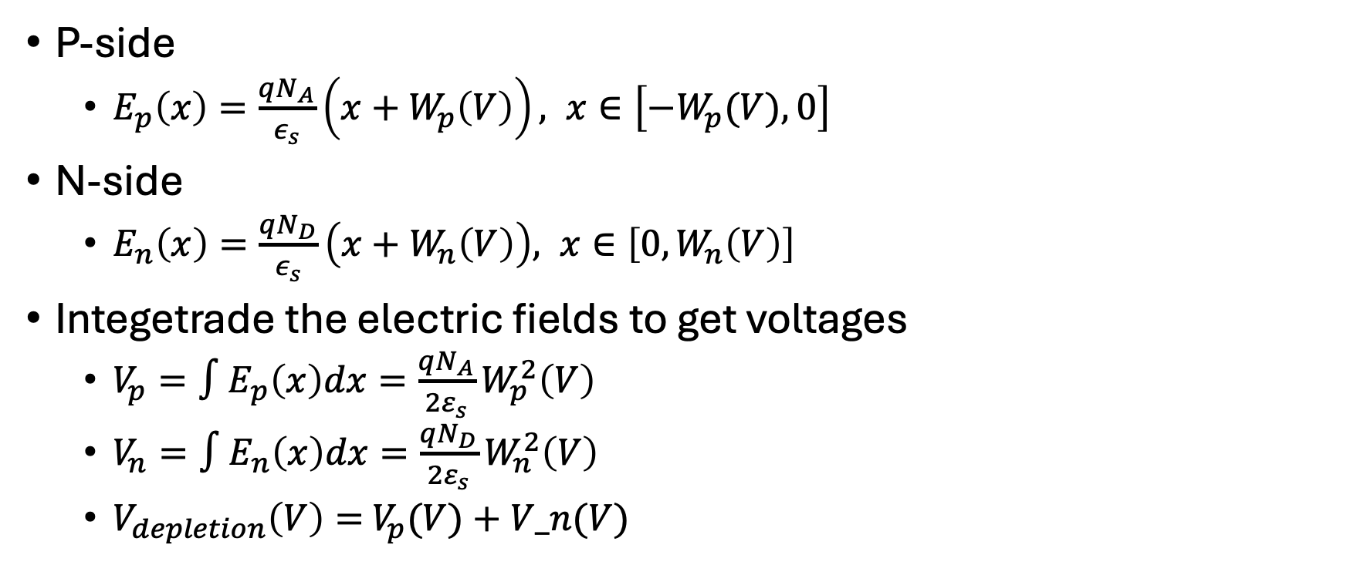
Integrate the poisson equation
P-side
  $E_{p}\left(x\right)=\frac{qN_{A}}{ε_{s}}\left(x+W_{p}\left(V\right)\right), x∈\left[−W_{p}(V),0\right]$
N-side
  $E_{n}\left(x\right)=\frac{qN_{D}}{ε_{s}}\left(x+W_{n}\left(V\right)\right), x∈\left[0,W_{n}\left(V\right)\right]$
Integetrade the electric fields to get voltages
  $V_{p}=∫E_{p}\left(x\right)dx=\frac{qN_{A}}{2ε_{s}}W_{p}^{2}\left(V\right)$
  $V_{n}=∫E_{n}\left(x\right)dx=\frac{qN_{D}}{2ε_{s}}W_{n}^{2}\left(V\right)$
  $V_{depletion}\left(V\right)=$ $V_{p}(V)+V_n(V)$

Slide 10
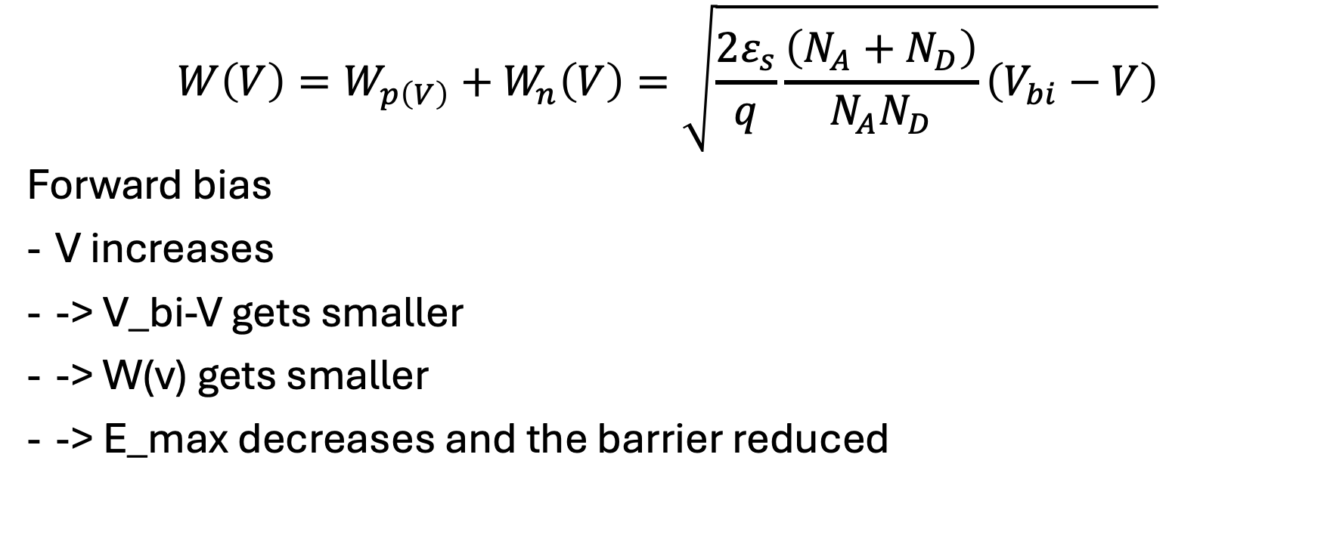
Apply charge neutrality condition
$$W\left(V\right)=W_{p\left(V\right)}+W_{n}\left(V\right)=\sqrt{\frac{2ε_{s}}{q}\frac{\left(N_{A}+N_{D}\right)}{N_{A}N_{D}}\left(V_{bi}−V\right)}$$
Forward bias
V increases
-> V_bi-V gets smaller
-> W(v) gets smaller
-> E_max decreases and the barrier reduced

Slide 11
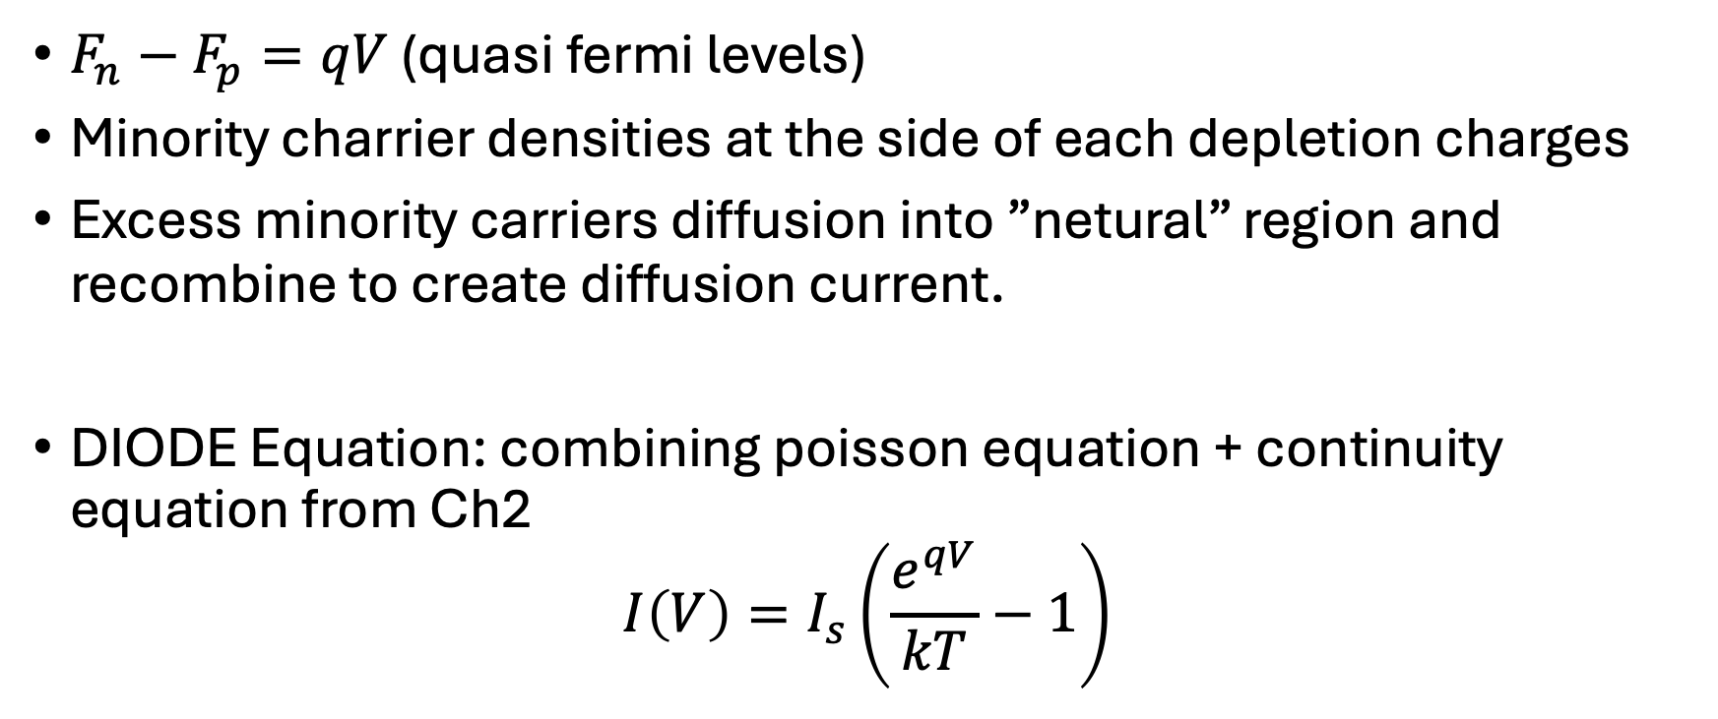
Transport piece
$F_{n}−F_{p}=qV$ (quasi fermi levels)
Minority charrier densities at the side of each depletion charges
Excess minority carriers diffusion into ”netural” region and recombine to create diffusion current.
DIODE Equation: combining poisson equation + continuity equation from Ch2
$$I\left(V\right)=I_{s}\left(\frac{e^{qV}}{kT}−1\right)$$

Slide 12
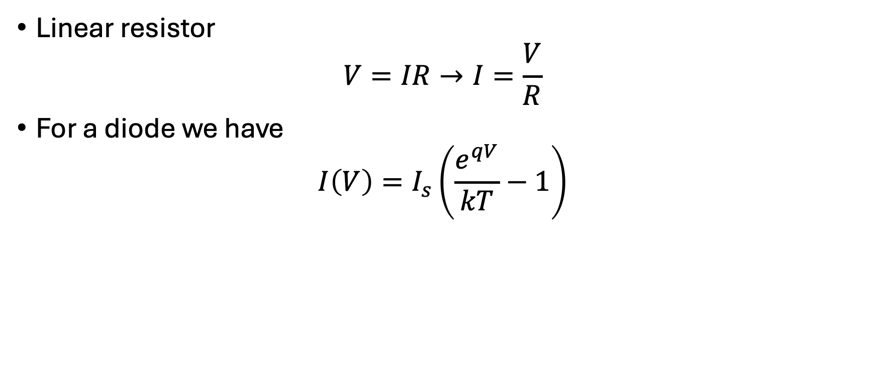
The effective resistance of a p-n junction changes under forward/backward biases
Linear resistor
$$V=IR→I=\frac{V}{R}$$
For a diode we have
$$I\left(V\right)=I_{s}\left(\frac{e^{qV}}{kT}−1\right)$$

