Slide 1
SEMPHY101
Extrinsic Semiconductor

Slide 2
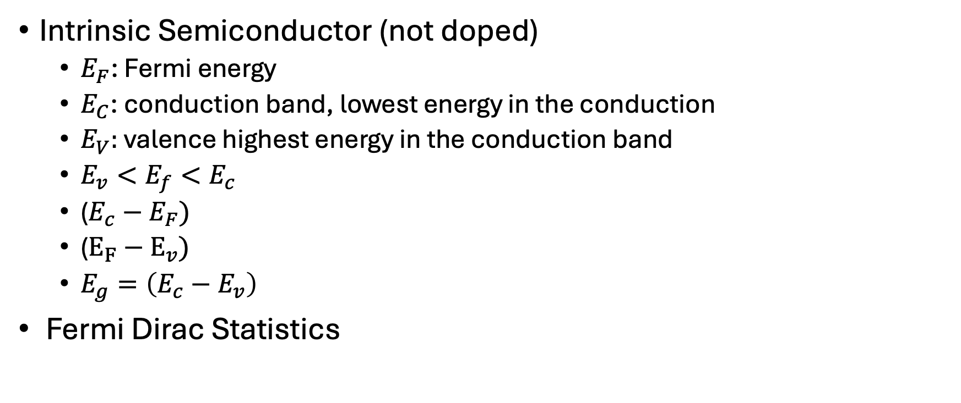
Review
Intrinsic Semiconductor (not doped)
  $E_{F}$: Fermi energy
  $E_{C}$: conduction band, lowest energy in the conduction
  $E_{V}:$ valence highest energy in the conduction band
  $E_{v}<E_{f}<E_{c}$
  ($E_{c}−E_{F})$
  ($E_{F}−E_{v})$
  $E_{g}=\left(E_{c}−E_{v}\right)$
Fermi Dirac Statistics

Slide 3
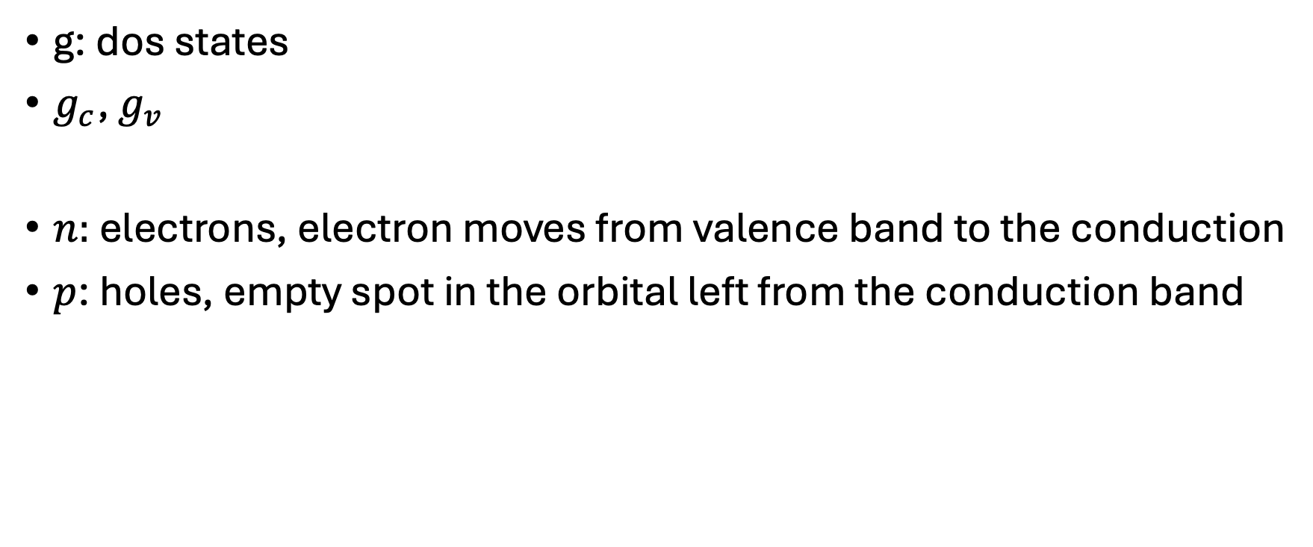
g: dos states
$g_{c}$, $g_{v}$
$n:$ electrons, electron moves from valence band to the conduction
$p$: holes, empty spot in the orbital left from the conduction band

Slide 4
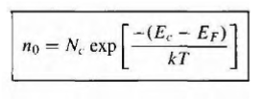

ç

Slide 5


$$e^{−}$$
$$E_c$$
$e^{−}$ $e^{−}$ $e^{−}e^{−}e^{−}e^{−}e^{−}e^{−}e^{−}e^{−}\{ \}e^{−}e^{−}e^{−}e^{−}e^{−}e^{−}e^{−}e^{−}e^{−}e^{−}e^{−}e^{−}e^{−}e^{−}e^{−}e^{−}e^{−}$
$$E_v$$

Slide 6
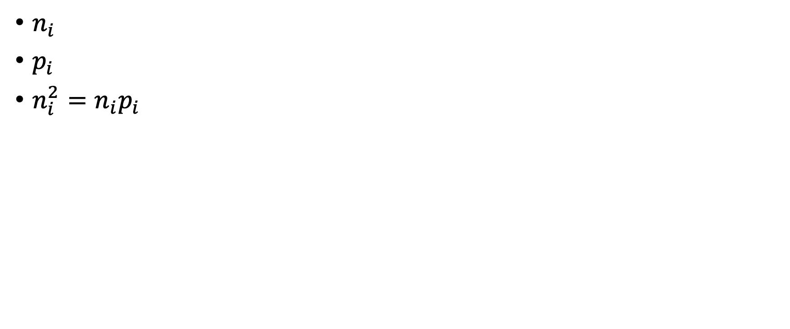
Calculate the concentrations of
$n_{i}$
$p_{i}$
$n_{i}^{2}=n_{i}p_{i}$

Slide 7
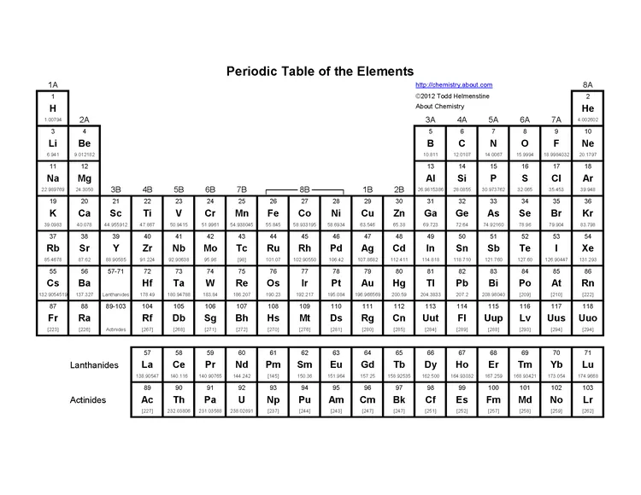

Slide 8
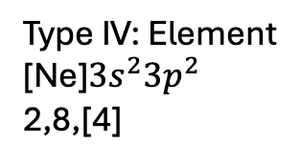
Silicon
Type IV: Element
[Ne]$3s^{2}3p^{2}$
2,8,[4]
Si
Si
Si
Si
Si
Two dopants that we use:
P = 5
B = 3

Slide 9
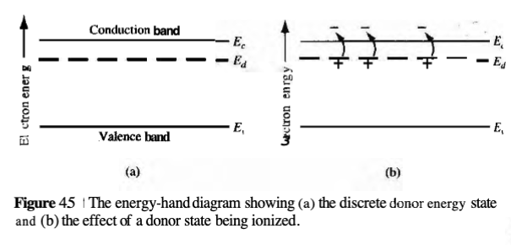

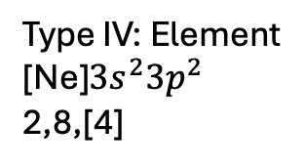

n_type doped Silicon (dope with P)
Type IV: Element
[Ne]$3s^{2}3p^{2}$
2,8,[4]
Si
$$E_{d}=donor energy$$
$$e^{−}$$
Two dopants that we use:
P = 5
B = 3
Si
P
Si
Si

Slide 10
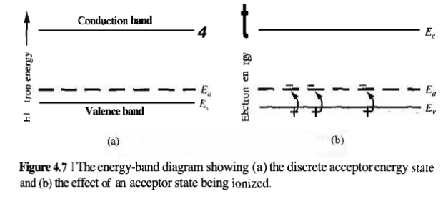

p-type doped Silicon (doped with B)
Si
Si
B
Si
Si
Si: 4 outer electrons
B: 3 outer electrons

Slide 11
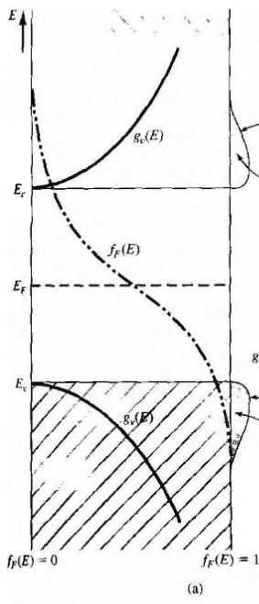
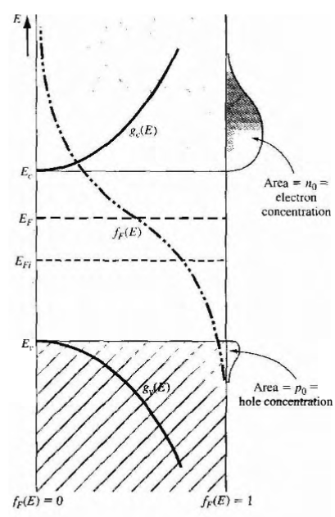

DoS impact (n-type)
$${\left(E_{F}\right)}_{i}→{(E}_{F})_n$$

Slide 12
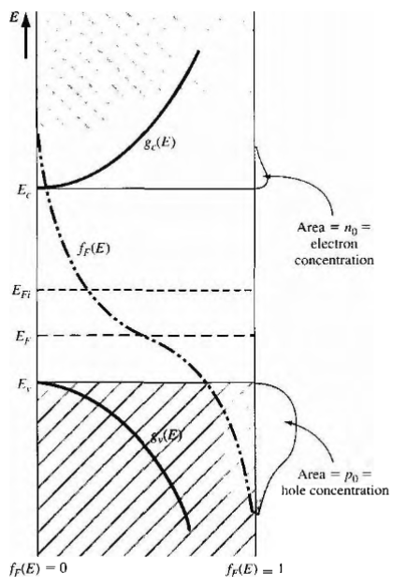
DoS impact (p-type)

Slide 13



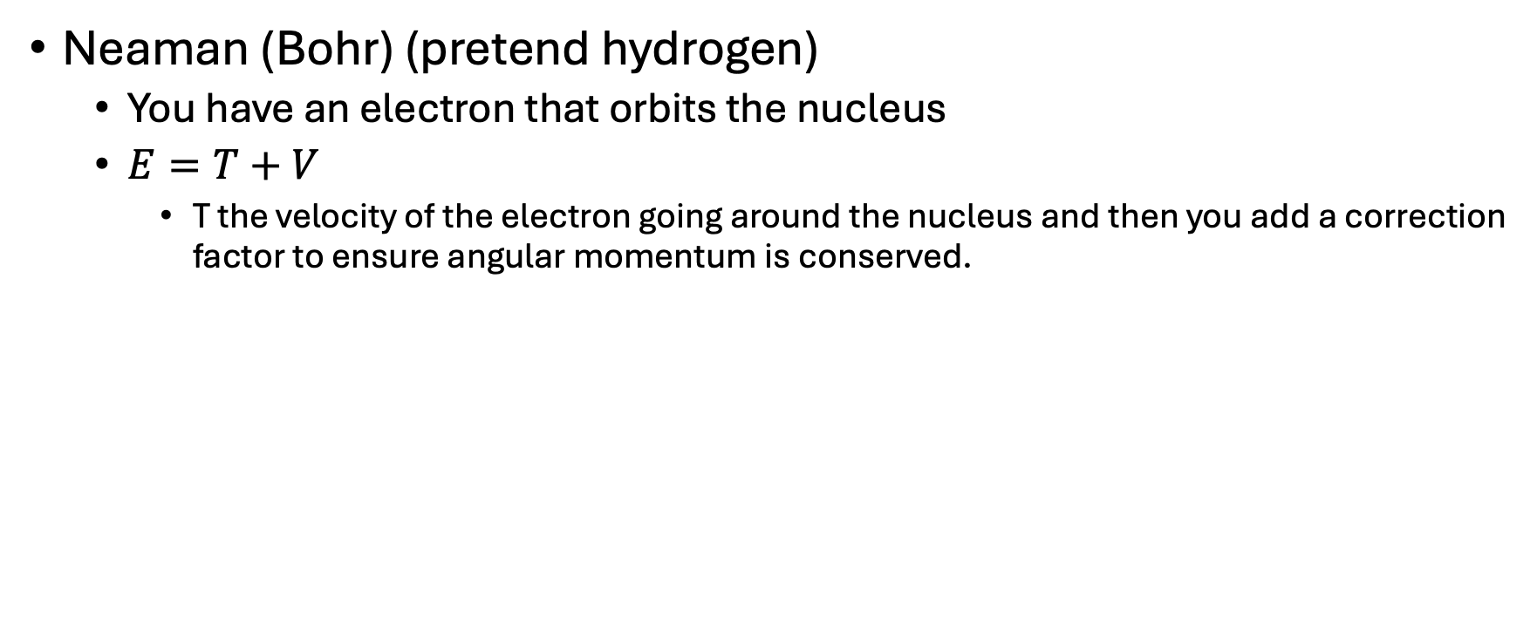
How to calculate ionization energies
Neaman (Bohr) (pretend hydrogen)
  You have an electron that orbits the nucleus
  $E=T+V$
    T the velocity of the electron going around the nucleus and then you add a correction factor to ensure angular momentum is conserved.

Slide 14
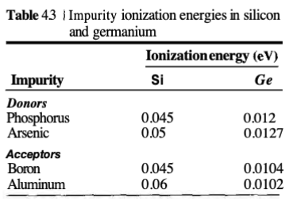

Slide 15


Thermal Equilibrium Concentration
For the intrinsic semiconductor,
n_i=p_i

Slide 16
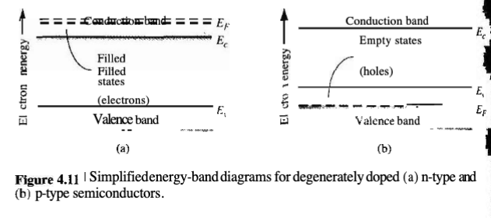
Degenerate Semiconductors

Slide 17
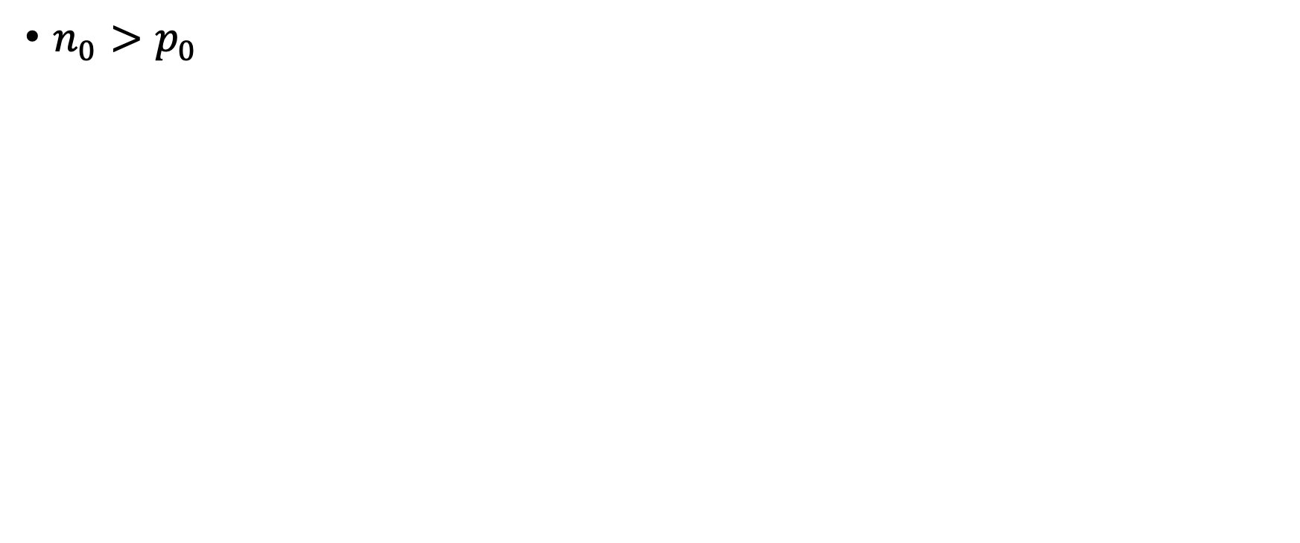
n-type semiconductors
$n_{0}>p_{0}$

Slide 18
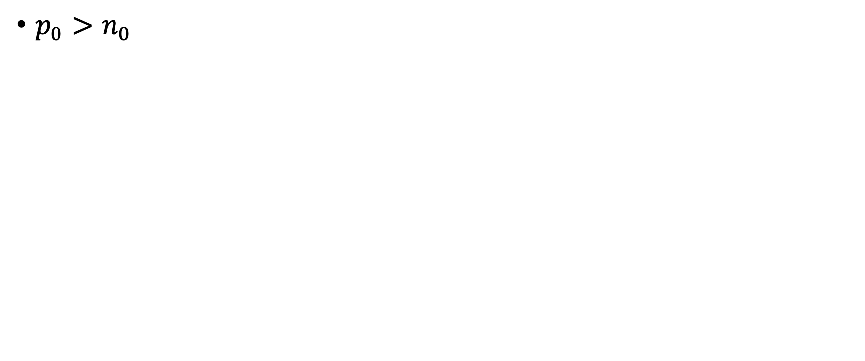
P-type semiconductors
$p_{0}>n_{0}$

