Slide 1
SEMPHY01
Resistance in a Semiconductor

Slide 2
Resistance
4 point probe
Hall effect

Slide 3
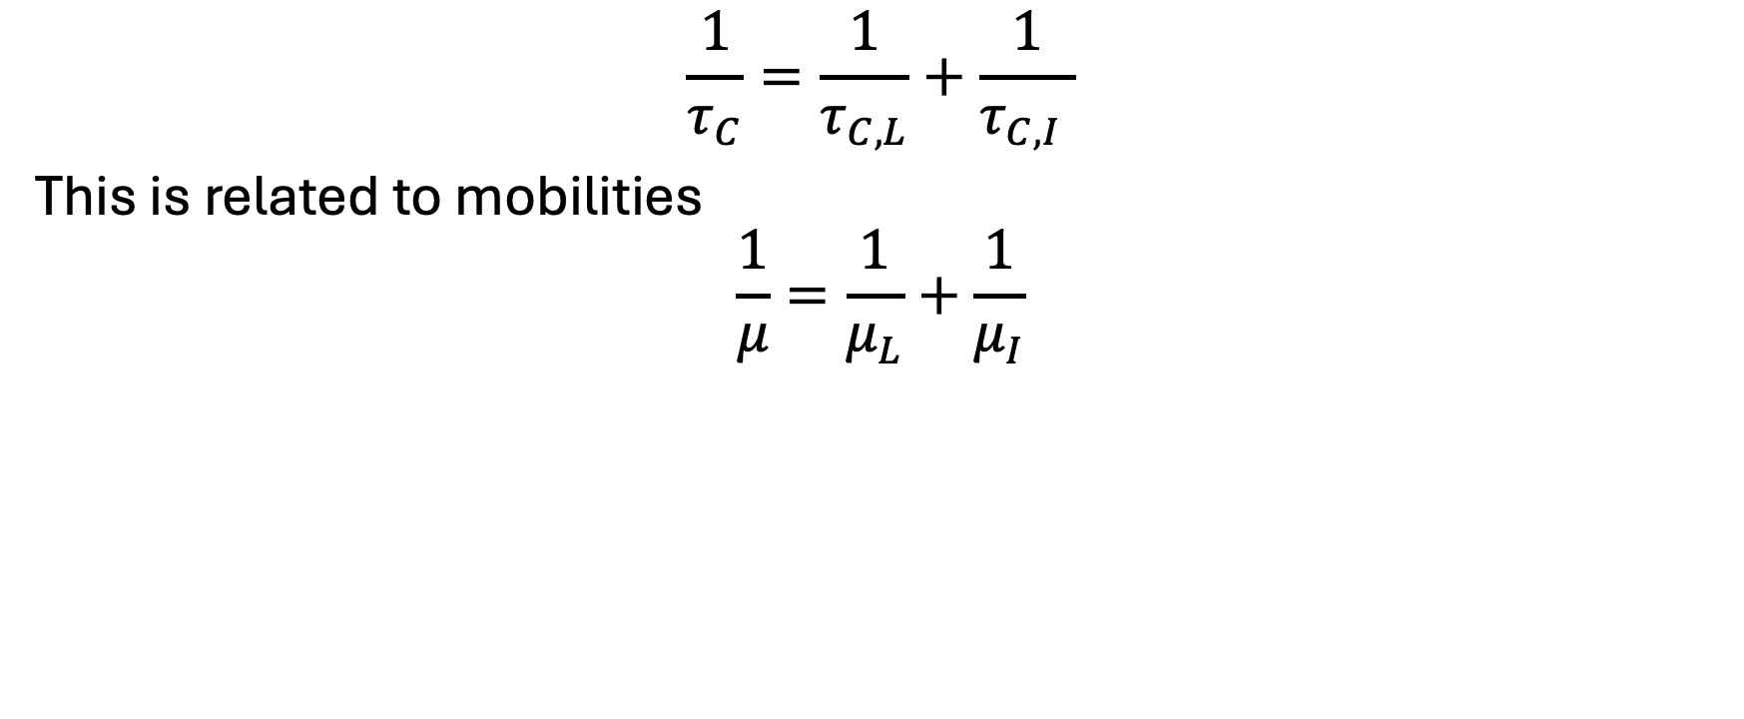
Mobility
$$\frac{1}{τ_{C}}=\frac{1}{τ_{C, L}}+\frac{1}{τ_{C,I} }$$
This is related to mobilities
$$\frac{1}{μ}=\frac{1}{μ_{L}}+\frac{1}{μ_{I}}$$

Slide 4
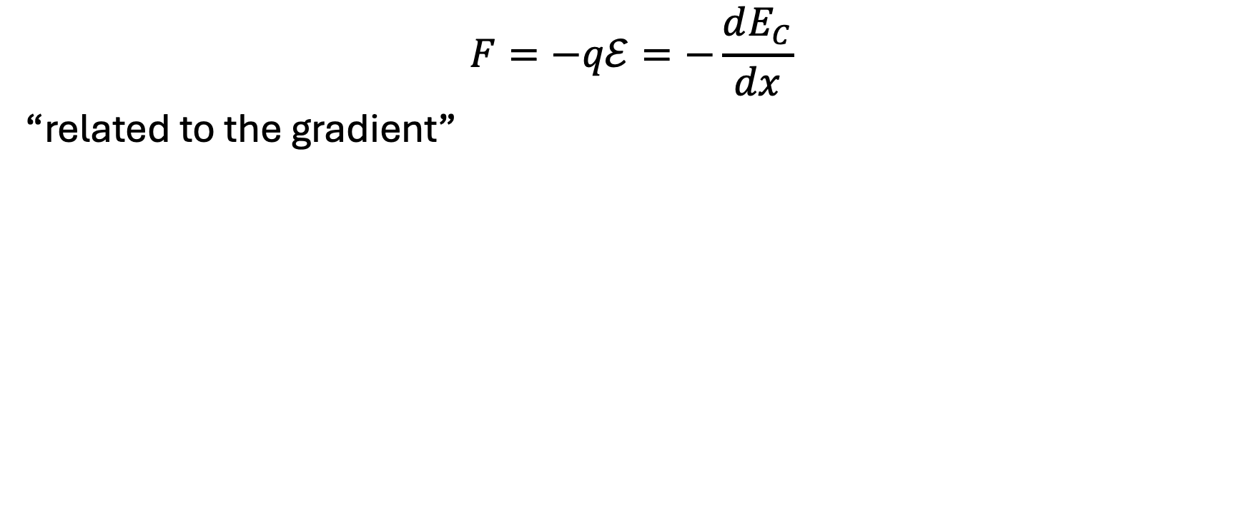
Resistivity
$$F=−qℰ=−\frac{dE_{C}}{dx}$$
“related to the gradient”

Slide 5
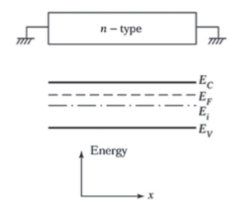

Neutral Semiconductor
$$\vec{ℰ}$$

Slide 6
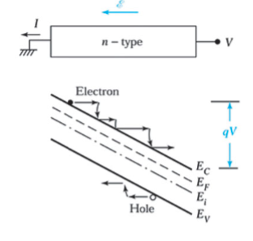
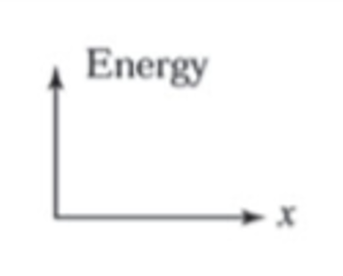
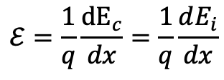
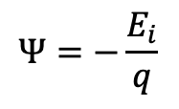

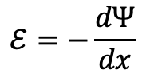
$$ℰ=\frac{1}{q}\frac{{dE}_{c}}{dx}=\frac{1}{q}\frac{dE_{i}}{dx}$$
$$Ψ:electrostatic potential$$
$$Ψ=−\frac{E_{i}}{q}$$
$$ℰ=−\frac{dΨ}{dx}$$

Slide 7
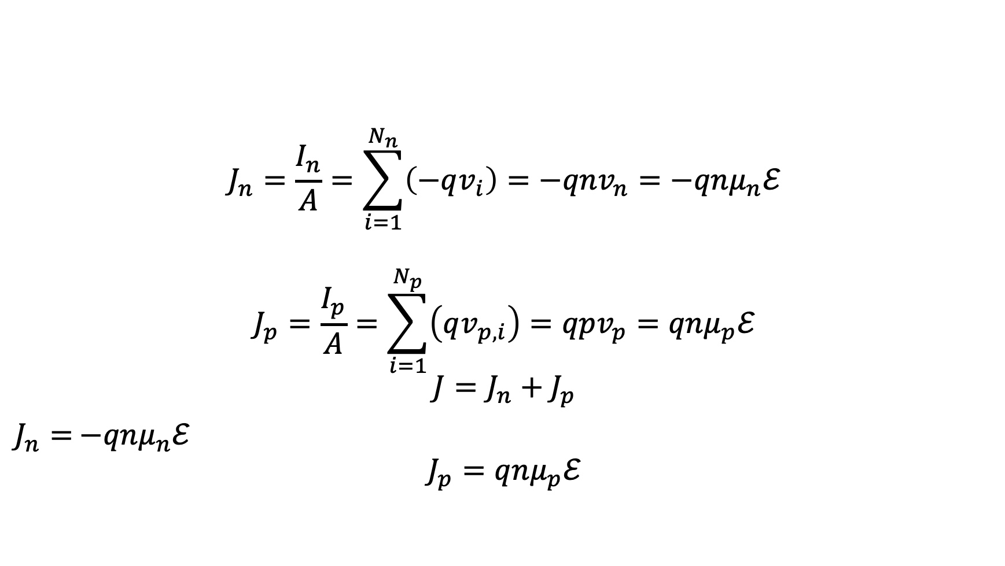

Connect this to $J$
$$J_{n}=\frac{I_{n}}{A}=\sum_{i=1}^{N_{n}}{\left(−qv_{i}\right)=−qnv_{n}=−qnμ_{n}ℰ}$$
$$J_{p}=\frac{I_{p}}{A}=\sum_{i=1}^{N_{p}}{\left(qv_{p,i}\right)=qpv_{p}=qnμ_{p}ℰ}$$
$$J=J_{n}+J_{p}$$
$J_{n}=$ $−qnμ_{n}ℰ$
$$J_{p}=qnμ_{p}ℰ$$

Slide 8
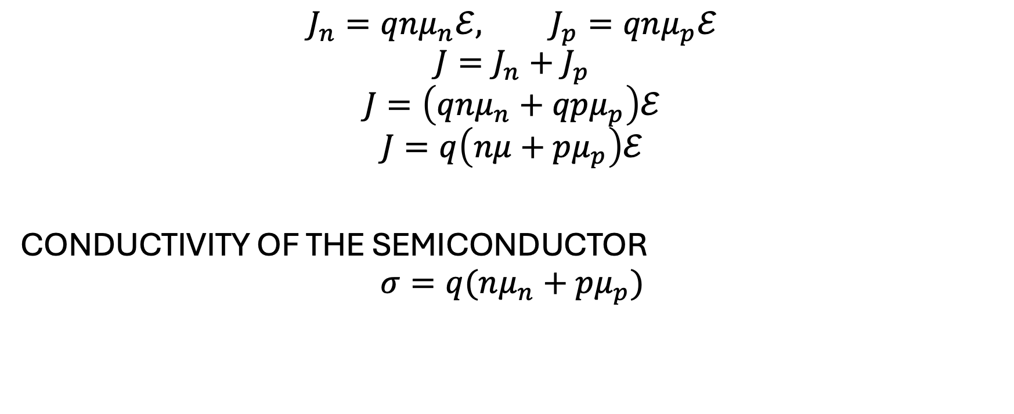
Conductivity
$$J_{n}=qnμ_{n}ℰ, J_{p}=qnμ_{p}ℰ$$
$$J=J_{n}+J_{p}$$
$$J=\left(qnμ_{n}+qpμ_{p}\right)ℰ$$
$$J=q\left(nμ+pμ_{p}\right)ℰ$$
CONDUCTIVITY OF THE SEMICONDUCTOR
$$σ=q(nμ_{n}+pμ_{p})$$

Slide 9
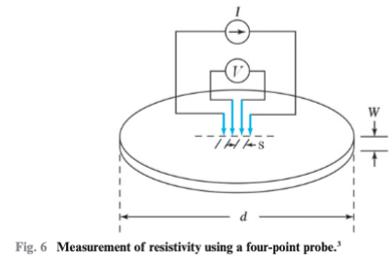
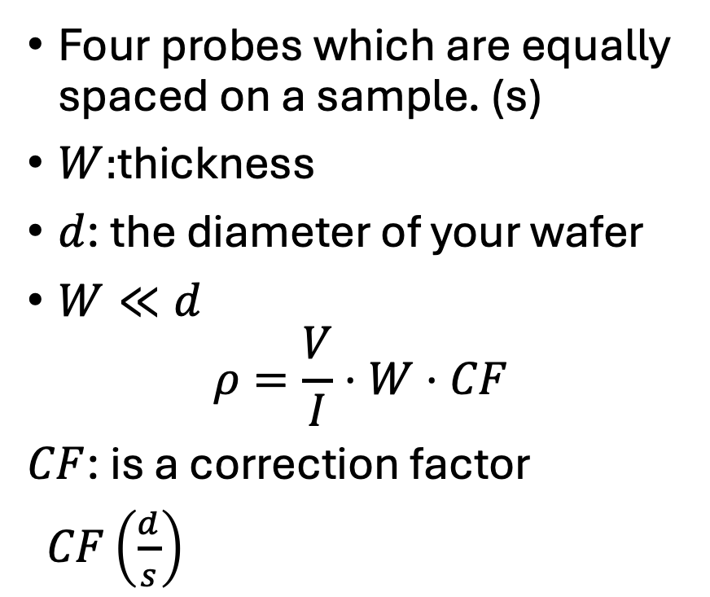
Four point probe
Four probes which are equally spaced on a sample. (s)
$W:$thickness
$d$: the diameter of your wafer
$W≪d$
$$ρ=\frac{V}{I}⋅W⋅CF$$
$CF$: is a correction factor
$CF\left(\frac{d}{s}\right)$

Slide 10
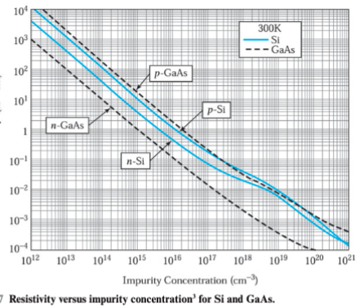

Slide 11
Hall Effect
Carrier Concentration
  Lorentz Force Law
  Current Density
  Drift Velocity
Cross product dependence
V_H

Slide 12
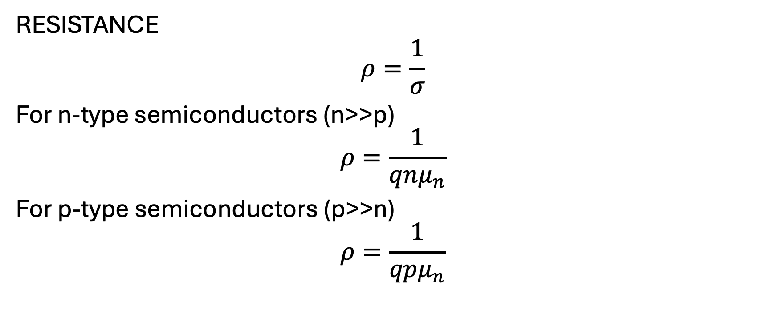
Resistance
RESISTANCE
$$ρ=\frac{1}{σ}$$
For n-type semiconductors (n>>p)
$$ρ=\frac{1}{qnμ_{n}}$$
For p-type semiconductors (p>>n)
$$ρ=\frac{1}{qpμ_{n}}$$

Slide 13
Jones Research Group at UF
Kevin Jones
  https://mse.ufl.edu/people/name/kevin-jones/
  AMD, Intel, Micron prepare samples for characterization and research
  Four point test
  Hall Effect test
  Morphology (SEM/TEM/Fib)

