Slide 1
Federated Learning Meets Knowledge Graphs: Challenges and Opportunities for Distributed Health AI 1st International Workshop on Knowledge Graphs for Health AIME 2026 July 10, 2026
Dr. Christoph Düsing
Semantic Computing Group
CITEC
Bielefeld University, Germany

Slide 2
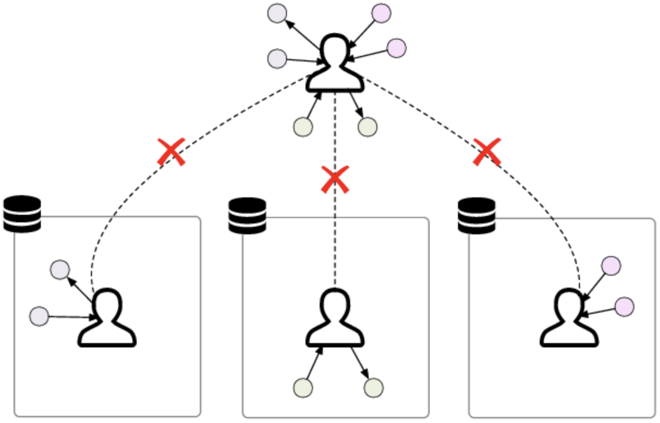
Motivation [1]
Problem
Key question
Knowledge is spread across hospitals, biobanks, and public biomedical resources
Each institution may hold only a partial view of the clinical knowledge space.
Sensitivity of knowledge might make centralization unfeasible
“How can we learn from distributed health knowledge without requiring all data and graph structures to be centralized?”
Dr. Christoph Düsing
Federated Learning Meets Knowledge Graphs

Slide 3
Federated Learning (FL)
Dr. Christoph Düsing
Federated Learning Meets Knowledge Graphs

Slide 4
From Federated Data to Federated Knowledge
Classical FL Setting | Each client holds a local dataset Clients train a shared model on structurally similar data The server aggregates model updates
KG-based Setting | Each client may hold a local graph Nodes, edges, relation types, and schemas may differ across clients The goal may be to learn embeddings, mappings, rules, or graph-based models without exchanging the full graph.
What changes? | The distributed object is no longer only a dataset, but a knowledge representation Heterogeneity is not only statistical, but also semantic and structural. Alignment between entities, relations, and ontologies becomes part of the learning problem.
Dr. Christoph Düsing
Federated Learning Meets Knowledge Graphs

Slide 5
Opportunities
Dr. Christoph Düsing
Federated Learning Meets Knowledge Graphs

Slide 6
Opportunity 1: Federated Knowledge Graph Embedding [1]
Idea
Approach
Applications
Instead of collecting all triples in one central KG, each institution keeps its local graph
A shared embedding model is trained collaboratively across clients.
Learn useful entity and relation representations without exchanging raw triples.
Local clients train a KG embedding model on their own triples.
Clients share model updates, embedding updates, or selected representation parameters.
The server aggregates updates to improve a global representation space.
Federated knowledge graph completion.
Link prediction across distributed graph fragments.
Learning from complementary institutional knowledge without central graph pooling.
Dr. Christoph Düsing
Federated Learning Meets Knowledge Graphs

Slide 7
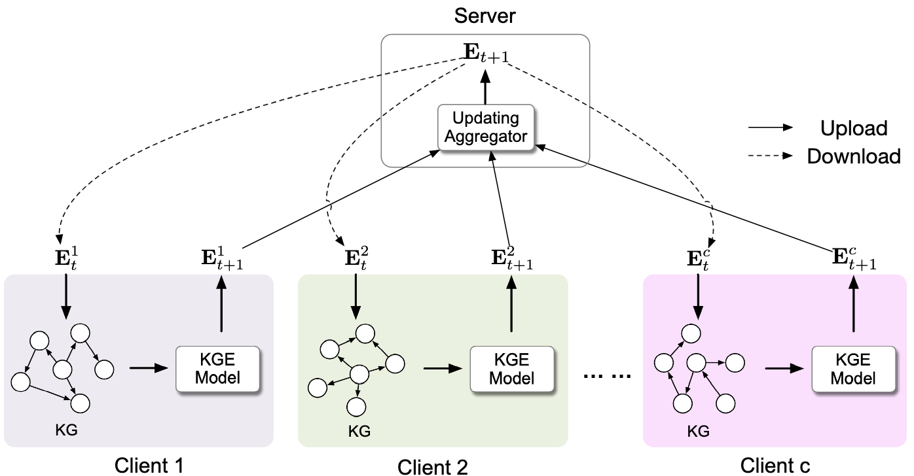
Opportunity 1: Federated Knowledge Graph Embedding [1]
Dr. Christoph Düsing
Federated Learning Meets Knowledge Graphs

Slide 8
Opportunity 2: Federated Graph Neural Networks (GNNs) [2]
Idea
Approach
Applications
Many biomedical problems are graph-structured
Instead of flattening these structures, GNNs can learn form nodes, edges and topology
FL allows multiple institutions to train graph-based models
Each client trains a local GNN (e.g., GCN) on graph structure
Much like in FL, clients only exchange model parameters (weights or gradients)
Disease classification from local omics and clinical data
Disease module discovery across institutions
Dr. Christoph Düsing
Federated Learning Meets Knowledge Graphs

Slide 9
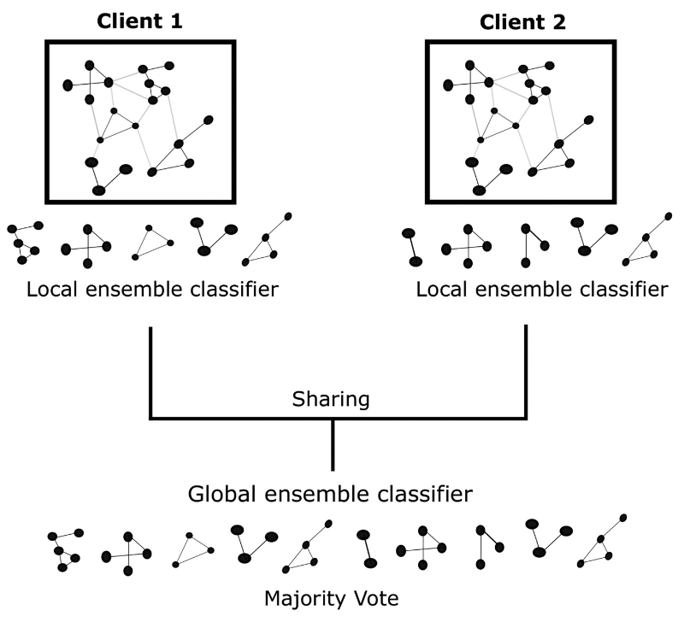
Opportunity 2: Federated Graph Neural Networks (GNNs) [2]
Dr. Christoph Düsing
Federated Learning Meets Knowledge Graphs

Slide 10
Opportunity 3: Semantic Harmonization for Federated Learning [2]
Idea
Approach
FL assumes that clients share the same feature space and label definitions.
Sites may use different coding systems, terminologies, and measurement practices.
KGs and ontologies can provide a shared semantic layer for aligning local data representations before or during FL.
Each client maps local variables and concepts to a shared semantic reference model.
The shared layer may include ontologies, concept hierarchies, and mappings.
Clients may exchange semantic mappings, feature correspondences, ontology-aligned metadata, or model updates over harmonized features.
Dr. Christoph Düsing
Federated Learning Meets Knowledge Graphs
Notes:
Opportunity 1 and 2 were about learning from graph-structured data. This third opportunity is slightly different: here, KGs are not primarily the object of learning, but the semantic coordination layer that makes federated learning across health institutions possible.

Slide 11
Opportunity 3: Semantic Harmonization for Federated Learning [2]
Example
Solution
Site A: “HbA1c”
Site B: “Glycated hemoglobin”
Site C: “LOINC 4548-4”
=> All referring to the same clinical concept, but different specificity
A shared KG/ontology layer can map these to a common concept while preserving local data ownership.
Dr. Christoph Düsing
Federated Learning Meets Knowledge Graphs
Notes:
measures the average blood glucose levels

Slide 12
Challenges
Dr. Christoph Düsing
Federated Learning Meets Knowledge Graphs

Slide 13
Challenge 1: Statistical Heterogeneity Becomes Graph Heterogeneity
In classical FL, data imbalance is a major concern
In KG settings, heterogeneity is even richer:
Different entities
Different relations
Different schemas
Different graph densities
Different ontology depth
Different missingness patterns
=> In federated KGs, clients may not just have different data distributions; they may represent the world differently
Dr. Christoph Düsing
Federated Learning Meets Knowledge Graphs

Slide 14
Challenge 2: What is Actually Shared?
In Fl, the exchanges object is often clear: model parameters or gradients
In KG settings, this is less obvious. Possible exchange objects are:
GNN parameters
Node embeddings
Ontology mappings
Graph summaries
Constraints or rules
=> What is the “model update” when the underlying object is a knowledge graph?
Dr. Christoph Düsing
Federated Learning Meets Knowledge Graphs

Slide 15
Challenge 3: Privacy Leakage from Graph Structure
Even if raw patient data is not shared, graph representations may leak information
Potential leakage sources
Rare entities
Unique neighborhoods
Sensitive edges
Embeddings that encode identifiable relations
Membership inference
Reconstruction attacks
=> Keeping the graph local does not automatically make the system private
Dr. Christoph Düsing
Federated Learning Meets Knowledge Graphs

Slide 16
Conclusion
Main message
Opportunities
Challenges
FL and KGs address complementary parts of the same problem: how to build useful health AI when data and knowledge is distributed?
Learn shared representations from distributed KGs
Train graph-based prediction models
Use KGs and ontologies as semantic infrastructure for cross-site harmonization
Clients may differ not only statistically, but also structurally and semantically
It is unclear what should be exchanged: parameters, embeddings, mappings, …
Keeping graphs local does not guarantee data privacy
Dr. Christoph Düsing
Federated Learning Meets Knowledge Graphs

Slide 17
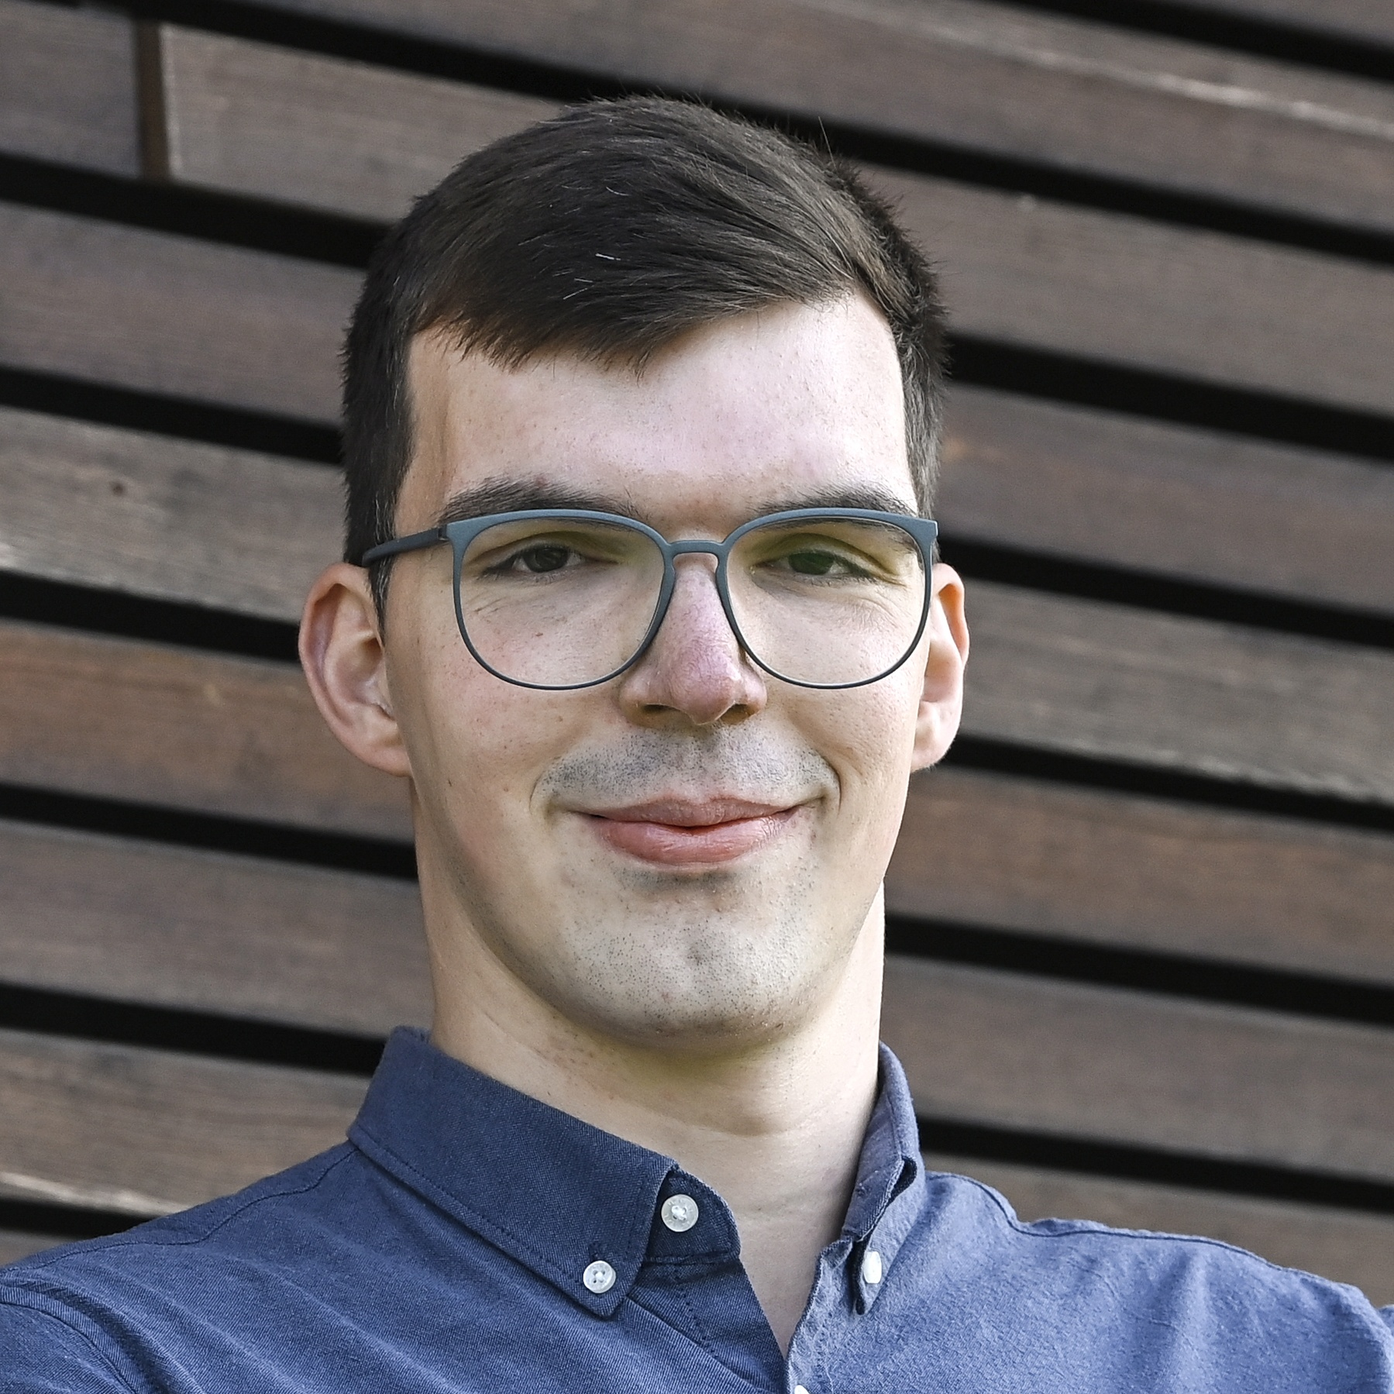
Thank you for your attention!
Christoph Düsing Bielefeld University
Dr. Christoph Düsing
Federated Learning Meets Knowledge Graphs

Slide 18
References
[1] Chen, M., Zhang, W., Yuan, Z., Jia, Y., & Chen, H. (2021, December). Fede: Embedding knowledge graphs in federated setting. In Proceedings of the 10th international joint conference on knowledge graphs (pp. 80-88).
[2] Pfeifer, B., Chereda, H., Martin, R., Saranti, A., Clemens, S., Hauschild, A. C., ... & Heider, D. (2023). Ensemble-GNN: federated ensemble learning with graph neural networks for disease module discovery and classification. Bioinformatics, 39(11), btad703.
[3] Kokash, N., Wang, L., Gillespie, T. H., Belloum, A. S., Grosso, P., Quinney, S., ... & De Bono, B. (2026). Ontology-and LLM-based data harmonization for federated learning in healthcare. Frontiers in Digital Health, 8, 1756555.
Dr. Christoph Düsing
Federated Learning Meets Knowledge Graphs

