Slide 1
Mutual Fund Analytics & Investor Insights Platform
End-to-End Data Analytics Capstone Project
Prepared By: Ekta Rajak

Slide 2
Business Problem
The mutual fund industry generates large amounts of investment, performance, and investor data.
Challenges:
Evaluating fund performance
Measuring risk
Understanding investor behavior
Tracking SIP growth
Identifying investment opportunities
Need:
A centralized analytics platform for actionable insights and decision-making.

Slide 3
Project Objectives
Objectives
Build ETL pipeline
Clean and validate financial datasets
Perform exploratory data analysis
Calculate advanced performance metrics
Develop Power BI dashboard
Analyze investor behavior
Create fund recommendation engine
Generate business insights

Slide 4
Data Sources
Datasets Used
Fund Master
NAV History
AUM by Fund House
Monthly SIP Inflows
Category Inflows
Industry Folio Count
Scheme Performance
Investor Transactions
Portfolio Holdings
Benchmark Indices
Total Schemes Analysed – 40

Slide 5
Project Architecture
End-to-End Workflow
Raw CSV Files
Data Ingestion
Data Cleaning
SQLite Database
EDA
Performance Analytics
Advanced Analytics
Power BI Dashboard
Business Insights

Slide 6
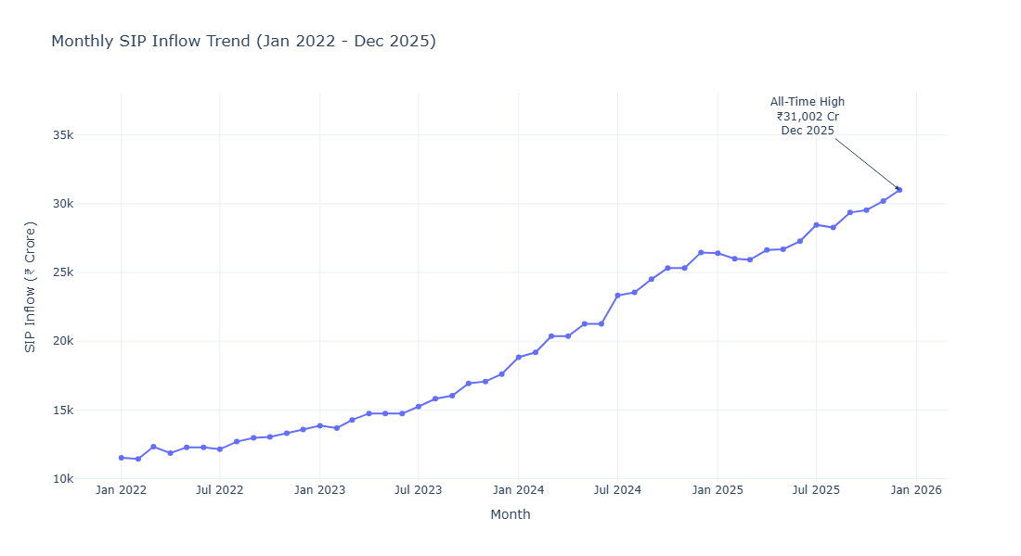
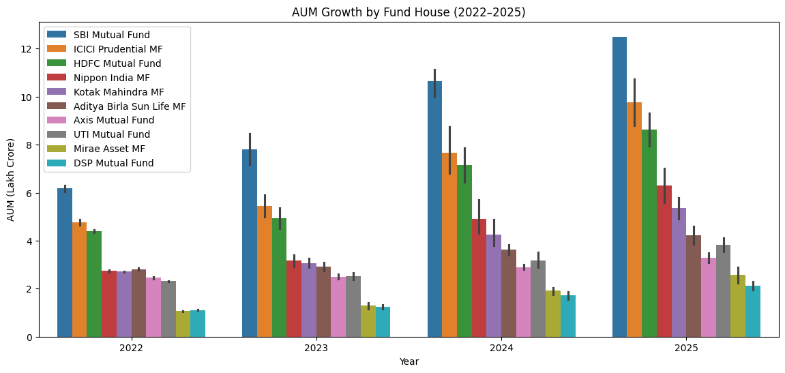
EDA Highlights
Industry Analysis
Key Findings:
Industry AUM grew significantly
SIP inflows reached record highs
Retail investor participation increased
Equity funds attracted higher inflows

Slide 7
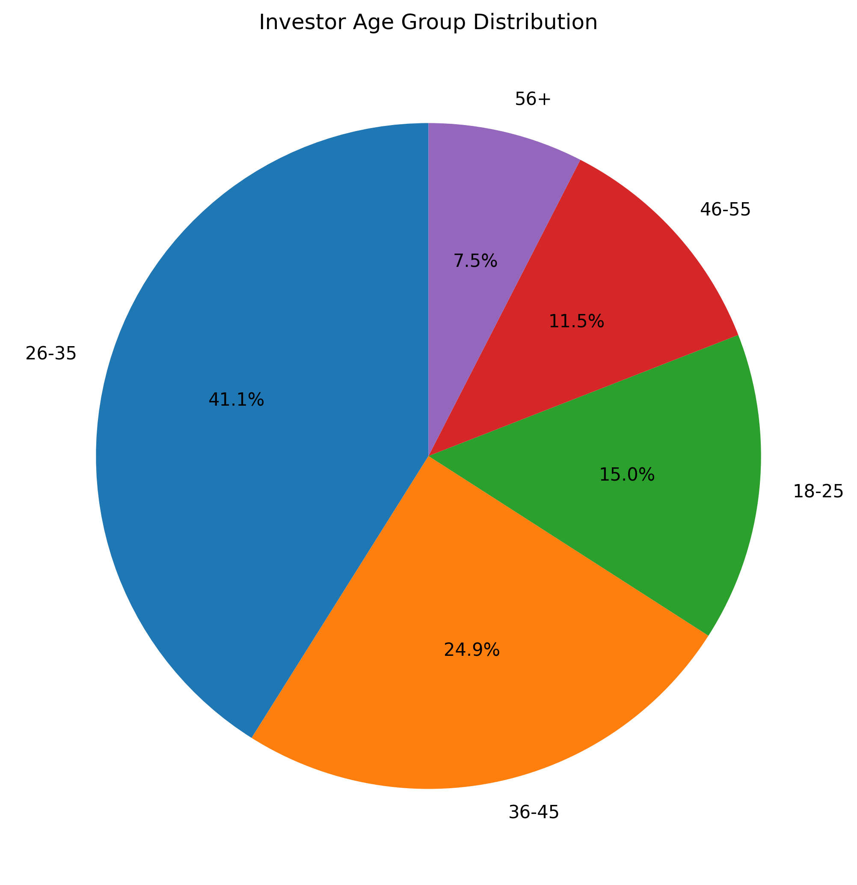
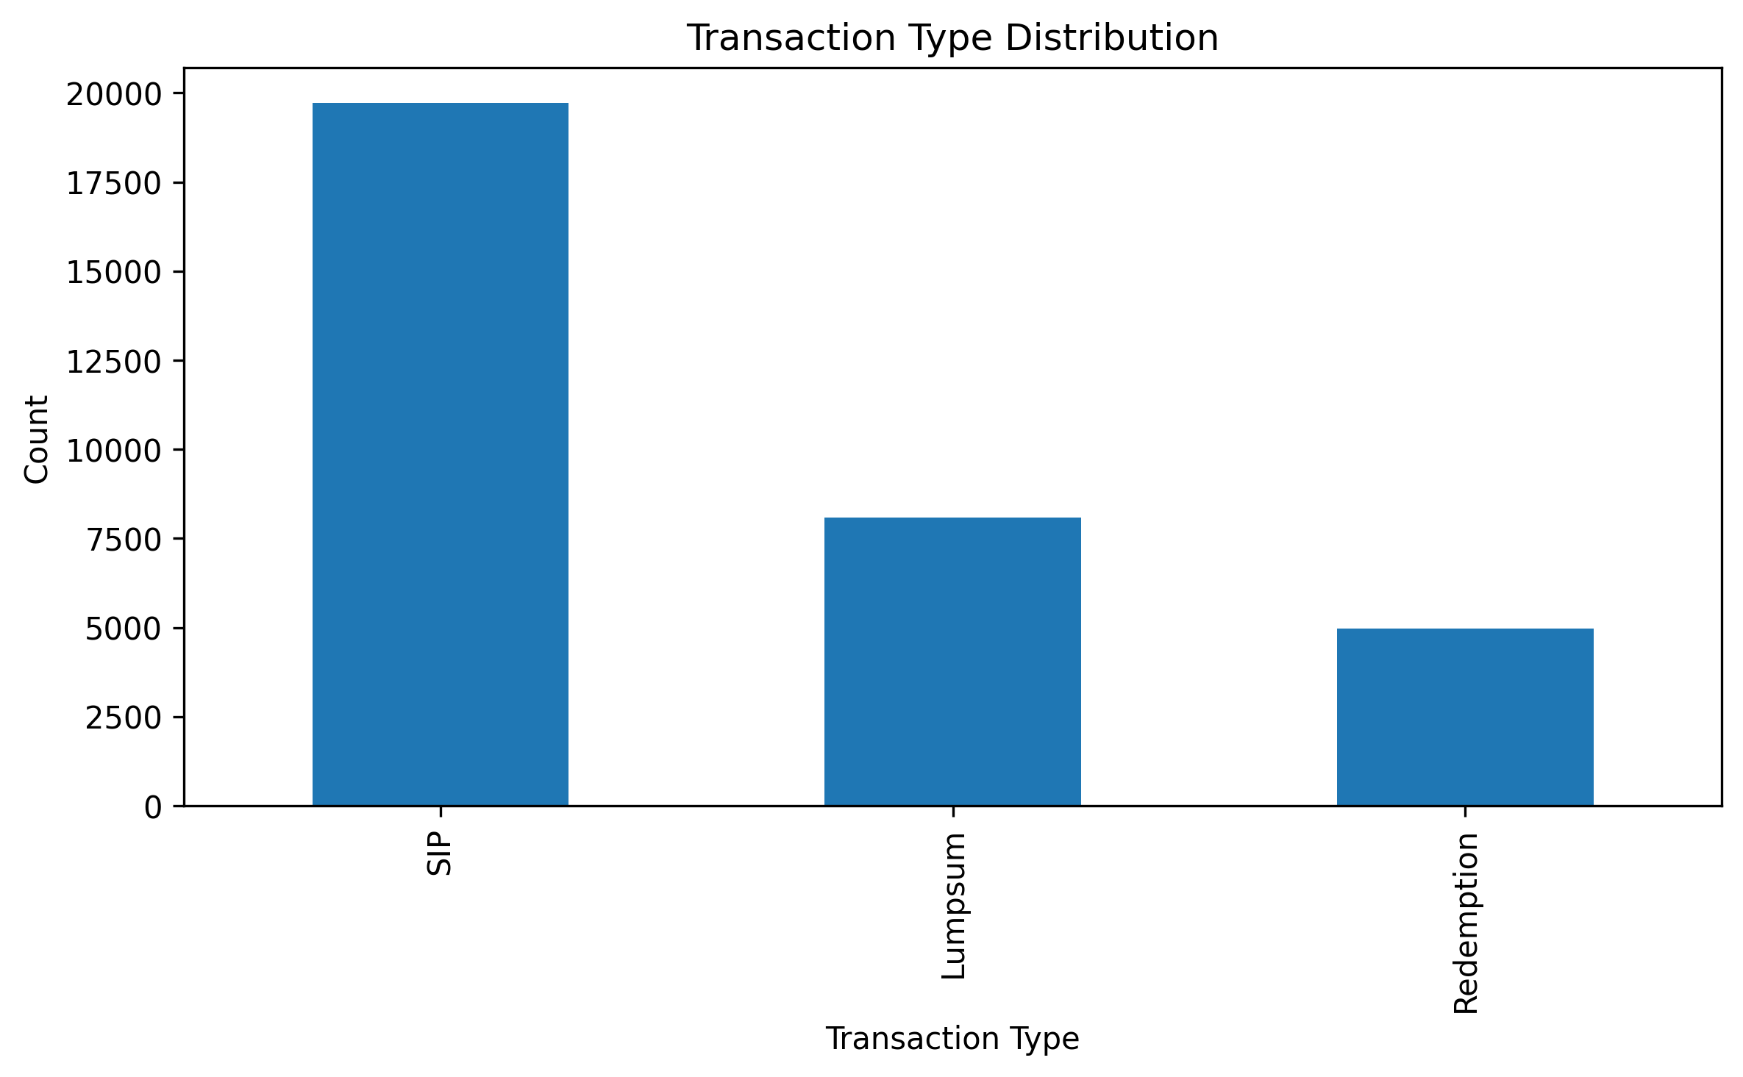
EDA Highlights – Investor Analytics
Investor Behavior Analysis
Findings:
Age group distribution identified key investor segments
State-wise investment concentration observed
SIP investments dominated transaction value
Strong growth in investor participation

Slide 8
Performance Metrics
Metrics Calculated:
CAGR
Sharpe Ratio
Sortino Ratio
Alpha
Beta
Maximum Drawdown
Purpose:
Evaluate returns, volatility, and risk-adjusted performance.

Slide 9
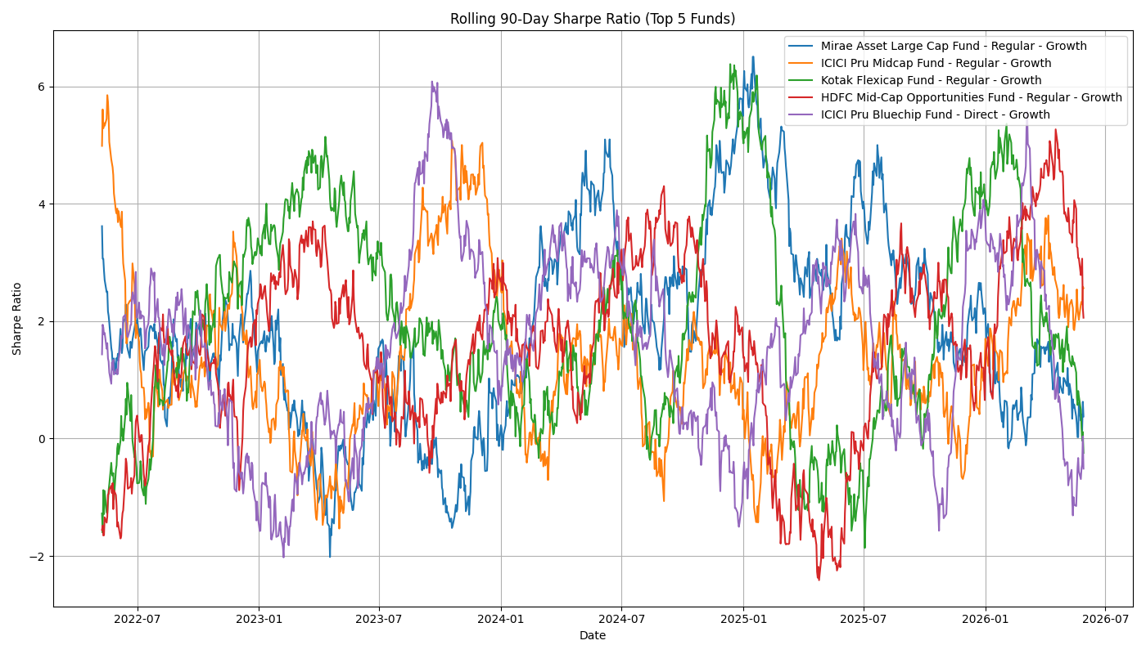
Advanced Analytics
Advanced Financial Analytics
Implemented:
Historical VaR
CVaR
Rolling Sharpe Ratio
Investor Cohort Analysis
SIP Continuity Analysis
Fund Recommender
HHI Concentration Analysis

Slide 10
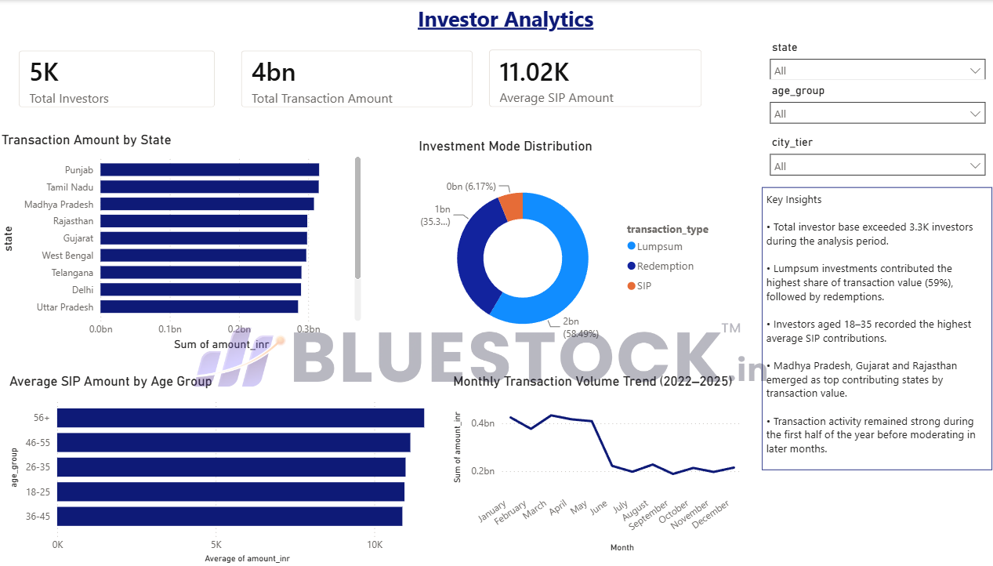
Dashboard Overview
Power BI Dashboard
Pages Developed:
Industry Overview
Fund Performance
Investor Analytics
SIP & Market Trends

Slide 11
Key Findings
Business Insights
Industry AUM demonstrated strong growth.
SIP inflows crossed ₹31K Cr.
Small-cap funds delivered higher returns but higher risk.
Investor participation increased significantly.
Most investors showed irregular SIP contribution patterns.
Diversification varied across mutual funds.
Risk-adjusted performance differed substantially among schemes.

Slide 12
Thank You
Prepared By: Ekta Rajak
GitHub Repository: https://github.com/erajak28/Mutual_Fund_Analytics_Project

